Slide 1
Parallel QuickSort
Overview, Analysis, and Implementation

Slide 2
Table Of Contents
01
Overview
02
Serial Imp.
Reviewing of the functionality of the QuickSort algorithm
Describing the Serial Implementation of the QuickSort Algorithm.
03
Parallel Imp.
04
Final Thoughts
Describing the Parallel Implementation of the QuickSort Algorithm.
Output comparison between serial and parallel QuickSort Algorithm using different array lengths

Slide 3
QuickSort Overview
01
Reviewing of the functionality of the QuickSort algorithm.

Slide 4
QuickSort Overview
1) Pivot Selection: Choose an element from the array as the pivot
2) Partitioning: Reorder the array with respect to the pivot.
3) Divide and Conquer: Recursively apply the above steps to the sub-arrays of elements

Slide 5
Serial Implementation
02
For QuickSort Algorithm

Slide 6
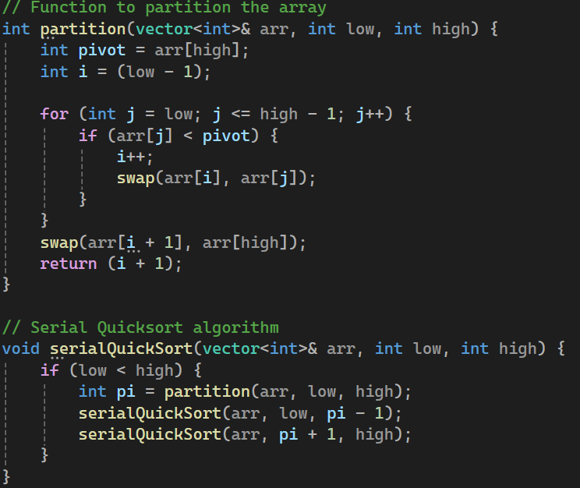
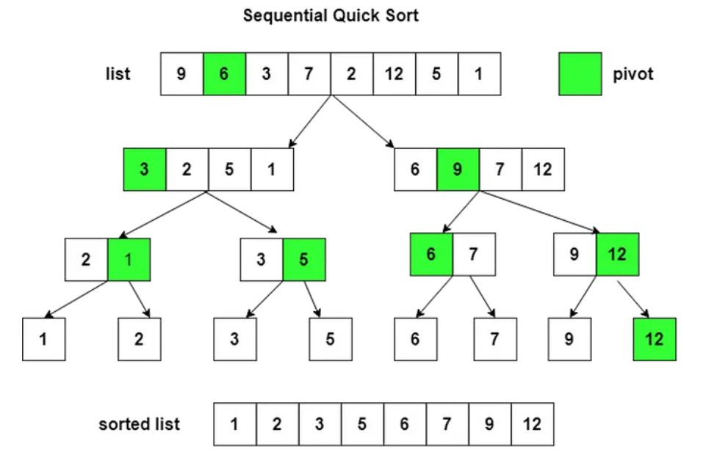
Serial Implementation

Slide 7
Parallel Implementation
03
For QuickSort Algorithm

Slide 8
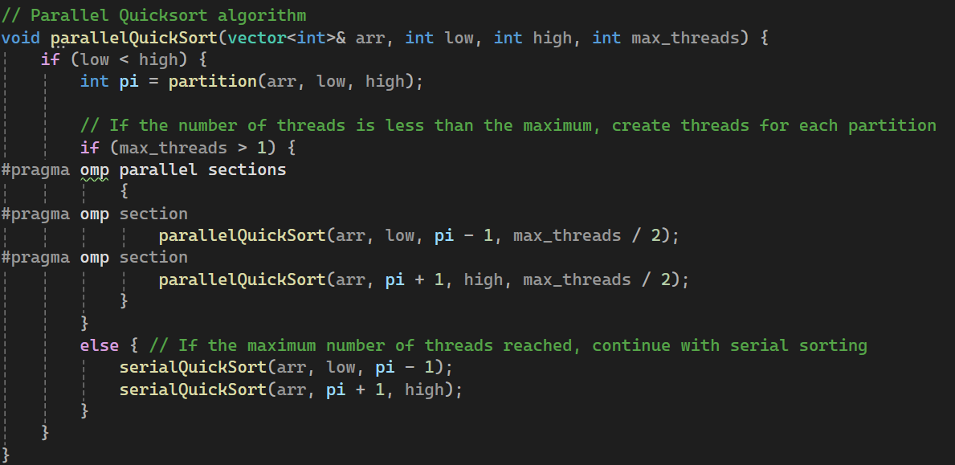
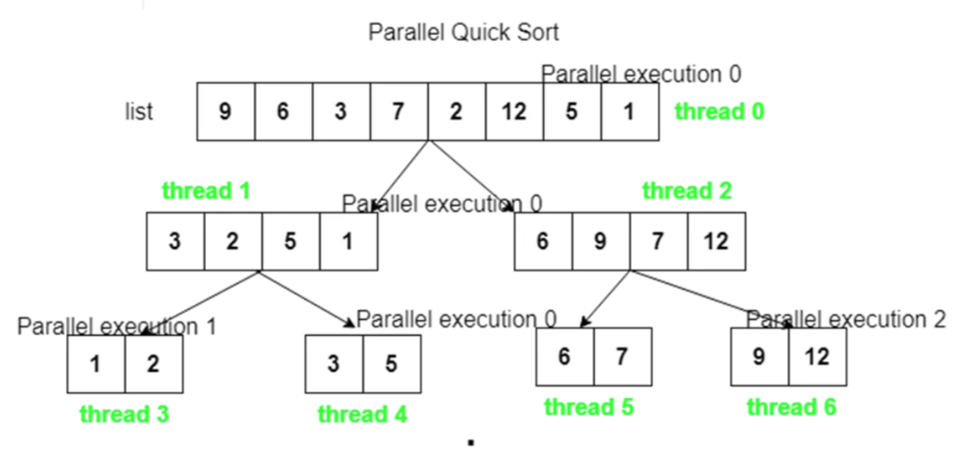
Parallel Implementation

Slide 9
Final Thoughts
04
Output comparison between serial and parallel QuickSort Algorithm using different array lengths.

Slide 10
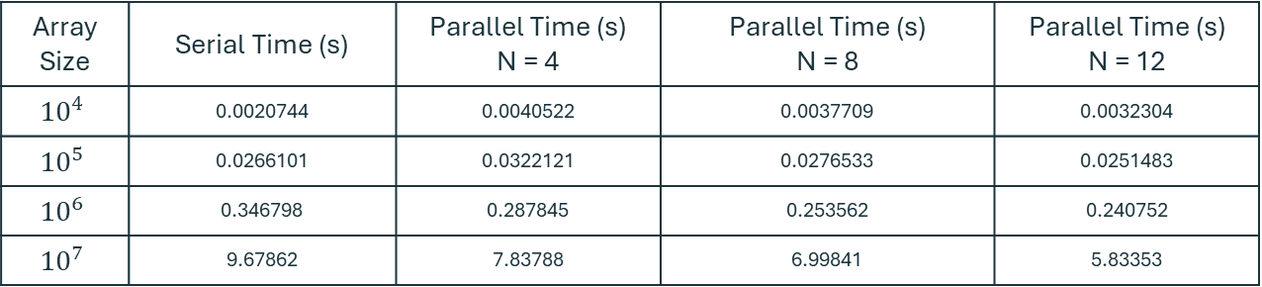
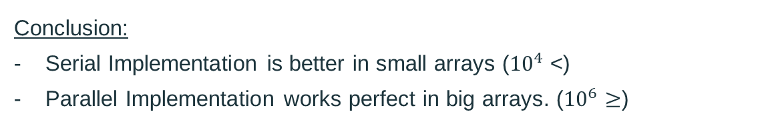
Final Thoughts
Array Size | Serial Time (s) | Parallel Time (s) N = 4 | Parallel Time (s) N = 8 | Parallel Time (s) N = 12
$${10}^{4}$$ | 0.0020744 | 0.0040522 | 0.0037709 | 0.0032304
$${10}^{5}$$ | 0.0266101 | 0.0322121 | 0.0276533 | 0.0251483
$${10}^{6}$$ | 0.346798 | 0.287845 | 0.253562 | 0.240752
$${10}^{7}$$ | 9.67862 | 7.83788 | 6.99841 | 5.83353
Conclusion:
Serial Implementation is better in small arrays (${10}^{4}$ <)
Parallel Implementation works perfect in big arrays. (${10}^{6}≥$)

Slide 11
Thanks!
Any Question?
Presented By:
Abdelrahim Mohamed Alsadiq
Ahmed Adel Abo Elwafa
Joseph Adel Adeeb

