Slide 1
Git & Github
By: Ahmed El-Nemr

Slide 2


Slide 3
What is version control
Version control systems are a category of software tools that help a software team manage changes to source code over time.
Version control software keeps track of every modification to the code in a special kind of database.
developers can turn back.

Slide 4
What is Git?
The most widely used modern version control system in the world today.
Git allows groups of people to work on the same documents (often code) at the same time, and without stepping on each other's toes. It's a distributed version control system.

Slide 5
Install Git
Download the latest Download
When you've successfully started the installer.
Open a Command Prompt (or Git Bash if during installation you elected not to use Git from the Windows Command Prompt).
Run the following commands to configure your Git username and email using the following commands
$ git config --global user.name “Ahmed“
$ git config --global user.email “tiger52671@gmail.com"

Slide 6
Setting up a repository
The high level points this guide will cover are:
Initializing a new Git repo
Cloning an existing Git repo
Committing a modified version of a file to the repo
Configuring a Git repo for remote collaboration
Common Git version control commands

Slide 7
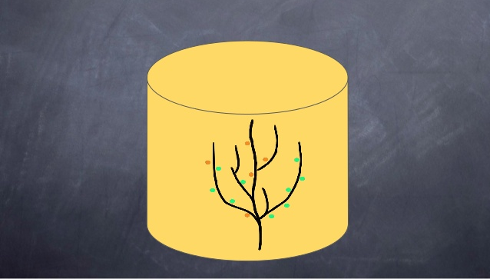

Slide 8
What is a Git repository?
A Git repository is a virtual storage of your project. It allows you to save versions of your code, which you can access when needed.

Slide 9
Initializing a new repository: git init
To create a new repo, you’ll create folder or use go to folder project.
using the following command
$ git init

Slide 10
Cloning an existing repository: git clone
If a project has already been set up in a central repository, the clone command is the most common way for users to obtain a local development clone.
$ git clone <repo url>

Slide 11
Git workflow
Untracked
Staged
Committed

Slide 12
Adding Changes
Update or add new file. “untracked”
To move from “untracked” to “Staged” using the following command.
$ git add <filename or . >
Dot => select all files
Checking for Changes
$ git status

Slide 13
Committing
To move from “Staged” to “Committed”
$ git commit -m "Add comment"

