Slide 1
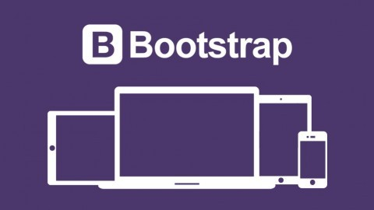

Slide 2
Bootstrap
2
What is Bootstrap?
Bootstrap is a free front-end framework (HTML and CSS) for faster and easier web development
Bootstrap is famous for being developed with components that have the ability to follow the property of responsive designs
Responsive Design is about using CSS and HTML to resize, hide, shrink, enlarge, or move the content to make it look good on any screen
Responsive Design allow your page works for computer, tablets and mobile phones.

Slide 3
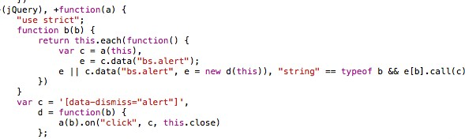
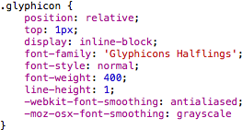
Bootstrap
3
What is Bootstrap?
In other words, bootstrap is a collection of CSS classes and JavaScript functions the you get ready to use and will not worry about write code like this:

Slide 4
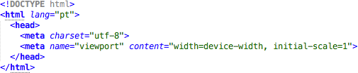
Bootstrap
4
First Bootstrap Page
Include the HTML5 doctype at the beginning of the page, along with the lang attribute and the correct character set

Slide 5
Bootstrap
6
First Bootstrap Page
You will need to include three files:
bootstrap.min.css
jquery.min.js
Popper.js
bootstrap.min.js
You must download it and include in you page
For this example, we include from the Internet

Slide 6
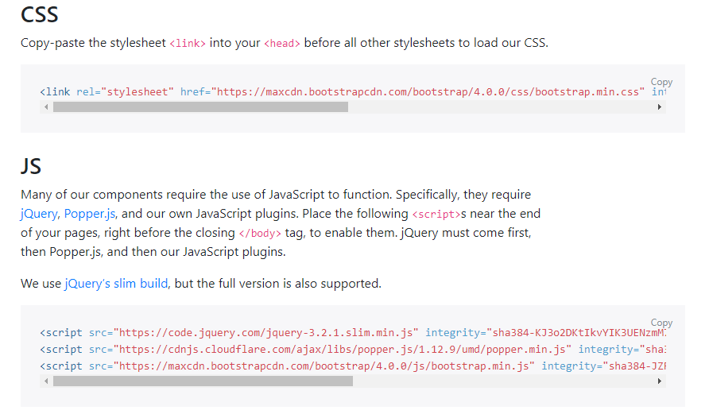
Bootstrap
6

Slide 7
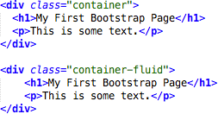
Bootstrap
7
First Bootstrap Page
Bootstrap has a concept of containing element to wrap site contents

Slide 8
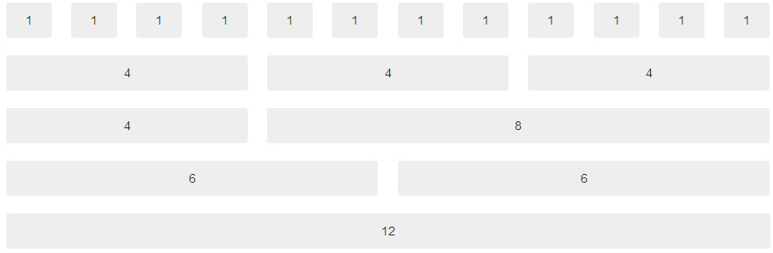
Bootstrap
8
Bootstrap Grids
Bootstrap's grid system allows up to 12 columns across the page
You can divide the container in rows and each row in columns with space multiple of the 12

Slide 9
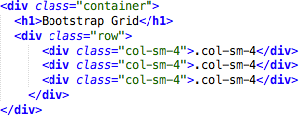
Bootstrap
9
Bootstrap Grids
In the bellow example, we divide the space inside the container in 1 row and this row in 3 columns with the same side. 4+4+4 = 12
You can use any combination that the sum be equal to 12.

Slide 10
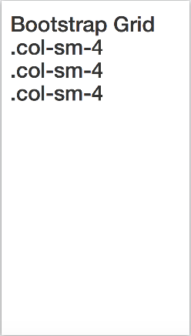
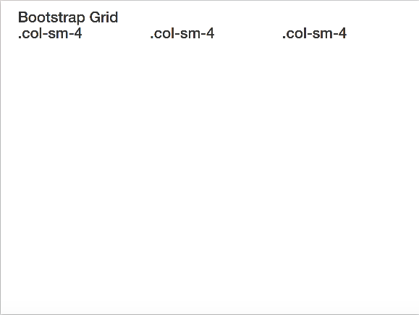
Bootstrap
10
Bootstrap Grids
Responsive Bootstrap's grid system with 3 columns
small screens
big screens

Slide 11
Bootstrap
11
Bootstrap Table
4 main classes:
.table
.table-striped
.table-bordered
.table-hover
5 contextual classes:
.active
.success
.info
.warning
.danger

Slide 12
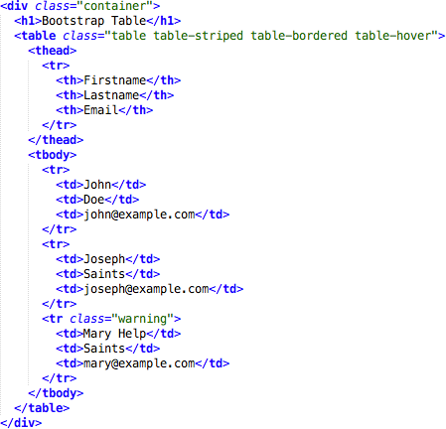
Bootstrap
12
Bootstrap Tables

Slide 13
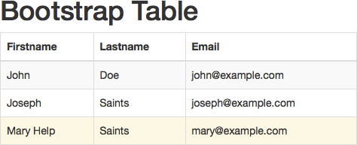
Bootstrap
13
Bootstrap Tables

Slide 14
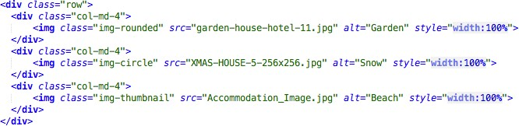
Bootstrap
14
Bootstrap Images
3 main classes:
. img-rounded
. img-circle
. img-thumbnail

Slide 15
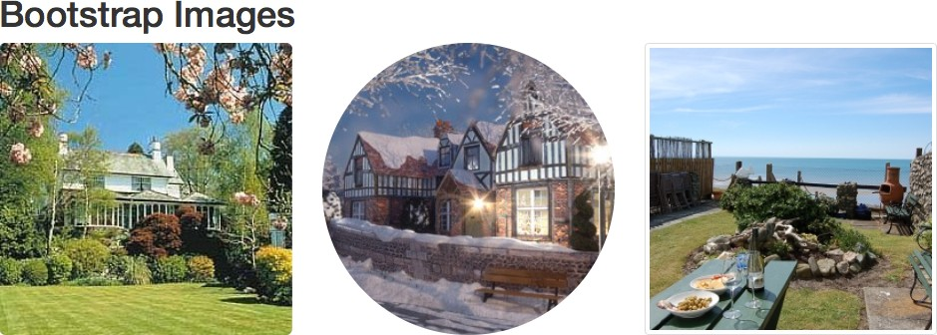
Bootstrap
15
Bootstrap Images

Slide 16
Bootstrap
16
Bootstrap Alerts
Bootstrap provides an easy way to create predefined alert messages
Alerts are created with the .alert class, followed by one of the four contextual classes
.alert-success
.alert-info
.alert-warning
.alert-danger

Slide 17
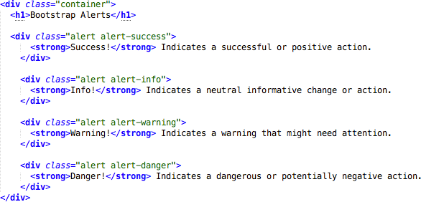
Bootstrap
17
Bootstrap Alerts

Slide 18
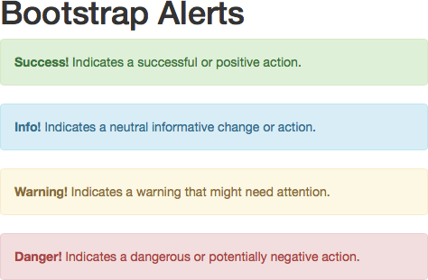
Bootstrap
18
Bootstrap Alerts

Slide 19
Bootstrap
19
Bootstrap Buttons
Bootstrap provides seven styles of buttons:
To achieve the button styles above, Bootstrap has the following contextual classes:
.btn-default
.btn-primary
.btn-success
.btn-info
.btn-warning
.btn-danger
.btn-link

Slide 20
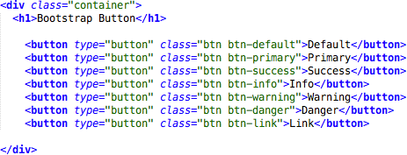
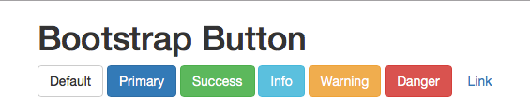
Bootstrap
20
Bootstrap Buttons

Slide 21
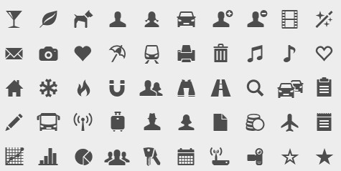
Bootstrap
21
Bootstrap Glyphicons
Bootstrap provides 260 glyphicons from the Glyphicons Halflings set
(http://getbootstrap.com/components/)

Slide 22
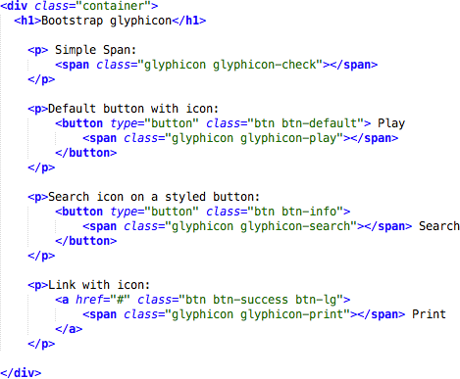
Bootstrap
22
Bootstrap Glyphicons

Slide 23
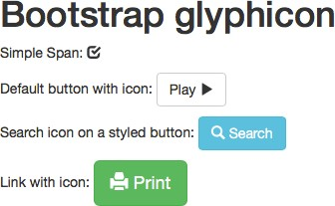
Bootstrap
23
Bootstrap Glyphicons

Slide 24
Bootstrap
24
Bootstrap Labels
Labels are used to provide information about something
Bootstrap create labels with colorful backgrounds to highlight the text inside de label
Use the .label class, followed by one of the six contextual classes .label-default, .label-
primary, .label-success, .label-info, .label-warning or .label-danger

Slide 25
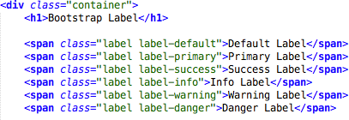

Bootstrap
25
Bootstrap Labels

Slide 26
Bootstrap
26
Bootstrap Panels
A panel in bootstrap is a bordered box with some padding around its content that can be use to highlight or separated some information
Like other bootstrap elements panel has contextual classes also (.panel-default, .panel-primary, .panel- success, .panel-info, .panel-warning, or .panel- danger)

Slide 27
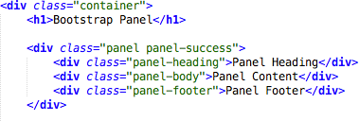
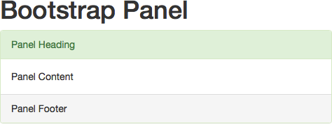
Bootstrap
27
Bootstrap Panels

Slide 28
Bootstrap
28
Bootstrap Themes and Templates
You can find several templates e themes free to download
A theme consists of customized CSS
A template consists of one or more predesigned HTML pages, which often make use of a theme
Both are collection of bootstrap elements (grids, buttons, panels), put together for someone, until have a fully functional website or web application.
You can find some free templates here:
https://startbootstrap.com/template-categories/all/

Slide 29
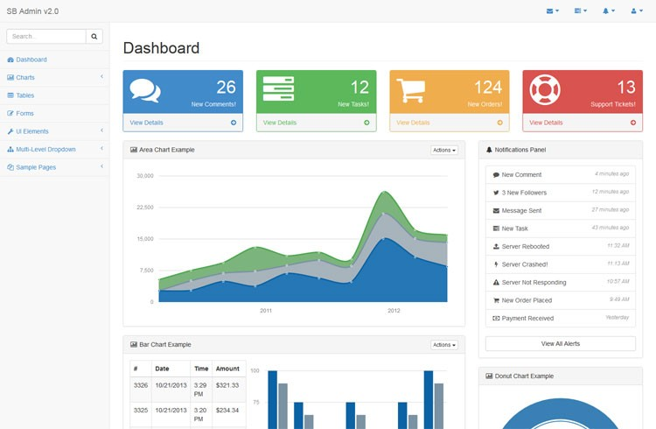
Bootstrap
29
Bootstrap Themes and Templates
For web application SB Admin 2 template is appropriate. It has forms, tables, charts and other useful components

Slide 30
Bootstrap
30
Bootstrap Themes and Templates
Download SB Admin 2 template for your computer and open the /pages/index.html in your web browser
Start to customize it, instead write you application design from scratch

Slide 31
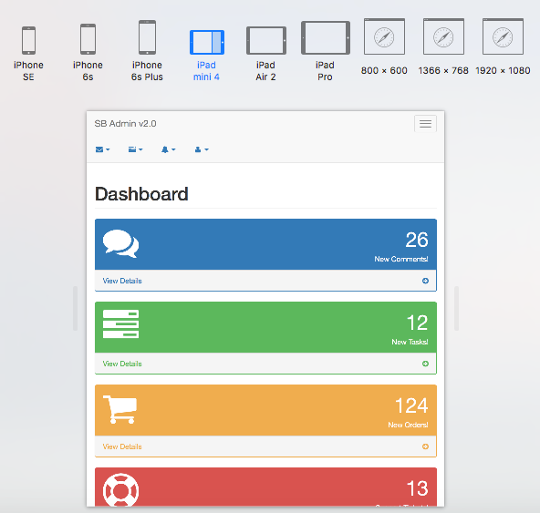
Bootstrap
31
Bootstrap Themes and Templates

Slide 32
Bootstrap
32
References
w3schools. Bootstrap 3 Tutorial. https:// www.w3schools.com/bootstrap/
Source Code
https://github.com/jadsonjs/bootstrap

