Slide 1
Sentiment Analysis of Movie Reviews
A project focused on using machine learning to classify movie reviews as positive or negative.

Slide 2

Project Introduction
Problem
Manual analysis of massive movie review data-set inefficient and time-consuming.
Solution
Automated sentiment analysis using machine learning to classify reviews as positive or negative.
Benefits
Enhanced decision-making for film marketing and production strategies.

Slide 3
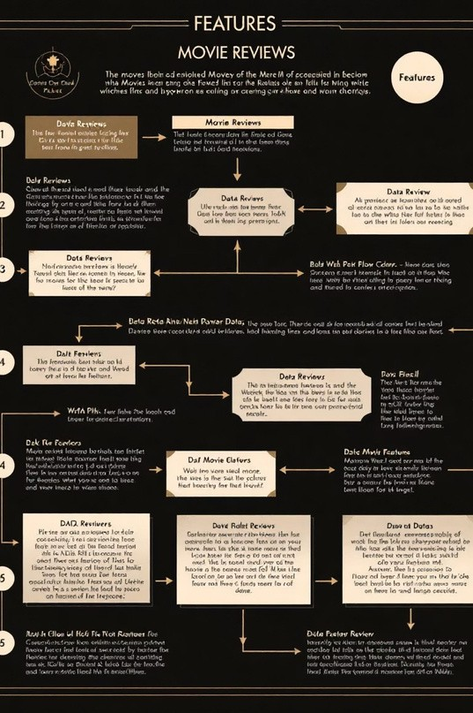
Project Methodology
DataCollection
IMDB movie reviews dataset with positive and negative labels.
Preprocessing
Cleaning,lowercasing, stopword removal, and tokenization.
Feature Extraction
TF-IDF vectorizationton convert text to numerical features.
Model Training
Logistic Regression classifier with 80/20 train-test split.

Slide 4





Technologies Used
Python
Core programming language for model development and implementation.
NLTK
Natural Language Toolkit for text processing and linguistic analysis.
Scikit-learn
Machine learning library for model training and evaluation.
Streamlit
Web application framework for interactive sentiment prediction interface.

Slide 5
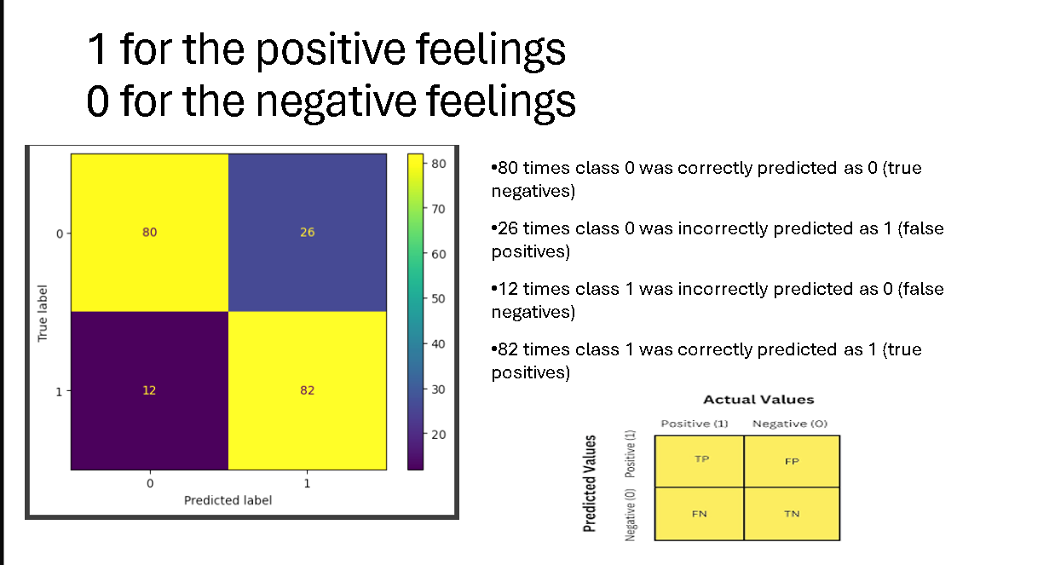

Slide 6

Practical Applications
Film Industry
Understand audience reactions. Guide marketing campaigns. Inform content creation decisions.
Online Platforms
Personalize recommendations. Improve search filters. Monitor user feedback automatically.
Business Intelligence
Track brand sentiment .Analyze customer feedback. Measure campaign effectiveness.

Slide 7

Future Enhancements
Advanced Models
Implement Deep-learning approaches like BERT for improved accuracy.
Multi-aspect Analysis
Analyzes percise aspects like acting, directing, and screenplay separately.
Multi modal Analysis
Incorporate audio and visual data along side text for comprehensive sentiment analysis.

