Slide 1
TCS-Net
Patient-Specific Temporal Cross-Antibiotic
Susceptibility Modeling
with an uncertainty-aware Smart-AST safety layer
CBIO313 · Data Mining & Machine Learning
Student Name: Abdalrahman Abdo
Student ID: 231001347
Instructor: Dr. Muhammad Elsayeh
August 2026

Slide 2
1. Problem and Project Question
Can a patient’s previous AST profile help predict resistance in a later recurrent E. coli urine culture?
Clinical problem
Simple baseline
TCS-Net idea
• Definitive AST is not immediately available when a new culture is collected.
• Recurrent infections often have prior microbiology history.
• A previous result may still be informative — but its value can change with time.
Use the previous result of the same antibiotic and the time since the last culture.
Example:
Previous Cipro = Resistant
Time = 15–90 days
Use the full previous susceptibility profile and explicitly model how cross-antibiotic patterns interact with time.
Goal: predict P(Resistance) for the later isolate.

Slide 3
2. Data and Cohort Construction
Two longitudinal microbiology datasets with the same locked cohort definition.
Stanford ARMD — development
UTSW ARMD — external validation
Raw microbiology cultures → positive urine E. coli → direct S/R AST → recurrent patients → consecutive transitions >14 days
Same main preprocessing rules. Stanford-trained models transferred directly without UTSW-specific retraining.
20,368
9,307
2008–24
11,801
5,813
2006–25
valid transitions
patients
date span
valid transitions
patients
date span
Positive urine
E. coli
Direct S/R AST
Recurrent ≥2
Remove conflicts
Gap >14d
Data sources: Stanford ARMD Dryad DOI 10.5061/dryad.jq2bvq8kp · UTSW ARMD Dryad DOI 10.5061/dryad.0rxwdbsd5

Slide 4
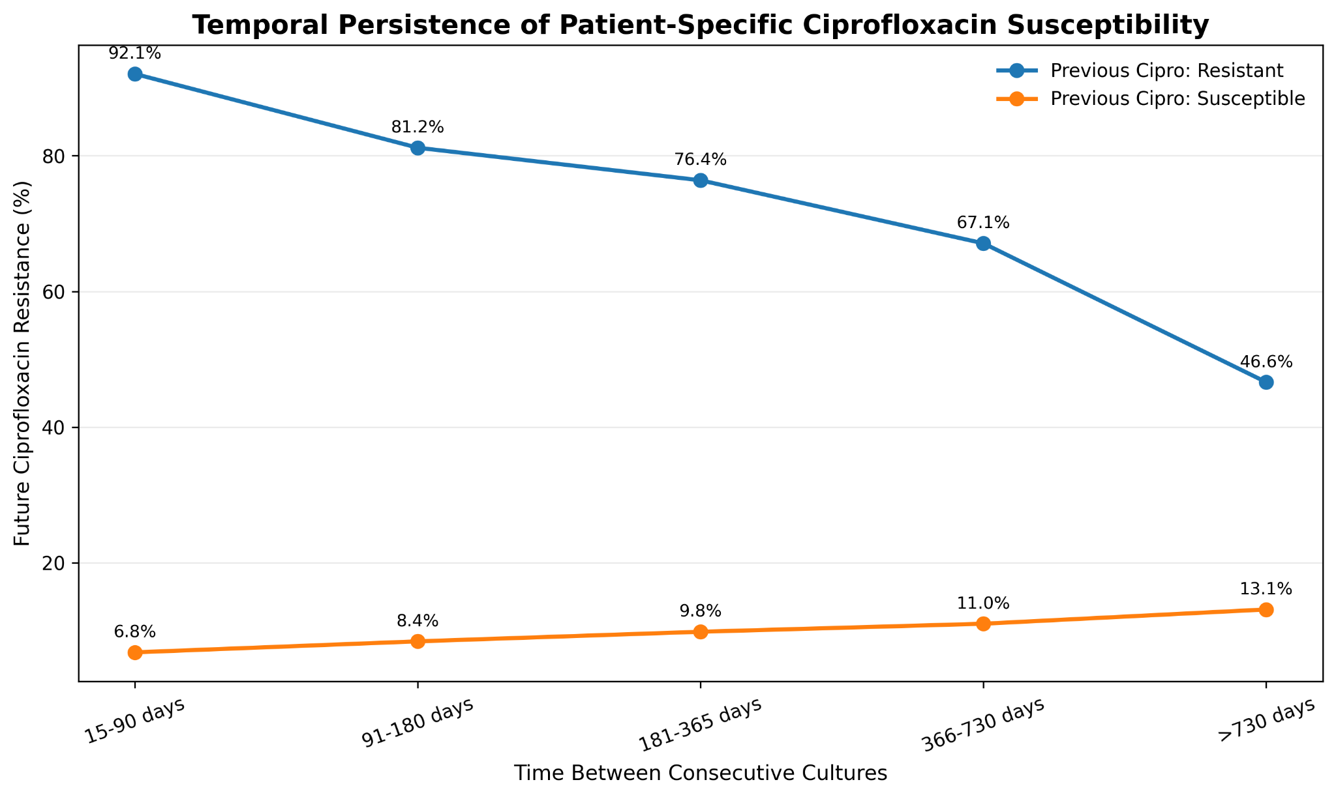
3. Why Time Matters
Previous same-drug susceptibility carries strong information, but that information changes with elapsed time.
92.1% → 46.6%
Future Cipro R after previous R
15–90 days → >730 days
6.8% → 13.1%
Future Cipro R after previous S
15–90 days → >730 days
Interpretation
Recent AST history is highly informative, but the “memory” of the previous result weakens or shifts with time.

Slide 5
4. TCS-Net Model Design
Inputs are transformed into temporal cross-antibiotic interaction features, then converted into a calibrated resistance probability.
Previous AST profile
Time
Interaction features
TCS-Net classifier
Target drug:
• Ciprofloxacin
Cross-antibiotics:
• Ampicillin
• TMP-SMX
• Gentamicin
• Cefazolin
• Ceftriaxone
Five windows:
15–90
91–180
181–365
366–730
>730 days
Example:
Previous Cipro R
× Ceftriaxone S
× 15–90 days
The model learns a separate weight for each observed combination.
Regularized Logistic Regression
with one-hot encoded categorical interactions
Output
Raw P(Resistance)
→ Platt calibration
→ Smart-AST decision
B2 = same drug + time
D2 = B2 + additive cross-AST
E / TCS-Net = D2 + explicit interactions

Slide 6
5. Algorithms and Validation Strategy
Course algorithms were implemented first; the final TCS-Net hypothesis was then tested using increasingly strict validation.
Logistic Regression
Decision Tree
Random Forest
Linear probabilistic baseline and the final regularized TCS-Net classifier.
Non-linear tree baseline used for course model comparison.
Ensemble tree baseline used to test whether non-linear additive structure was sufficient.
1
2
3
4
5
Patient split
Temporal test
New-patient
Ampicillin
UTSW external
No patient overlap
2022–2023
Unseen patients
Locked target replication
No retraining

Slide 7
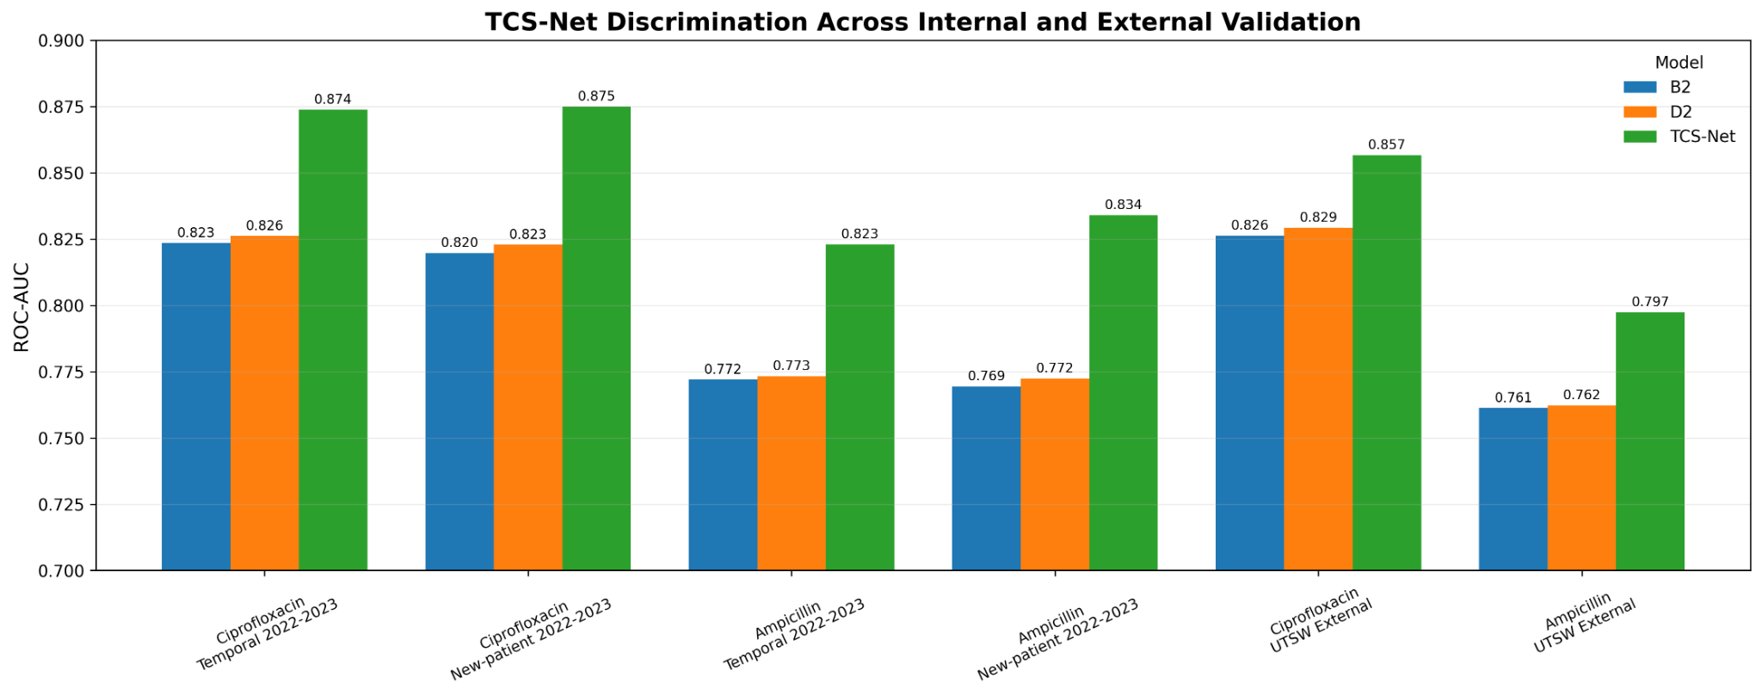
6. Main Predictive Performance
Across six validation settings, TCS-Net had the best ROC-AUC and PR-AUC and the lowest Brier Score.
0.8737
0.8230
0.8566
0.7974
Cipro Stanford ROC-AUC
Ampicillin Stanford ROC-AUC
Cipro UTSW ROC-AUC
Ampicillin UTSW ROC-AUC
vs 0.8235 B2
vs 0.7720 B2
no retraining
no retraining

Slide 8
7. Independent UTSW External Validation
The Stanford-trained models were transferred directly to a different healthcare system.
No UTSW-specific retraining or tuning
Ciprofloxacin
Ampicillin
B2 ROC-AUC: 0.8263
D2 ROC-AUC: 0.8292
TCS-Net ROC-AUC: 0.8566
ΔROC vs B2: +0.0303
95% CI: 0.0230 to 0.0377
PR-AUC: 0.8001
Brier: 0.1305
B2 ROC-AUC: 0.7613
D2 ROC-AUC: 0.7623
TCS-Net ROC-AUC: 0.7974
ΔROC vs B2: +0.0361
95% CI: 0.0298 to 0.0430
PR-AUC: 0.8152
Brier: 0.1825
35.0%
53.5%
Key result
UTSW Cipro resistance
UTSW Ampicillin resistance
The interaction benefit generalized across both targets in an independent institution.
site distribution shift
site distribution shift

Slide 9
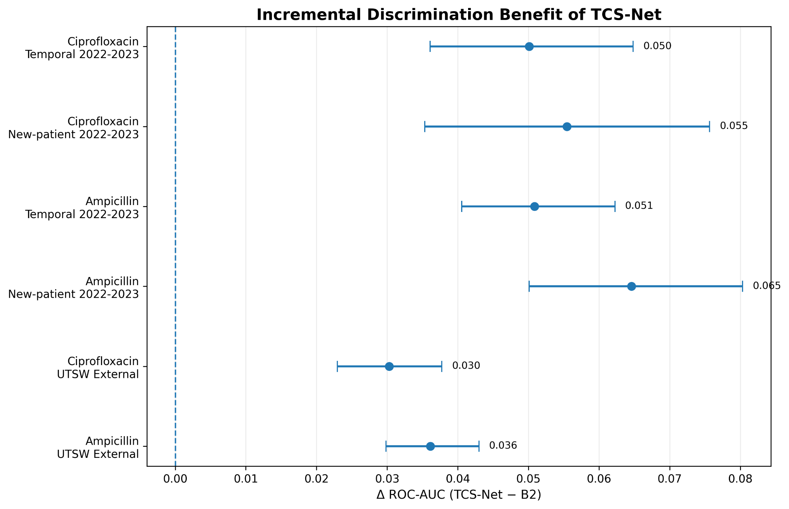
8. Statistical Confidence of the Improvement
Patient-level paired bootstrap: every ROC-AUC improvement interval remained above zero.
Internal validation
Largest gain:
Ampicillin new-patient
ΔROC = +0.0646
External validation
Cipro: +0.0303
Ampicillin: +0.0361
Both 95% CIs > 0
Same pattern also held for PR-AUC and Brier improvement

Slide 10
9. What Did the Model Learn?
Explainability was used to inspect predictive behavior, not to make causal claims.
244
221
Examples of interaction signal
encoded features
interaction terms
High-support interactions included combinations involving Ceftriaxone, Gentamicin, Ampicillin and Cefazolin.
Example interaction label:
Previous Cipro R × Ceftriaxone S × 15–90 days
SHAP ranked previous Cipro status first, followed by time and temporal cross-antibiotic interactions.
final Cipro model
explicit temporal cross-AST
Strong main effects
Previous Cipro S: coefficient ≈ −1.09
Previous Cipro R: coefficient ≈ +1.04
15–90 days: ≈ +0.35
>730 days: ≈ −0.33
The previous target-drug state remained the strongest signal.

Slide 11
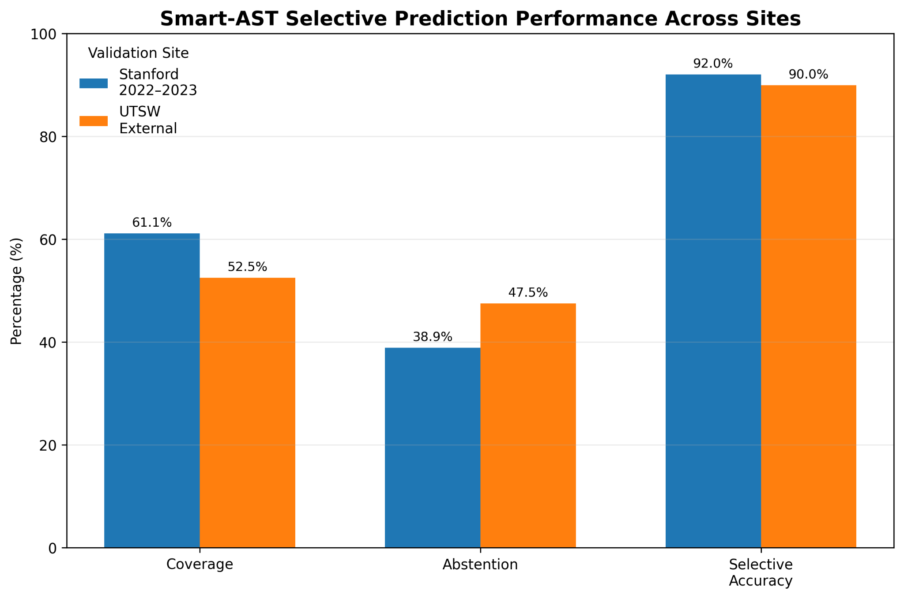
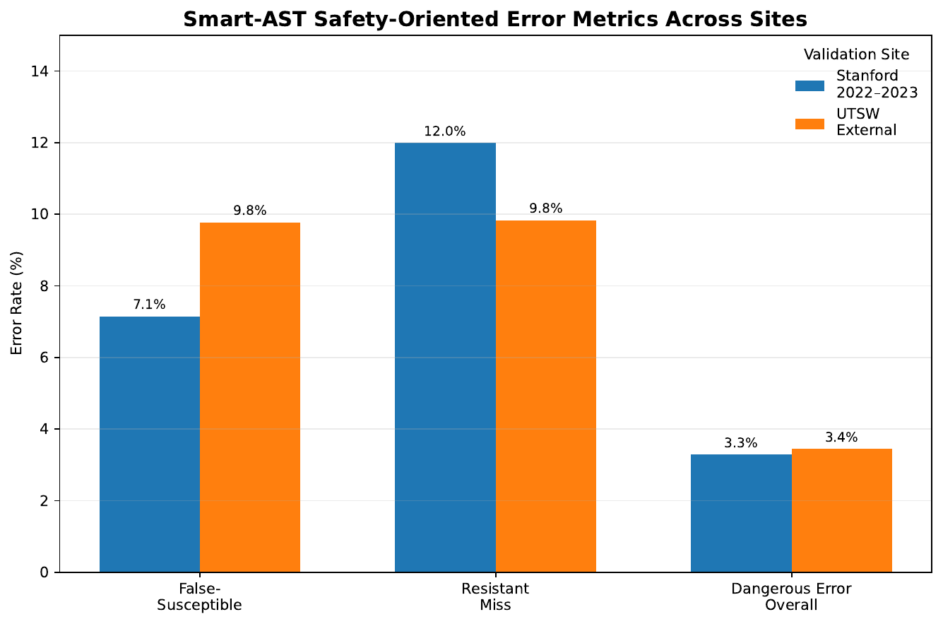
10. Smart-AST: Abstain When Uncertain
The model is not forced to classify every case. A broad uncertainty region sends the sample back to laboratory AST.
P(R) ≤ 0.10 → Likely Susceptible
0.10 < P(R) < 0.80 → Lab AST Required
P(R) ≥ 0.80 → Likely Resistant
Stanford: 61.1% coverage · 92.0% selective accuracy
UTSW: 52.5% coverage · 90.0% selective accuracy
Takeaway: thresholds partially transport; recalibration may be needed

Slide 12
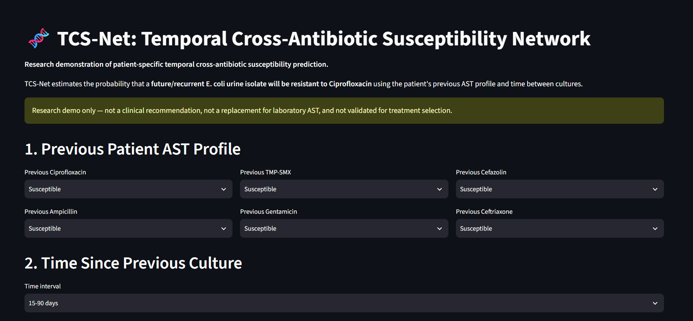
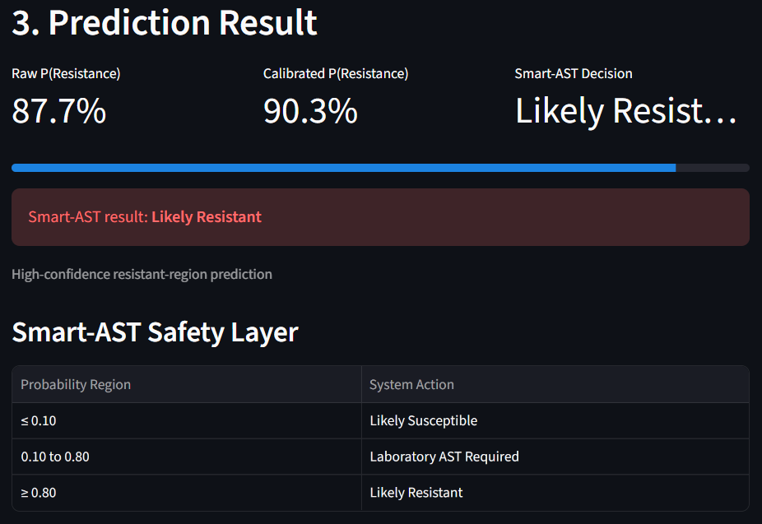
11. Live Streamlit Demo
Input a previous AST profile and time interval; the app returns the raw probability, calibrated probability and Smart-AST decision.
Demo flow
Previous AST + time → interaction features → TCS-Net → Platt calibration → Smart-AST
5.1% → Likely Susceptible
45.0% → Laboratory AST Required
90.3% → Likely Resistant

Slide 13
12. Conclusions and Limitations
Main conclusions
Important limitations
1. Previous AST history contains strong patient-specific temporal information.
2. Explicit temporal cross-antibiotic interactions improved prediction beyond same-drug and additive baselines.
3. The benefit replicated for Ampicillin and generalized to UTSW without site-specific retraining.
4. Discrimination transported better than exact probability calibration.
• Same species ≠ same strain or lineage.
• Observational data cannot establish causal collateral-susceptibility mechanisms.
• AST missingness and testing practices may differ across years and sites.
• Smart-AST thresholds are research operating points, not clinical treatment cutoffs.
Final message: TCS-Net is a research prediction framework — not a replacement for laboratory AST.

Slide 14
Thank you
Questions?
TCS-Net · CBIO313

