Slide 1

Final Project
Machine Learning Workshop
GDSC’22/23

Slide 2
The Problem
Our problem target here is to predict the insurance costs (Charges) according to this information of the patient like age , sex, body mass index , children, smoke status and region.

Slide 3
Data Understanding
This dataset contains information about patients with medical insurance and it contains info like age , sex, body mass index , children, smoke status , region and charges(target).
This leads us to find some relations between this features and the target.

Slide 4
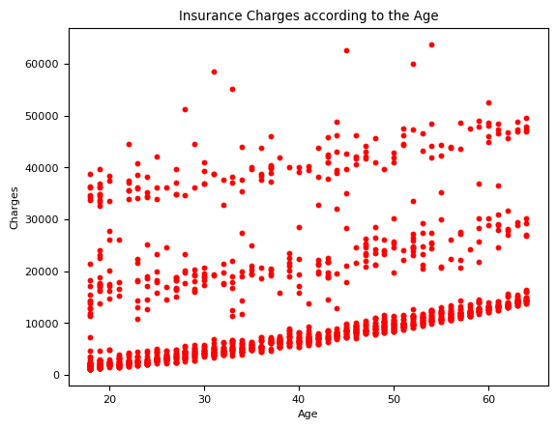
Insurance Charges according to the age

Slide 5
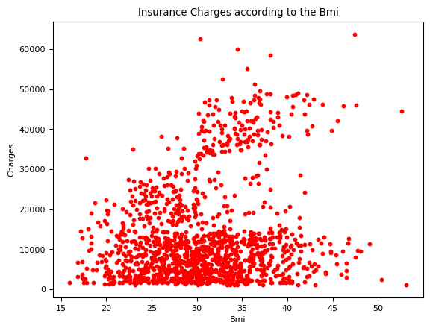
Insurance charges according to the BMI

Slide 6
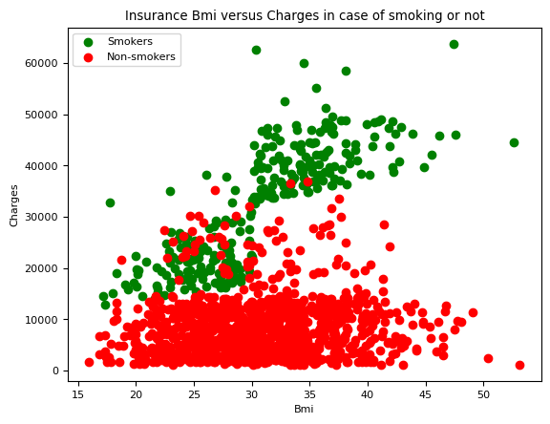
Relation between BMI and Charges in case of smoking or not

Slide 7
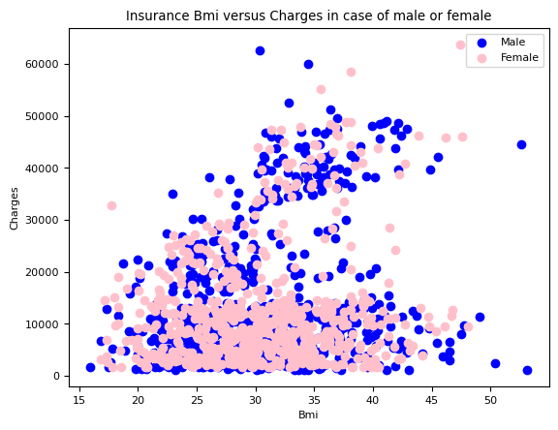
Relation between BMI and Charges in case of male or female

Slide 8
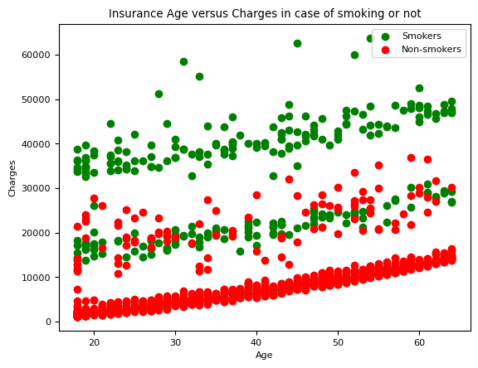
Relation between Age and Charges in case of smoking or not

Slide 9
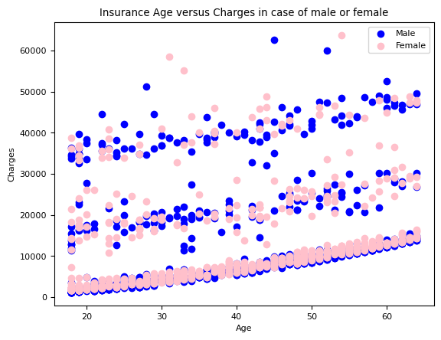
Relation between BMI and Charges in case of male or female

Slide 10
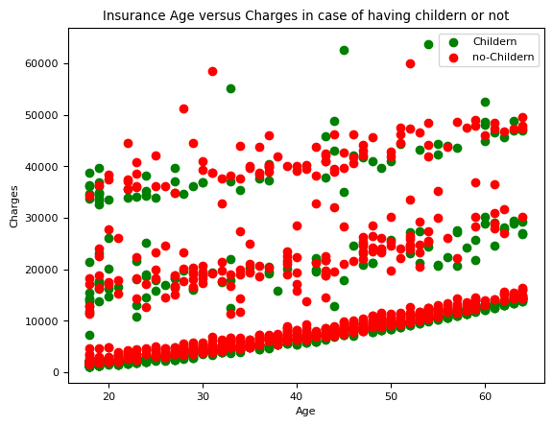
Relation between Age and Charges in case of having Children or not

Slide 11
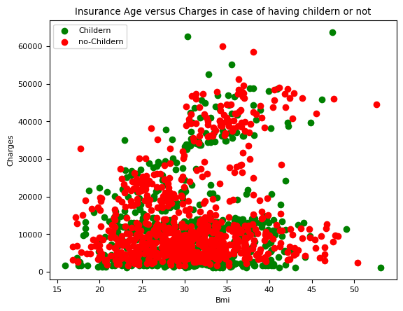
Relation between Age and Charges in case of having children or not

Slide 12
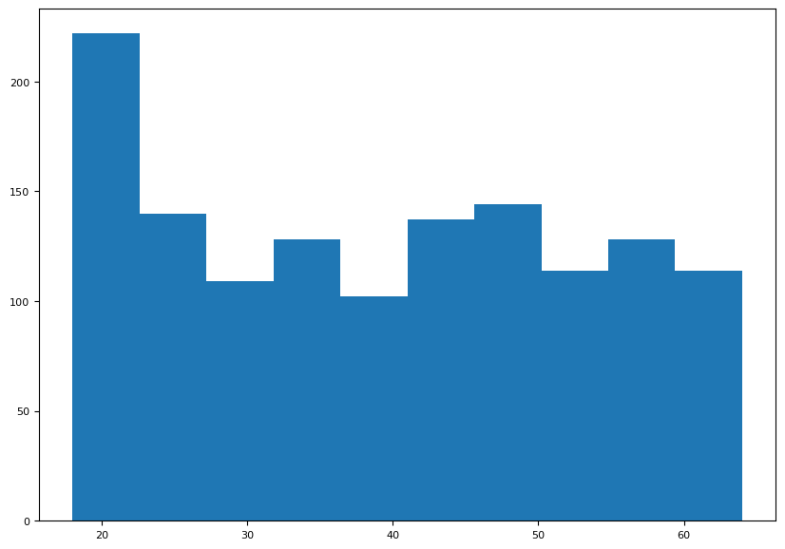
Histogram for Age Frequencies

Slide 13
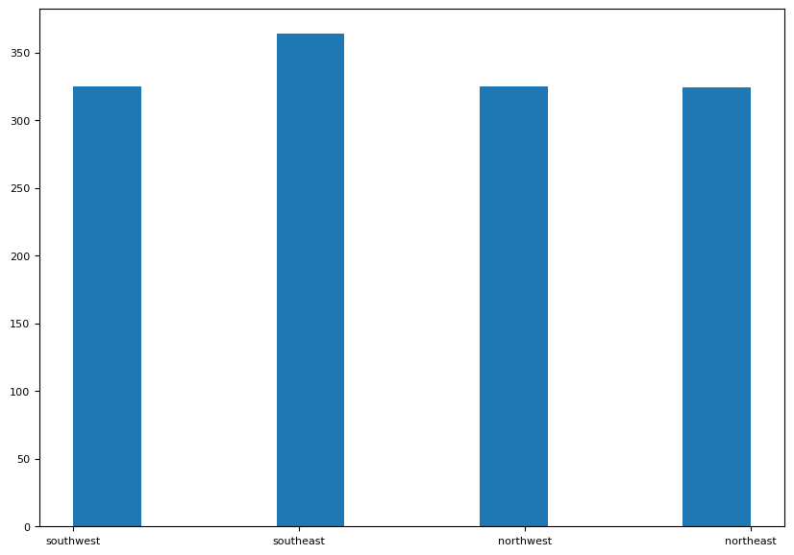
Histogram for Region frequencies

Slide 14
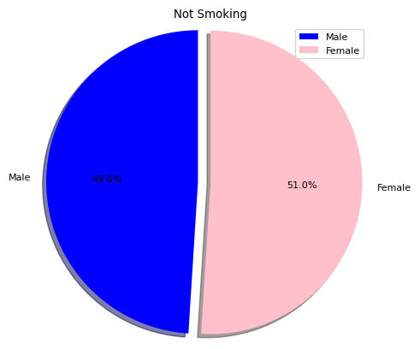
Pie chart for non-smoker for male and females

Slide 15
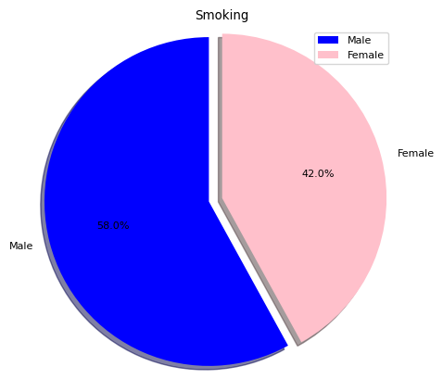
Pie chart for non-smoker for male and females

Slide 16
Data Preparation
First, I checked that we don’t have any missing values in the data in any feature, then I found that the region isn’t an important feature to use in prediction, so I didn’t use it.
Secondly, I converted sex and smoker features data types into int
And I used these as features: [Age , Sex , BMI , Children , Smoker] and [Charges] as a target.
Then I spitted the data into train and test sets

Slide 17

Models
Used Linear Regression

Slide 18
Evaluations
According to test_size = 0.1 , random_state = 0.
Score Achieved: 0.8223733995140989
Accuracy: 82.2373399514099%
-Using Different error functions:
R^2 : 0.8223733995140989
MAE : 4261.680502662962
RMSE: 5868.765621029101

