Slide 1
EEV-20.1
ETNAFS Team

Slide 2
Medical ventilators and COVID-19
30% of Covid-19 hospitalized patients are likely to require mechanical ventilation (estimated 450,000 ventilator world wide in ninth of April 2020)
The mechanical ventilators prices can range from $5,000 to $50,000.

Slide 3
EEV-20.1
EEV-20.1 have 3 ways of power
Internal rechargeable battery sustain the device for more than 1 hour.
12Volt 3 ampere power supply.
Two 9 volt batteries.

Slide 4
EEV-20.1
Adjustable modes
                Continuous Positive Airway Pressure. (CPAP)
                Continuous Mandatory Ventilation. (CMV)
                Synchronous Intermittent Mandatory Ventilation. (SIMV)
                Airway Pressure Release Ventilation. (APRV)
                Pressure Support Ventilation. (PSV)
Range 5 to 37 cm H O adjustable in 1 cmH O increment(+-0.001cmH O).
Expiratory ratio (I:E) adjustable in the range 1.0 to 4.0 in 1 increment.
Range 10 to 30 breaths per minute in increments of 1 (+-1breath).
Tidal Volume (Vt) optionally Range 250 to 800 ml in steps of 10ml (+-30ml).
Oxygen percent control range 21% to 100% increments of 1% (+-2 %).
2
2
2

Slide 5
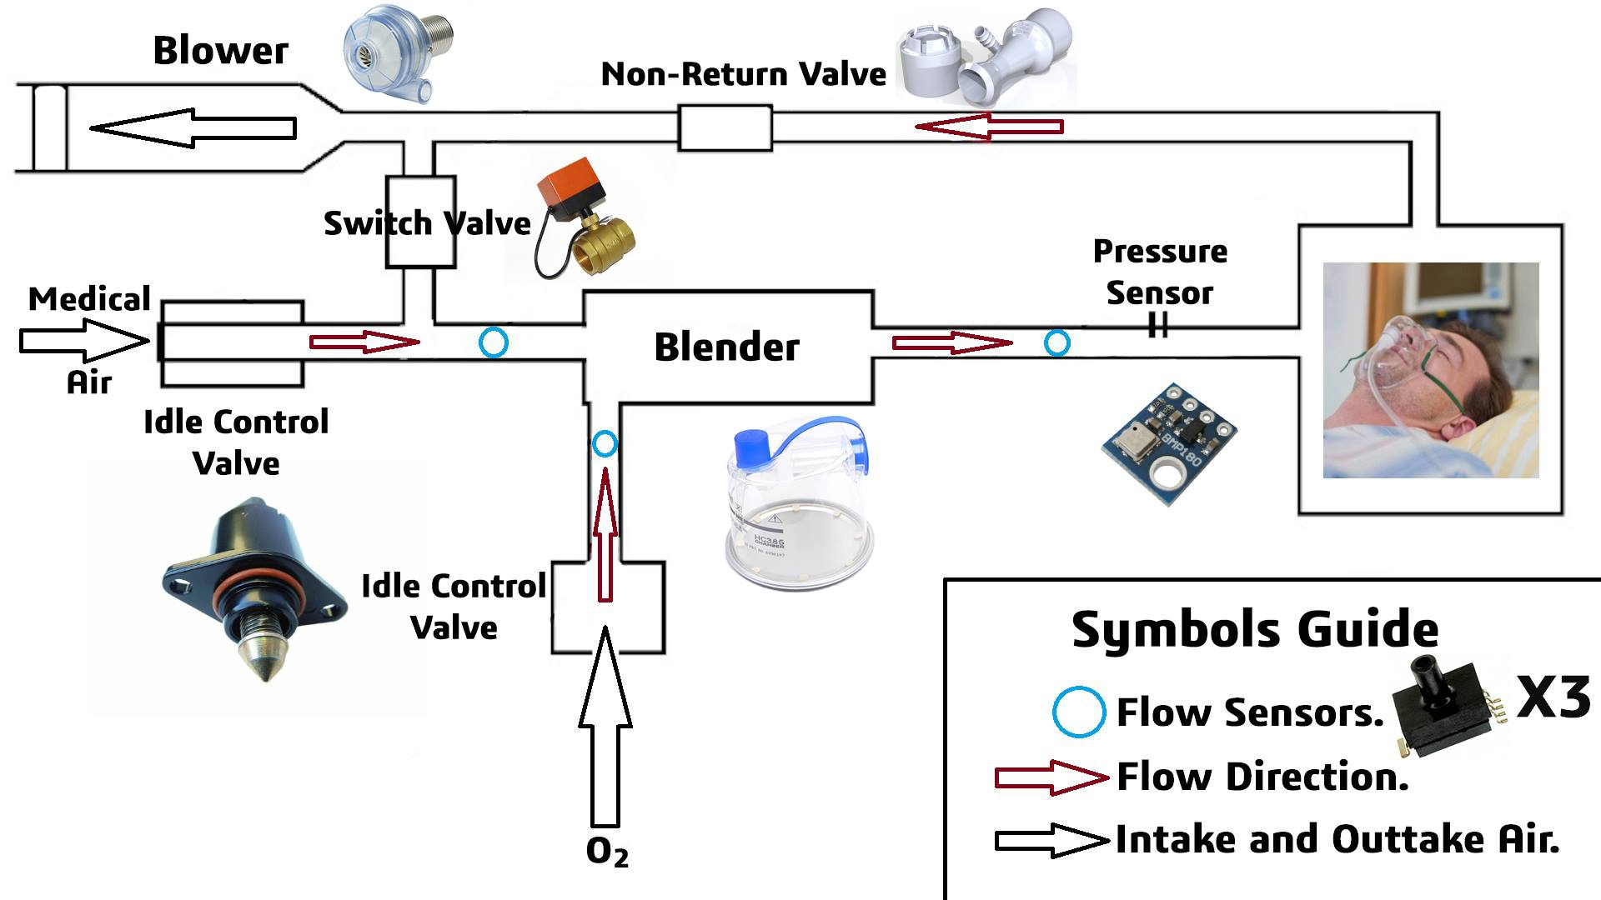
EEV-20.1 works in two different enviroments
Hospital (medical air system)

Slide 6
EEV-20.1 works in two different enviroments
2. Field hospital

Slide 7
Monitoring and Control EEV-20.1
Step 1
Install ETNAFS App.
Step 2
Scan Device QR-code
Step 3
Monitor the graphs
Monitor from any device by MQTT
Easy to control

Slide 8
EEV-20.1 Mechanical Properties
1- Simplicity.
2- Low Weight ( Doesn’t Exceed 3kg )
3- Will be injected in a Plastic Mold (Material - - -> Plastic ABS)
4- Each Mechanical & Pneumatic Component are widely available in Egypt

