Slide 1



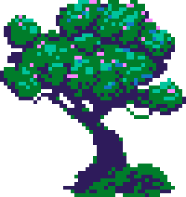






PUZZLE GAME

Slide 2

CREATOR
AHMED MOHAMED ABD ELFATAH MATTER
202006730

Slide 3
TOOLS
React
Js
css

Slide 4
PROJECT IDEA
I HAVE DEVELOPED AN ENGAGING PUZZLE GAME THAT INVOLVES CUTTING A PICTURE INTO PIECES AND CHALLENGING THE USER TO REARRANGE THEM. USERS CAN SELECT ANY PICTURE THEY LIKE AND CHOOSE THEIR LEVEL OF DIFFICULTY. THE GAME IS USER-FRIENDLY AND INTENDED TO PROVIDE HOURS OF ENTERTAINMENT AND ENJOYMENT.

Slide 5

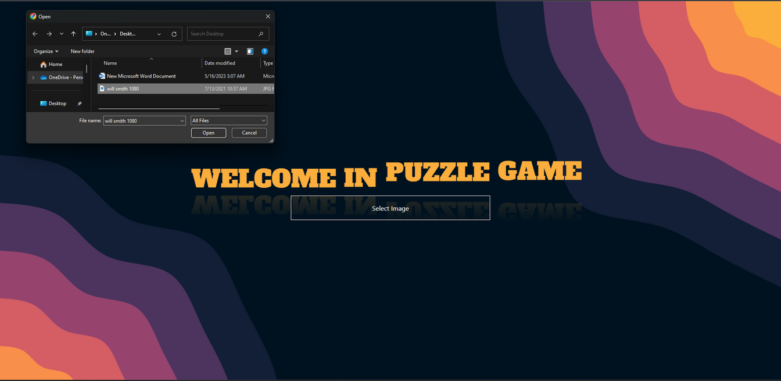
STEP 1
CHOOSE PICTURE

Slide 6
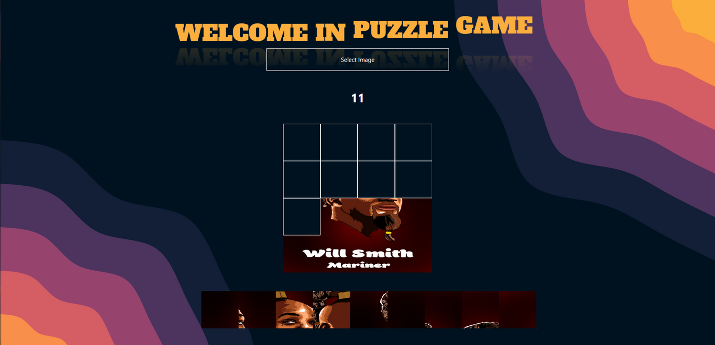
STEP 2
PLAY A GAME

Slide 7
THANK YOU FOR PLAYING WITH US!

