Slide 1

Smart Stick for the Blind
An Arduino-based IoT obstacle detection system designed to enhance mobility and independence for visually impaired individuals

Slide 2
Project Team
Abdelrahman Mamdouh Rabie Ahmed
Abdelrahman Eid Ahmed Abdel Wahab
Habiba Ahmed Talaat
Ali Hamdi Mohamed
Manar Nady Helmy
Menna Mohamed Abdel Moez Rashad
Abdelrahman Hany Issa
Ali Zaki Ali
Mayar Milad Atef
Abdelrahman Mostafa Ibrahim
Mohamed Ayman Abdel Aziz

Slide 3
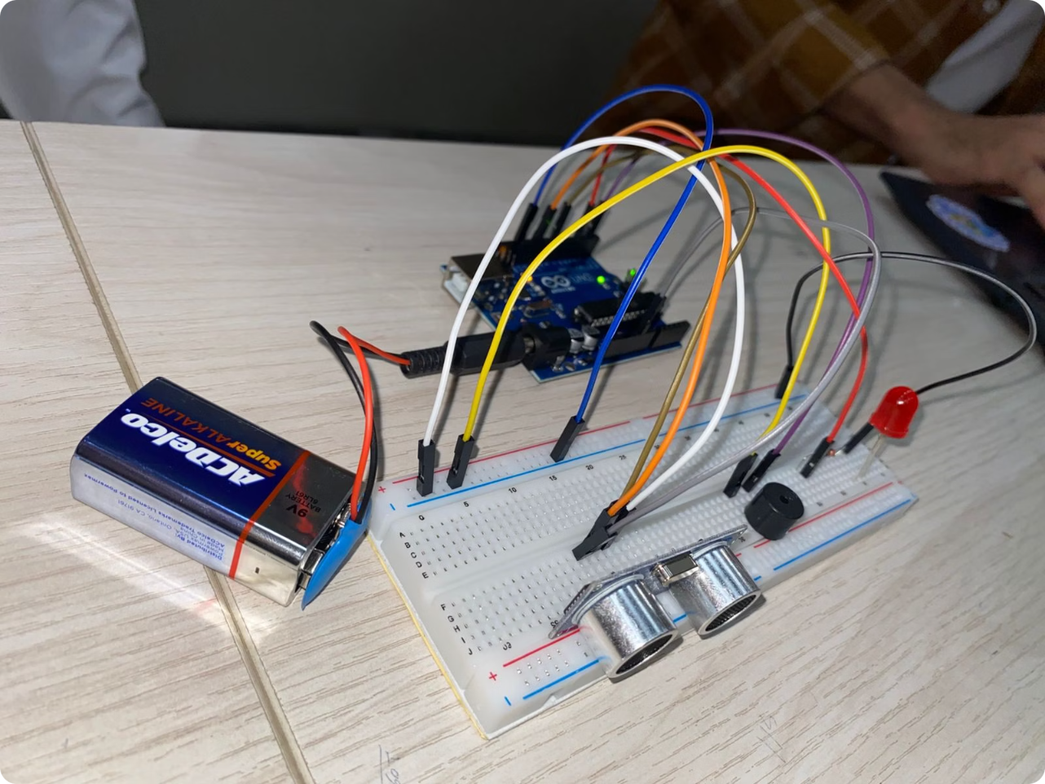
Project Overview
What It Does
The Smart Stick for the Blind is an IoT-based assistive device that detects obstacles and alerts users through audible and visual signals. By integrating an ultrasonic sensor with an Arduino microcontroller, it enhances the independence of visually impaired individuals.
How It Works
HC-SR04 sensor emits sound pulses and measures echo return time
Arduino calculates distance using: distance = duration \times 0.034 / 2
Obstacles ≤20 cm trigger buzzer and LED alert
Clear path (>20 cm) turns off alerts

Slide 4
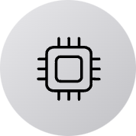

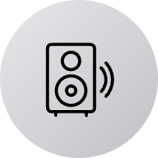


Components & Specifications
Arduino UNO
HC-SR04 Sensor
Active Buzzer
Red LED
Main processing unit for sensor data and alert control
Ultrasonic sensor for continuous distance measurement
Audible alert output when obstacles are detected
Visual indicator with 220Ω current limiting resistor
Breadboard & Wires
Circuit assembly and component connections

Slide 5
Circuit Diagram & Connections
The circuit connects HC-SR04 sensor, buzzer, and LED to Arduino UNO on a breadboard.
Component
Arduino Pin
Function
HC-SR04 VCC
5V
Power supply
HC-SR04 GND
GND
Ground connection
HC-SR04 TRIG
Pin 11
Trigger pulse
HC-SR04 ECHO
Pin 8
Echo return
Buzzer (+)
Pin 2
Alert output
LED Anode (+)
Pin 5
Via 220Ω resistor

Slide 6

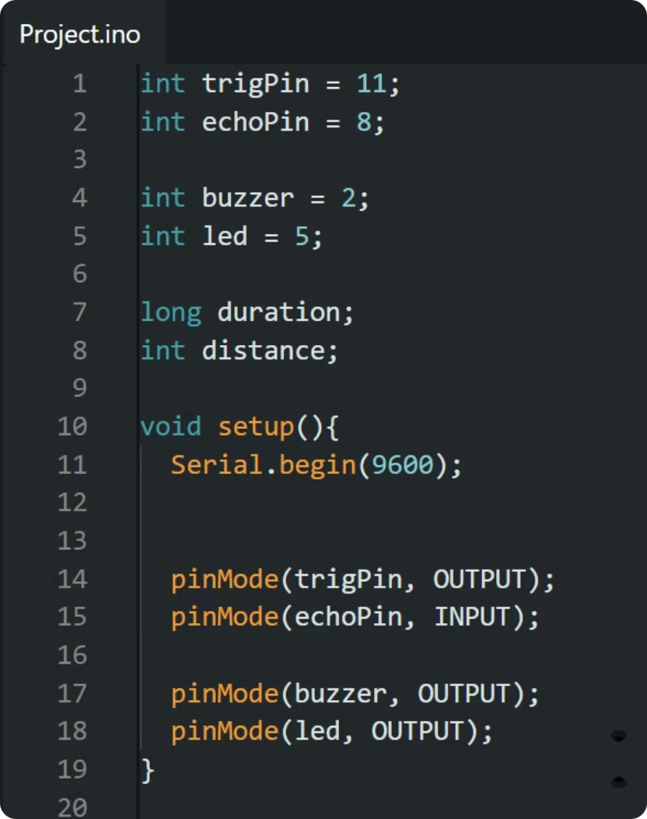
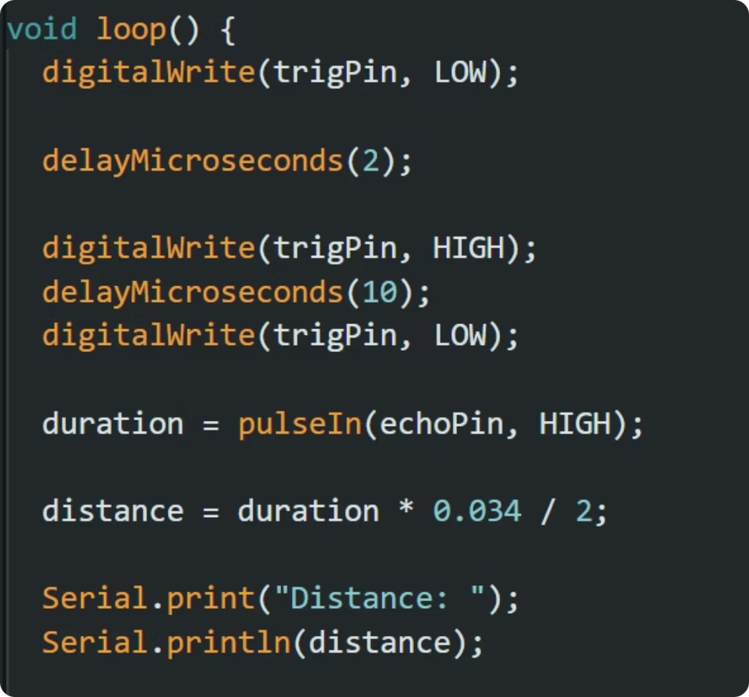
Source Code Implementation
Setup & Variables
Distance Measurement Loop
The code reads distance from HC-SR04 sensor and triggers alerts when obstacles are ≤20 cm away.

Slide 7

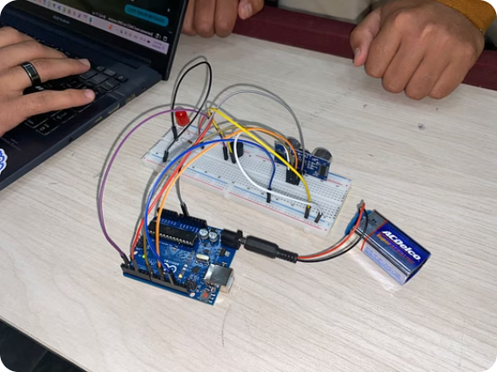

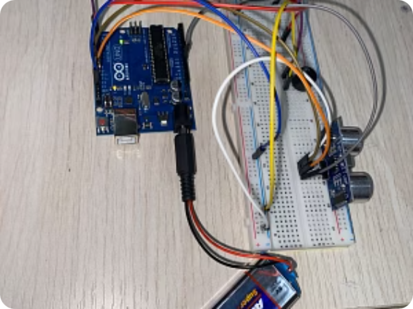
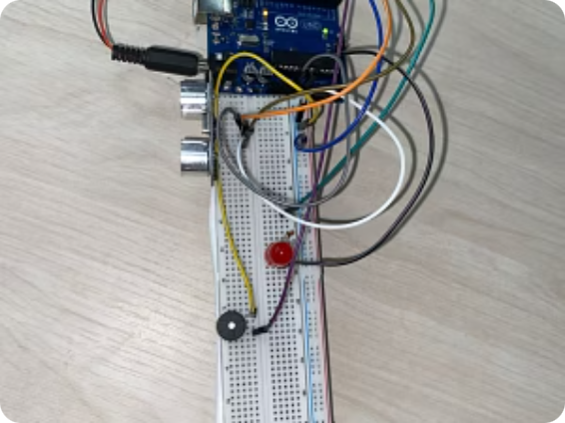
Project Build & Documentation
Project Build & Documentation: Physical implementation and testing of the Smart Stick prototype.

Slide 8
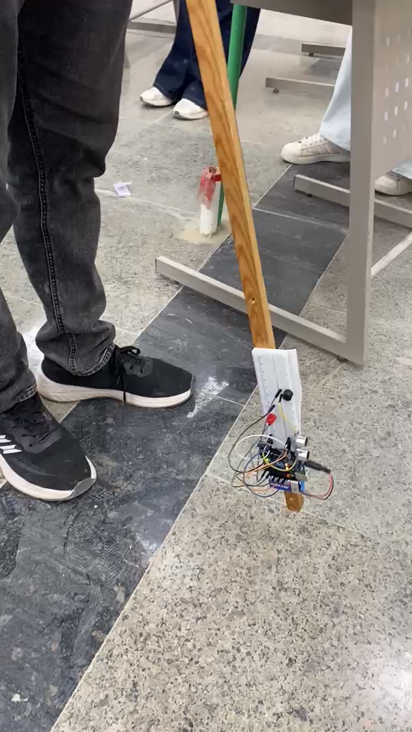

Slide 9
