Slide 1
Selected 2 Project
Team ID: 36
Team Leader:
Alaa Eid Mahmoud-201900161
Team Members:
Asmaa Khaled Tawfeek-201900147
Eslam Shaaban Eid-201900142
Bothina Sayed Abdelsalam-201900221
Asem Emad Abdellatef-201900395
Abdelrahman Hussien Hamdy-201900412
Mo’men Momdouh Khlil-201900864
Mohamed Mohanad Farouk-201900738

Slide 2
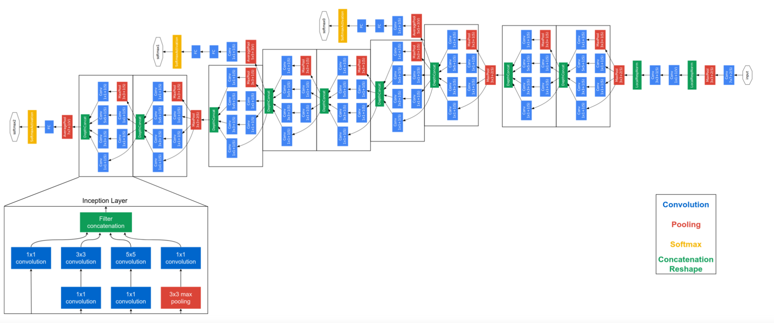
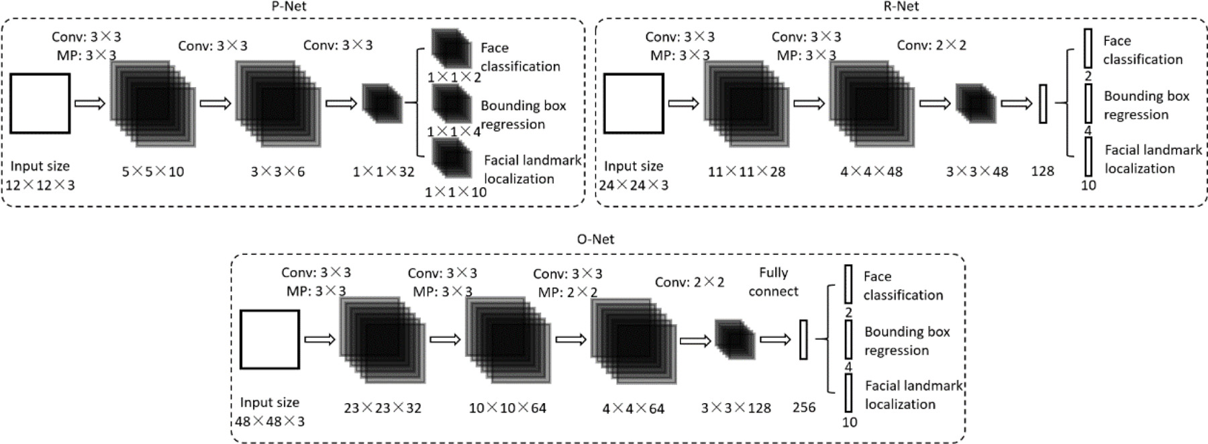
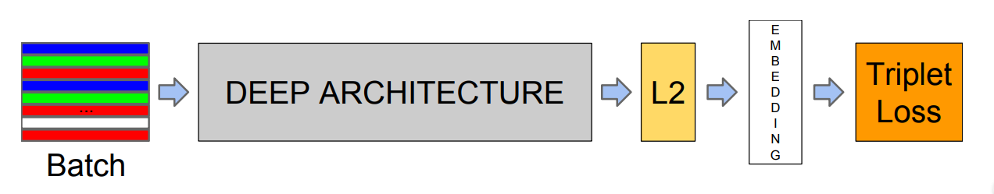
Architecture used:
MTCNN
Using 3*3 filters reduce the computing and increase the depth to get a better performance.
We apply ReLU as nonlinearity activation function after the convolution and fully connection layers (except output layers).
FaceNet
FaceNet is a pretrained model directly trains its output to be a compact 128-D embedding using a triplet-based loss function based on LMNN.
SVM
We developed a model to classify face embeddings as one of the known faces in the Dataset.
We need to normalize the embedding vector, and SVM is very effective at separating the face embedding vectors.

Slide 3
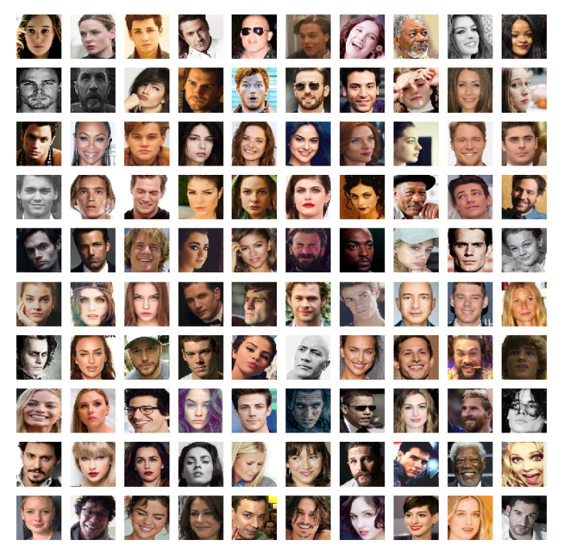
Dataset details:
Pins Face Recognition
This dataset from Kaggle, The images has been collected from Pinterest and cropped. There are 105 celebrities and 17,534 faces.
About dataset
The images is split into 105 directory; Each directory represents a person.
We split the dataset into 70% Train, 20% Validation and 10% Test. Then converting them into RGB, then into np arrays to be ready for MTCNN stage.
Download Dataset
ClickHere.

Slide 4
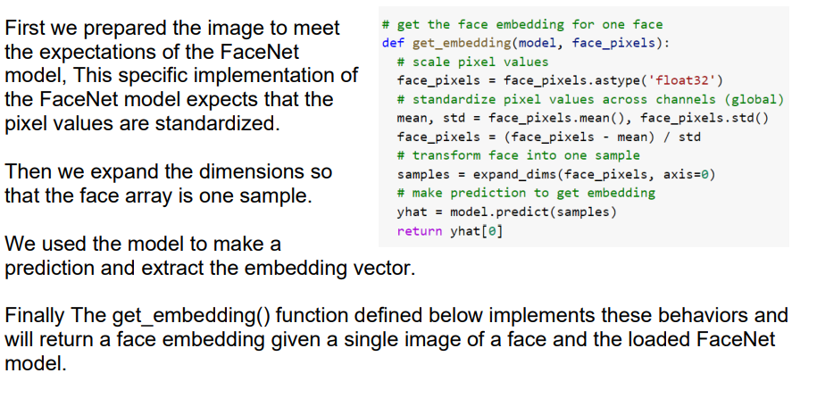
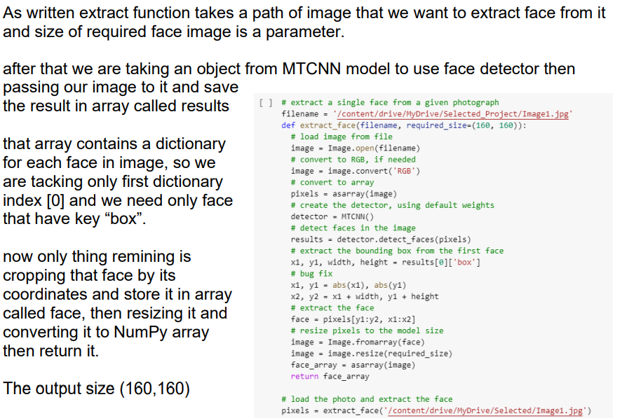
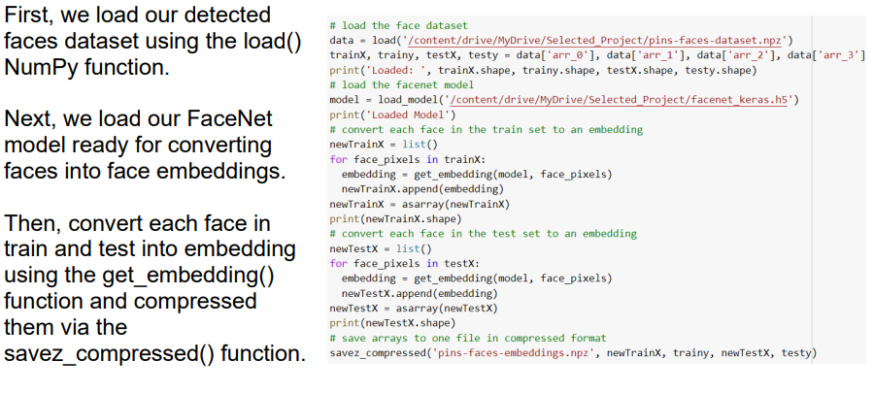
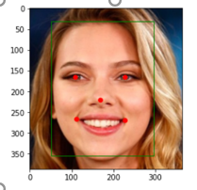
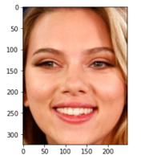
Implementation details and visualization:
MTCNN
FaceNet

Slide 5

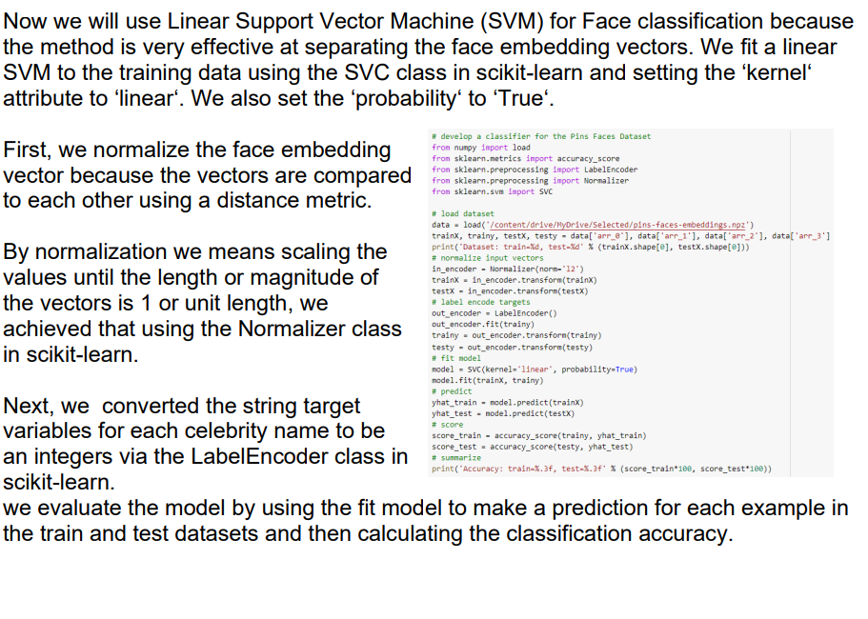
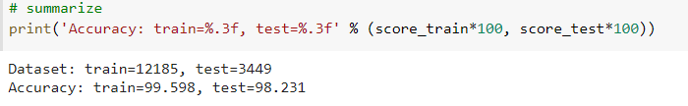
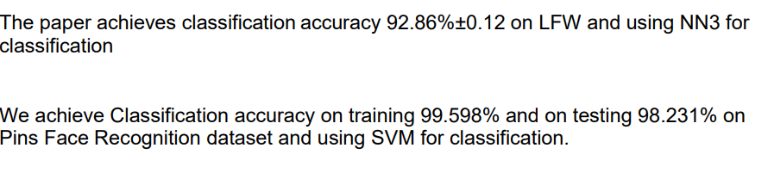
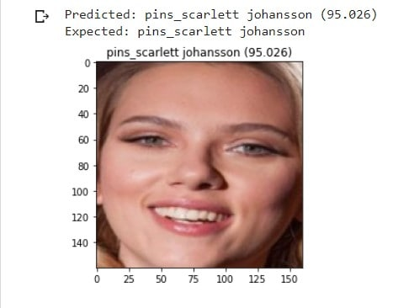
Results:
SVM
Performance in Pins Dataset :

