Slide 1

Arithmetic Logic Unit ALU
Presented to:
Dr/Ghada Abozaid
Eng/Rawan Omar
Edited by:
Abdelrahman Rabie

Slide 2




Table of contents
01
02
03
04
05
06
Introduction
Basic ALU
Complex ALU
Flags
Practical
Conclusion
07
Resources

Slide 3
Titels
1 - Introduction
2 - Basic ALU
1- Accumulator-Based Architecture
2- Register-Based Architecture
3- Stack-Based Architecture
1- Arthematic
2- Logical
3- Shifting
3 - Complex ALU
4 - Flags
1- Arthematic
2- Logical
3- Shifting
1 - Zero Flag
2 - Carry Flag
3 - Overflow Flag
4 - Negative Flag
5 - Parity Flag
6 - Signed Flag

Slide 4

01
Introduction

Slide 5
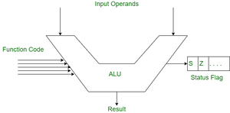
Introduction
The Arithmetic Logic Unit (ALU)
is a critical component of modern
computer architecture,
responsible for performing
arithmetic and logical
operations on binary data.

Slide 6
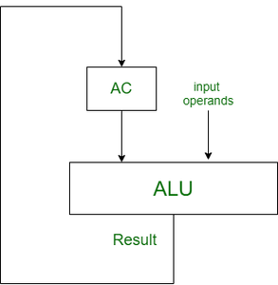
Accumulator-Based Architecture
In this type of architecture,
ALU gets one of its input operands
from Accumulator( AC ) and another
input operand from anywhere
may be from the register, memory, etc.
After getting input operand
ALU performs an operation on operands
and Result will be stored in Accumulator(AC).
Ex:- (Intel 4004, Intel 8080)

Slide 7
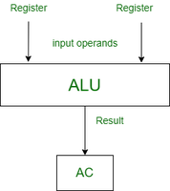
Register-Based Architecture
In this type of architecture,
ALU takes both two inputs operands from
Register, After getting the input operand
ALU performs an operation on operands
and the result will be stored in Accumulator(AC).
suppose initially your input operands stored
into memory then first you have
transferred from the memory to one of the
registers for execution.
Ex:- (ARM Cortex-M, AVR)

Slide 8
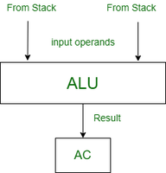
Stack-Based Architecture
In this type of architecture,
ALU gets both of its input operands
taken from Stack by just pop two top
most elements of the stack after getting
input operand ALU performs an operation
on operands and Result will be
stored in Accumulator(AC).
Ex :- PIC microcontrollers

Slide 9
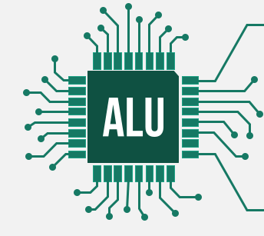
02
Basic ALU

Slide 10
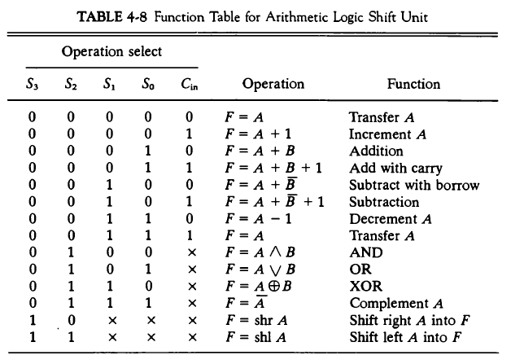
Basic ALU
The ALU handles 4-bit inputs
(A and B).
The 5-bit output is useful for operations like addition and subtraction, where an overflow or carry-out is needed.
The control signal (Op) determines which operation (e.g., addition, subtraction, AND, OR, etc.) is to be performed.

Slide 11

03
Complex ALU

Slide 12
Complex ALU
Inputs: The inputs A and B are 4-bit values, while the control signal Op determines which operation to perform.
Outputs: The output Out is 8 bits to accommodate potential carry, overflow, and larger results like multiplication.
Operations:
Addition and Subtraction might still result in a 4-bit number, but the 8-bit output is used to handle overflow or provide a wider result.
Multiplication of two 4-bit numbers typically results in an 8-bit number, which fits directly into the 8-bit output.

Slide 13
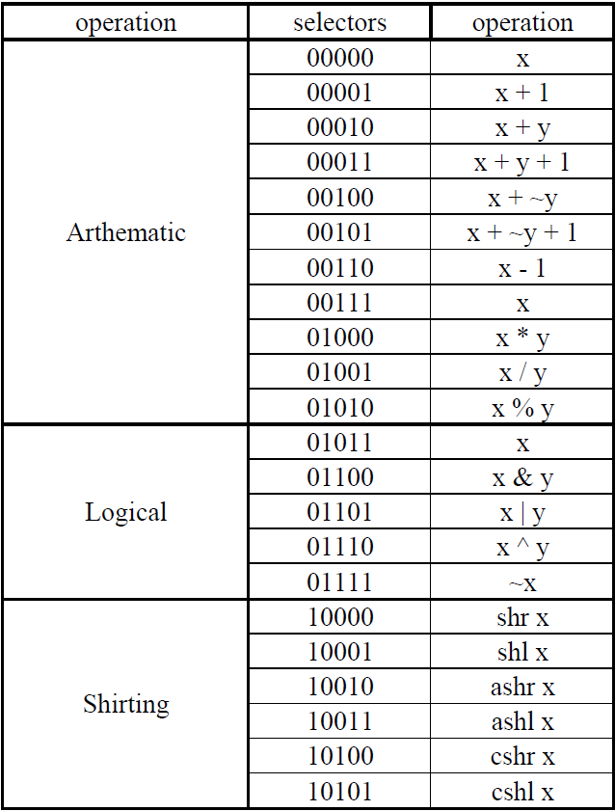
Complex ALU

Slide 14

04
Flags

Slide 15
Flags
1- Zero Flag (Z):
Indicates that the result of an operation is zero.
This can be useful for detecting certain types of errors,
such as division by zero.
2- Carry Flag (C):
Signals that an arithmetic operation has resulted in a
carry out of the most significant bit.
This can indicate overflow in addition operations.

Slide 16
Flags
3- Overflow Flag (O):
Indicates that an arithmetic overflow has occurred, meaning the result of an operation is too large to be represented in the available number of bits.
4- Negative Flag (N):
Set when the result of an operation is negative. This can help identify errors in signed arithmetic operations.

Slide 17
Flags
5- Parity Flag (P):
Used to indicate whether the number of set bits in the result is even or odd, which can assist in error detection in certain contexts.
6- Signed Flag (N):
Similar to the negative flag, this indicates the sign of the result, which can be useful for signed number operations.

Slide 18
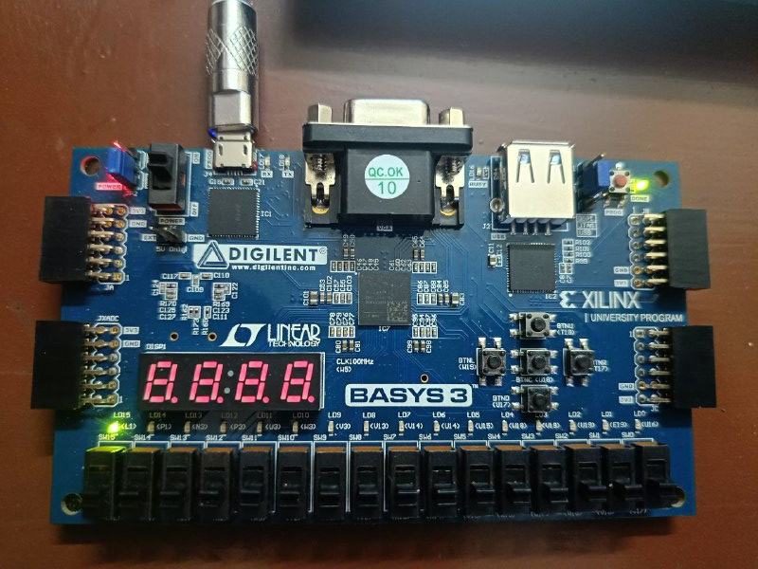
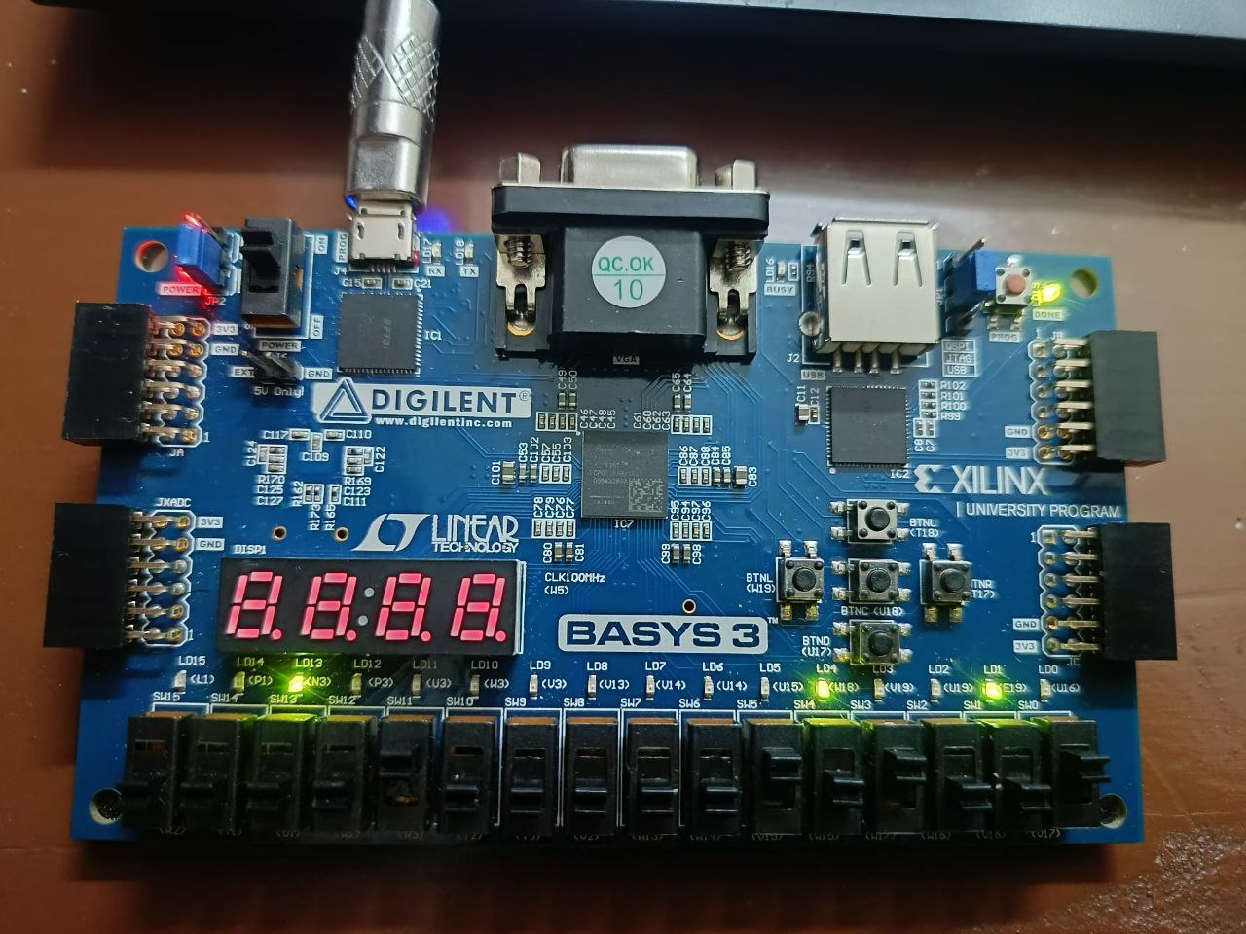
Practical
Multiplication operation overflow Flag
And operation Zero Flag

Slide 19
Conclusion
The ALU is a vital component that performs both arithmetic and logical operations on binary data. It is at the heart of computation in most digital systems, enabling a wide range of tasks. By providing operations such as addition, subtraction, logical comparison, and shifting, it plays an indispensable role in everything from basic computing to advanced algorithm processing. The output bit width and the operations available in the ALU are critical factors that impact performance, flexibility, and the overall capability of a computing system.
Future Trends: Explore advancements in ALU design for emerging technologies, like quantum computing and AI.

Slide 20
Resources
https://www.geeksforgeeks.org/types-of-architecture-based-on-input-to-alu/
Computer Systems Architecture - Morris Mano section 4-7 Athematic logic shift
Computer Organization and Design RISC-V edition - David A. Patterson chapter 3
https://www.researchgate.net/publication/377737488_The_Mechanism_of_The_Arithmetic_Logic_Unit
https://www.researchgate.net/publication/319277334_Design_and_implementation_of_arithmetic_and_logic_unit_ALU_using_novel_reversible_gates_in_quantum_cellular_automata
https://ieeexplore.ieee.org/xpl/conhome/6902668/proceeding
https://ieeexplore.ieee.org/abstract/document/8014578

Slide 21




Thanks!
Do you have any questions?

