Slide 1

Polynomial Regression and Overfitting
Machine Learning 2023-2024
Lab 4

Slide 2
Agenda
Polynomial Regression
Overfitting Vs Generalization
Train, Test, Validation and Cross Validation
Feature Selection
Assignment

Slide 3


Polynomial Regression
The linear features in :
Can be transformed to Polynomial :
This is still considered to be linear model as the coefficients/weights associated with the features are still linear. x² is only a feature. However the curve that we are fitting is quadratic in nature.

Slide 4
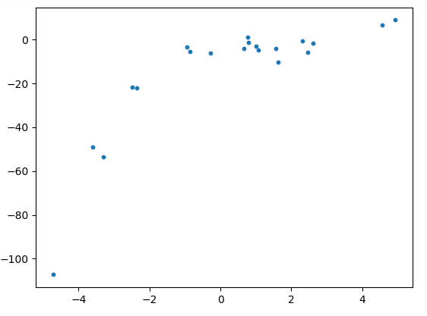
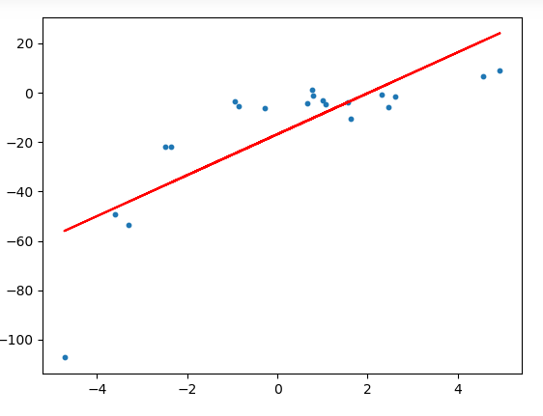
Polynomial Regression
Why Polynomial Regression?
To understand the need for polynomial regression, let’s generate some random points first.
Original Points
After applying a linear regression model

Slide 5
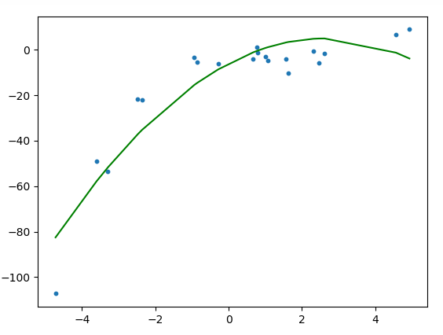
Polynomial Regression
To convert the original features into their higher order terms we will use the Polynomial Features class provided by scikit-learn.
if an input sample is two dimensional and of the form [a, b], the degree-2 polynomial features will be [1, a, b, a^2, ab, b^2].
It is quite clear from the plot that the quadratic curve is able to fit the data better than the linear line

Slide 6
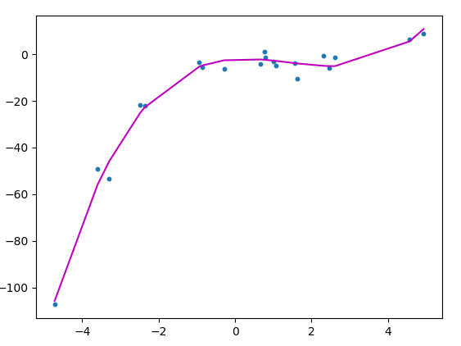
Polynomial Regression
If we try to fit a cubic curve (degree=3) to the random points, we can see that it passes through more data points than the quadratic and the linear plots.

Slide 7
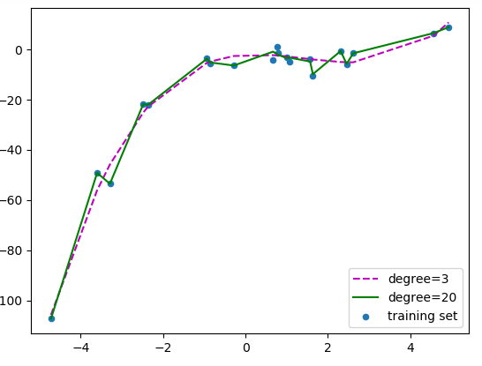
Polynomial Regression
If we further increase the degree to 20, we can see that the curve passes through more data points.

Slide 8
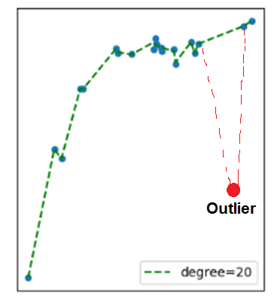
Polynomial Regression
For degree=20, the model is also capturing the noise in the data. This is an example of over-fitting. Even though this model passes through most of the data, it will fail to generalize on unseen data.

Slide 9
Overfitting
Overfitting happens when model learns signal as well as noise in the training data and wouldn’t perform well on new data on which model wasn’t trained on. In the example below, you can see underfitting in first few steps and overfitting in last few.
Our model doesn’t generalize well from our training data to unseen data.
This is known as overfitting, and it’s a common problem in machine learning and data science.

Slide 10
Overfitting
How to Prevent Overfitting
Detecting overfitting is useful, but it doesn’t solve the problem. Fortunately, you have several options to try.
Here are a few of the most popular solutions for overfitting:
- Cross-validation
- Train with more data
- Remove features
- Regularization
- Early stopping

Slide 11
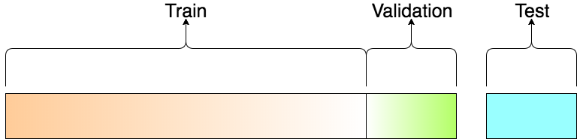
Train, Test and Validation Sets
Training Dataset: The sample of data used to fit the model. Validation Dataset: The sample of data used to provide an unbiased evaluation of a model fit on the training dataset while tuning model hyperparameters. The evaluation becomes more biased as skill on the validation dataset is incorporated into the model configuration.
Test Dataset: The sample of data used to provide an unbiased evaluation of a final model fit on the training dataset.

Slide 12
Dataset Splits
In splitting the data, we have 3 options:
Simply split into train and test: But that way tuning a hyperparameter makes the model 'see' the test data (i.e. knowledge of test data leaks into the model)
Split into train, validation, test sets: Then the validation data would eat into the training set
Cross-validation: Split into train and test, and train multiple models by sampling the train set. Finally, just test once on the test set.

Slide 13
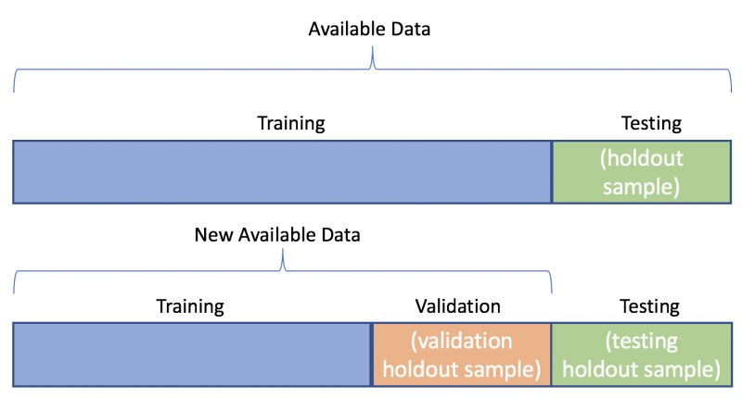
Train, Test and Validation Sets

Slide 14
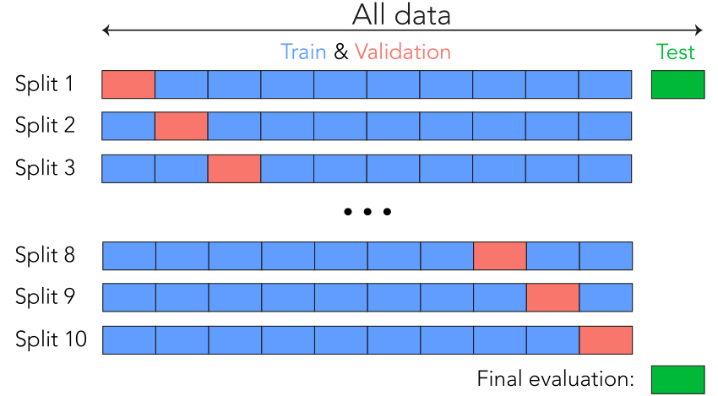
K-Fold Cross-Validation
Notes:
K-fold cross validation steps:
Shuffle the dataset randomly.
Split the dataset into k groups
For each unique group:
Take the group as a hold out or test data set
Take the remaining groups as a training data set
Fit a model on the training set and evaluate it on the test set
Retain the evaluation score and discard the model
Summarize the skill of the model using the sample of model evaluation scores

Slide 15
Feature Selection
Data Correlation: Is a way to understand the relationship between multiple variables and attributes in your dataset. Using Correlation, you can get some insights such as:
One or multiple attributes depend on another attribute or a cause for another attribute.
One or multiple attributes are associated with other attributes.
Why is correlation useful?
Correlation can help in predicting one attribute from another (Great way to impute missing values).
Correlation can (sometimes) indicate the presence of a causal relationship.
Correlation is used as a basic quantity for many modelling techniques

Slide 16
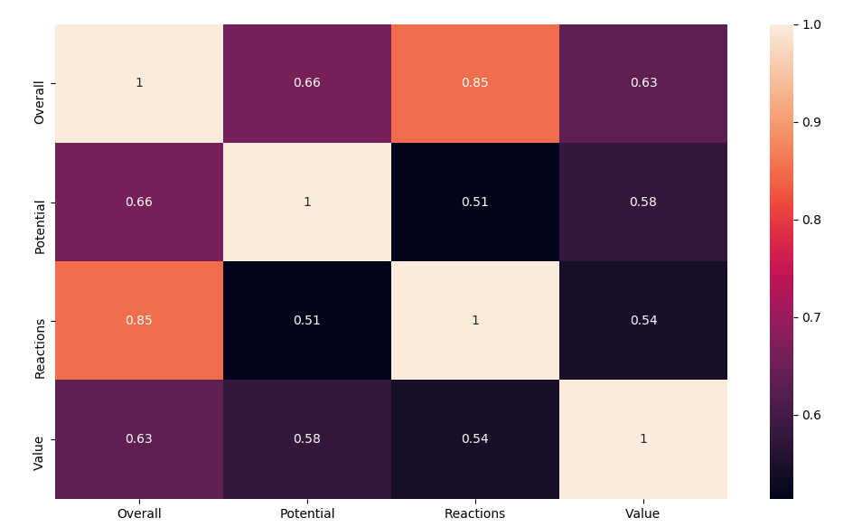
Feature Selection
Positive Correlation: means that if feature A increases then feature B also increases or if feature A decreases then feature B also decreases.
Negative Correlation: means that if feature A increases then feature B decreases and vice versa.
No Correlation: No relationship between those two attributes.
In python, dataframe.corr() computes the correlation of the columns and returns the correlation matrix.

Slide 17
Feature Selection
There are four main types of feature selection methods:
A. Filter methods
B. Wrapper methods
C. Embedded methods such as Lasso Regularization
D. Hybrid methods
Filter Methods:
Filter Methods Examples:
Chi-squared test, information gain, and correlation coefficient scores.

Slide 18
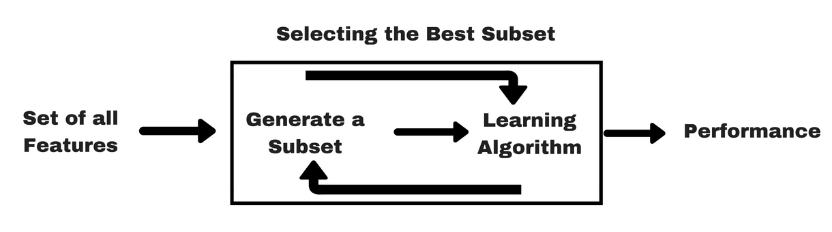
Feature Selection
Wrapper Methods:
Wrapper Methods Examples: forward feature selection, backward feature elimination, recursive feature elimination, etc

Slide 19
Assignment
Apply Polynomial regression from scratch to reduce the mean square error acquired on the updated student performance dataset “assignment2dataset.csv” attached with lab 4
Your code should be dynamic (allow degree=2, degree=3 and so on).
Built-in Polynomial Transformation is NOT ALLOWED
You can use linear regression built in for the regression model but not Polynomial features transformation built in
You should handle the preprocessing of the “Extracurricular Activities” column
You should apply feature selection (you must choose 2 or more features) and use
a train-test split (80% train-20% test)
Show your process in the code.
Assignment Deadline: Thursday 21/3/2024 11:59 PM.

Slide 20
Thank You
Notes:
https://www.kdnuggets.com/2020/05/dataset-splitting-best-practices-python.html https://stackoverflow.com/questions/48244219/is-sklearn-metrics-mean-squared-error-the-larger-the-better-negated

