Slide 1
Support Vector Machine (SVM)

Slide 2
Agenda
Non-Linear SVM
Bias vs Variance with SVM
SVM vs Logistic Regression
Kernel Functions

Slide 3
Linear SVM
Data: <x_{i},y_{i}>, i=1,..,l
x_{i} ∈ R^{d}
y_{i} ∈ {-1,+1}
f(x)
=-1
=+1
All hyperplanes in R^{d} are parameterize by a vector (w) and a constant b.
Can be expressed as w•x+b=0 (remember the equation for a hyperplane
from algebra!)
Our aim is to find such a hyperplane f(x)=sign(w•x+b), that
correctly classify our data.

Slide 4
Non-linear SVMs: Feature spaces
General idea: the original input space can always be mapped to some higher-dimensional feature space where the training set is separable:
Φ: x → φ(x)

Slide 5
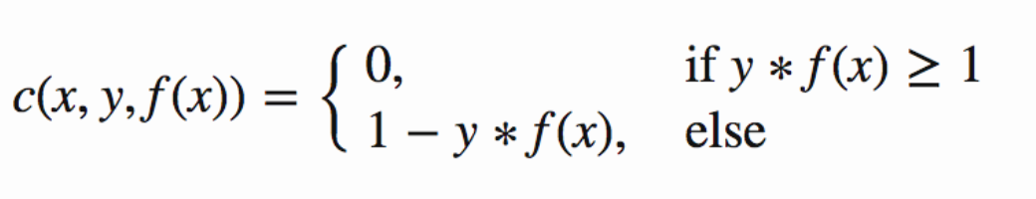
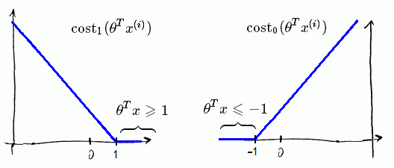
Hinge Loss

Slide 6
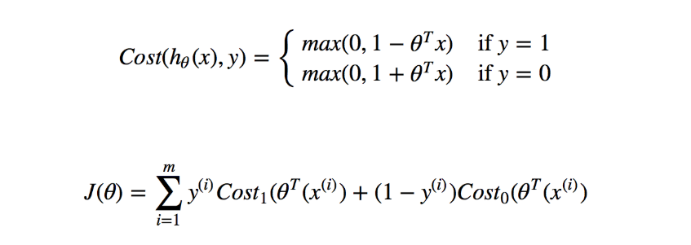
Hinge Loss

Slide 7
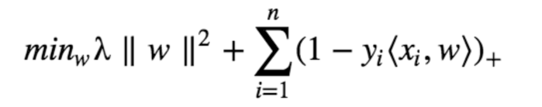
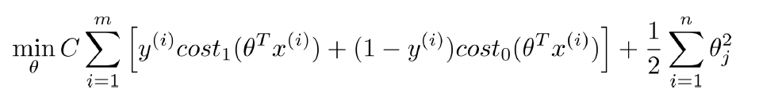
SVM Optimization Objective General Form
≈ 1/λ

Slide 8
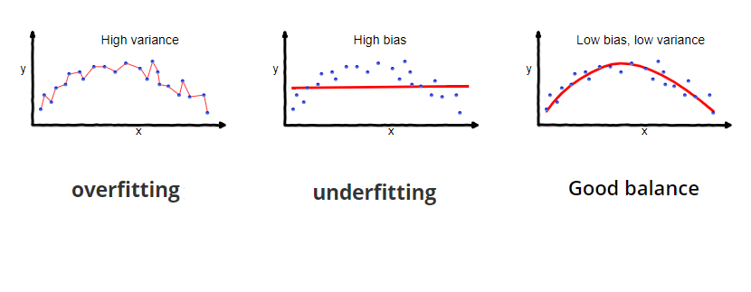
Bias vs Variance

Slide 9
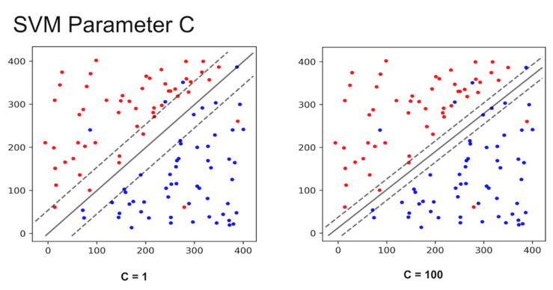
If you set C to be a low value (say 1), the SVM classifier will choose a large margin decision boundary at the expense of larger number of misclassifications. When C is set to a high value (say 100), the classifier will choose a low margin decision boundary and try to minimize the misclassifications.

Slide 10
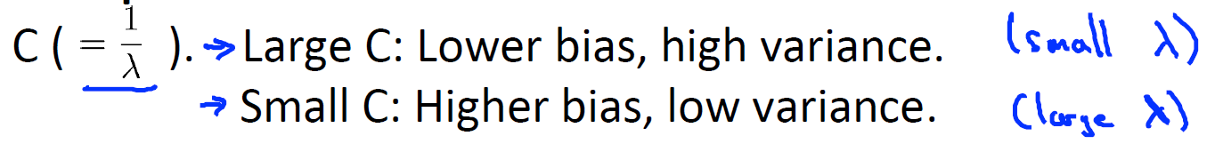
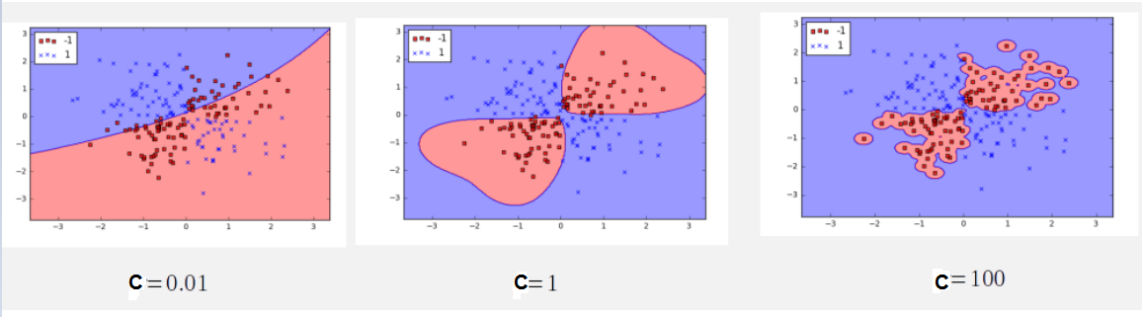

Slide 11
Kernel Functions
The linear classifier relies on dot product between vectors K(x_{i},x_{j})=x_{i}^{T}x_{j}
If every data point is mapped into high-dimensional space via some transformation Φ: x → φ(x), the dot product becomes:
K(x_{i},x_{j})= φ(x_{i}) ^{T}φ(x_{j})
A kernel function is some function that corresponds to an inner product in some expanded feature space.

Slide 12
Examples of Kernel Functions
Linear: K(x_{i},x_{j})= x_{i} ^{T}x_{j}
Polynomial of power p: K(x_{i},x_{j})= (1+ x_{i} ^{T}x_{j})^{p}
Gaussian (radial-basis function network):
Sigmoid: K(x_{i},x_{j})= tanh(β₀x_{i} ^{T}x_{j} + β₁)

Slide 13
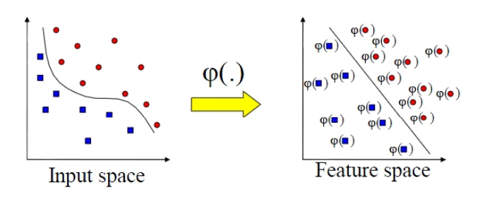
Kernel Functions
Mapping to a feature space can produce problems:
High computational burden due to high dimensionality
Many more parameters
SVM solves these two issues simultaneously
”Kernel trick” produces efficient classification

Slide 14
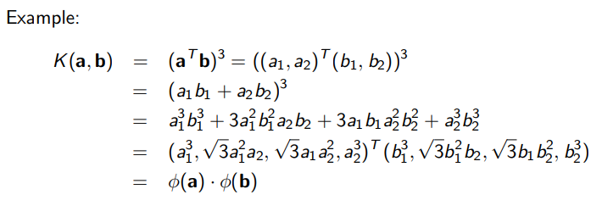
Kernel Functions
Idea: work directly on x, avoid having to compute φ(x)

Slide 15
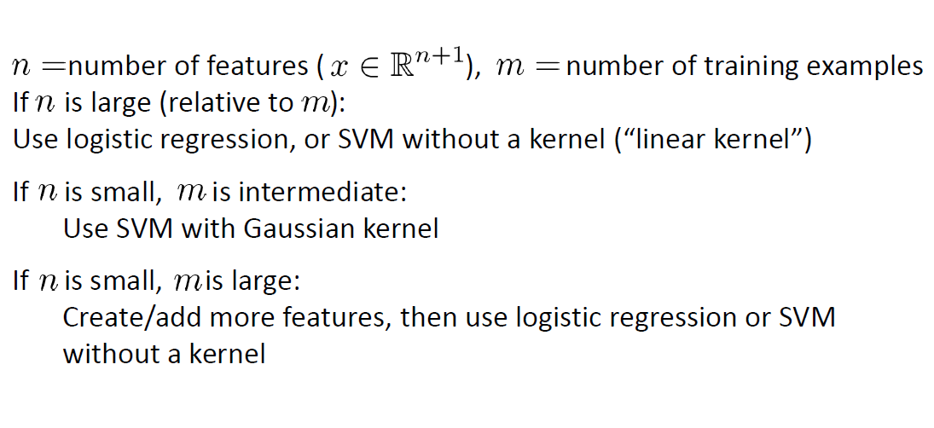
SVM vs Logistic Regression
Which one to use?
As always, depends on the problem.

Slide 16
Feature Selection
There are four main types of feature selection methods:
A. Filter methods
B. Wrapper methods
C. Embedded methods such as Lasso Regularization
D. Hybrid methods
Filter Methods:
Filter Methods Examples:
Chi-squared test, information gain, and correlation coefficient scores.

Slide 17
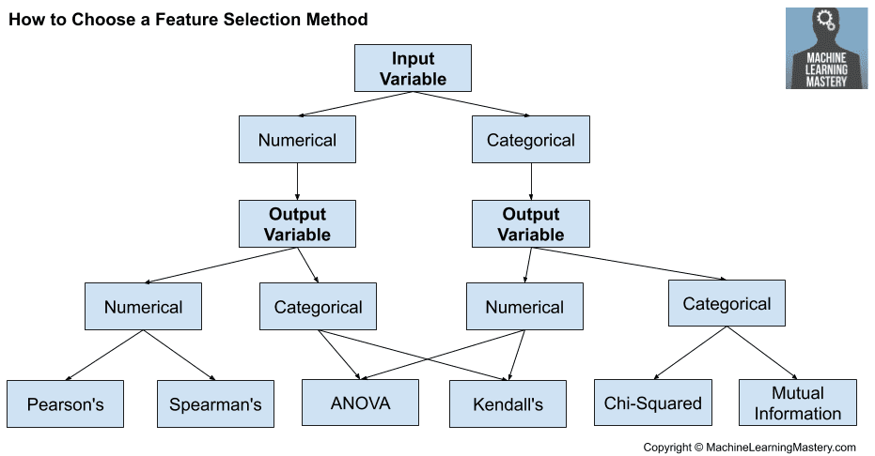
How to choose feature selection Method

Slide 18
Assignment 3
Solve the classification problem attached with Lab 8 which consists of train folder and test folder. Each of which contain four folders for the classes of the dataset. The folder name represents the class name.
The four classes are: accordian, dollar_bill, motorbike and Soccer_ball
1-Extract the features of the training set using HOG.
2-Use the extracted features (fd) to train SVM on the training dataset with an appropriate kernel function.
3-Test the trained model and calculate the accuracy the test dataset.

Slide 19
Resources
SVM :
1- https://docs.opencv.org/2.4.13.7/doc/tutorials/ml/introduction_to_svm/introduction_to_svm.html
2- http://mlwiki.org/index.php/Support_Vector_Machines#Support_Vector_Machines
SciKit Documentation:
https://scikit-learn.org/stable/modules/generated/sklearn.svm.SVC.html#sklearn.svm.SVC

