Slide 1

Transcription factors: Bridge between cell signaling and gene regulation

Slide 2
Team members
Ahmed Osama
Nada Samir
Youstina magdy
Iprahim Mohamed
Mohamed mamdouh
Abdelrahman Atef Gamal

Slide 3
Objectives
What is transcription factors (TFs) ?
Intrinsic function ?
Extrinsic function ?
How to detect TFs activities ?
Examples
Use of single-molecule imaging techniques in TFs detection

Slide 4
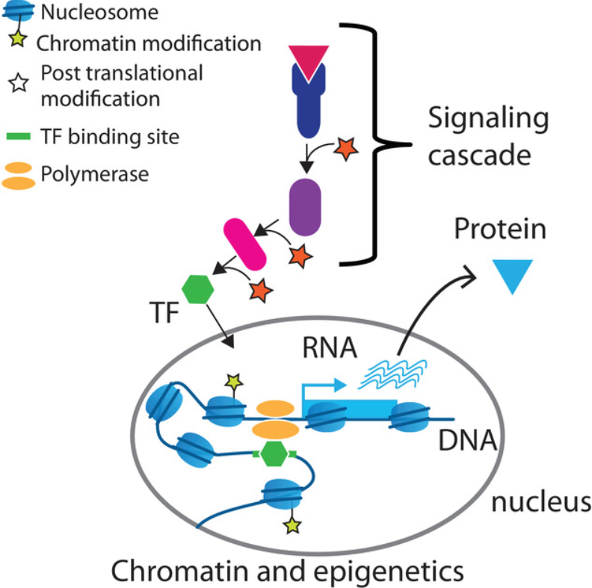
What is transcription factors (TFs) ?
key regulators of intrinsic cellular processes, such as differentiation and development, and of the cellular response to external perturbation through signaling pathways

Slide 5
Intrinsic function ?
such as development and differentiation
Differentiation and reprogramming processes are typically driven by the transcriptional induction of a set of TFs, which then drive the required gene regulatory programs
Yamanaka factors (Oct4, Sox2, Klf4 and c-Myc) that are sufficient to reprogram fibroblasts into induced pluripotent stem cells (iPSCs)

Slide 6
Extrinsic function ?
the response to external cues is typically initiated by receptor activation and cell signaling, which acts on a time-scale of minutes, often through cascades of post-translational modifications (PTMs) resulting in the modulation of a set of TFs

Slide 7
How to detect TFs activities ?
The activity of a TF can be regulated either by modulating the abundance of its active form (including transcription, translation, and post-translational regulation), or by modulating the accessibility of its binding sites (including epigenetic processes and cell-type specific chromatin states). Once bound, TFs can open the chromatin for other factors to bind or prevent other factors from binding, and activate or repress the transcription of genes.

Slide 8
How to detect TFs activities ?
the function of TFs depends on PTMs and binding to interaction partners. Thus, their expression level does not necessarily correlate with their functional activity. On the other hand, the binding of TFs to chromatin can be readily assayed, for example, using chromatin immunoprecipitation followed by sequencing (ChIP-seq) and similar assays, which results in genome-wide maps of TF binding. Yet, it remains a challenge to delineate functional binding sites from unspecific binding events

Slide 9
Examples
Examples of well-known signaling cascades that lead to the activation of TFs are TGFbeta signaling leading to activation the of SMAD family TFs , Jak-STAT signaling activating the STAT TFs , Erbb2 signaling typically activating Jun and Myc Hippo signaling targeting the TEA-domain-containing (TEAD) family (TEAD1–TEAD4) of TFs and Notch signaling that induces dissociation of DNA-bound RBPJ from a corepressor complex and recruitment of a coactivator complex instead. Examples of TFs that are inactivated by signaling include the FOXO family, a subclass of Forkhead TFs. In the absence of insulin, FOXO TFs are bound to DNA and activate gene expression.

Slide 10
Use of single-molecule imaging techniques in TFs detection
We highlighted that TFs are a strong candidate for linking the two processes (end point of signaling, starting point of gene regulation) and are ideally suited to do so also practically
- The employment of single-molecule imaging techniques adds another layer of insight into the dynamics, regulation and binding properties of TFs. Imaging of TFs, interaction partners, chromatin and gene expression has the power to observe and quantify the spatial and temporal processes underlying the gene regulatory machinery in vivo

Slide 11
Use of single-molecule imaging techniques in TFs detection
Methods such as fluorescence recovery after photobleaching (FRAP), single molecule tracking (SMT) and fluorescence correlation spectroscopy (FCS) helped to investigate the kinetics and timescales of TF-chromatin interaction, uncovered the presence of fast and transient TF binding and aid in studying nuclear-cytoplasmic shuttling of TFs upon signaling activation

Slide 12
Thank you

