Slide 1
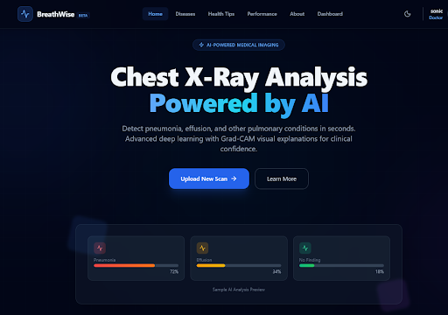
BreathWise
AI Chest X-Ray Analysis and Clinical Decision Support System
University of Sadat City
Faculty of Computers and Artificial Intelligence
Department of Information Systems — Academic Year 2026
AbdAlrahman Magdy | Mahmoud Gamal | Seif Mohamed
Mohamed Karam | Ahmed Eldamasy | Mahmoud Fadl
Supervised by:
Prof. Engy Elshafey & Prof. Asmaa Saad

Slide 2
The Problem
🏥 Radiologist Shortage & Burnout
Imaging volume growing faster than radiologist training. Cognitive fatigue → diagnostic errors.
⏱️ Diagnostic Delay in Emergencies
Hours of delay detecting Pneumothorax in ER/ICU can be fatal.
🔀 Inter-Observer Variability
Same X-ray, different diagnoses depending on the reader and experience level.
🔒 The 'Black Box' Barrier
Clinicians distrust AI that can't visually explain its reasoning.

Slide 3
Disease Burden — Why These 4 Conditions?
Pneumonia
450M cases/yr
Leading infectious killer in children under 5 (740K deaths/yr)
Cardiomegaly
64M cases/yr
Heart failure, cardiomyopathy — high mortality & hospitalization
Pleural Effusion
10M cases/yr
Secondary to heart failure, pneumonia, and malignancies
Pneumothorax
0.5M cases/yr
Acute life-threatening emergency requiring immediate intervention

Slide 4
Project Objectives
🎯 High-Accuracy Classification
Multi-label prediction with >90% accuracy across all thoracic conditions
⚡ Near Real-Time Inference
<0.5s per scan (single pass), ~2s with Test-Time Augmentation
👁️ Explainability by Design
Grad-CAM heatmaps overlaying every prediction to break the 'black box'
📋 Clinical Workspace
Patient tracking, scan histories, automated PDF reports with QuestPDF

Slide 5
System Architecture (3-Tier Microservices)
React Frontend
Port 5173
TypeScript, Vite, TailwindCSS Recharts, Axios
ASP.NET Core 8 Backend
Port 5169
C#, EF Core, SQL Server JWT + RBAC, QuestPDF
FastAPI / PyTorch AI Service
Port 8000
Python, DenseNet-121 Grad-CAM, OpenCV
Backend acts as secure proxy → AI service never exposed to public internet. Internal auth: Authorization: internal-key

Slide 6
Technology Stack
Frontend
• React 19
• TypeScript
• Vite
• TailwindCSS
• Recharts
• Axios
Backend
• C# .NET 8
• ASP.NET Core 8
• Entity Framework Core
• SQL Server
• QuestPDF
• JWT + RBAC
AI Service
• Python 3.12
• FastAPI + Uvicorn
• PyTorch (DenseNet-121)
• OpenCV + PIL
• torchvision
• Grad-CAM

Slide 7
End-to-End Data Flow
1
Upload
Doctor uploads X-ray via React drag-and-drop
2
Save
C# saves image as wwwroot/uploads/[GUID].png
3
AI Call
C# sends internal POST to localhost:8000/predict
4
Inference
Python runs DenseNet-121 + TTA (3 passes) + Grad-CAM
5
DB Write
C# decodes base64 heatmap writes ScanResult to SQL
6
Display
React renders diagnosis + interactive heatmap toggle

Slide 8
The AI Model — DenseNet-121
Dense Connectivity
Each layer receives feature maps from ALL preceding layers
Growth Rate k = 32 (new feature maps per layer)
Transition Layers: 1×1 conv + 2×2 avg pool between blocks
Classifier Head
nn.Linear(1024, 5) — 5 output logits
Loss: BCEWithLogitsLoss (Binary Cross-Entropy)
Optimizer: Adam, LR = 1e-4, Batch Size = 32
Why DenseNet over ResNet?
1024 output features (vs ResNet's 2048) → more compact
Better gradient flow through all layers

Slide 9
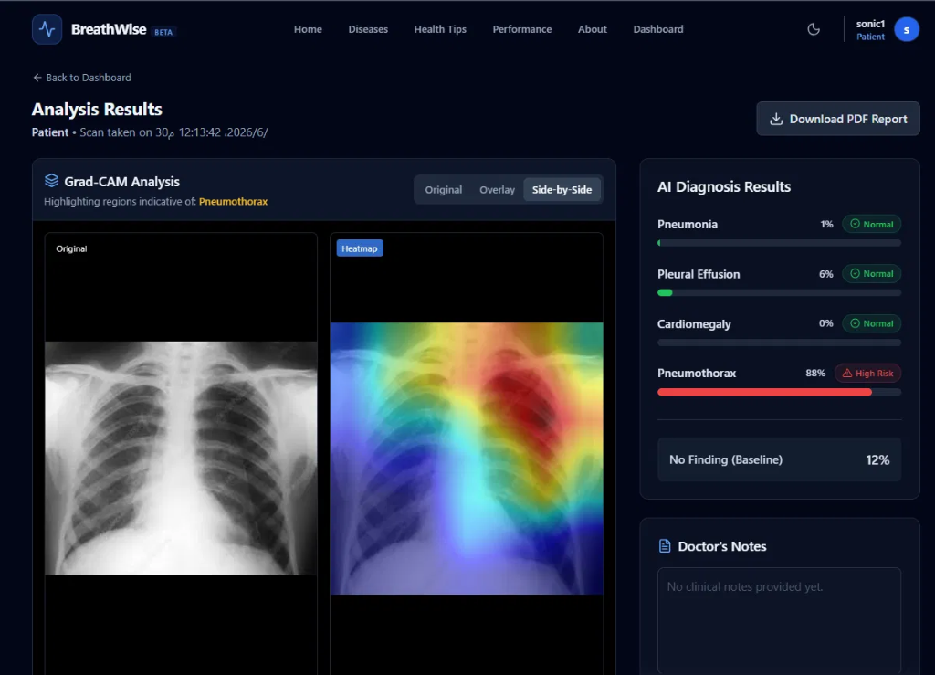
Explainability — Grad-CAM
Breaking the Black Box
Computes gradients of class score vs DenseBlock4 activations
Global Average Pooling → importance weights α
Weighted sum → ReLU → upsampled to 224×224
Mapped to JET color palette, blended α=0.4
3 View Modes: Original | Overlay | Side-by-Side

Slide 10
Dataset & Class Balancing
Original NIH ChestX-ray14
112,120 images — 30,805 patients
15 finding labels (14 pathologies + No Finding)
Heavily imbalanced: No Finding = 60,361 (53.8%)
Rarest: Hernia = 227 (0.2%)
Problem: Training on raw data → biased model that always predicts 'Healthy'
Filtered & Balanced (BreathWise)
Filtered to 5 target conditions
Balanced to 5,500 per class
Total: 27,500 images
Train: 22,000 (80%) / Val: 5,500 (20%)
Pneumonia (1,431 → 5,500) via oversampling with replacement

Slide 11
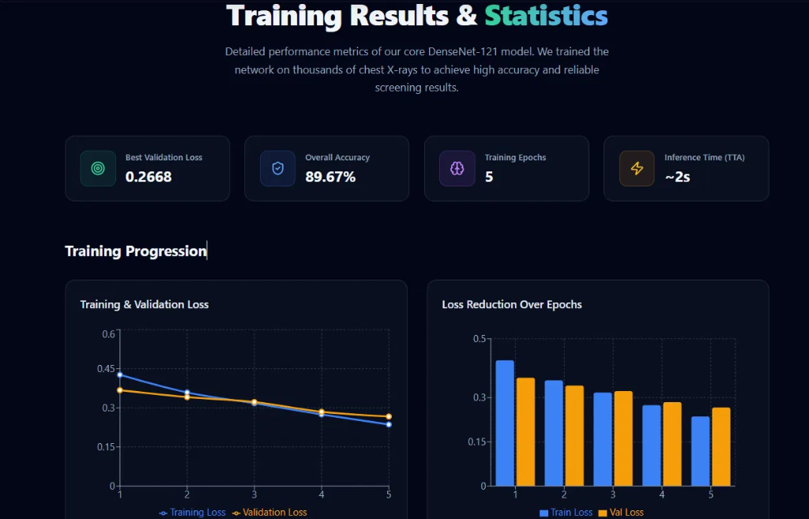
Training & Results

Slide 12
Per-Class Performance (Classification Report)
Condition Precision Recall F1-Score Support
Cardiomegaly ★ 0.82 0.85 0.84 1,250
Pneumonia 0.85 0.77 0.81 1,148
Pneumothorax 0.79 0.76 0.77 1,194
Pleural Effusion 0.79 0.72 0.75 1,928
No Finding 0.73 0.66 0.69 1,113
Macro Avg 0.80 0.75 0.77 6,633
★ Cardiomegaly = highest F1 (0.84) due to distinct visual signature of enlarged heart No Finding = lowest F1 (0.69) — expected, as it represents absence of features. Mitigated by mathematical derivation in production.

Slide 13
Post-Training Optimizations
Optimal Threshold Tuning
Default 0.5 → sweep 0.0–1.0, maximize F1 per class
Pneumonia: 0.39
Effusion: 0.45
Cardiomegaly: 0.54
Pneumothorax: 0.39
No Finding: 0.43
Acute conditions get lower thresholds → higher sensitivity → fewer missed diagnoses
Test-Time Augmentation (TTA)
3 predictions per image:
Original + H-Flip + 10° Rotation
Final = arithmetic mean of 3 sigmoid outputs
Progressive Accuracy:
Baseline (0.5): 89.37%
+ Thresholds: 89.33%
+ TTA: 89.67% ✓

Slide 14
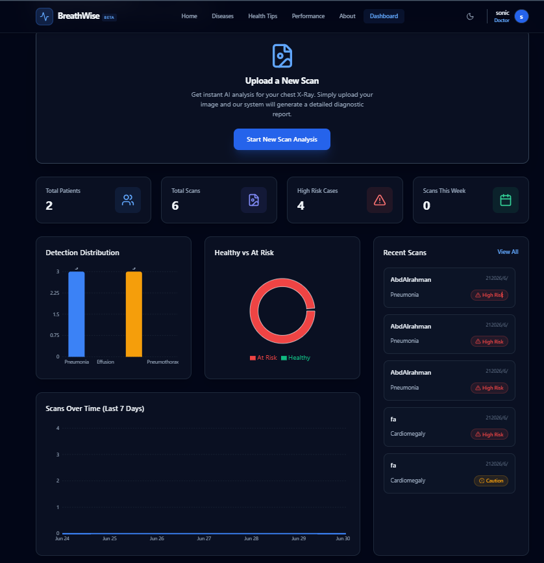
Doctor Dashboard — Clinical Workspace
KPI Cards (Total Patients, Total Scans, High Risk Cases) • Detection Distribution Chart • Healthy vs At Risk Donut • Recent Scans with Risk Badges • Scans Over Time (Last 7 Days)

Slide 15
AI Diagnosis & Grad-CAM Results
Grad-CAM Side-by-Side View • Original X-ray vs Heatmap Overlay • AI Diagnosis Panel with Risk Badges • Download PDF Report Button • Doctor's Notes Section

Slide 16
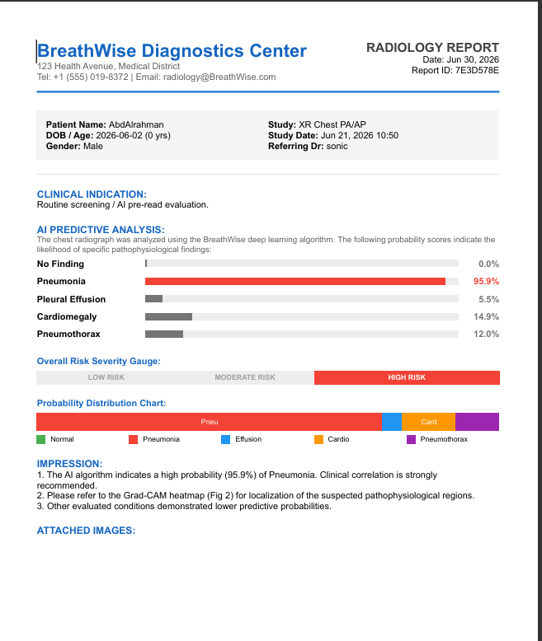
Automated Clinical PDF Reports
QuestPDF Report Engine
Professional radiology report layout
Patient demographics & study info
AI Predictive Analysis with probability bars
Overall Risk Severity Gauge (Low / Moderate / High)
Probability Distribution Chart
Clinical Impression with recommendations
Attached X-ray + Grad-CAM heatmap images
Generated via C# QuestPDF — instant compilation
Requires clinician's electronic signature (human-in-the-loop)

Slide 17
Security & Regulatory Compliance
🔐 JWT Authentication
24-hour token expiry, validated on every API request
👥 Role-Based Access (RBAC)
Doctor (full CRUD), Patient (read-only own data), Admin
🔑 PBKDF2 Password Hashing
HMAC-SHA256 + unique 128-bit salt per user, 10,000 iterations
🏷️ Anonymized GUID Filenames
X-rays saved as 8c4e2a87-19db-4382.png — no patient names on disk
📜 HIPAA/GDPR Alignment
Query-level isolation matches JWT identity claims. 17 secured API endpoints

Slide 18
Reliability — Graceful Degradation
1
AI Service DOWN
Network timeout, crash, or GPU unavailable
2
C# Catch Block
AiService catches exception → falls back to GetMockScores()
3
UI Uninterrupted
Doctors can still log in, view patients, browse dashboard
Also: Python AI service has its own demo mode — if densenet121.pt weights are missing, it serves mock predictions so frontend testing can proceed.

Slide 19
Limitations & Future Roadmap
Current Limitations
✗ Dataset scope — NIH only, may vary on different equipment
✗ JPEG/PNG input only — no native DICOM support
✗ Single modality — chest X-rays only (no CT/MRI)
✗ No real-time multi-physician collaboration
✗ On-premise deployment only
Future Roadmap
→ DICOM & PACS Integration (fo-dicom C-STORE)
→ VLM Report Writing (LLaVA-Med / Med-PaLM)
→ More Pathologies: TB (1.3M deaths/yr), Atelectasis, COPD
→ Federated Learning across hospitals
→ Cloud-Native auto-scaling deployment

Slide 20
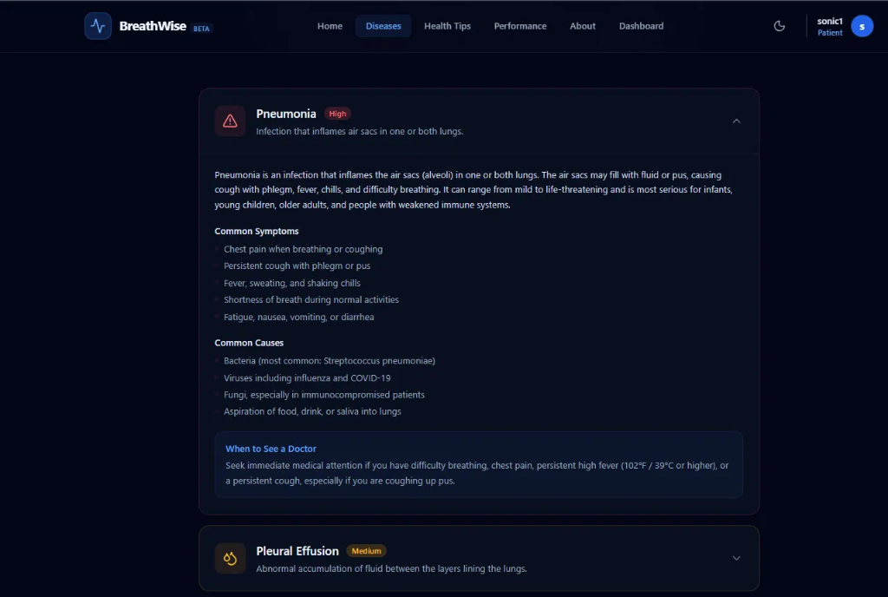
Patient Education — Disease Knowledge Base
Comprehensive disease information • Common symptoms & causes • When to See a Doctor alerts • Patient-accessible (read-only role)

Slide 21
BreathWise
AI won't replace radiologists, but radiologists who use AI will replace those who don't.
✅ Multi-label classification (AUC 0.91–0.96)
✅ Explainable AI — Grad-CAM in production
✅ Secure RBAC on all 17 API endpoints
✅ Automated PDF reports (QuestPDF)
✅ Real-time dashboard (7 live metrics)
✅ Graceful degradation & demo mode
✅ HIPAA-aligned privacy (GUID, PBKDF2, JWT)
✅ Modular, extensible REST architecture
Thank You!
Prof. Engy Elshafey & Prof. Asmaa Saad

