Slide 1
بسم الله الرحمن الرحيم
ALGHAMDI, HUDA 语嫣

Slide 2
Research title
Applying Machine Learning Algorithms to Improve the Accuracy of Medium- to Long-Term Sand and Dust Storm Forecasting

Slide 3
Introduction

Slide 4
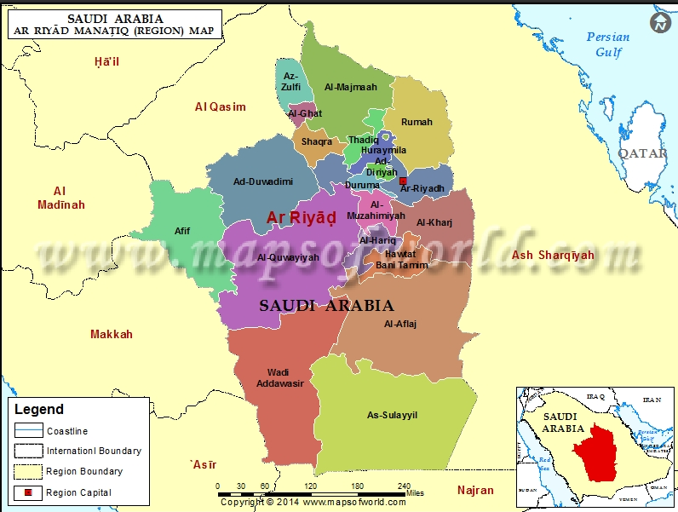
Riyadh City

Slide 5
Riyadh, is the capital of the Kingdom of Saudi Arabia, is situated in the central Arabian Peninsula on the Najd Plateau.
At approximately 46.67° E longitude , and 24.71° N latitude with an average elevation of approximately 600 m above sea level, it 380,000 square kilometers..
The city is characterized by an arid desert climate, extremely hot summers, limited annual precipitation, and extensive surrounding desert landscapes.

Slide 6
According to the 2022 Saudi census, Riyadh had approximately 7.01 million inhabitants, making it the country's most populous city.
The Royal Commission for Riyadh City's 2024 dataset identifies 20 sub-municipalities distributed across six geographical sectors.

Slide 7
Riyadh also represents a major economic center, contributing substantially to Saudi Arabia's non-oil economic activity and hosting key government institutions, financial organizations, industrial facilities, and commercial enterprises.
The Royal Commission reports that Riyadh contributes approximately 47% of the Kingdom's non-oil, non-governmental Gross Domestic Product (GDP).

Slide 8
Consequently, the city's geographical location, population concentration, extensive infrastructure, and economic importance make it particularly vulnerable to the adverse consequences of sand and dust storms.
These characteristics highlight the importance of developing accurate medium- to long-term dust storm forecasting models using machine learning algorithms to support environmental management, public health protection, transportation safety, and sustainable economic development.

Slide 9
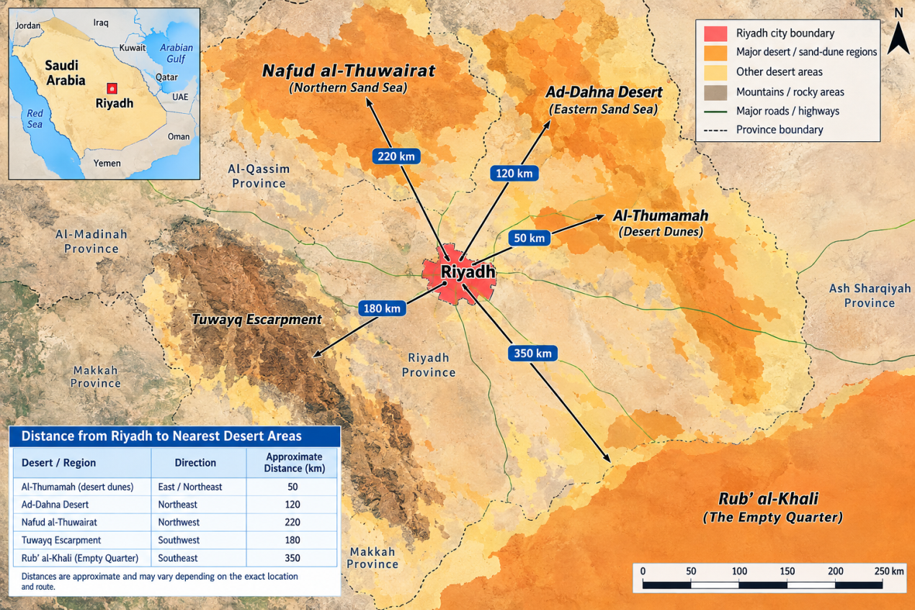

Slide 10
Al-Thumamah desert area: is nearest well-known desert-dune area to central Riyadh, The nearby red sand dunes are approximately 40–50 km from central Riyadh, depending on the exact destination and route.
The Ad Dahna Desert :(Local Source - North & East) This narrow, crescent-shaped sand sea wraps around the eastern perimeter of the Riyadh region.
The Rub' al Khali Desert : (Primary Regional Source – South): The massive Empty Quarter to the south is the primary regional driver for high Aerosol Optical Depth (AOD) values over central Saudi Arabia.
An Nafud & Iraqi Deserts: (Remote Northern Sources): During the spring months, the Mediterranean storm track pushes cyclonic systems and cold fronts southward.
Wadi Hanifa & The Tuwayq Escarpment (Micro-Environments: Riyadh sits east of the limestone Tuwayq Mountain escarpment along the Wadi Hanifa bed.

Slide 11
The economic impact of sand storm on Riyadh region
Dust storms cause a sharp reduction in horizontal visibility: leading to traffic accidents (for instance, 354 traffic accidents were recorded in Riyadh during one such past event), the disruption of road traffic, and the delay or diversion of flights.
Construction and Business Sector: Work at construction sites and outdoor projects is temporarily halted to ensure the safety of workers and protect equipment.
Energy and Electricity: Layers of dust accumulating on solar panels reduce their efficiency in generating clean energy; dust also affects electrical transmission lines and equipment.
Health and Healthcare Costs: There is an increase in hospital and emergency room admissions due to respiratory illnesses and asthma, resulting in additional medical costs and a temporary decline in human productivity.

Slide 12
A World Bank report further estimated that the broader economic and welfare costs associated with dust pollution exceed US$150 billion annually across the region.
severe dust storm in April 2015 affected aviation operations across the Middle East, including Riyadh.
More than 1,000 flights operated by Saudi Arabia's national airline were affected over three days, demonstrating the potential economic consequences of severe dust events

Slide 13
History of sand storm attacks in Riyadh region
The Riyadh Region has experienced recurrent sand and dust storms (SDS) over the past decade (2016–2026), representing a significant environmental, meteorological, public health, and socioeconomic challenge. These events are associated with the region's arid climate, sparse vegetation, exposed desert surfaces, strong seasonal winds, and atmospheric instability.
Riyadh is particularly vulnerable to dust transported from surrounding desert regions, including the Ad-Dahna Desert to the east and northeast, the An-Nafud Desert to the north, and the Rub' al Khali (Empty Quarter) to the south.

Slide 14
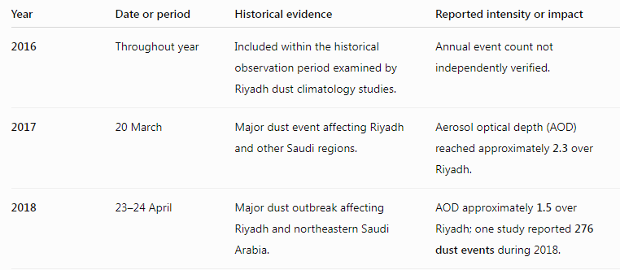
Major documented sand and dust storm events (2016–2026)The following table summarizes selected documented events and scientific observations affecting Riyadh. It is not a complete inventory of every storm during the decade.

Slide 15
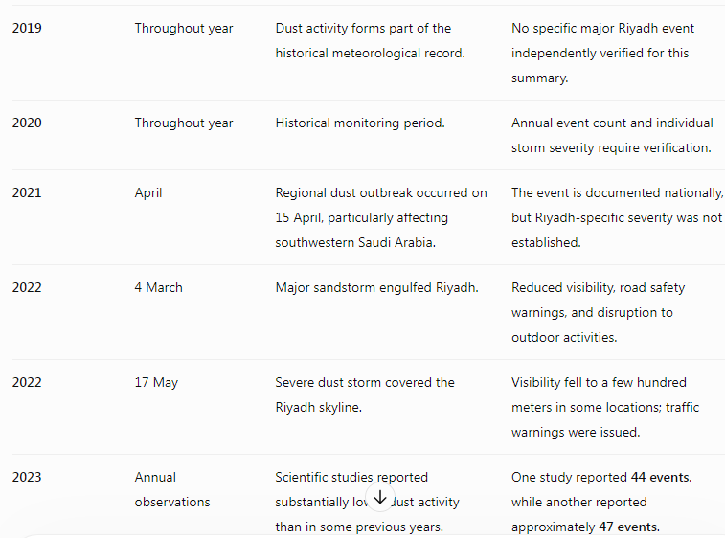

Slide 16
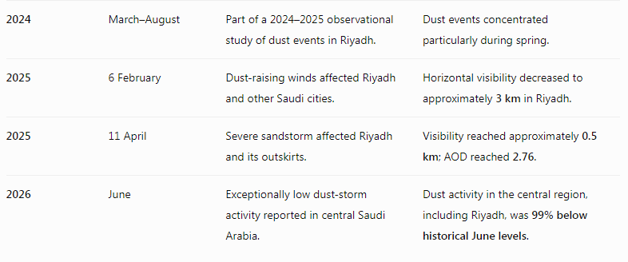

Slide 17
Important of Sand and Dust Storm Forecasting in Riyadh region
Accurate sand and dust storm (SDS) forecasting is essential for protecting public health, minimizing economic losses, improving environmental sustainability, and strengthening climate resilience in Riyadh Region, Saudi Arabia.
Riyadh is particularly vulnerable to dust storms because of its geographical location within the arid Najd Plateau, proximity to extensive desert landscapes, limited vegetation cover, and exposure to strong seasonal winds.

Slide 18
These environmental conditions, combined with rapid urbanization, population growth, and expanding industrial activities, increase the region's susceptibility to airborne particulate pollution.
Sand and dust storms contribute to elevated concentrations of particulate matter (PM₁₀ and PM₂.₅), reduced atmospheric visibility, deterioration of air quality, and increased risks of respiratory and cardiovascular diseases.
Consequently, reliable forecasting systems are necessary to provide early warnings, particularly for vulnerable populations, including children, older adults, and individuals with pre-existing respiratory conditions.

Slide 19
Sand and Dust Storm Forecasting
Sand and Dust Storm (SDS) Forecasting is the process of estimating future atmospheric dust conditions by analyzing historical and current meteorological and environmental variables, including:
wind speed
wind direction
air temperature
relative humidity
atmospheric pressure
Precipitation
soil moisture
vegetation cover.

Slide 20
Forecasting Methodology

Slide 21
Taxonomy Sitemap: 5 Forecasting Branches
Branch 1
Traditional Physics & Statistics
Branch 2
Dynamics: Multi-Scale Physics
Branch 3
Line A ML: Statistical Learning
Branch 4
Line B DL: Spatiotemporal Deep Learning
Branch 5
Tri-Pillar: Societal Impact
Methodological paradigm evolution
Expert-driven
Physical understanding
Statistical learning
Nonlinear & spatiotemporal
AI + GIS + social impact
Each branch builds on the previous one, from expert judgement to integrated, physics-aware AI.

Slide 22
Branches 1 & 2: Physics-Based Foundations
Branch 1: Traditional Physics & Statistics
Branch 2: Dynamics, Multi-Scale Physics
Synoptic charts & manual analysis
ARIMA & empirical regression
Dynamical NWP (GFS, WRF, CAMS)
Operational civil warnings
Microscale: Haboob downdrafts
Mesoscale: Shamal wind fronts
Synoptic: jet stream teleconnections
Tuwayq escarpment bluff effects

Slide 23
Branches 3, 4 & 5: Learning and Impact
Branch 3: Line A ML
Branch 4: Line B DL
Branch 5: Tri-Pillar
Tree ensembles: RF & XGBoost
NWP bias correction, 72h-120h
Quantile regression (P10, P50, P90)
Bi-LSTM sequence modeling
Temporal Fusion Transformer (TFT)
Dynamic ST-GNN corridor graph
Multimodal AI fusion
GIS spatial hazard mapping
Hospital ER & aviation alerts
Saudi Vision 2030 integration

Slide 24
End-to-End Pipeline
1. INGESTION
5 raw modalities
6 ground stations (OERK, OEGS, OEPS, ...) · ECMWF ERA5 reanalysis · CAMS & IFS NWP forecasts · MODIS & AERONET AOD · SRTM 90 m DEM
2. HYGIENE & QC
Data cleaning
Strict UTC 1h reindexing · bounds clamping [0.05, 30 km] · MAD despiking (4.5x MAD) · Akima spline imputation · 1-to-1 time synchrony
3. PHYSICS ENGINE
Feature engineering
Wind vector (u10, v10, Ek) · Owen saltation emission Q · vapor pressure deficit (VPD) · dry air density (rho) · strict non-leakage lags
4. DUAL MODELING
Line A & Line B
Line A: RF, XGBoost for NWP debiasing (72-120h) · Line B: ST-GNN + TFT + Bi-LSTM + PINN for 3-15 days
5. DISPATCH
XAI & action
TreeSHAP & DeepSHAP · P10/P50/P90 quantile bounds · 5-tier hazard classification · airport & civil alert triggers

Slide 25
Data & Preprocessing

Slide 26
Tools: Data Acquisition & Geoprocessing
Tool | Role in the pipeline
cdsapi & Copernicus ADS | Automated retrieval of ECMWF ERA5 and CAMS atmospheric composition models
NASA earthaccess | Programmatic extraction of MODIS AOD, Sentinel-3 and SMAP surface moisture
CDO (Climate Data Operators) | High-performance regridding and NetCDF/GRIB coordinate projection
xarray & netCDF4 | Multi-dimensional chunked atmospheric array handling
GDAL, rasterio & geopandas | DEM terrain slope, aspect, roughness and polygon corridor masks

Slide 27
Tools: Modeling, Optimization & XAI
Tool | Role in the pipeline
scikit-learn & RandomForest | Classical baseline ensembles and evaluation pipelines
XGBoost & LightGBM | Fast histogram GBDT with custom quantile pinball loss heads
CatBoost | Categorical ordered boosting that prevents corridor target leakage
PyTorch 2.2+ & PyTorch Geometric | GPU-accelerated ST-GNN and Transformer tensor learning
Optuna & SHAP | Bayesian hyperparameter tuning and Shapley value physical attribution

Slide 28
Multi-Modal Data: Tabular & Time-Series
Modality | Content | Shape | Source
Ground in-situ truth | 6 stations (OERK, OERY, OEPS, OEDM, OEWD, OEGS) | 216,174 rows x 14 cols | Quotsoft / NOAA ISD
ECMWF ERA5 reanalysis | 6 spatial domains, 2020-2024: u10, v10, gusts, T2m, BLH, soil moisture (0-7 cm) | 43,848 h x 6 x 8 channels | cds.climate.copernicus.eu
NASA AERONET | Solar Village (Riyadh) sunphotometer: spectral AOD 340-1020 nm, Angstrom exponent | QA spectral column | aeronet.gsfc.nasa.gov
Ground path: data/raw/ground/

Slide 29
Multi-Modal Data: Gridded, Spatial & NWP
Modality | Content | Shape | Source
CAMS & IFS operational NWP | Point forecasts & fields, 72h-120h leads: PM10, dust AOD, u/v wind | 54 cycles x 17 leads x 6 nodes | ads.atmosphere.copernicus.eu
ECMWF TIGGE extended NWP | 51-member ensemble for days 6-15 (144h-360h) | 15 days x 6h cadence | apps.ecmwf.int/datasets/tigge
SRTM 90 m DEM | Elevation, slope angle, aerodynamic roughness length z0 | 21 x 21 raster (614-1119 m) | USGS Earth Explorer

Slide 30
Ground Stations Network
ICAO | Station | Role
OERK | King Khalid Intl Airport (KKIA) | Target: Riyadh
OERY | Riyadh Air Base | Corridor node
OEPS | Al-Kharj | Upstream corridor node
OEDM | Duwadimi | Upstream corridor node
OEWD | Dawasir | Upstream corridor node
OEGS | Gassim | Upstream corridor node

Slide 31
Scale of the Multi-Modal Dataset
All 2,183 verified dust-storm hours are preserved: zero listwise row deletion.

Slide 32
Preprocessing Protocol: 4 Steps
1. UTC sync
Localize to UTC, 1h grid, 43,800 h timeline
2. QC & clamping
Physical bounds on V, RH, gusts
3. Despike & freeze
MAD 4.5x, flatline >= 12 h
4. Imputation
Akima (<=3h), corridor regression (3-24h)
Raw METAR / ERA5 / NWP streams → clean, synchronized, gap-free dataset

Slide 33
Quality Control & Imputation Rules
Check | Rule | Purpose
Timezone | Localize all records to UTC (AST = UTC+3) | Remove offsets
Frequency | Snap :20 / :50 METAR to :00; 1h grid | 43,800 h continuous index
Visibility | clip(V, 0.05, 30.0 km) | Physical bounds
Humidity | clip(RH, 1.0, 100.0 %) | Physical bounds
Wind | wind_gust_ms >= wind_speed_ms | Kinematic consistency
Spikes | Rolling MAD > 4.5x when wind < 5 m/s | Remove sensor spikes
Sensor freeze | Static >= 12 h during active wind | Detect flatlines
Gap <= 3 h | Akima cubic spline | Keep diurnal curve
Gap 3-24 h | Corridor linear regression (upstream station) | Spatial fill

Slide 34
Physics-Informed Feature Engineering

Slide 35
Physics-Informed Features
1. Wind Vector & Energy
2. Owen (1964) Saltation Flux
u10 = -W sin(drct), v10 = -W cos(drct)
Ek = 0.5 W²
Continuous vectors from compass bearings
Q ~ u*³ max(0, 1-(u*t/u*)²) e^(-15 SM_top)
Threshold u*t ≈ 0.28 m/s
Suppressed by topsoil moisture
3. Vapor Pressure Deficit
4. Cyclical Harmonics
es = 0.61078 exp(17.27T / (T+237.3))
VPD = max(0, es - ea)
High VPD + wind = crust desiccation
sin_DOY = sin(2π DOY / 365.25)
cos_DOY = cos(2π DOY / 365.25)
No jump between Dec 31 and Jan 1

Slide 36
Multi-Modal Merging Logic
Ground obs (OERK)
ECMWF ERA5
Master feature matrix
Temporal & spatial join
MODIS AOD, dust mass, solar
43,800 rows × 55+ cols
Static GIS topography
Ground + ERA5: inner join on UTC hour
Satellite: left join
GIS: nearest neighbor (KKIA 614 m, slope 1.85°, z0 0.042 m)

Slide 37
Strict Anti-Leakage Lag Engine
t-24h
t-12h
t-6h
t-3h
t-1h
t (now)
Only strictly past data feeds the model
Lag & rolling features
Output formats
Lags: PM10, wind, visibility at t-1, 3, 6, 12, 24 h
Rolling mean / max / std over 6, 12, 24 h
closed="left": only past values
Format A (Line A): 2D tabular feature store for tree ensembles
Format B (Line B): 5D tensors [B, C, T, H, W] + dynamic adjacency A(t)

Slide 38
Modeling: Line A & Line B

Slide 39
Main Line A: Tree Ensembles
Random Forest
XGBoost
LightGBM
Bagging ensemble
Hundreds of de-correlated trees
Resists extreme outlier noise
Non-linear baseline benchmark
Exact greedy boosting
2nd-order Taylor loss optimization
Strong L1/L2 leaf regularization
Responsive to wind gust spikes
Histogram & GOSS
Gradient-based one-side sampling
Exclusive feature bundling (EFB)
Native pinball loss for P10, P50, P90

Slide 40
Why Basic NWP Fails Near 72 h
Topographic smoothing
Idealized roughness
~12 km grids flatten the 800 m Tuwayq ridge
Slope wind acceleration underestimated
Static z0 fails over mobile dunes
Ad-Dahna and Nafud surfaces shift
Convective blindness
Chemical discontinuation
Downdraft cold pools drive Haboobs
Below the grid-cell resolution
CAMS gives no aerosol chemistry beyond Day 5 (120 h)

Slide 41
Residual Learning & Quantile Loss
NWP forecast y_NWP(t+τ)
+
GBDT correction f(X_ground, X_ERA5, X_desert, X_GIS)
=
Calibrated ŷ(t+τ)
Target: Δy(t+τ) = y_obs(t+τ) - y_NWP(t+τ), the systematic bias
Pinball loss at α ∈ {0.10, 0.50, 0.90}: confidence envelope [P10, P90]
Goal: ΔRMSE ≥ 25% versus raw NWP

Slide 42
Line A Outcomes: 5-Tier Hazard Classification
Tier | PM10 (µg/m³) | Visibility | Condition & action
0 Normal | < 50 | > 10 km | Clear air; standard city operations
1 Moderate | 50 - 150 | 6 - 10 km | Mild suspension; advisory for sensitive groups
2 Elevated | 150 - 300 | 3 - 6 km | Active blowing sand; caution for transport & health
3 Severe | 300 - 600 | 1 - 3 km | Major sandstorm; airport flight-diversion alerts
4 Haboob | > 600 | < 500 m | Catastrophic; citywide emergency protocol

Slide 43
Hazard Tiers: PM10 Lower Thresholds

Slide 44
Why Classical ML Drifts at Long Range
Classical ML bottleneck
Strategic investment: Line B
Recursive error compounding beyond 72-120 h
Flat tabular blindness: no spatial wave propagation
Loss of NWP anchor after Day 5
Severe peak flattening of Haboobs
Multi-station graphs and 2D fields
End-to-end sequence memory, no drift
ST-GNN tracks plume advection
PINN embeds physical constraints

Slide 45
Main Line B: Deep Spatiotemporal Architecture
B1: Bi-LSTM
B2: TFT
B3: ST-GNN
Encodes 72 h history
Diurnal heating and nocturnal inversion
Continuous memory, no autoregressive breakdown
Multi-head self-attention
Gated residual networks filter calm noise
Variable selection finds source corridors
6 stations + 5 deserts as directed graph G=(V,E,A(t))
Chebyshev spectral convolutions
Tracks dust advection into Riyadh

Slide 46
Corridor Graph: Upstream Early Warning
An-Nafud (north)
Gassim (OEGS)
Ad-Dahna (NE)
Riyadh KKIA (OERK)
Duwadimi (OEDM)
Al-Kharj (OEPS)
Tuwayq ridge (~800 m) blocks western edges
Dawasir (OEWD)
Rub' al-Khali (SE)
Orange: desert source Blue: ground station Schematic layout

Slide 47
Physics-Informed Loss Constraints
L_total = L_Data (Huber/Quantile) + λ1·L_Saltation + λ2·L_Continuity + λ3·L_NonNeg
Owen saltation
Mass continuity
Non-negativity
L = mean(ReLU(u*t - u*) · ŷ)
Zero emission below u*t ≈ 0.28 m/s
||∂ŷ/∂t + u ∂ŷ/∂x + v ∂ŷ/∂y − S||²
Advection-diffusion mass conservation
L = mean(ReLU(−ŷ))
No negative PM10 concentrations

Slide 48
Explainable AI: SHAP Attribution
1
Upwind friction velocity u* (Nafud, Dahna)
Institutional trust
2
Desert topsoil moisture 0-7 cm
TreeSHAP & DeepSHAP Shapley values
Waterfall for the April 2025 event, flagged 4 days ahead
Audit: model follows real atmospheric dynamics
3
NWP baseline CAMS forecast (t+τ)
4
Corridor wind alignment cos(θ−φ)
5
Autoregressive lags (t-1h, t-3h, t-24h)
6
Tuwayq ridge slope roughness & BLH
Global importance order

Slide 49
Validation & Impact

Slide 50
Validation: Temporal Walk-Forward Split
2020
Train
2021
Train
2022
Train
2023
Train
2024
Test (held-out)
time
Strict chronology: train 2020-2023, evaluate on future 2024
Zero shuffling: random cross-validation is prohibited (future-to-past leakage)
Operational simulation: mirrors real forecasting conditions

Slide 51
Validation: Spatial, Stress & Sensitivity Tests
Leave-one-station-out
Extreme stress tests
Perturbation sensitivity
Withhold a whole corridor station (e.g. Gassim)
Proves ST-GNN interpolates unmonitored sectors
Tests robustness to telemetry failure
Super-storms: Mar 2021, Mar 2022, Apr 2025
Haboob peaks > 600 µg/m³ must not collapse
Perturb soil moisture and wind gusts
Output must respond monotonically, as Owen physics requires

Slide 52
Evaluation Metrics & WMO Targets
Metric | Target | Meaning
ΔRMSE% | ≥ 25% | Error reduction versus raw CAMS/IFS NWP
R² | ≥ 0.70 | Explains ≥ 70% of PM10 variance
POD | ≥ 0.80 | Hits / (Hits + Misses)
CSI | ≥ 0.60 | Hits / (Hits + Misses + False alarms)
FAR | ≤ 0.25 | False alarms / (Hits + False alarms)
PICP | ≥ 85% | Observations inside [P10, P90] bounds

Slide 53
Verification Targets at a Glance
FAR is an upper limit; all other metrics are minimum targets.

Slide 54
Comparative Synthesis: Line A vs Line B
Aspect | Line A: Tree ensembles | Line B: Deep spatiotemporal
Lead times | Days 3-5 (+72h to +120h) | Days 3-15 (extended range, S2S)
Algorithms | LightGBM, CatBoost, XGBoost, RF | ST-GNN + TFT + Bi-LSTM
Data structure | 2D feature store (43,800 x 55+) | Dynamic graph A(t) + 5D tensors
Mechanism | NWP residual post-processing | End-to-end plume advection learning
Physics | Via NWP baseline | Mass continuity PDE & Owen loss
Inference speed | Ultra-fast (< 5 s) | Heavier GPU inference
Key trait | Drifts beyond Day 5; needs NWP aerosol | No recursive drift; tracks plumes

Slide 55
Operational Early Warning Playbook
T - 0h
Ingestion
Hourly ground telemetry pulled · ERA5 & satellite streams ingested · Owen saltation checked in 5 deserts
T + 1h
Dual model
Line A debiases CAMS NWP (72-120h) · Line B runs ST-GNN to 15 days · P10/P50/P90 envelopes
Alert trigger
PM10 > 500 or Vis < 1 km
Automated red alert triggered · SHAP attribution attached to the report
City action
Municipal response
Aviation ground-stop at KKIA · highway traffic advisory · hospital ER pediatric teams alerted
Loop & retrain
Continuous learning
Observed truth logged · model error tracked · self-correcting PINN update cycle

Slide 56
Conclusions & Saudi Vision 2030
Academic contributions
National strategic alignment
Breaks the 72 h NWP limit with a dual-line paradigm
Physics-informed deep learning with Owen and PDE losses
First multi-desert dynamic advection network linking 5 basins to Riyadh
Vision 2030: climate resilience, smart-city management, public health
Saudi Green Initiative: protects afforestation and mega-projects
Economy: cuts aviation diversion, solar-loss and healthcare costs

Slide 57
Thank You

