Slide 1
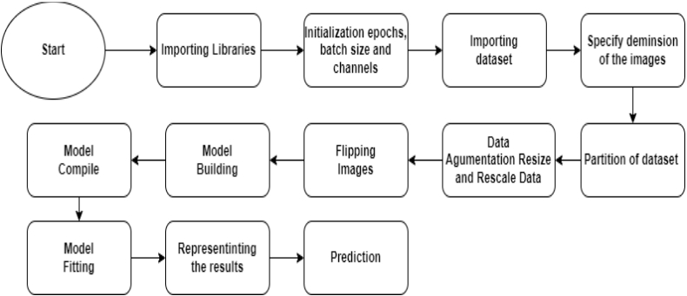
Presentation
Block Diagram :
--------------------------------------------------------------------------------------------------------------------------------------
Step 1:
Importing os and global libraries : to extract dimension of images images from from dataset.
Importing Libraries
Importing Pandas : to put size of images in Matrix
Importing model,layers from tensorflow.keras :
to use algorithms as
• Conv2D
• MaxPooling2D
• Flatten
• Dense
To build the model. -----------------------------------------------------------------------------------------------------
Step 2:
Initialize the number of epochs : 30, Initialization

Slide 2
BatchSize:1,
Channels:3
And convert image from dimension 256 X 256 to 64 X 64. -----------------------------------------------------------------------------------------------------
Step 3:
Importing dataset
Importing the dataset and -----------------------------------------------------------------------------------------------------
Step 4:
Specify Dimension
In this block we use libraries as
• glop to get all Images with type jpg
• pandas to put them in matrices
• (256, 256, 3) 1323
• (768, 1024, 3) 8
• (1200, 675, 3) 7
• (2448, 3264, 3) 7
• (900, 1200, 3) 5
• ...
• (1024, 650, 3) 1
• (640, 360, 3) 1
• (371, 788, 3) 1
• (200, 250, 3) 1
• (378, 420, 3) 1
Of The Images in dataset
-----------------------------------------------------------------------------------------------------
Step 5:
Shuffling the data
3350 for Training
418 for Validation
420 for Testing
Partition of dataset Represent number of images and for training, validation and testing and shuffling the data
-----------------------------------------------------------------------------------------------------
Step 6:
Convert the data from 256 X 256 to 64 X 64
Data Agumentation
Resize and Rescale Data

Slide 3
And rescale the images to (1.0/255) -----------------------------------------------------------------------------------------------------
Step 7:
Flapping some images to increase the dataset To increase the accuracy.
Flipping Images
-----------------------------------------------------------------------------------------------------
Step 7:
At First: Initializing BATCH_SIZE=32
And input share that represent dimension of images.
The model consists of 3 hidden layers are maked by layers.Dense which from
Model Building
(tensorflow.keras) library, and Conv2D to makes Convolutional processing By making 10 filters size of 3 X 3 with activation function “relu” to ignore the negative values, and flatten to input the results to the Neural Network used algorithms :
• Conv2D
• MaxPooling2D
• Dense
• Flatten
Used hyperparameters:
In First Conv2D
• 10
• (3,3)
• Activation function = 'relu'
• Input Shape
---------------------------------------------------------
In Second Conv2D
• 20
• (3,3)
• Activation function = 'relu'
• Input Shape
----------------------------------------------------------
In First MaxPooling2D
• 10
• (2,2)
----------------------------------------------------------

Slide 4
In Second MaxPooling2D
• 20
• (2,2)
----------------------------------------------------------
In Three Dense
• 128
• activation='relu'
--------------------------------------------------------
Model Summary:
_________________________________________________________________
Layer (type) Output Shape Param #
=================================================================
sequential (Sequential) (None, 64, 64, 3) 0
sequential_1 (Sequential) (None, 64, 64, 3) 0
conv2d_10 (Conv2D) (None, 62, 62, 10) 280
max_pooling2d_10 (MaxPoolin (None, 27, 27, 10) 0
g2D)
conv2d_11 (Conv2D)
(None, 25, 25, 20)
1820
max_pooling2d_11 (MaxPoolin (None, 3, 3, 20) 0
g2D)
flatten_5 (Flatten)
(None, 180)
0
dense_20 (Dense) (None, 128) 23168
dense_21 (Dense) (None, 128) 16512
dense_22 (Dense) (None, 128) 16512
dense_23 (Dense) (None, 4) 516
=================================================================
Total params: 58,808 Trainable params: 58,808 Non-trainable params: 0
_________________________________________________________________
-----------------------------------------------------------------------------------------------------
Step 8:
Using algorithm ‘adam’ and put the accuracy In metrices.
Model Compile
-----------------------------------------------------------------------------------------------------
Step 8:
Model Fitting

Slide 5
Train the model with epoch 30
Epoch 1/30
3350/3350 [==============================] - 39s 8ms/step - loss: 0.6319 -
accuracy: 0.7469 - val_loss: 1.0388 - val_accuracy: 0.5670 Epoch 2/30
3350/3350 [==============================] - 37s 9ms/step - loss: 0.5603 - accuracy: 0.7687 - val_loss: 0.3445 - val_accuracy: 0.8493
Epoch 3/30
3350/3350 [==============================] - 34s 8ms/step - loss: 0.4372 - accuracy: 0.8212 - val_loss: 0.3614 - val_accuracy: 0.8325
Epoch 4/30
3350/3350 [==============================] - 34s 8ms/step - loss: 0.4334 - accuracy: 0.8242 - val_loss: 0.4223 - val_accuracy: 0.8541
Epoch 5/30
3350/3350 [==============================] - 37s 9ms/step - loss: 0.4170 - accuracy: 0.8227 - val_loss: 0.4083 - val_accuracy: 0.8230
Epoch 6/30
3350/3350 [==============================] - 35s 8ms/step - loss: 0.4345 - accuracy: 0.8167 - val_loss: 0.4168 - val_accuracy: 0.8493
Epoch 7/30
3350/3350 [==============================] - 35s 8ms/step - loss: 0.4250 - accuracy: 0.8239 - val_loss: 0.5464 - val_accuracy: 0.8014
Epoch 8/30
3350/3350 [==============================] - 34s 8ms/step - loss: 0.4061 - accuracy: 0.8319 - val_loss: 0.3238 - val_accuracy: 0.8708
Epoch 9/30
3350/3350 [==============================] - 34s 8ms/step - loss: 0.4090 - accuracy: 0.8194 - val_loss: 0.4530 - val_accuracy: 0.8206
Epoch 10/30
3350/3350 [==============================] - 37s 9ms/step - loss: 0.4070 - accuracy: 0.8212 - val_loss: 0.3774 - val_accuracy: 0.8397
Epoch 11/30
3350/3350 [==============================] - 34s 8ms/step - loss: 0.3886 - accuracy: 0.8328 - val_loss: 0.3875 - val_accuracy: 0.8325
Epoch 12/30
3350/3350 [==============================] - 35s 8ms/step - loss: 0.3961 - accuracy: 0.8242 - val_loss: 0.4422 - val_accuracy: 0.8086
Epoch 13/30
3350/3350 [==============================] - 34s 8ms/step - loss: 0.3915 - accuracy: 0.8263 - val_loss: 0.3826 - val_accuracy: 0.8182
Epoch 14/30
3350/3350 [==============================] - 35s 9ms/step - loss: 0.3788 - accuracy: 0.8328 - val_loss: 0.4288 - val_accuracy: 0.8110
Epoch 15/30
3350/3350 [==============================] - 35s 9ms/step - loss: 0.3802 - accuracy: 0.8278 - val_loss: 0.3506 - val_accuracy: 0.8278
Epoch 16/30
3350/3350 [==============================] - 34s 8ms/step - loss: 0.3828 - accuracy: 0.8275 - val_loss: 0.3649 - val_accuracy: 0.8301
Epoch 17/30
3350/3350 [==============================] - 34s 9ms/step - loss: 0.3801 - accuracy: 0.8349 - val_loss: 0.3801 - val_accuracy: 0.8278
Epoch 18/30
3350/3350 [==============================] - 34s 8ms/step - loss: 0.3785 - accuracy: 0.8376 - val_loss: 0.3461 - val_accuracy: 0.8325

Slide 6
Epoch 19/30
3350/3350 [==============================] - 37s 9ms/step - loss: 0.3961 - accuracy: 0.8364 - val_loss: 0.3571 - val_accuracy: 0.8373
Epoch 20/30
3350/3350 [==============================] - 37s 9ms/step - loss: 0.3874 - accuracy: 0.8319 - val_loss: 0.3946 - val_accuracy: 0.8373
Epoch 21/30
3350/3350 [==============================] - 34s 8ms/step - loss: 0.3788 - accuracy: 0.8272 - val_loss: 0.3656 - val_accuracy: 0.8373
Epoch 22/30
3350/3350 [==============================] - 37s 9ms/step - loss: 0.3819 - accuracy: 0.8352 - val_loss: 0.3779 - val_accuracy: 0.8062
Epoch 23/30
3350/3350 [==============================] - 34s 8ms/step - loss: 0.3794 - accuracy: 0.8278 - val_loss: 0.3965 - val_accuracy: 0.8325
Epoch 24/30
3350/3350 [==============================] - 34s 8ms/step - loss: 0.3738 - accuracy: 0.8409 - val_loss: 0.3535 - val_accuracy: 0.8469
Epoch 25/30
3350/3350 [==============================] - 36s 9ms/step - loss: 0.3817 - accuracy: 0.8388 - val_loss: 0.3958 - val_accuracy: 0.8254
Epoch 26/30
3350/3350 [==============================] - 34s 8ms/step - loss: 0.3538 - accuracy: 0.8424 - val_loss: 0.4526 - val_accuracy: 0.8206
Epoch 27/30
3350/3350 [==============================] - 34s 8ms/step - loss: 0.3859 - accuracy: 0.8343 - val_loss: 0.3349 - val_accuracy: 0.8804
Epoch 28/30
3350/3350 [==============================] - 34s 8ms/step - loss: 0.3772 - accuracy: 0.8388 - val_loss: 0.4249 - val_accuracy: 0.8612
Epoch 29/30
3350/3350 [==============================] - 37s 9ms/step - loss: 0.3890 - accuracy: 0.8322 - val_loss: 0.3817 - val_accuracy: 0.8421
Epoch 30/30
3350/3350 [==============================] - 33s 8ms/step - loss: 0.3593 - accuracy: 0.8397 - val_loss: 0.3339 - val_accuracy: 0.8517
----------------------------------------------------------------------------------------------------- Final accuracy for testing : 0.8619.
-----------------------------------------------------------------------------------------------------
Step 8:
Represent the results with a 2 graphs
First graph : Losses Second : accuracy
X = Epochs. X : Epochs
Y = Loss. Y = accuracy.
Representinting the results

Slide 7
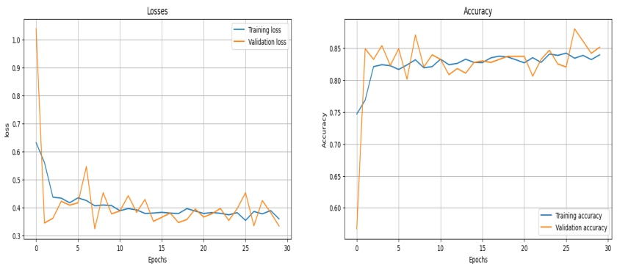
Step 8:
The meaning of ds.take(1) that take some of this data
then predict their classes.
Prediction

