Slide 1

TEAM 3 · EMBEDDED SYSTEMS PROJECT
Environmental Monitoring & Data Logging Station
A practical embedded system for sensing, displaying, storing, and communicating environmental conditions.
Abdelrahman Mohamed Ibrahim · Abdelrahman Ibrahim adelbary Youssef mohamed ghait · Mohamed Raafat Hassan
SENSE · INTERPRET · REMEMBER · RESPOND

Slide 2

01 / WHY THIS PROJECT
From raw signals to useful awareness
Sense
Capture environmental inputs through dedicated sensors.
Environmental conditions change continuously, but raw sensor signals are difficult to interpret on their own. Our system turns temperature and light measurements into clear local status, persistent records, and immediate alerts.
Interpret
Convert signals into readable status and threshold decisions.
Act
Display, store, alert, and communicate the result.
MAKE THE INFORMATION ACTIONABLE

Slide 3

02 / WHAT THE STATION DELIVERS
One compact station, four practical outcomes
The project is more than a sensor circuit. It is a small, complete monitoring workflow.
A
B
C
D
Sense
Understand
Remember
Respond
Capture temperature and light through dedicated analog inputs.
Translate measurements into a clear local status on the LCD.
Preserve periodic readings in EEPROM for later retrieval.
Raise an alarm when needed and communicate with a PC.
A COMPLETE EMBEDDED INTERACTION LOOP

Slide 4

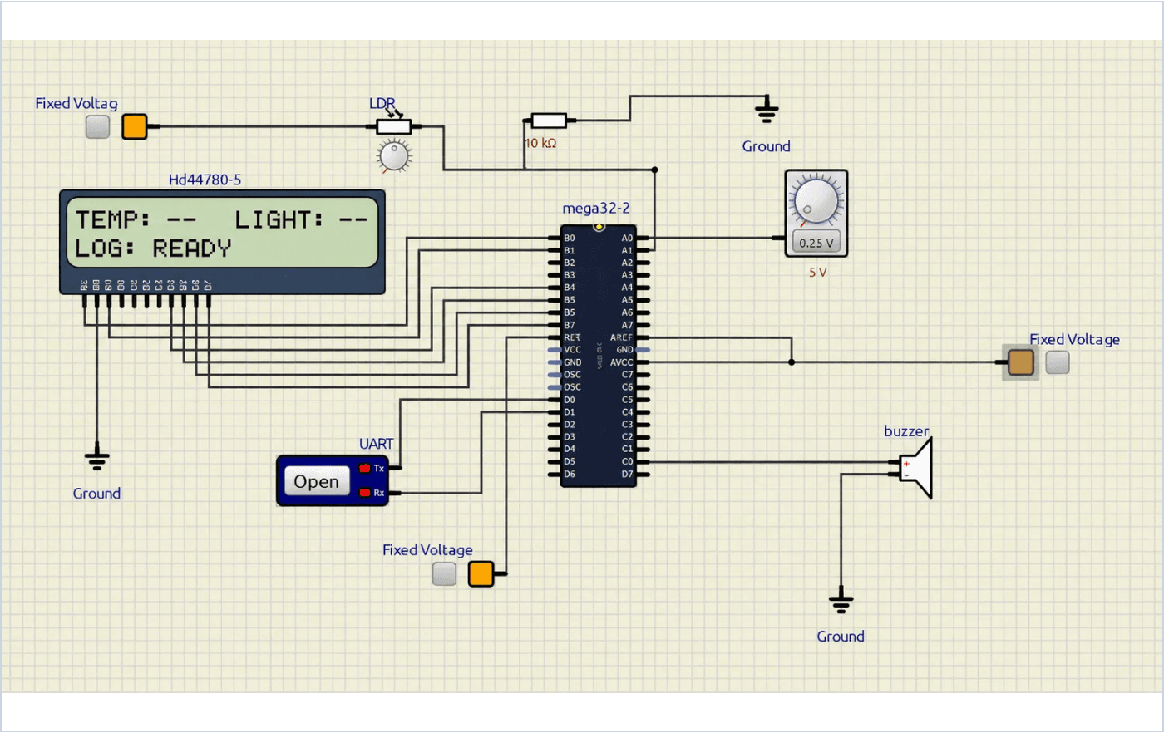
03 / SYSTEM VALIDATION
The simulator validates the complete interaction loop
The Proteus-style model brings sensing, processing, and communication paths together in one view.
LCD DISPLAY
LCD Interface: The operator's first point of contact for real-time status.
→
ATMEGA32
UART Terminal: A bridge from the embedded device to a desktop workflow.
→
Alarm Path: Direct response channel via the buzzer for threshold alerts.
→
ALARM BUZZER
UART BRIDGE
FOCUS ON DESIGN AND BEHAVIOR

Slide 5

04 / INTERFACE PHILOSOPHY
The interface is designed around decisions
A clear status display answers three questions quickly: what is being monitored, whether the system is ready, and whether attention is needed.
STATION_MONITOR // v1.0
CLARITY FIRST
TEMPERATURE
-- °C
Neutral placeholders communicate that the device is waiting for live measurements rather than presenting invented results.
LIGHT LEVEL
-- %
VISUAL HIERARCHY
The visual language uses strong hierarchy and restrained color to highlight critical alerts over routine data.
SYSTEM LOG
READY
FUTURE READY
The same logic can be extended into a richer PC dashboard without changing the embedded sensing core.
DESIGNED FOR CLEAR STATES, NOT CLUTTER

Slide 6

05 / SYSTEM DESIGN
Application Layer (APP)
A layered architecture keeps the system maintainable
Coordinates sampling, alarm logic, logging, display updates, and serial commands.
Hardware Abstraction Layer (HAL)
Provides reusable drivers for the LCD, LM35 Temperature Sensor, LDR, and Buzzer.
Separating responsibilities makes the project easier to test, explain, and extend. Our structure follows professional embedded standards, ensuring that high-level logic remains independent of specific hardware registers.
Microcontroller Abstraction Layer (MCAL)
Manages Digital I/O, ADC, Timers, EEPROM, UART, and External Interrupts.
Common Definitions
Centralizes shared types and constants to maintain consistency across all modules.
PROFESSIONAL EMBEDDED SOFTWARE STACK

Slide 7






06 / SYSTEM ARCHITECTURE
The data path is short, explicit, and dependable
Sensors
ADC
Logic
Storage
Output
LM35 and LDR produce continuous analog voltage signals.
10-bit conversion translates voltage into digital values.
ATmega32 processes data and checks alert thresholds.
Periodic samples are committed to non-volatile EEPROM.
LCD updates locally while UART handles PC data dumps.
END-TO-END SIGNAL INTEGRITY

Slide 8



07 / OPERATIONAL MODES
The system supports both live monitoring and history
Live Awareness
Persistent History
Real-Time Feedback
EEPROM Logging
Immediate awareness of current conditions via the local LCD interface, providing instant visibility for operators.
Periodic samples are stored in non-volatile memory, preserving environmental context even after power cycles.
Threshold Alarms
UART Data Export
Configurable alert logic triggers the buzzer instantly when environmental limits are breached, ensuring rapid response.
A controlled serial bridge allows the entire history to be dumped to a PC terminal for deeper analysis and archiving.
BRIDGING IMMEDIATE ACTION WITH LONG-TERM DATA

Slide 9





08 / OPERATIONAL LOGIC
Designed for clear states, not clutter
READY
MONITORING
ALERT
EXPORT
Initialization
Active Sensing
Threshold
Data Dump
System hardware is verified and the station waits for the first live sensor measurement.
LCD presents real-time environmental status while the application logs periodic samples.
The buzzer indicates that a configured limit has been exceeded and needs attention.
Stored history is transmitted to a PC terminal via UART for review and clearing.
A PREDICTABLE INTERACTION LIFECYCLE

Slide 10

09 / THE TEAM
Team 3 combines application, platform, and interface work
Abdelrahman Mohamed Ibrahim
Abdelrahman Ibrahim adelbary
TEAM LEADER
MCAL SPECIALIST
APP layer development and system integration
•
Digital I/O (Dio) driver implementation
•
Sampling schedule and alarm logic coordination
•
Analog-to-Digital Converter (Adc) module
•
System pin mapping and architecture review
•
EEPROM data logging storage management
•
Youssef mohamed ghait
Mohamed Raafat Hassan
MCAL SPECIALIST
HAL & DESIGN SPECIALIST
UART serial communication for data dump
•
LCD, LM35, LDR, and Buzzer HAL drivers
•
Timer0 CTC 1ms system tick implementation
•
Proteus hardware design and simulation
•
External Interrupts (Exti) for system control
•
System wiring and interface validation
•
COLLABORATIVE EMBEDDED ENGINEERING

