Slide 1
SEMANTIC SEGMENTATION

Slide 2
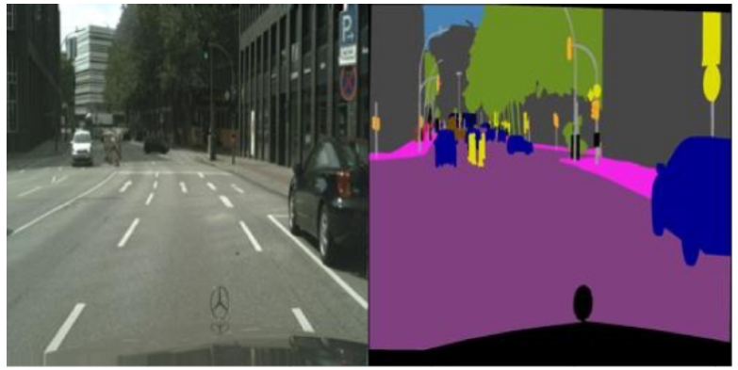
The Goal
Enable the car to be able to Segment all objects of the scene and classify each pixel to the suitable class

Slide 3
Why ?
one of the fundamental tasks in the field of computer vision
because it can be considered as a substantial preprocessing
tool for other tasks, including object detection, and scene understanding.

Slide 4
Cityscapes Dataset
Dataset is a Collection of recorded videos of vehicles driven in Germany in different seasons and different times of the day.
Dataset has 2975 training images files and 500 validation image files.

Slide 5
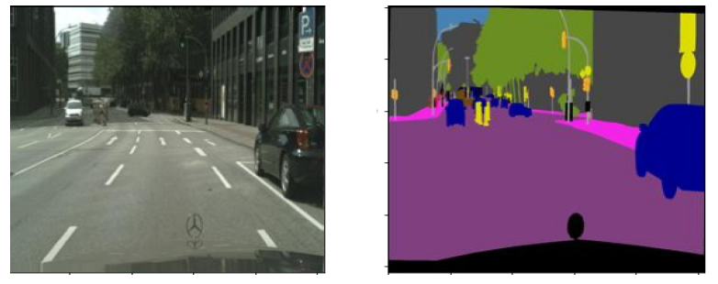
Data Preprocessing
Each data in the data file is about one combined image, the left half represents the
landscape(real image) and the right half represents the ground truth (label) of the landscape.

Slide 6
Label Clustering
The label image is three channels, so we have to convert it to one channel manner so we can do training as supervised learning because each pixel in the landscape image, the corresponding of its in label image has to be a number represents the number of true class.
Using K-Means Cluster algorithm the problem has been solved.

Slide 7
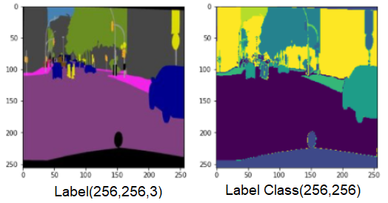
K-means Algorithm
It's an iterative algorithm that tries to partition the dataset into K pre-defined
distinct non-overlapping subgroups where each data point belongs to only one group.

Slide 8
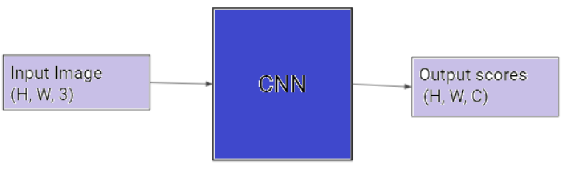
The Architecture Of The Network
Fully Convolutional Neural Networks
Because we want the output shape of the network equals the input shape of the network, we have to use FCNN rather than the normal CNN.
In CNN the architecture has fully connected layers in the last layers and this idea is not suitable for this task, where we want the desired output includes localization.

Slide 9
U-Net Paper
The architecture consists of a contracting path to capture context and a symmetric expanding path that enables precise localization.
The main idea of the architecture is to supplement a usual contracting network by successive layers, where pooling operators are replaced by upsampling operators.Where, these layers increase the resolution of the output. In order to localize, high resolution features from the contracting path are combined with the upsampled output.A successive convolution layer can then learn to assemble a more precise output based on this information.

Slide 10
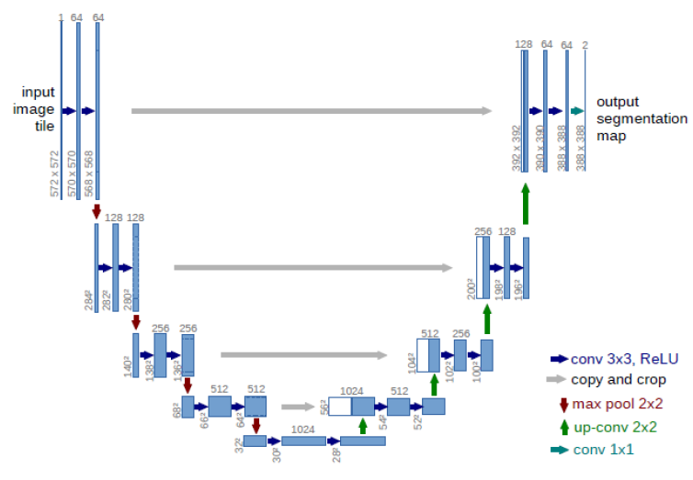

Slide 11
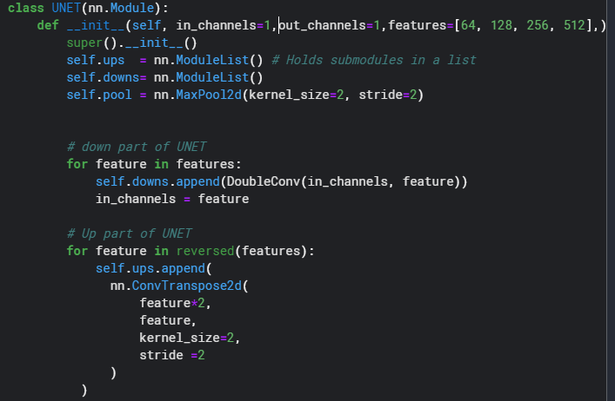
Paper Implementation

Slide 12
Hyberparamets
Batch_size ⇒ 16
Epochs ⇒ 240
Learning rate ⇒ 1e-3
The training data in terms of patches is much larger than the number of training images.

Slide 13
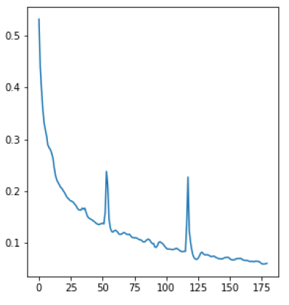
Loss Function

Slide 14
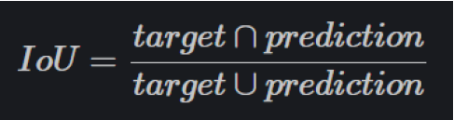
Intersection Over Union
The Intersection over Union (IoU) metric, is essentially a method to quantify the percept overlap between the target mask and our prediction output.
The IoU metric measures the number of pixels common between the target and prediction masks divided by the total number of pixels present across both masks.

Slide 15
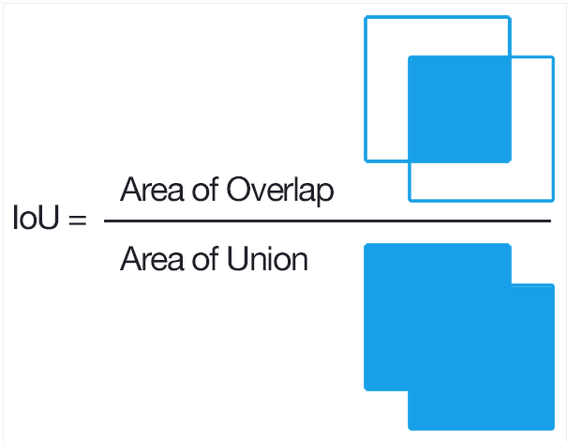

Slide 16
Accuracy!
After Training of 240 epochs on a strong GPU and using IoU score to evaluate, we
finally have achieved accuracy higher than 98%.

Slide 17
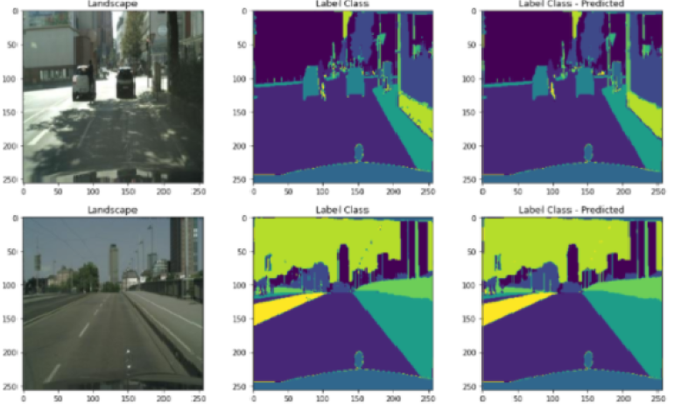
Visualization

Slide 18
Thank You!

