Slide 1
CSS in depth

Slide 2
Pseudo-elements
Pseudo-elements create new elements that are not specified in the markup of the document and can be manipulated much like a regular element.
::first-letter
::first-line
::before
::after

Slide 3
pseudo-class
Pseudo-classes select regular elements but under certain conditions, like when their position relative to siblings or when they’re under a particular state.
:hover
:first-child
:nth-child()

Slide 4
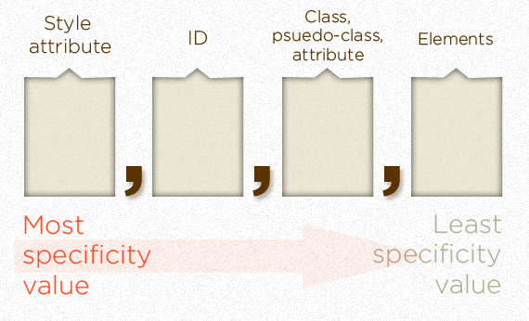
Specificity
If you have two (or more) conflicting CSS rules that point to the same element, there are some basic rules that a browser follows to determine which one is most specific and therefore wins out.

Slide 5
Sample calculations
ul#nav li.active a (0, 1, 1, 3)
body.home .col_3 h2 ~ h2 (0, 0, 2, 3)
<li style="color: red"></li> (1, 0, 0, 0)

Slide 6
Important Notes
The universal selector (*) has no specificity value (0,0,0,0)
Pseudo-elements (e.g. :first-line) get 0,0,0,1 unlike their psuedo-class brethren which get 0,0,1,0
The pseudo-class :not() adds no specificity by itself, only what's inside it's parentheses.
The !important value appended a CSS property value is an automatic win. It overrides even inline styles from the markup. The only way an !important value can be overridden is with another !important rule declared later in the CSS and with equal or great specificity value otherwise. You could think of it as adding 1,0,0,0,0 to the specificity value.

Slide 7
BEM conventions
create reusable components and code sharing in front-end development

Slide 8
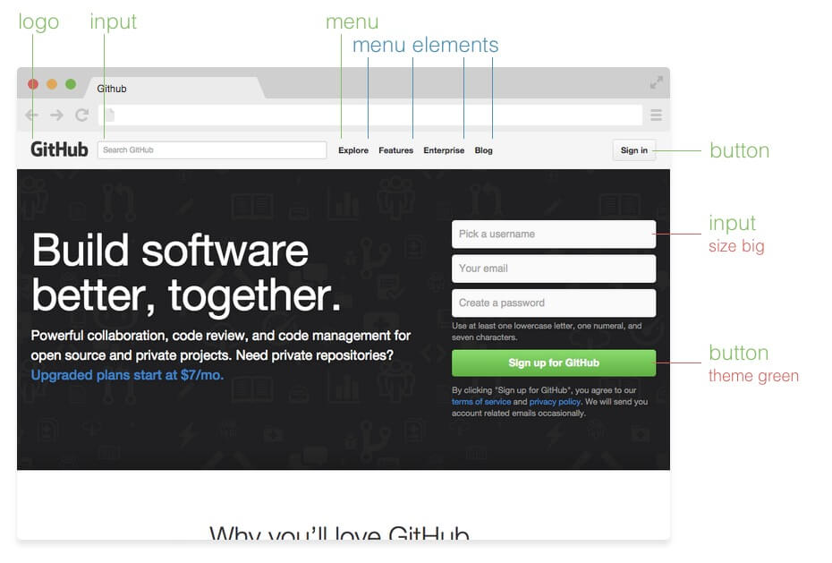
Block, Element and Modifier

Slide 9

Tasks
https://goo.gl/rri5MY

