Slide 1
Animation
Make it moving

Slide 2
Key frames
@keyframes example {
0% {background-color: red;}
25% {background-color: yellow;}
50% {background-color: blue;}
100% {background-color: green;}
}

Slide 3
animation
animation: 3s ease-in 1s 2 reverse both paused example;
/*duration | timing-function | delay | iteration-count | direction | fill-mode | play-state | name */
as each of the properties of the shorthand:
animation-name: none
animation-duration: 0s
animation-timing-function: ease
animation-delay: 0s
animation-iteration-count: 1
animation-direction: normal
animation-fill-mode: none
animation-play-state: running

Slide 4
animation-fill-mode
Forwads
animation-direction | animation-iteration-count | last keyframe encountered
normal | even or odd | 100% or to
reverse | even or odd | 0% or from
alternate | even | 0% or from
alternate | odd | 100% or to
alternate-reverse | even | 100% or to
alternate-reverse | odd | 0% or from

Slide 5
animation-fill-mode
Backwards
Both
The animation will follow the rules for both forwards and backwards, thus extending the animation properties in both directions.
animation-direction | first relevant keyframe
normal or alternate | 0% or from
reverse or alternate-reverse | 100% or to

Slide 6
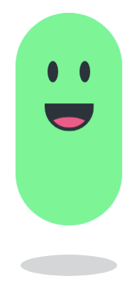
Example
https://goo.gl/rri5MY

Slide 7
Tasks
https://goo.gl/8SfnjQ
https://goo.gl/LLTT1K

