Slide 1
Stylus Advanced
mixins, functions, iterations and much more

Slide 2
Mixins
// stylus
border-radius($n)
-webkit-border-radius $n
-moz-border-radius $n
border-radius $n
form input[type=button]
border-radius(5px)
// CSS
input[type=button] {
-webkit-border-radius: 5px;
-moz-border-radius: 5px;
border-radius: 5px;
}

Slide 3
Functions
// stylus
add($a, $b)
$a + $b
body
padding add(10px, 5)
// CSS
body {
padding: 15px;
}

Slide 4
ITERATION
// stylus
body
for num in 1 2 3
foo num
// CSS
body {
foo: 1;
foo: 2;
foo: 3;
}

Slide 5
BEM conventions
create reusable components and code sharing in front-end development

Slide 6
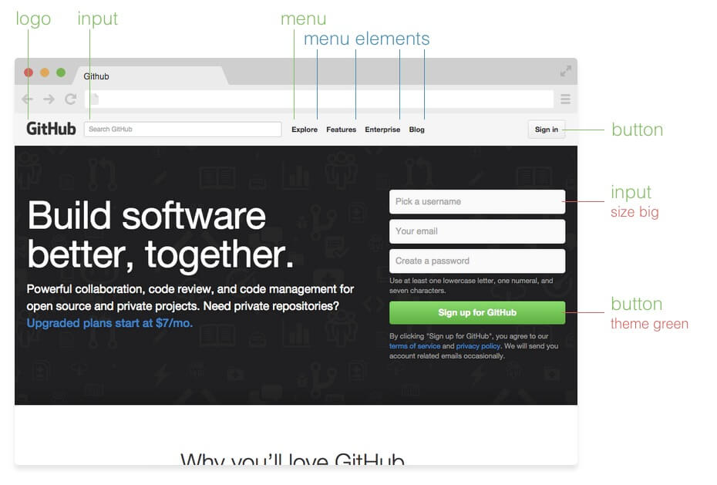
Block, Element and Modifier

