Slide 1
Flexbox

Slide 2
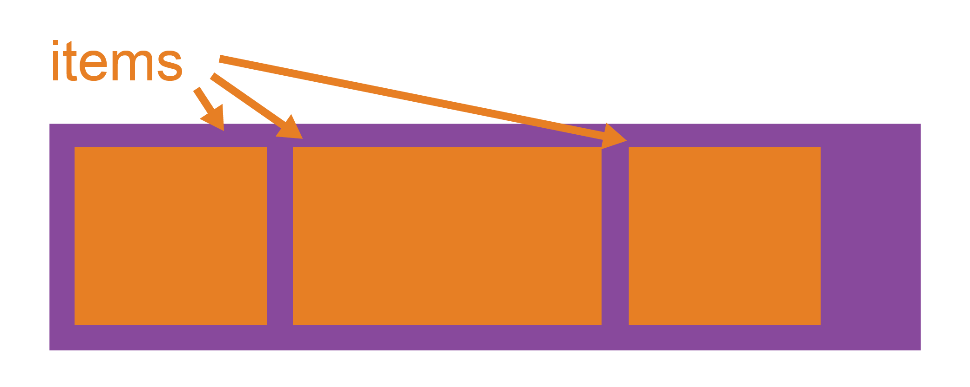
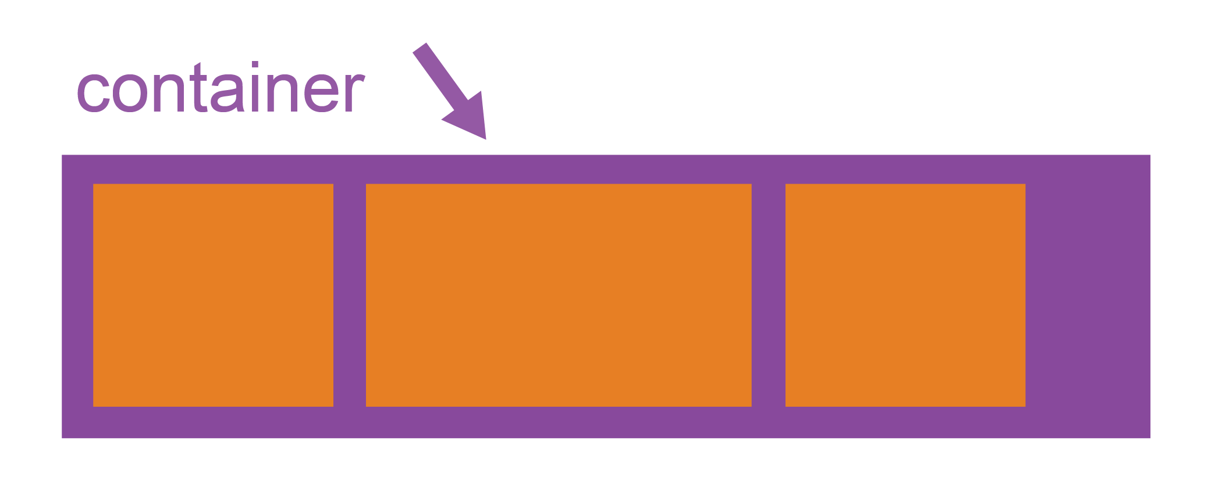
Basics
Since flexbox is a whole module and not a single property, it involves a lot of things including its whole set of properties. Some of them are meant to be set on the container (parent element, known as "flex container") whereas the others are meant to be set on the children (said "flex items").

Slide 3
Display
<!-- HTML -->
<div class="container">
<div class="item"></div>
<div class="item"></div>
<div class="item"></div>
</div>
/* CSS*/
.container {
display: flex;
}

Slide 4
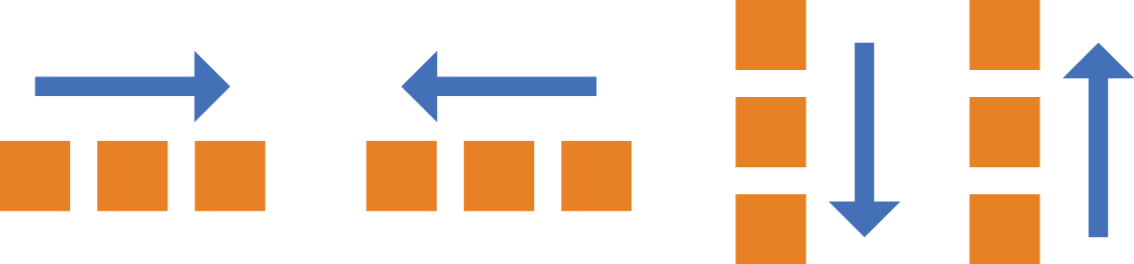
Flex-direction
.container {
flex-direction: row | row-reverse | column | column-reverse;
}

Slide 5
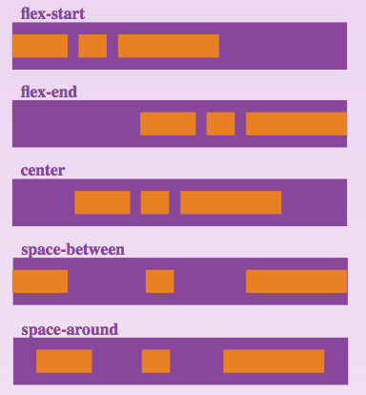
Justify-content

Slide 6
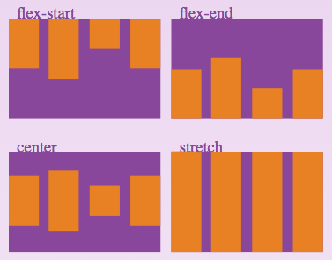
align-items

Slide 7

Flex-grow
.item {
flex-grow: <number>; /* default 0 */
}

Slide 8
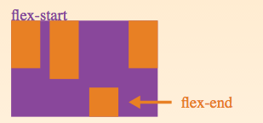
align-self
.item {
align-self: auto | flex-start | flex-end | center | baseline | stretch;
}

Slide 9
references
https://css-tricks.com/snippets/css/a-guide-to-flexbox/
https://developer.mozilla.org/en-US/docs/Web/CSS/CSS_Flexible_Box_Layout/Using_CSS_flexible_boxes

