Slide 1
Media Queries
Start responsive design

Slide 2
@media
used to target styles at specific media, such as screen or print
@media screen and (max-width: 1000px) {
#content {
width: 100%;
}
}

Slide 3
orientation
@media screen and (orientation: landscape) {
#nav {
float: left;
}
}
@media screen and (orientation: portrait) {
#nav {
float: none;
}
}

Slide 4
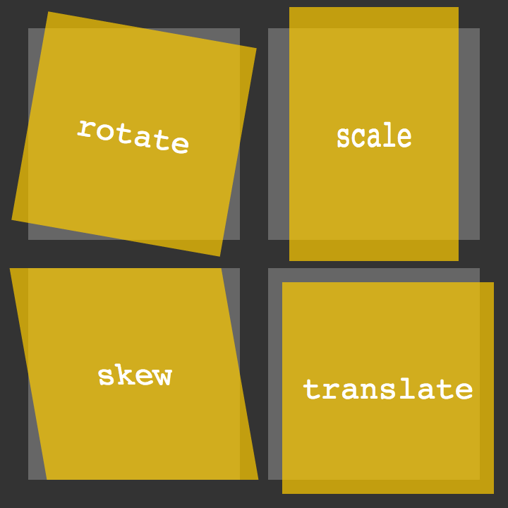
Transformations
Rotate
Scale
Skew
Translate
matrix

Slide 5
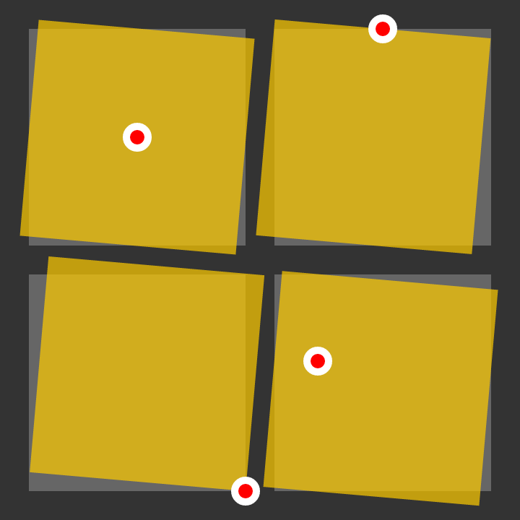
transform-origin

Slide 6
Tables
<table>
<thead>
<tr>
<th>Header content 1</th>
<th>Header content 2</th>
</tr>
</thead>
<tbody>
<tr>
<td>Body content 1</td>
<td>Body content 2</td>
</tr>
</tbody>
</table>
https://developer.mozilla.org/en/docs/Web/HTML/Element/table

