Slide 1

Data Science Job Salaries: Trends, Drivers & Insights
SIC – AI803
Team 21

Slide 2

Agenda
Team Members
Motivation & Problem Statement
Dataset Overview & Cleaning
Exploratory Data Analysis & Statistical Analysis
Dashboard Design
Final Results
Future Enhancements
Samsung Innovation Campus

Slide 3

Team Members
Abdelrahman Helmy - EDA & Statistical Analysis​
Khaled Waleed - Data Cleaning & Preprocessing​
Ziad Hany - Power BI Dashboard​
Mariam Ramy - Reporting & Presentation​
Samsung Innovation Campus

Slide 4
Motivation & Problem Statement
Samsung Innovation Campus

Slide 5
Motivation & Problem Statement
Data science salaries vary widely making compensation benchmarking difficult for both job seekers and employers.
Business problems:
Which factors most influence a data science salary?
How can this inform hiring budgets, compensation strategy, and career decisions?
Goal: Identify salary drivers and translate them into data backed recommendations.
Samsung Innovation Campus

Slide 6
Dataset Overview & Cleaning
Samsung Innovation Campus

Slide 7
Dataset Overview
Data Source is from Kaggle, "Data Science Job Salaries" dataset (ds_salaries.csv)
Raw dataset: 607 rows × 12 columns
Final cleaned dataset: 607 rows × 11 columns
Key variables: work_year, experience_level, employment_type, job_title, salary, salary_currency, salary_in_usd, employee_residence, remote_ratio, company_location, company_size
salary_in_usd used as the single standardized measure so all currencies are comparable on one scale
Samsung Innovation Campus

Slide 8
Data Cleaning: Structure and Duplicates Removal
Removed the redundant "Unnamed" index column
Checked missing values across all columns
Split columns into:
Numerical: work_year, salary, salary_in_usd, remote_ratio
Categorical: experience_level, employment_type, job_title, salary_currency, employee_residence, company_location, company_size
Built a data quality summary table (column, data type, missing count, classification) to confirm the dataset was analysis-ready
Checked for duplicate rows — No exact duplicate records were identified.
Standardized all categorical columns by stripping extra whitespace, for consistency
Samsung Innovation Campus

Slide 9
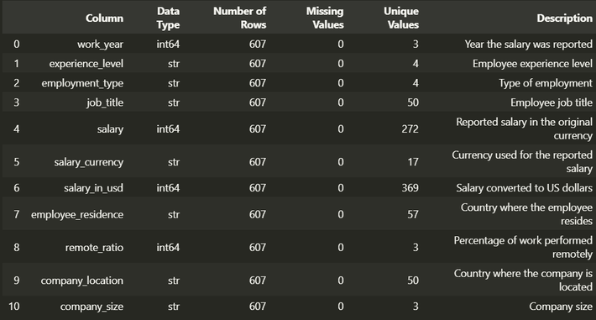
Data Cleaning: Outlier Detection & Finalization
Outliers were visually inspected using boxplots and were retained because they were not confirmed as data-entry errors.
Reset the index and exported the result as cleaned_dataset.csv, the file used throughout the EDA.
Produced a full data dictionary to document the dataset for the team
Samsung Innovation Campus

Slide 10
Exploratory Data Analysis & Statistical Analysis
Samsung Innovation Campus

Slide 11
Research Questions & Hypotheses
Does salary increase with experience level?
Which job titles have the highest typical salaries?
Does company size relate to salary?
Do salaries differ by remote-work arrangement?
Which company locations have higher salaries?
How do salaries change over the available years?
Is there a salary difference between Data Scientists and Data Analysts?
Samsung Innovation Campus

Slide 12
Descriptive Statistics
Mean salary: ~$112,298
Median salary: ~$101,570
Mean > Median → right-skewed distribution
Wide range between minimum and maximum shows substantial variation across roles
Standard deviation: $70,957.26, indicating substantial variation in salaries.
Samsung Innovation Campus

Slide 13
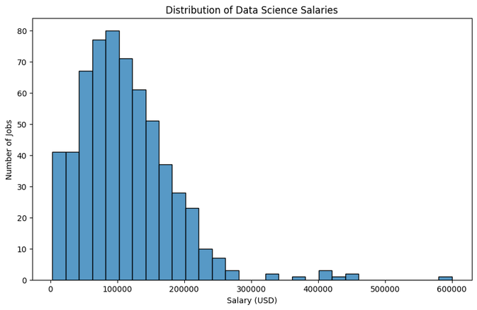
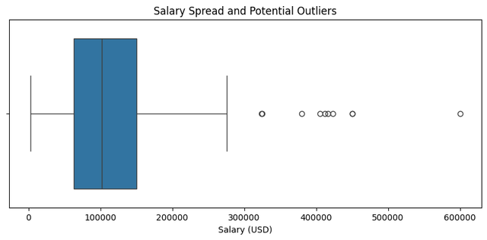
Descriptive Statistics
Most salaries cluster in the mid-range, with a long right tail of high earners
Boxplot confirms the right-skew and highlights unusually high-paying outlier roles
Samsung Innovation Campus

Slide 14
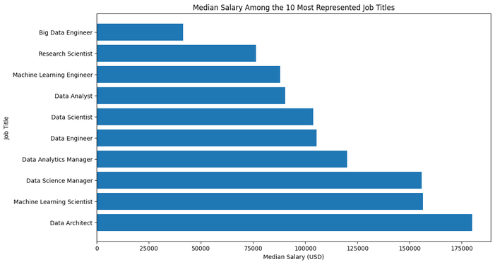
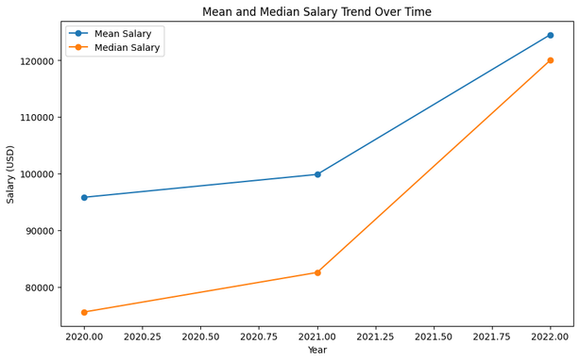
Descriptive Statistics
Among the 10 most represented roles, Data Architect has the highest median salary
Salary levels increased from 2020 to 2022
Samsung Innovation Campus

Slide 15
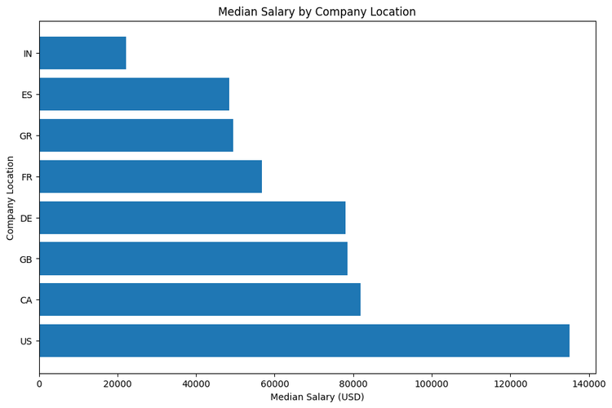
Descriptive Statistics
The US has the highest median salary among included locations, followed by Canada
Sample sizes differ a lot between countries, so results should be read with that in mind
Samsung Innovation Campus

Slide 16
Research Questions: Summary of Findings
Experience level → Yes, salary rises from Entry to Executive
Job title → Data Architect has the highest median among top 10 roles
Company size → Yes, Small pays less than Medium/Large
Remote work → Yes, Fully Remote pays the most
Location → US highest among sufficiently represented countries
Time → Salaries rose 2020–2022, biggest jump 2021–2022
DS vs. DA → Yes, Data Scientists earn more
Samsung Innovation Campus

Slide 17
Data Insights & Patterns
Experience is strongly associated with salary differences
Data Scientists earn more than Data Analysts in the sample
Fully remote roles have the highest salary levels among remote-work groups
Small companies show lower typical salaries than Medium or Large companies
Salary levels increased from 2020 to 2022
Correlations with salary are weak overall as no single numeric variable dominates, salary is driven by a mix of categorical factors
Samsung Innovation Campus

Slide 18
Data Insights & Patterns
Correlation Findings
The correlations are weak overall:
Salary and Work Year: 0.170
Salary and Remote Ratio: 0.132
Work Year and Remote Ratio: 0.076
No strong linear relationship with salary was observed among the analyzed numerical variables.
Samsung Innovation Campus

Slide 19
Dashboard Design
Samsung Innovation Campus

Slide 20
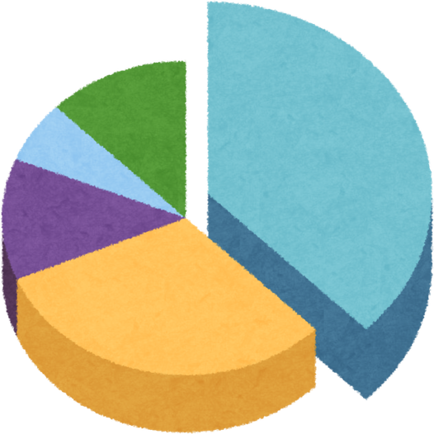
Dashboard Design
Built on a star-schema data model: Fact table + Employment_Dim + Company_Dim.
5 core DAX measures: Average_Salary, Median_Salary, Highest_Salary, Total_Salary, and numb_job.
4 interactive report pages with slicers for Work Year, Experience Level, Company Size, and Remote Ratio.
Page 1 – Salary Overview
Average Salary by Experience Level
Average Salary by Work Year
Median Salary by Remote Ratio
Number of Jobs by Salary Range
Samsung Innovation Campus

Slide 21
Dashboard Pages
Page 2 – Jobs Overview
Median Salary by Company Location
Median Salary by Job Title
Jobs by Company Size
Jobs by Experience Level
Page 3 – Experience Level
Average vs Median Salary by Experience Level
Correlation Analysis
Data Scientist vs Data Analyst Salary
Samsung Innovation Campus

Slide 22
Final Results
Samsung Innovation Campus

Slide 23
Conclusion & Recommendations
Final Results
Salary levels vary across experience level, job role, company size, location, remote-work arrangement, and year.
Recommendations
Benchmark compensation bands by experience level to reflect differences in salary across career stages.
Use role-specific salary benchmarks rather than applying a single pay scale across different job titles.
Consider company size when setting compensation budgets, as smaller companies show lower typical salaries in the analyzed sample.
Consider remote-work arrangement as one factor in compensation strategy, while recognizing that the observed salary differences do not imply causation.
Samsung Innovation Campus

Slide 24
Future Enhancements
Samsung Innovation Campus

Slide 25
Limitations & Next Steps
Limitations
The dataset only covers up to 2022, so more recent data would provide a more current view of salary trends.
Some countries have very small sample sizes, which limits confidence in location-based salary comparisons.
Future Work
Develop predictive salary models to estimate salary ranges.
Include additional variables that may help explain salary differences.
Expand geographic coverage to improve the representativeness of location comparisons.
Samsung Innovation Campus

Slide 26

ⓒ2020 SAMSUNG. All rights reserved.
Samsung Electronics Corporate Citizenship Office holds the copyright of book.
This book is a literary property protected by copyright law so reprint and reproduction without permission are prohibited.
To use this book other than the curriculum of Samsung innovation Campus or to use the entire or part of this book, you must receive written consent from copyright holder.

