Slide 1

2024 NASA Space Apps Challenge – SDG EduLab
Empowering Youth through SDGs Education
Team Members
Abdelrahman Ahmed Eldaba
Khalid Ehab Elabd
Ahmed Saeed Alshnwany
Noha Khalil Abdulkarim

Slide 2

SDG EduLab Overview
Mission: Integrate SDGs into education
Vision: Foster creative learning experiences
1
Software Development
Building interactive tools for learning
2
Education
Creating engaging lesson plans.
3
Data Science
Analyzing NASA Earth observation data.
4
Competing
Providing rewarding competitions.

Slide 3
Our Approach
Interactive learning through hands-on activities.
Leveraging Earth observation data for impactful lesson plans.
Problem Identification
1
Define an SDG to address
2
Data Acquisition
Retrieve NASA Earth observation data
Lesson Development
3
Design engaging activities and simulations
4
Implementation
Test and refine the lesson plan
Evaluation
5
Assess student understanding

Slide 4
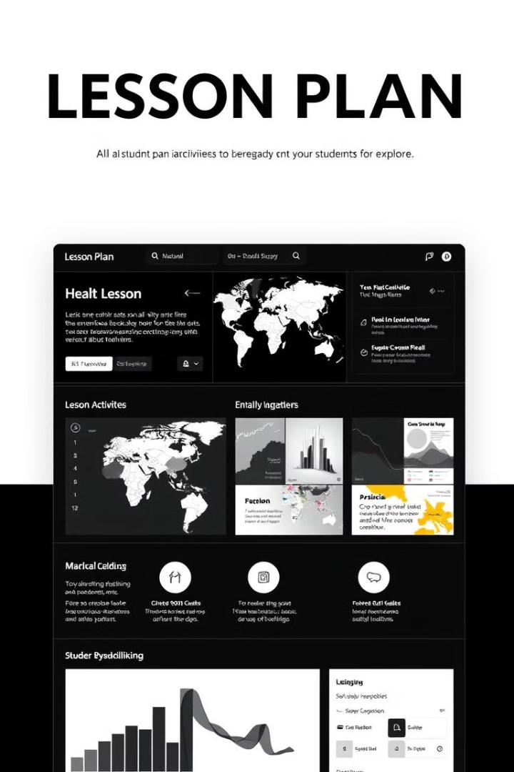
SDG-Focused Lesson Plan
Topic: Climate Action, Zero Hunger, or other SDG.
Curriculum Integration: Blended into existing science units.
Topic
Climate Change
Curriculum
Weather and Climate
Tools
NASA Earth observation data
Engagement
Interactive simulations, videos

Slide 5
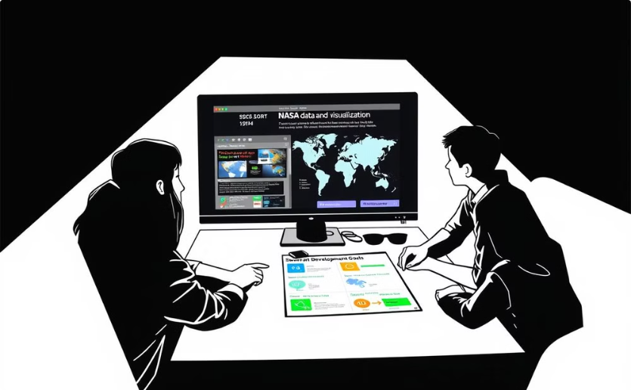
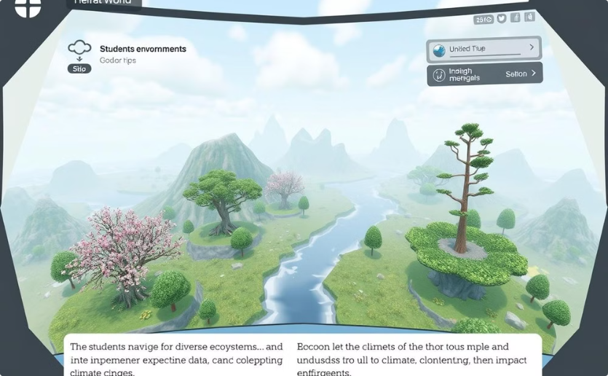
Innovative Features
Interactive videos and games to make SDGs relatable.
Data visualization tools for exploring NASA satellite data.
Interactive Videos
Interactive Games
Engaging storytelling to bring SDGs to life.
Gamifying learning to make it fun and engaging.

Slide 6



Impact
Empowering youth with knowledge and skills.
Sharing lesson plans globally through EO4SDG partners.
Increased Awareness
Students understand SDG challenges.
Empowered Action
Students develop solutions to address SDGs.
Global Citizenship
Students become active citizens in tackling global issues.

Slide 7




Call to Action
Join our mission, share our lesson plans.
Collaborate to spread SDG awareness in classrooms.
Follow Us
Space Apps Connect, social media, and webinars.
Spread the Word
Share our lesson plans with educators.
Get Involved
Join our community and collaborate.

Slide 8
Any question?

