Slide 1


REPORT: Competitor Analysis Insights from Parch and Posey
Oluwagbemiga Adegboyega

Slide 2



Introduction: Overview of Competitor (Parch & Posey)
Parch and Posey is a company that sells paper.
They have 50 sales reps spread across 4 regions in America. (source: sales_reps and region table)
They sell 3 types of paper which is Standard Type, Gloss Type, and Poster Type. (source: orders table)
Their customers are big companies (with 351 accounts )and they attract by advertising online via Google Adwords, Facebook, and Twitter, and also attract by advertising offline via Organic, Direct, and Banner. (source: web_events table)
They have sales record between 4th December, 2013 and 2nd January, 2017
Parch & Posey Mode of Operation
Interacts to set goals and targets
Reaches out via different channels
Reports back to the company
Gives Feedback
Sales Representative
Parch & Posey
Customers

Slide 3

O
BJECTIVES
CoreDataEngineers is expanding into the sales of goods and services.
To make informed business decisions and develop a competitive strategy, it is essential to conduct a comprehensive analysis of its competitor, Parch & Posey.
Key Aims:
To gain a clear understanding of the sales of goods and services market dynamics.
To evaluate Parch & Posey’s competitive strengths and weaknesses across products, pricing, customer engagement etc.
To identify potential customer segments and assess unmet needs.
To uncover market gaps and opportunities that CoreDataEngineers can capitalize on.
To evaluate industry best practices in sales and customer service.
To assess emerging trends and consumer preferences within the industry.
To inform strategic positioning and guide data-driven decision-making for market entry and growth.

Slide 4
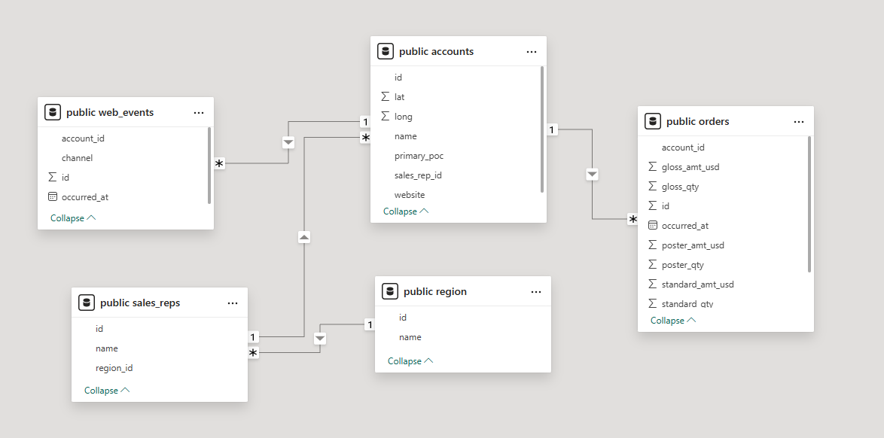
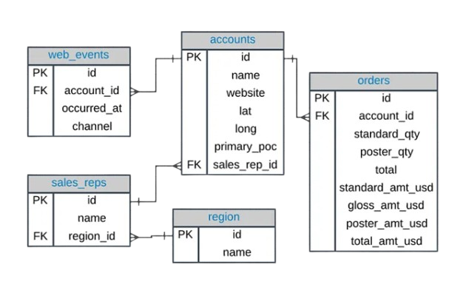
Parch & Posey Data Model
In the Parch & Posey database, there are five entities, which are: web_events, accounts, orders, sales_reps and region.
Entity Relationship Diagram (ERD)
Accounts : This table contains information on customer accounts such as account id, account name, primary person of contact, account location and sales_reps_id.
Orders : This table contains information on account_id, quantity of orders, amount spent on the orders for each paper type, as well as the date the transaction occurred.
Region : This table contains information about region id and the name of the region.
Sales_reps: This table contains information about the sales_reps name and id as well as region_id.
Web_events : This table contains details regarding the channels through which customers discovered our Company and the timing of their discovery.

Slide 5






Exploratory Data Analysis
The below shows the data flow which aided the EDA. The Parch & Posey data was loaded from csv into Postgres via bash scripting, analyzed using SQL and visualized using PowerBI
Bash Script
Analysis
Visualization
Data Loading…

Slide 6

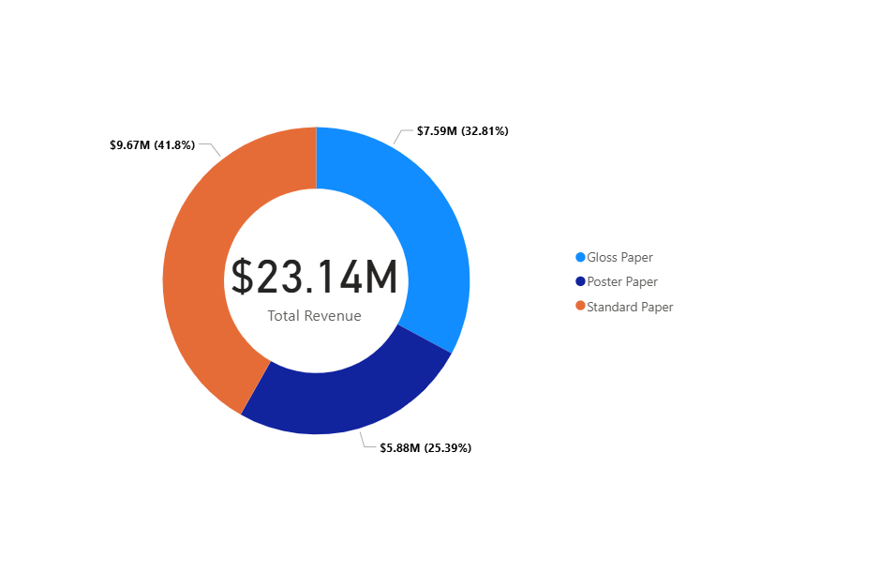
Insights: Revenue by Paper Type
Standard Paper Product Type contributes the largest percentage of the Total Revenue with $9.67M at 41.8%, while Poster Paper contributes the least amongst the three Paper Types.

Slide 7
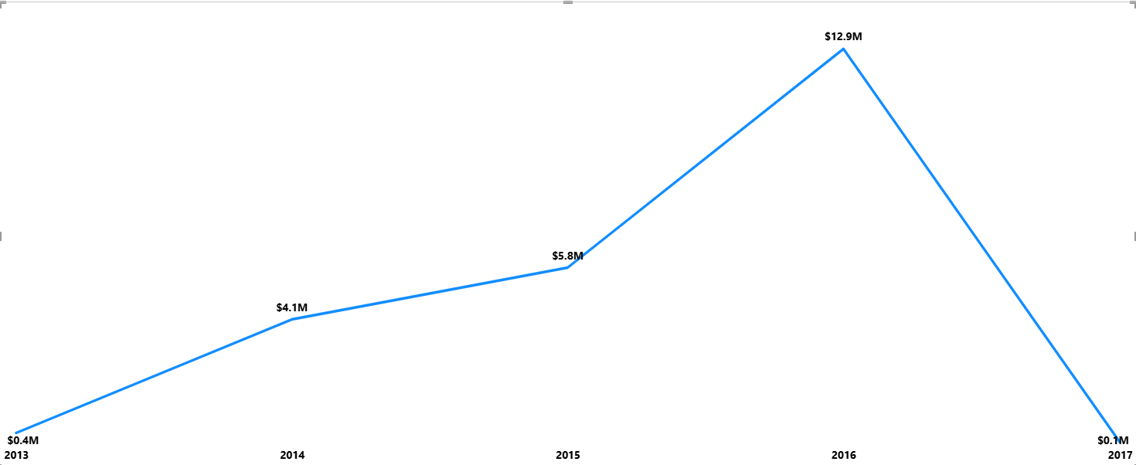
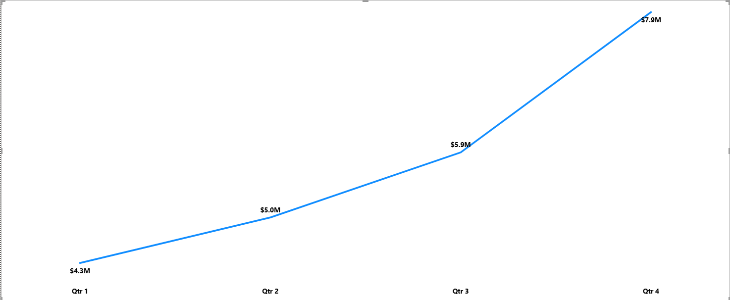
Insights: Revenue Trend Analysis
From the Revenue Trend Analysis on Year and Quarter, Year 2016 shows a positive turnover in revenue over the years with $12.9M as against the low-figures of other years. While the last Quarter shows an increase in the customers’ purchasing power thereby yielding the highest revenue as compared to other quarters, and this could have some correlation with the occurrence of festivities in this quarter.

Slide 8
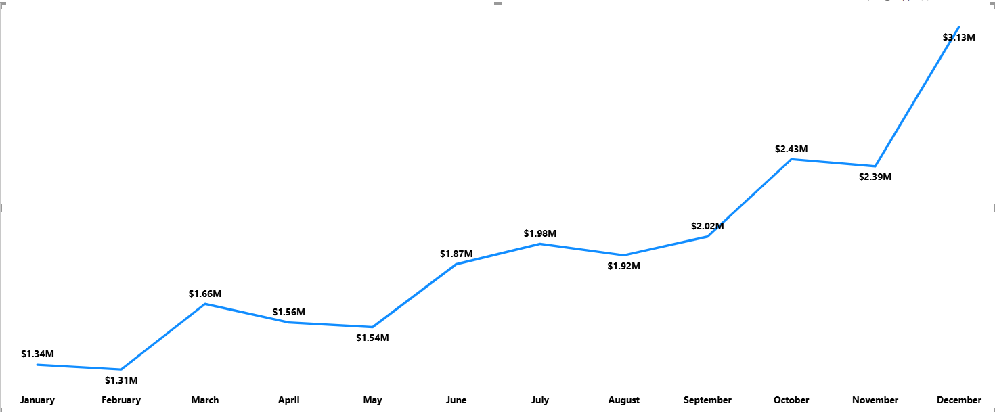
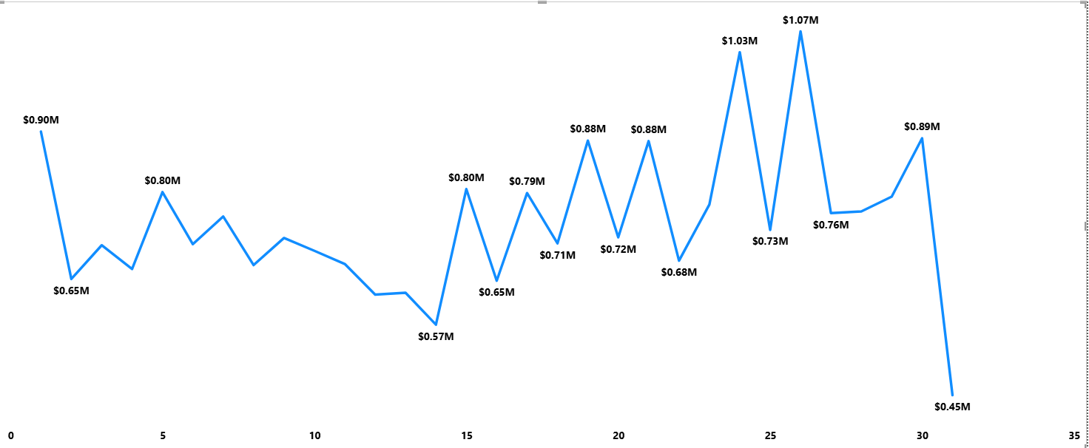
Insights: Revenue Trend Analysis
As revenue increases towards the end of each year as shown by the MoM trend analysis, it is also worthy to note that revenue also increases towards the end of each month, and this could suggest that most customers are salary-earners and have a boost in their purchasing power when salaries are being paid towards the month-end. This could help in deciding which time of the month to run ads or discount.

Slide 9
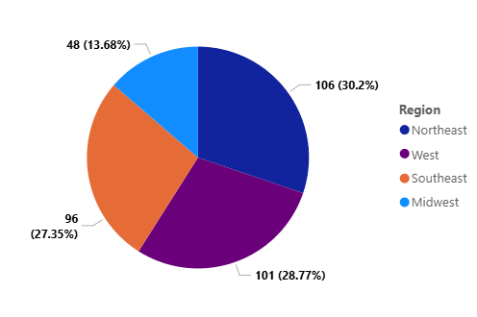
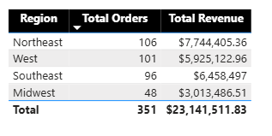
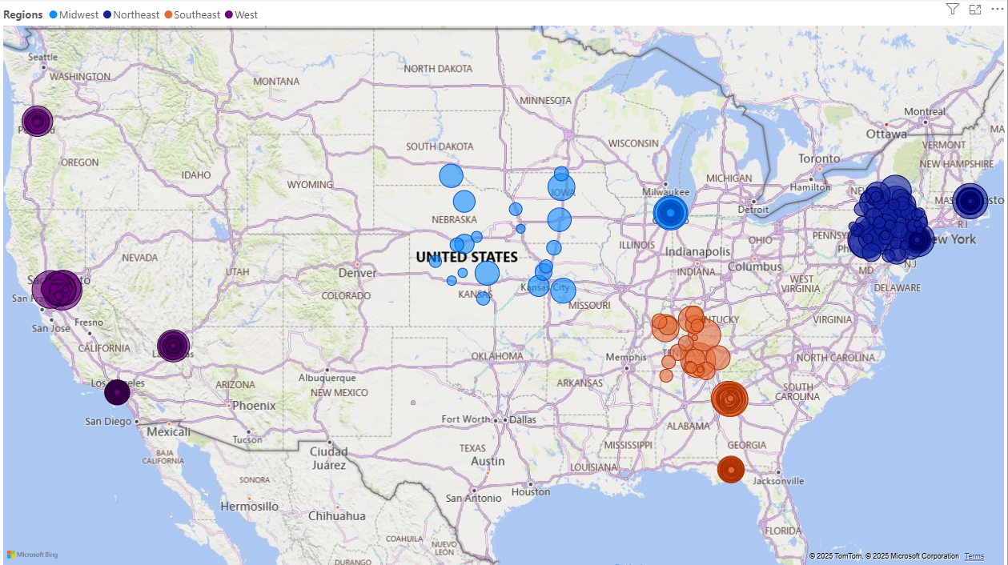
Insights: Regional Performance
Parch and Posey unapologetically have a larger dominance in the Northeast and West region compared to the southeast and Midwest where they have the least dominance.

Slide 10
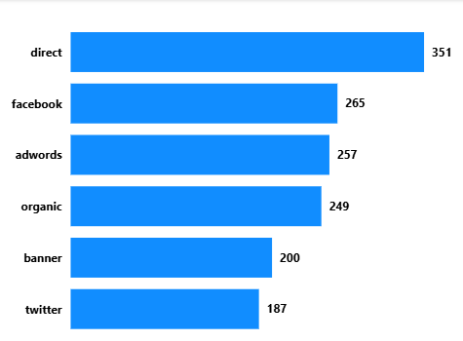
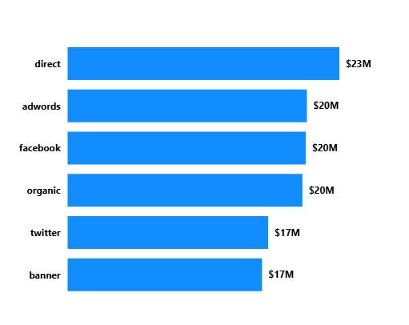
Insights: Channel Patterns
As direct Channel tops the chart in the number of orders, it also results into a significant amount in terms of revenue.
The Total number of Orders by Channel shows that direct ads are more resourceful than other channels

Slide 11
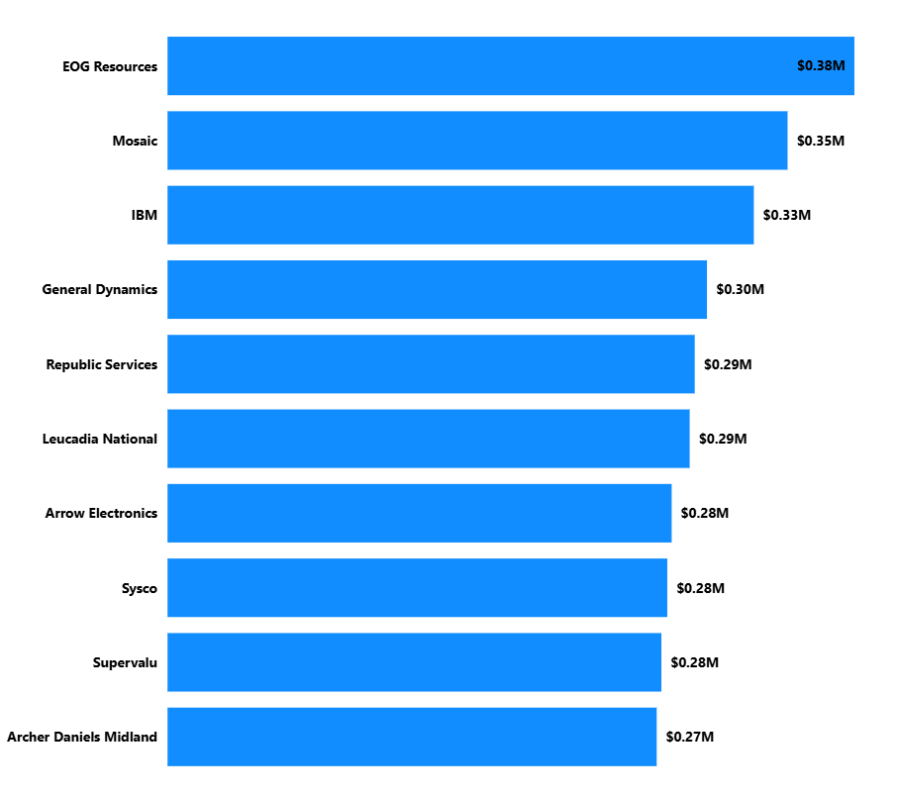
Insights: Customer Analysis
The Total Revenue by Top 10 customers places EOG resources at the top of the chart, and helps the company to know their MVP customers as against exiting customers.

Slide 12
Recommendations
Technically, Data Engineers at CDE should create another entity called products when modelling their data, as against Parch and Posey’s model that allows for redundancy of certain product columns when a customer doesn’t include such product in their order.
CDE can penetrate the market by focusing on regions were Parch and Posey are less dominant as this will help them capitalize on their weakness from customer’s feedbacks.
Understudy Parch and Posey’s top-performing sales representatives and regions while allocating resources to your top-performing sales representatives and regions to maximize revenue.
Promote or Invest more in high-performing paper types and optimize inventory to boost sales performance.
Invest more in channels that effectively drive customer acquisition.
Develop strategies to retain existing customers, like offering discounts etc., and increase customer loyalty.
Streamline production processes and improve inventory management to reduce costs and enhance efficiency

Slide 13
Conclusion
The analysis of Parch and Posey’s operational performance offers a comprehensive overview of the company’s operations and customer base, providing valuable insights into key areas for improvement.
By implementing the recommendations outlined in this report, CDE can make informed decisions to seamlessly diversify into the sales of goods and services, and also enhance operational efficiency, drive revenue growth, and improve overall business performance.

Slide 14

Thank You

