Slide 1



Customer Feedback Analysis and Improvement

Slide 2

About us
Set up an SQL database to manage customer feedback and import historical data. Implement a data warehouse to store and aggregate feedback. Use Python to clean and preprocess the data, then build sentiment analysis models to classify feedback as positive, neutral, or negative. Finally, deploy the sentiment analysis model through a web application.

Slide 3
Agenda
Introduction
SQL Database Setup and Data Collection
Data Warehouse and Python Data Processing and Azure
Sentiment Analysis
MLOps & Deployment
Summary

Slide 4
Introduction
In today's competitive market, understanding customer feedback is crucial for improving products and services. This project aims to develop a comprehensive system that collects, stores, and analyzes customer feedback to uncover valuable insights. By setting up an SQL database, implementing a data warehouse, and utilizing Python for data cleaning and sentiment analysis, we will classify feedback as positive, neutral, or negative. The final solution will be deployed through a web application, providing real-time feedback trends that help drive data-driven decisions.

Slide 5
SQL Database Setup and Data Collection
Create a SQL database to manage customer feedback and Create all tables that we will use .
Import historical customer feedback data into the database and Check that all tables are fill with data SQL server.
Make the database diagram

Slide 6
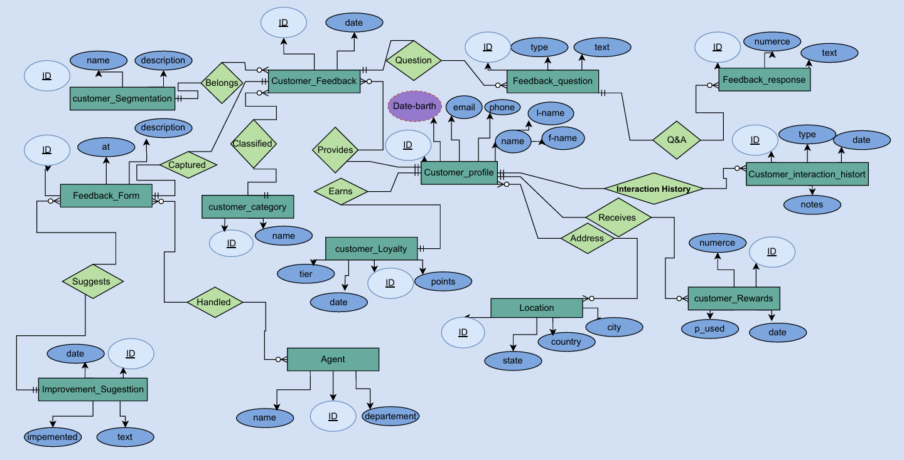
ERD

Slide 7
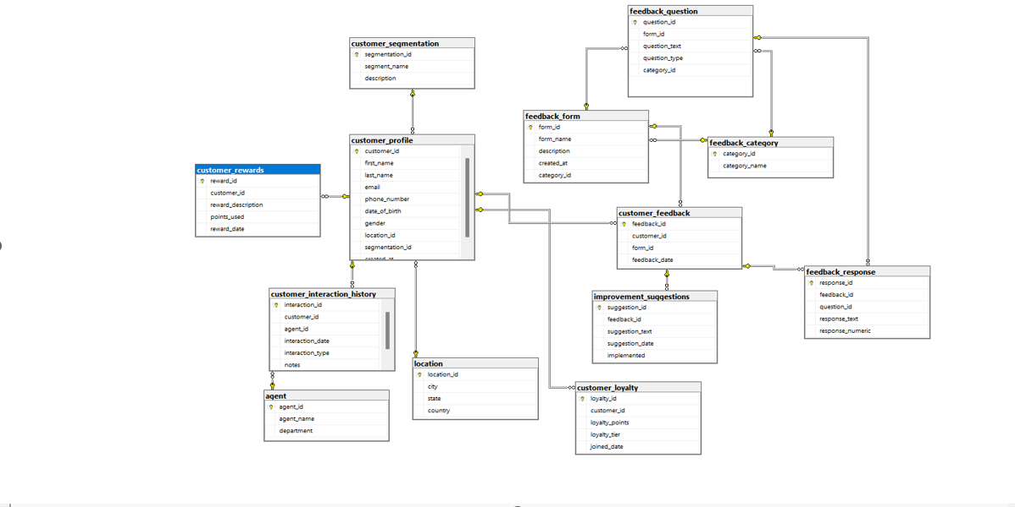
Database Diagram

Slide 8
Data Warehouse and Python Analysis & Processing
Implement a data warehouse to aggregate and store feedback data and make bus matrix for it .
Load feedback data into the data warehouse by SSIS and Azure Cloud .
Processing: Use Python to clean and preprocess feedback data, including text processing for sentiment analysis.
Python data Analysis using charts

Slide 9
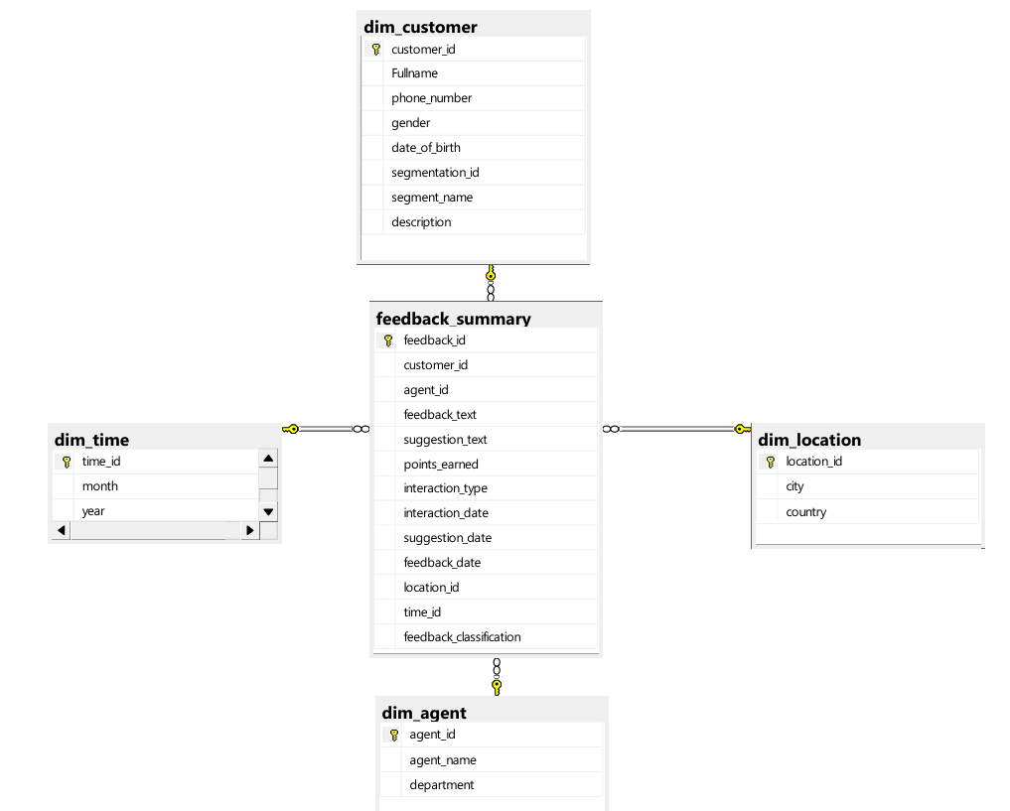
Data Warehouse Diagram

Slide 10
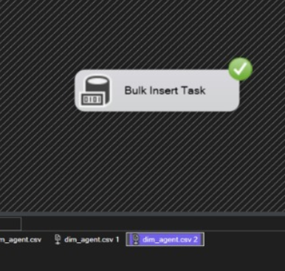
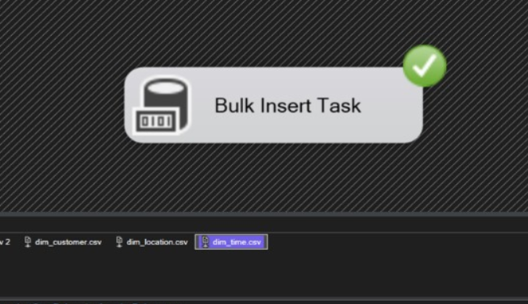
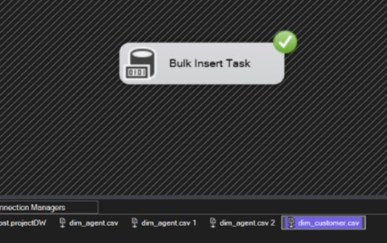
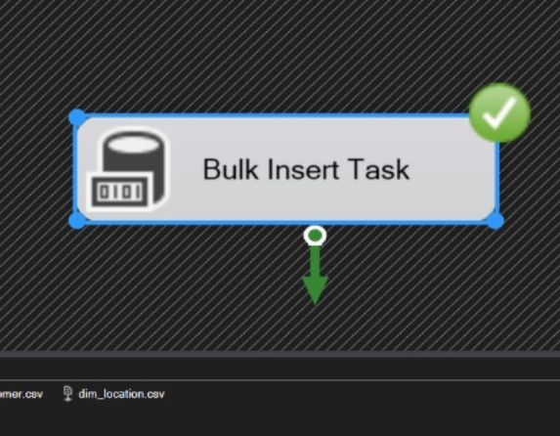
Some of Successfully Bulk Insert

Slide 11
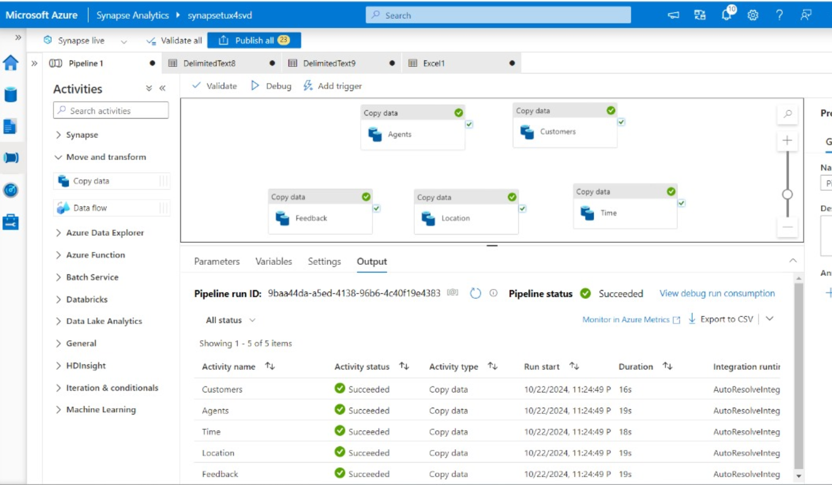
Microsoft Azure

Slide 12
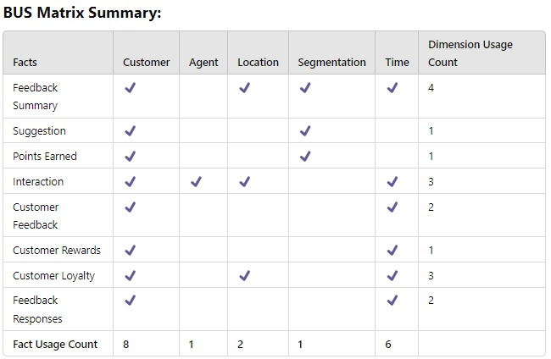

Slide 13
Python Clean and preprocess
Text Preprocessing:
--Cleans, tokenizes, and stems text, removing unnecessary words and characters to prepare it for analysis.
Vectorization:
--Converts the feedback text into numerical features for machine learning by considering both individual words and word pairs (unigrams and bigrams).

Slide 14
Python Data Analysis

Slide 15
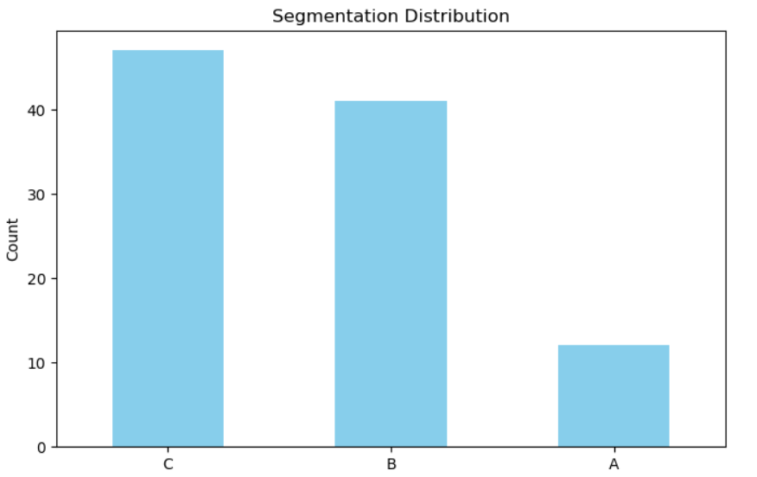
Customer segmentation
The segmentation distribution chart illustrates the relative prevalence of three distinct customer segments, labeled C, B, and A, which can provide valuable insights for strategic marketing decisions.

Slide 16
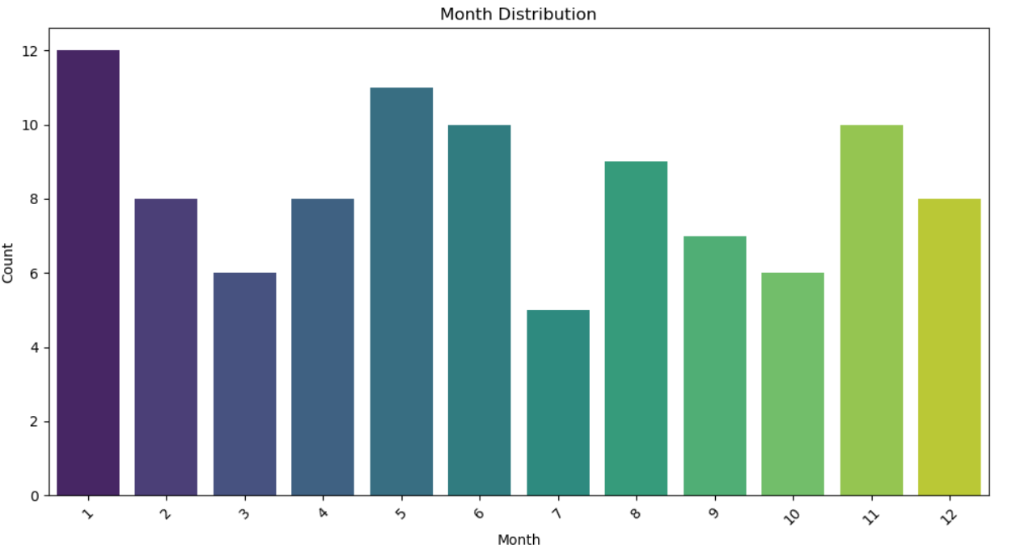
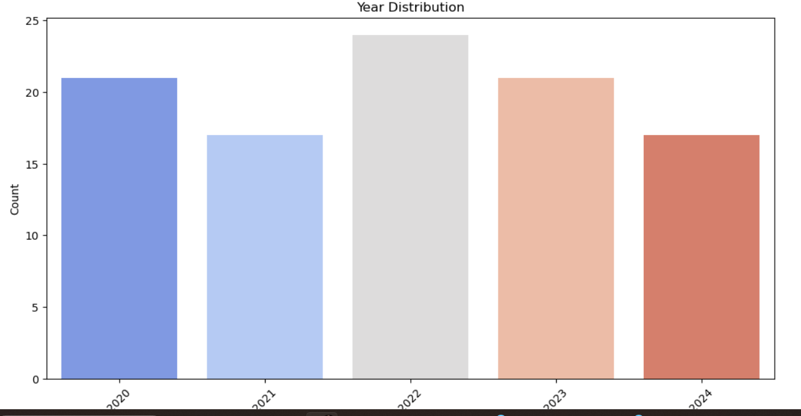
Date of Feedback
The month distribution chart provides a visual representation of the relative activity or occurrence across different months, which can offer insights into seasonal trends or patterns within the data.

Slide 17
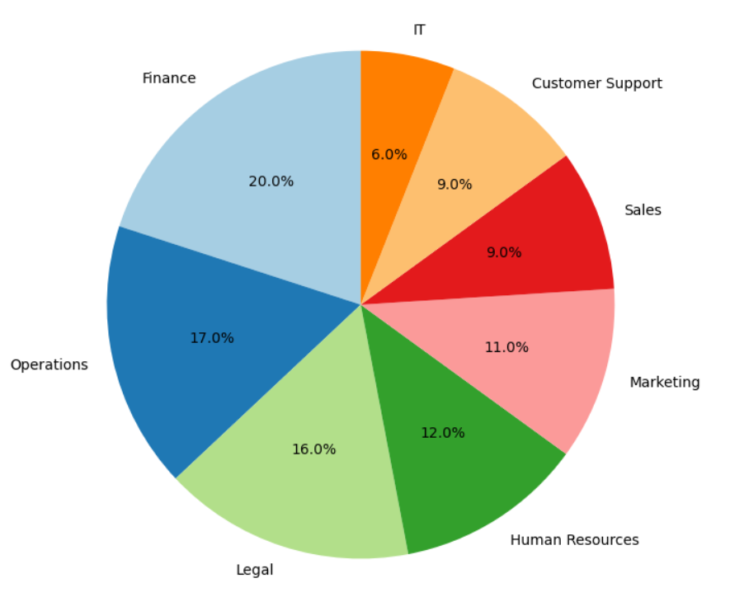
Department distribution
The pie chart provides a visual breakdown of the distribution of employees or resources across different departments within an organization, highlighting the relative proportions allocated to areas such as Finance, Operations, Legal, Human Resources, Marketing, Sales, Customer Support, and IT.

Slide 18
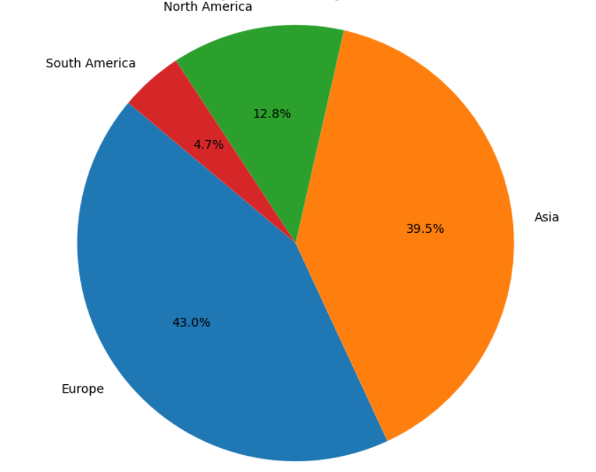
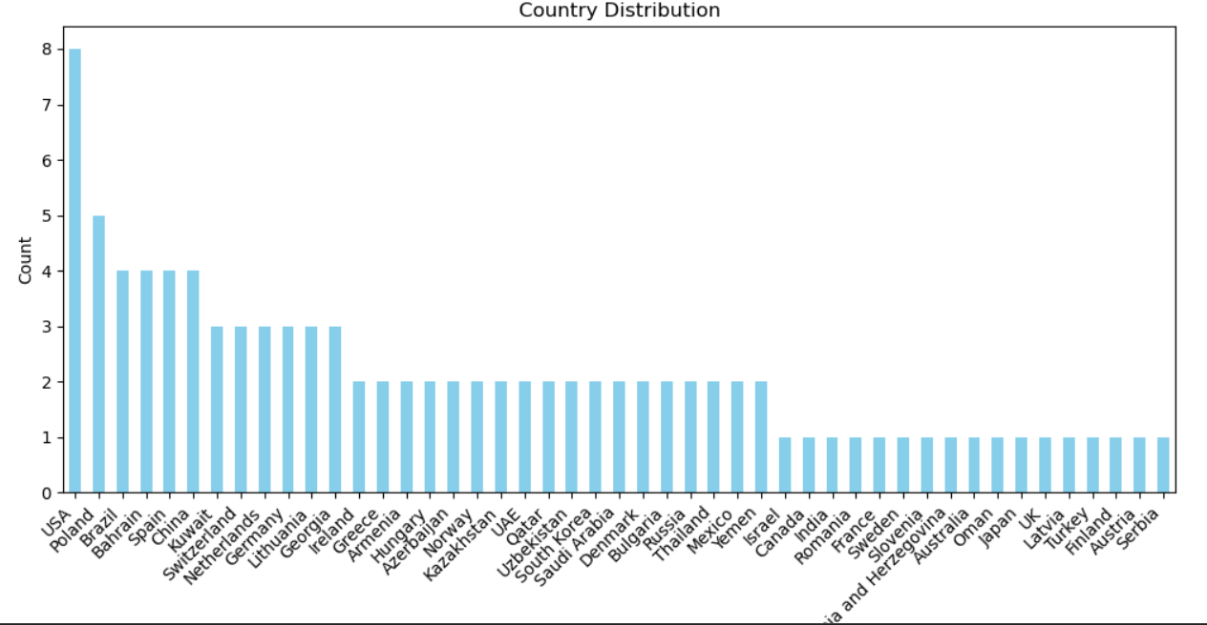
Customers Continent
The pie chart provides a breakdown of the geographic distribution of a dataset, highlighting the relative contribution or share of various regions such as Asia, Europe, North America, South America, and others.

Slide 19
Sentiment Analysis Model
Build sentiment analysis models using Python to classify feedback into positive, neutral, or negative categories.

Slide 20
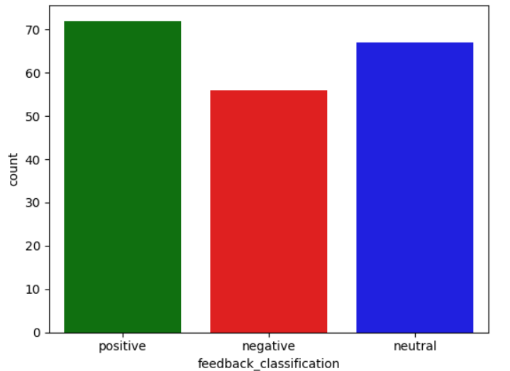
Feedback Classification
The bar chart displays the distribution of feedback classifications across three categories: positive, negative, and neutral, providing a visual representation of the relative prevalence or proportions of each type of feedback within the dataset.

Slide 21
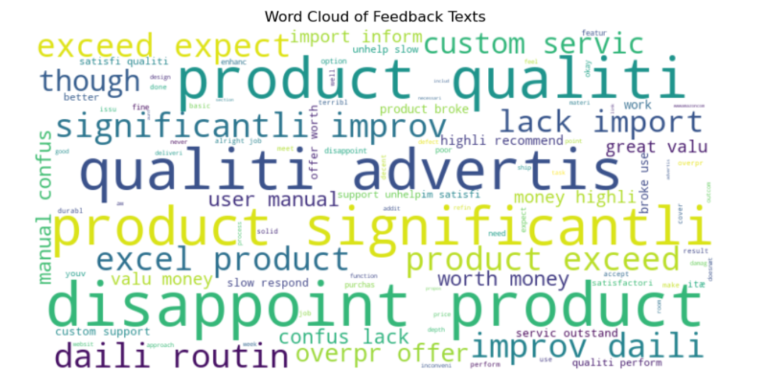
Word cloud of Feedback Texts

Slide 22
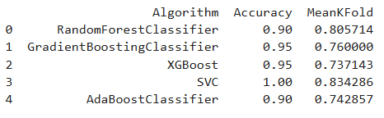
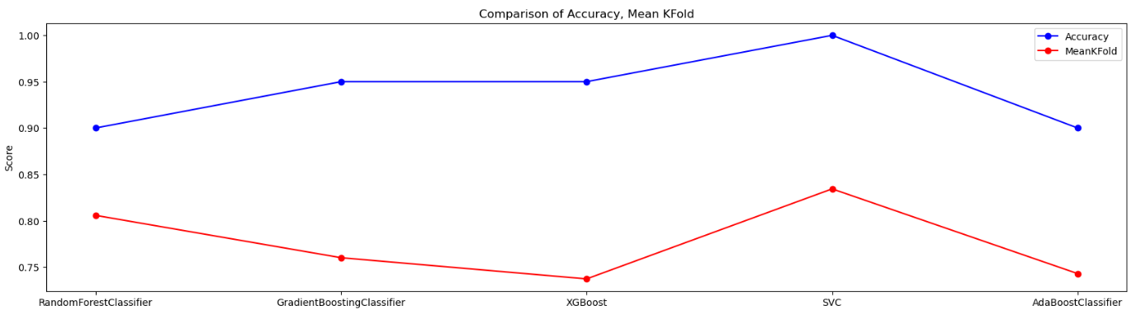
Algorithms Report
The table presents the performance metrics, including Accuracy and Mean K-Fold, for various machine learning algorithms applied to a dataset, allowing for comparative analysis of their relative effectiveness.

Slide 23
Deployment the Model
Deploy the sentiment analysis model via a web application.

Slide 24
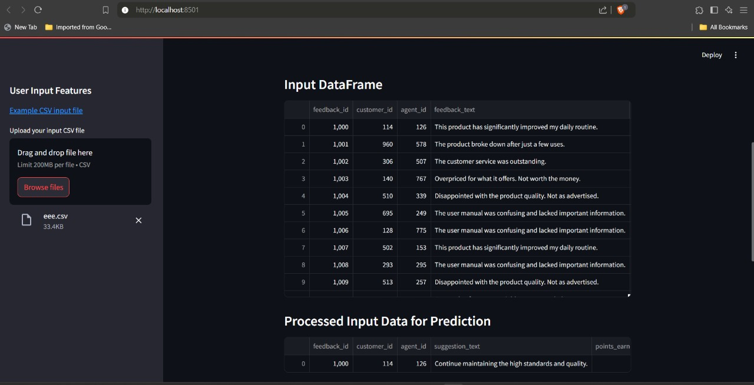

Slide 25
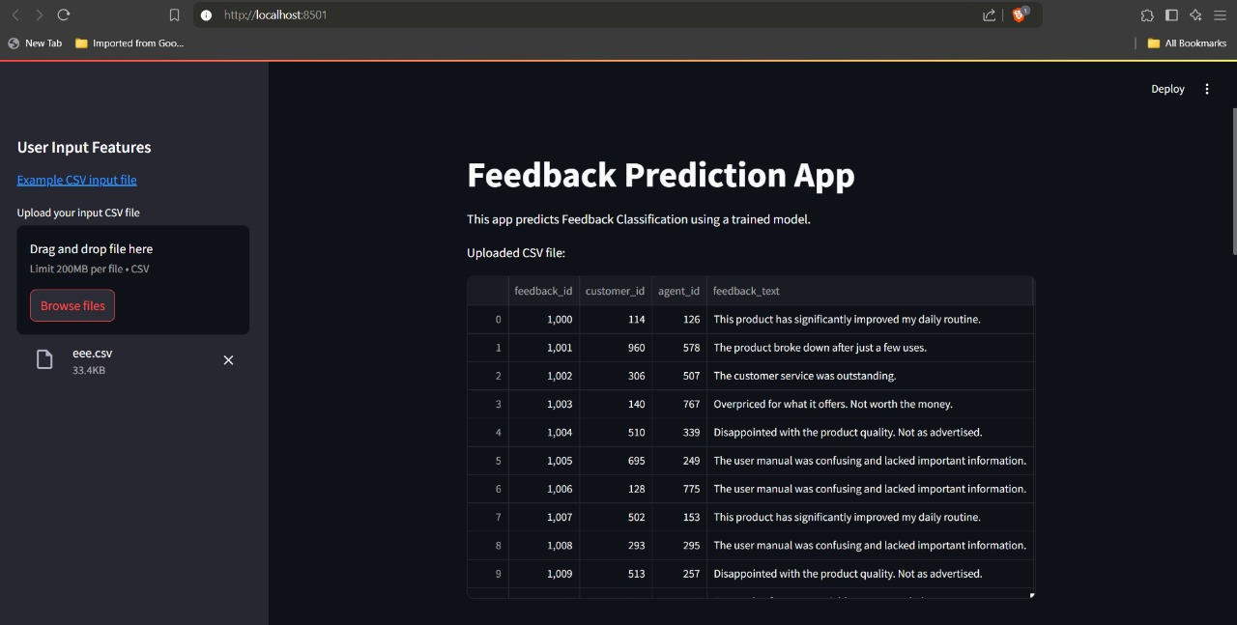

Slide 26
Conclusion
The "Customer Feedback Analysis and Improvement" project effectively turned customer feedback into actionable insights. By setting up a SQL database and data warehouse, we ensured organized storage and easy access to feedback data. Python scripts enabled us to clean, process, and analyze feedback sentiment, categorizing it into positive, neutral, or negative sentiments.
Integrating Azure Data services allowed for scalable storage and advanced analysis, while deploying the sentiment models through a web application made feedback trends easily accessible. This streamlined approach empowers us to better understand customer needs and drive product improvements, ensuring a data-driven strategy for ongoing customer satisfaction.

Slide 27

Question time

Slide 28
Thank you
Presented by
Abdelrahman Afify Hussien (Team Leader)
Nourhanne Salah Eldin Mohammed
Abdullah Elsaeed Mohammed
Omar Khaled Ahmed
Youssef Ali Anwer
Marwan Mohammed Ibrahim

