Slide 1
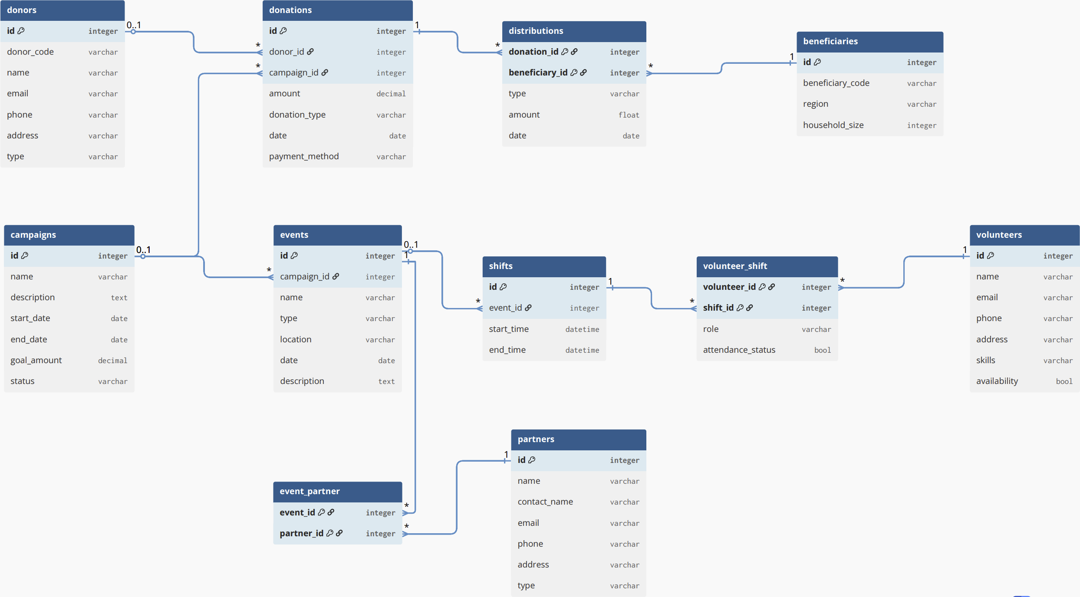
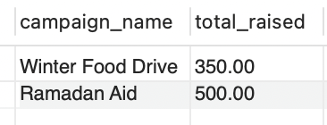
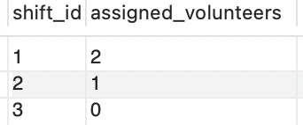
Charity Operations Management Database Abdel Rahman Alashel,
Habeeb Adelagun,
Mohamed Elsabah,
Haisen Wang.
Entity-Relationship Model
SQL Schema
donors
id integer [primary key]
donations
id integer [primary key]
donor_id integer [foreign key]
campaign_id integer [foreign key]
campaigns
id integer [primary key]
events
id integer [primary key]
campaign_id integer [foreign key]
beneficiaries
id integer [primary key]
distributions
donation_id integer [primary key]
beneficiary_id integer [primary key]
shifts
id integer [primary key]
event_id integer [foreign key]
volunteers
id integer [primary key]
volunteer_shift
volunteer_id integer [primary key]
shift_id integer [primary key]
partners
id integer [primary key]
event_partner
event_id integer [primary key]
partner_id integer [primary key]
Project goal: design and implement a relational database that centralizes campaign/event operations, donation tracking, partner contributions, beneficiary servicing, and volunteer/staff scheduling enabling reliable integrity constraints and standard reporting queries.
Real-world scenario: In many small-to-mid regional teams, operational data is spread across spreadsheets, online forms, email threads, and chat messages. This fragmentation creates recurring operational problems, including duplicate or inconsistent donor/beneficiary records, weak traceability from donations to campaigns/events and onward to distributions and beneficiaries, scheduling conflicts caused by inconsistent shift assignments and unreliable attendance tracking, and reporting gaps that make it slow and error-prone to produce accurate totals for funds raised, partner contributions, volunteer hours, and beneficiaries served.
Why a Relational Database?
A relational database is a strong fit because charity operations naturally involve multiple entities and relationships.
(donors–donations, campaigns–events, events–shifts, volunteers–shifts, beneficiaries– requests–distributions, partners–contributions).
SQL enforces structure and integrity while supporting complex queries across linked data exactly what relational modeling is designed for.
Design Decisions
Distribution is used as a bridge between donations and beneficiaries. “Which donation helped which beneficiary”
Assuming every donation is linked to a campaign, not directly to an event.
Synthetic Data
Donors
('DNR-1001', 'Alice Johnson', 'alice@example.com', '123-456-7890', '123 Main St', 'Individual’)
Campaigns
('Winter Food Drive', 'Providing food supplies during winter', '2026-01-01', '2026-02-28', 10000, 'Active’)
Donations
(1, 1, 200.00, 'Cash', '2026-01-10', 'Credit Card’)
Events
(1, 'Food Distribution Day 1', 'Distribution', 'Community Center', '2026-01-20', 'first round of distribution’)
Beneficiaries
('BEN-001', 'Charlottetown Area', 4)
Distributions
(1, 1, 'Food', 50.00, '2026-01-20’)
Shifts
(1, '2026-01-20 09:00:00', '2026-01-20 12:00:00’)
Volunteers
('John Doe', 'john@example.com', '555-1111', '12 Elm St', 'Cooking, Driving', TRUE)
Queries & Results
How much did each campaign raise?
SELECT c.name AS campaign_name, SUM(d.amount) AS total_raised
FROM campaigns c
LEFT JOIN donations d ON c.id = d.campaign_id
GROUP BY c.name;
Are events properly staffed?
SELECT s.id AS shift_id,
COUNT(vs.volunteer_id) AS assigned_volunteers
FROM shifts s
LEFT JOIN volunteer_shift vs ON s.id = vs.shift_id
GROUP BY s.id;
These queries support reporting needs such as campaign performance and volunteer engagement, which were identified as key challenges in the problem context.
Reflection
All crucial information required by the real-world charity fits in SQL database perfectly.
The challenge is to decide the entities and relationships between them. It is relatively easy to have a big picture, but challenging to make decisions about details.
For a SQL database development, the structure of database is the most important part through the whole process.

