Slide 1
INTRODUCTION TO programming using python

Slide 2
Outline
File Input Output
Modules
Packages
Python Standard Library
External Libraries
Demo

Slide 3
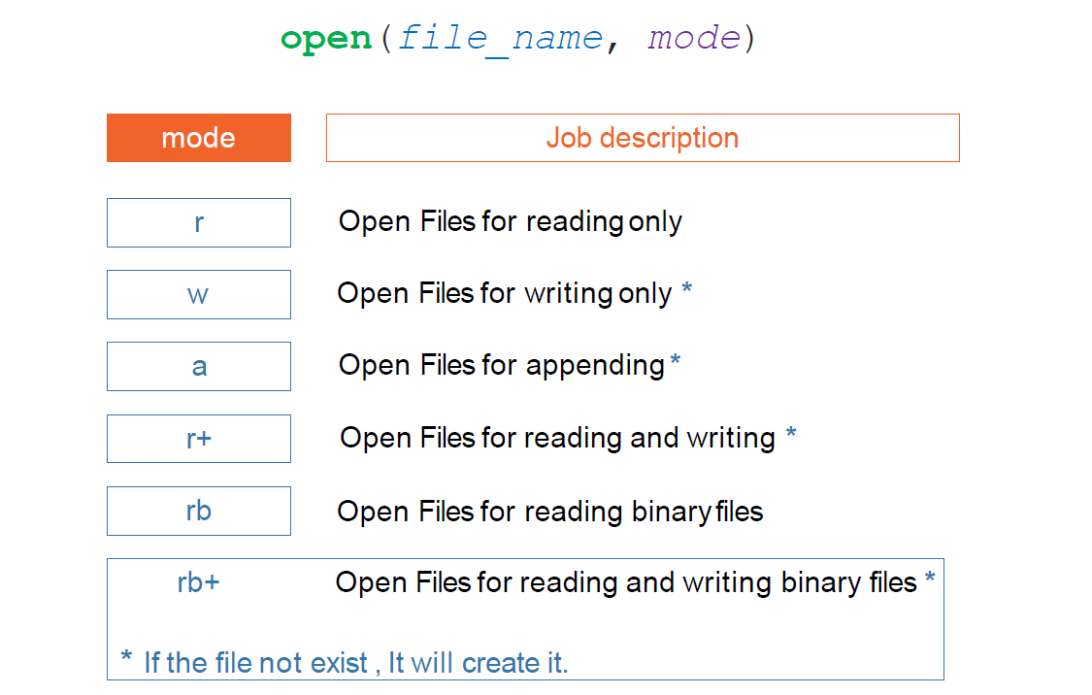
File Input Output (Open)
Open file

Slide 4
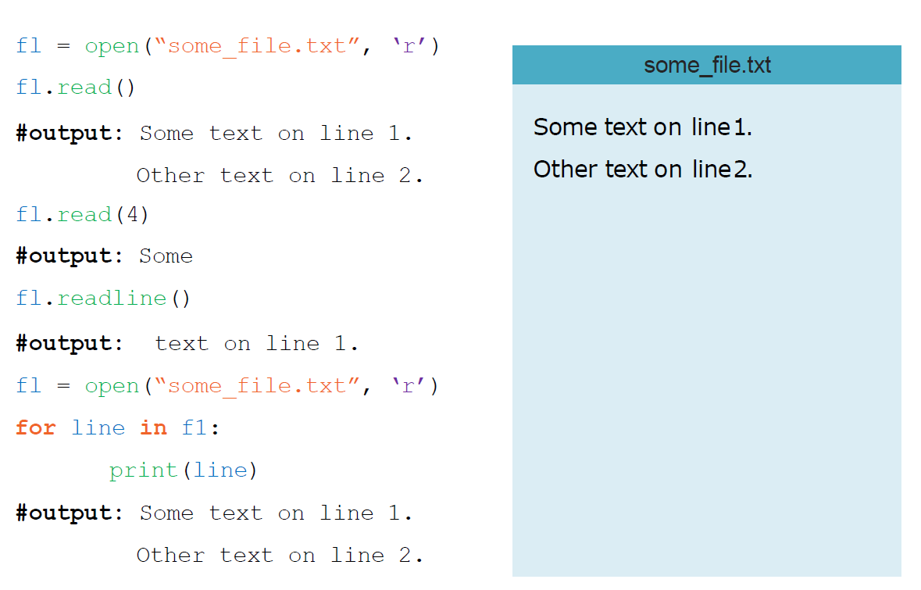
File Input Output (Read)
Open file

Slide 5
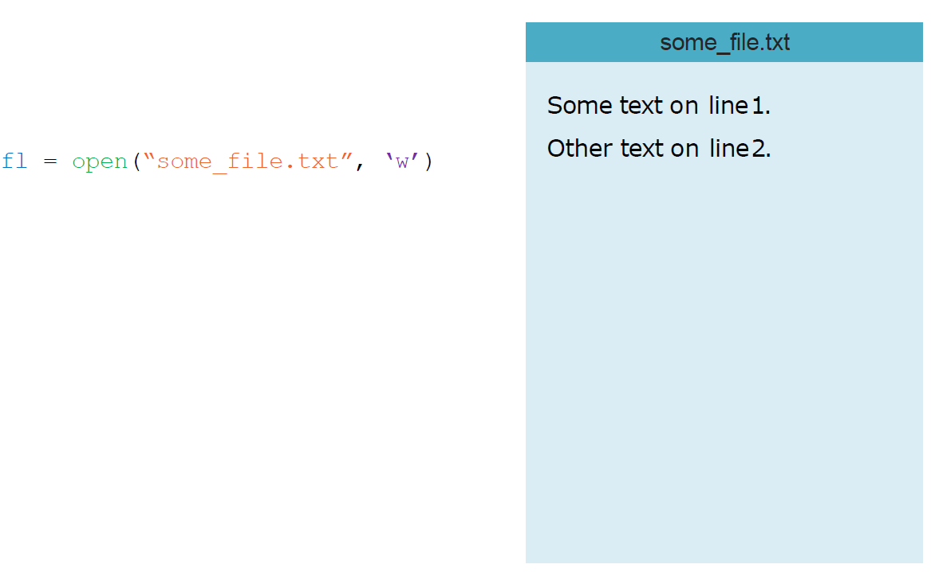
File Input Output (Write)
Open file

Slide 6
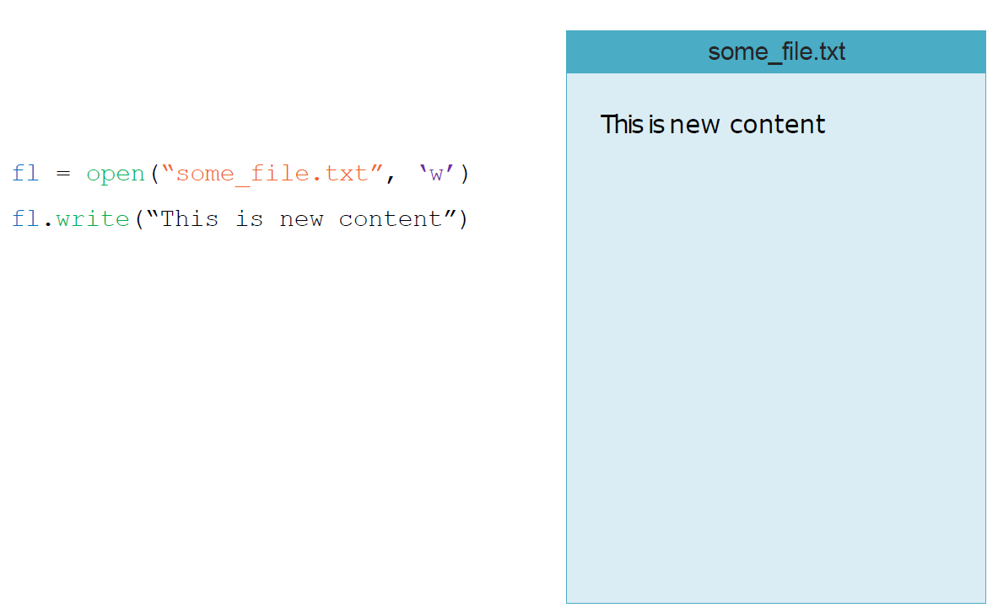
File Input Output (Write)
Open file

Slide 7
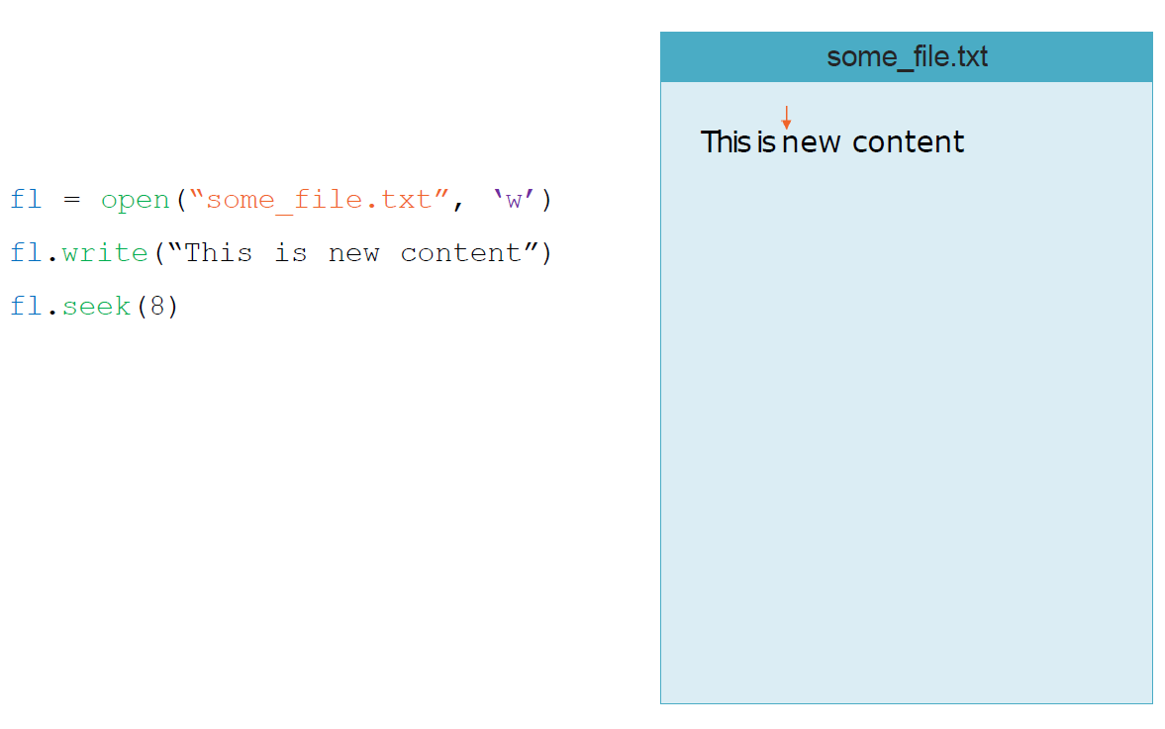
File Input Output (Write)
Open file

Slide 8
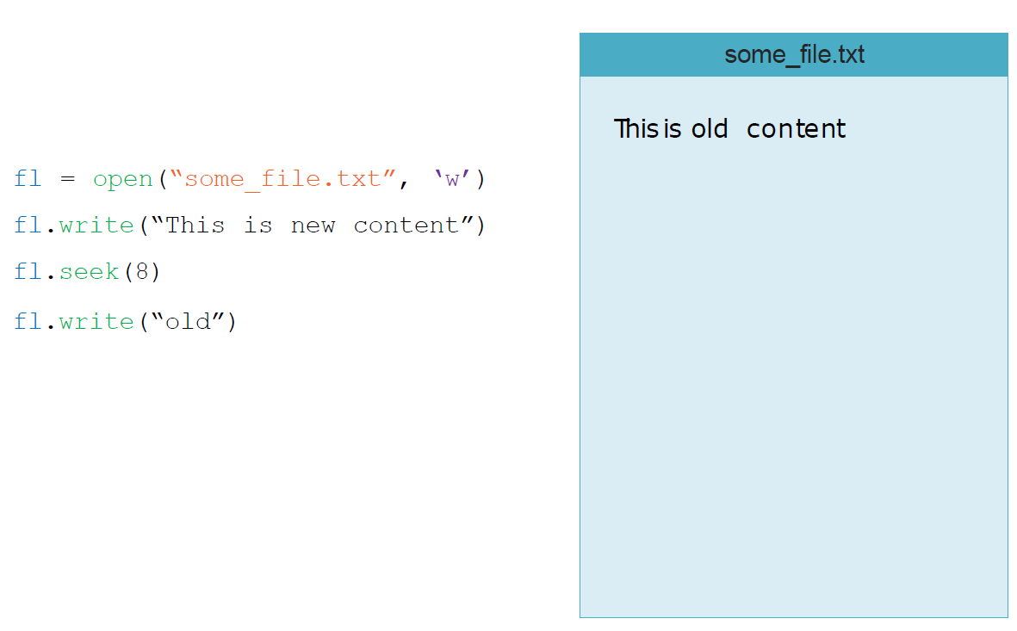
File Input Output (Write)
Open file

Slide 9
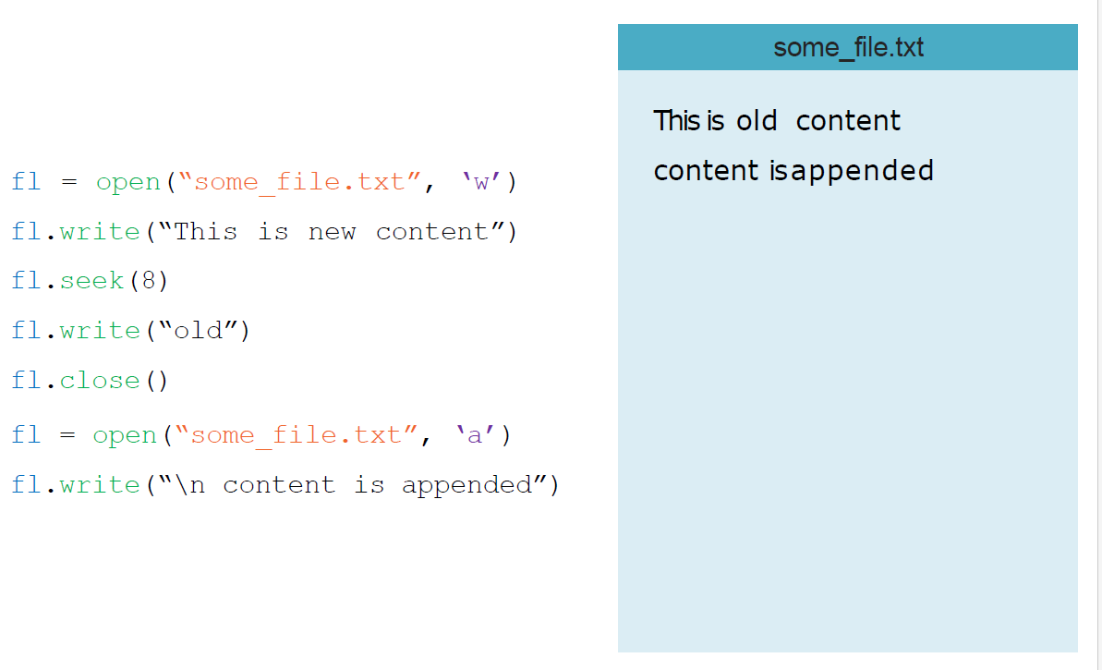
File Input Output (Write)
Open file

Slide 10
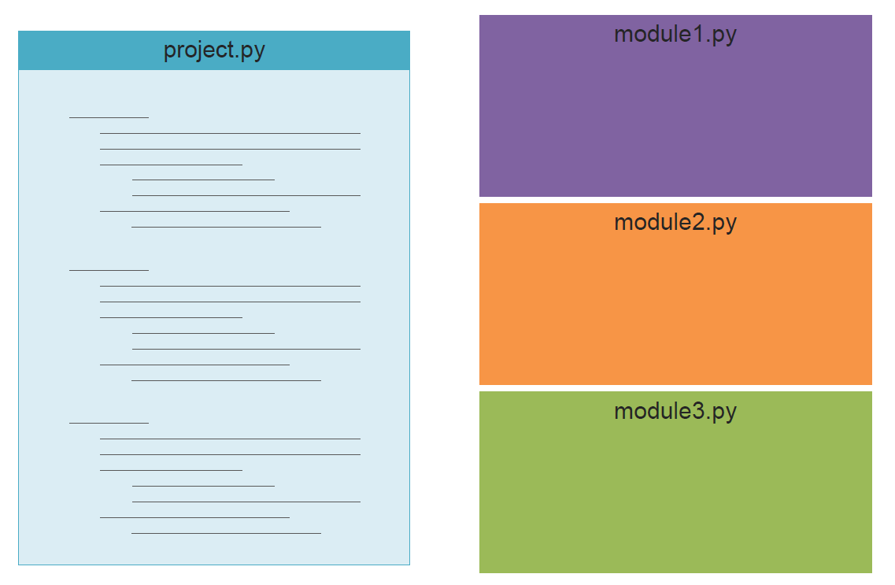
Modules
To make your code more modular

Slide 11
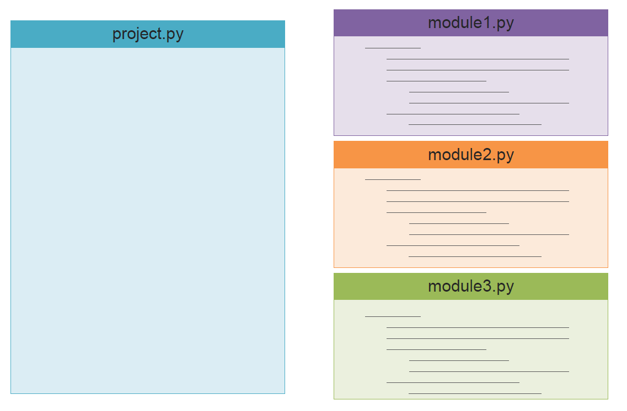
Modules

Slide 12
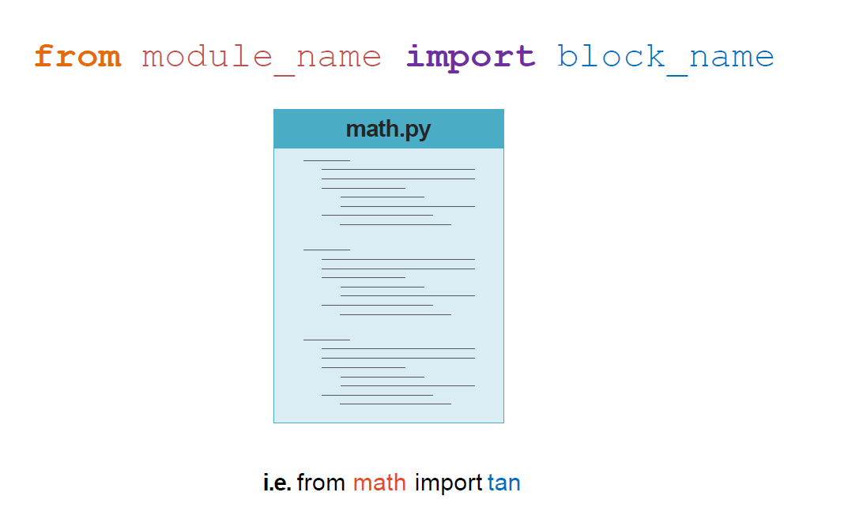
How To

Slide 13
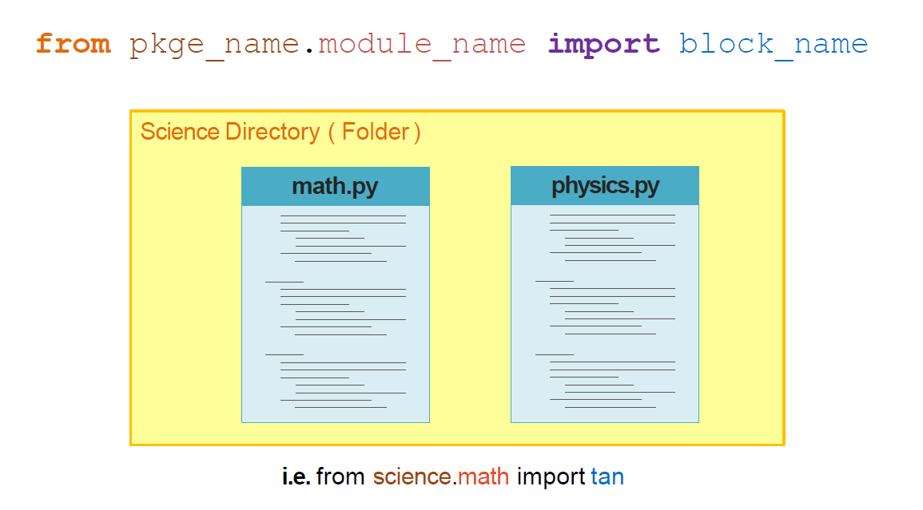
Packages

Slide 14
Standard Library
os
math
re
Sys
socket

Slide 15
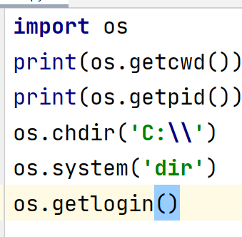
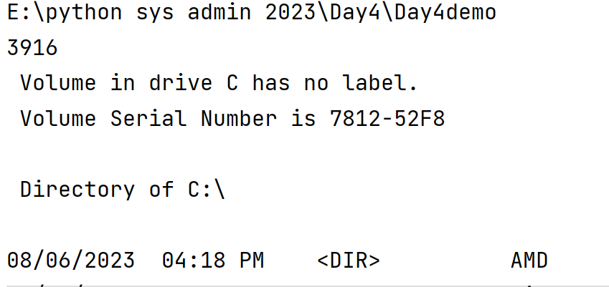

os
module provides functions for interacting with the operating system

Slide 16
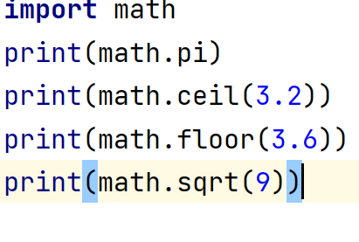
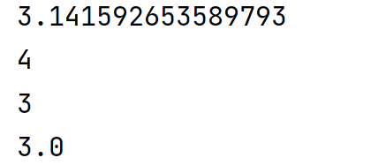
math
module provides access to the mathematical functions by the C standard

Slide 17
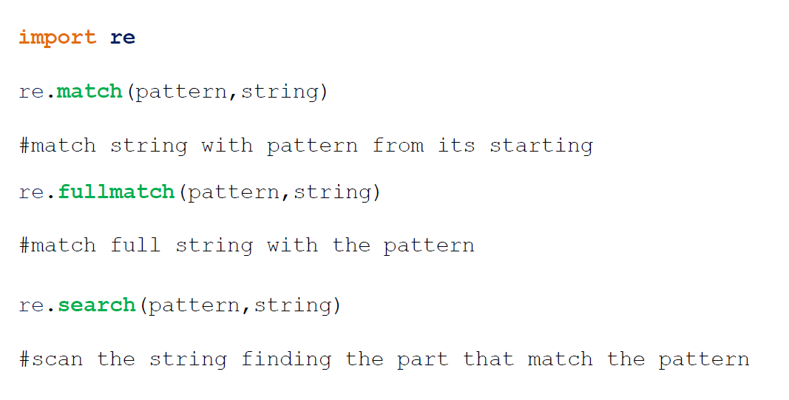
re
provides regular expression matching operations

Slide 18
re
import re
emailregulareexression=''
statment='asd@yahoo.com'
re.fullmatch(statment,emailregulareexression)
statment='asd@yahoo.com plpalapl plaplspals'
re.match(statment,emailregulareexression)
statment='palpalp asd@yahoo.com palpalp asd@yahoo.com'
re.search(statment,emailregulareexression)
re.findall(statment,emailregulareexression)

Slide 19
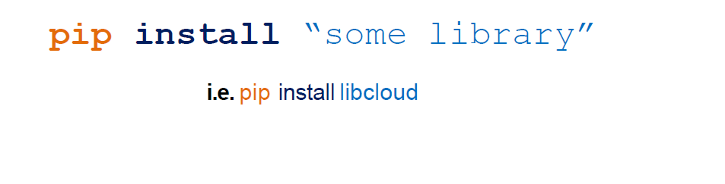
External Libraries
Pip is a package management system used to install and manage software packages written in Python

Slide 20
Demo

Slide 21
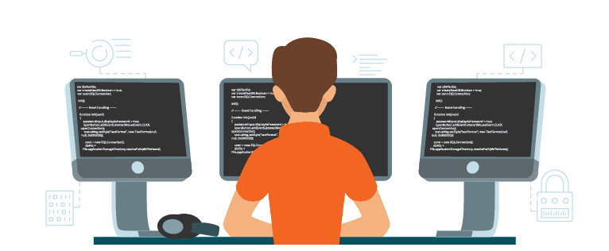
Exercises

Slide 22


