Slide 1
OOP using python

Slide 2
Outline
Inheritance
Polymorphism
Encapsulation
Special Methods

Slide 3
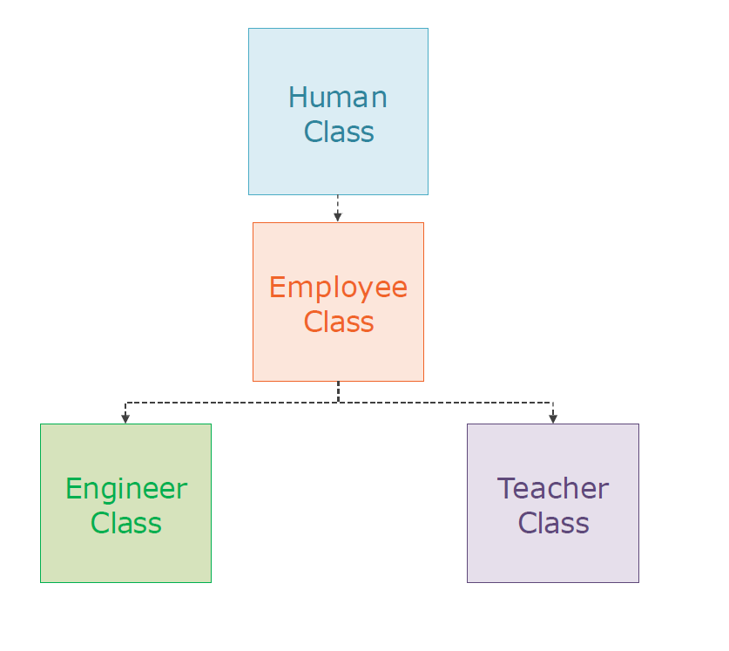
Inheritance
Parent class
Child Class
Is a relation

Slide 4
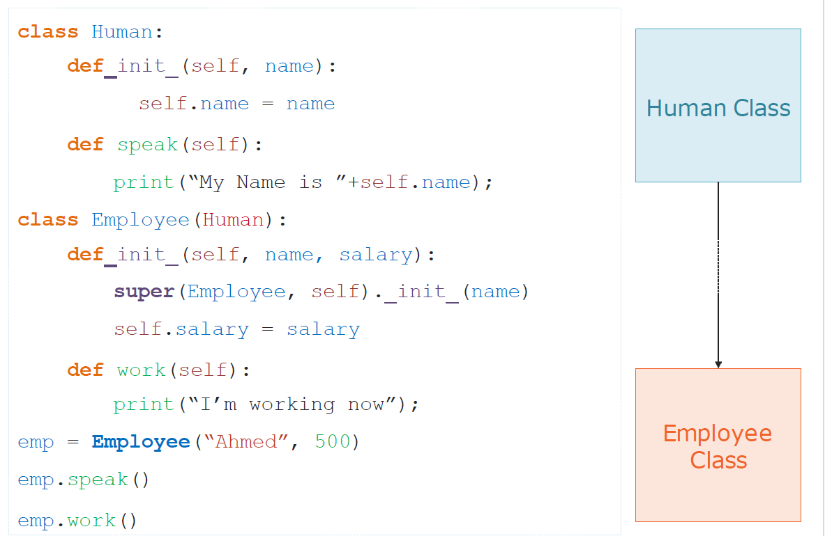
Example

Slide 5
Multiple Inheritance
Notes:
Python is one of the few modern programming languages that supports multiple inheritance. Multiple inheritance is the ability to derive a class from multiple base classes at the same time. Multiple inheritance has a bad reputation to the extent that most modern programming languages don't support it.

Slide 6
Encapsulation

Slide 7
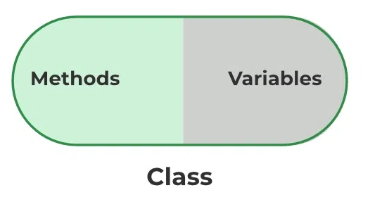
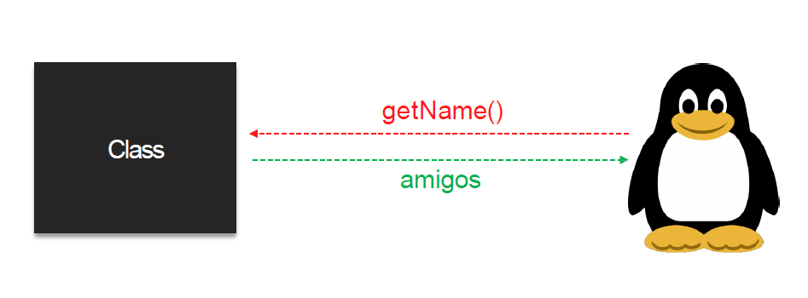
Encapsulation
packing of data and functions into one component (for example, a class) and then controlling access to that component

Slide 8
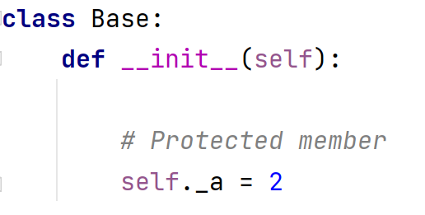
Protected members
Protected members (in C++ and JAVA) are those members of the class that cannot be accessed outside the class but can be accessed from within the class and its Childs classes.
In python prefixing the name of the member by a single underscore “_”
Although the protected variable can be
accessed out of the class
as well as in the derived
class (modified too in derived class),
it is customary(convention not a rule)
to not access the protected out the class body

Slide 9
Private members
define a private member prefix the member name with double underscore “__”
Mangling

Slide 10
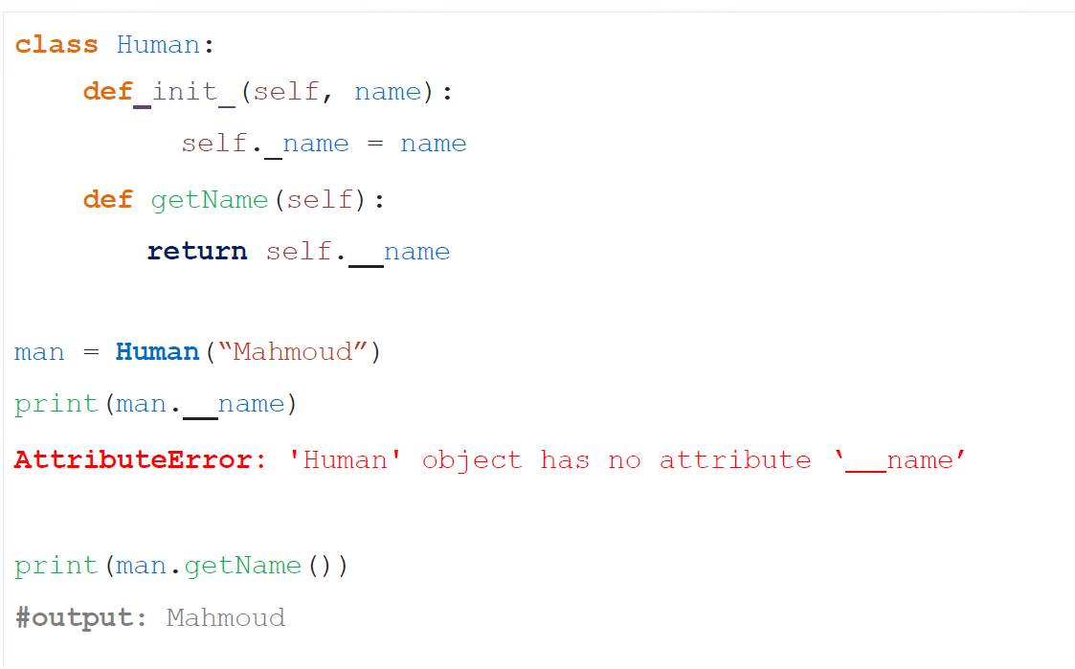
Encapsulation

Slide 11
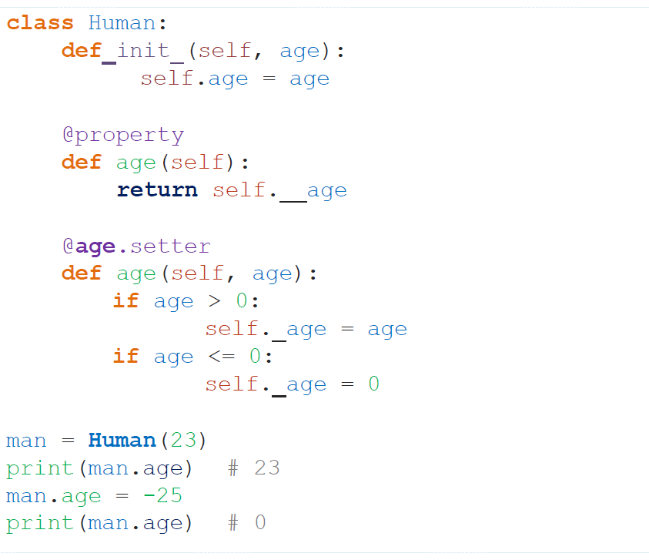
@property

Slide 12
Polymorphism

Slide 13
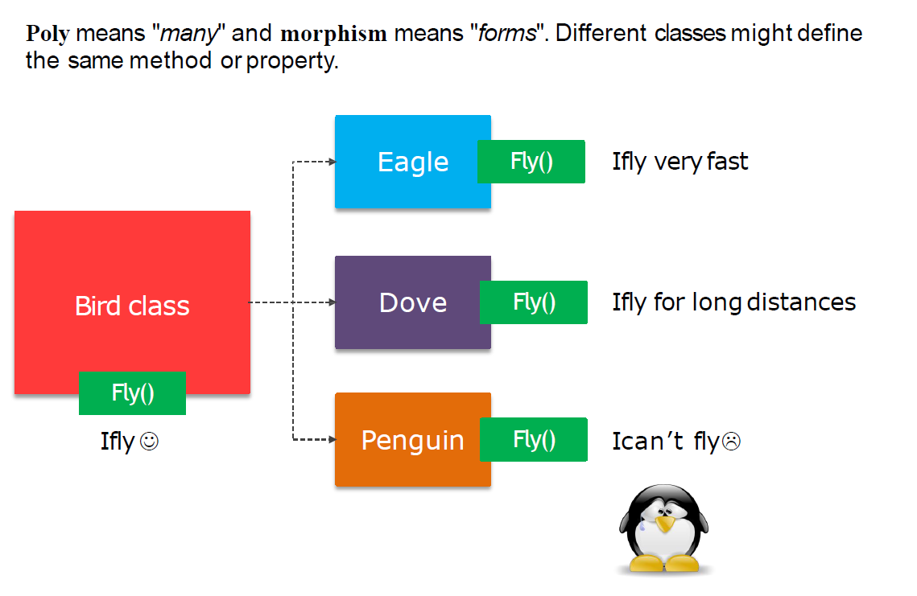
Polymorphism

Slide 14
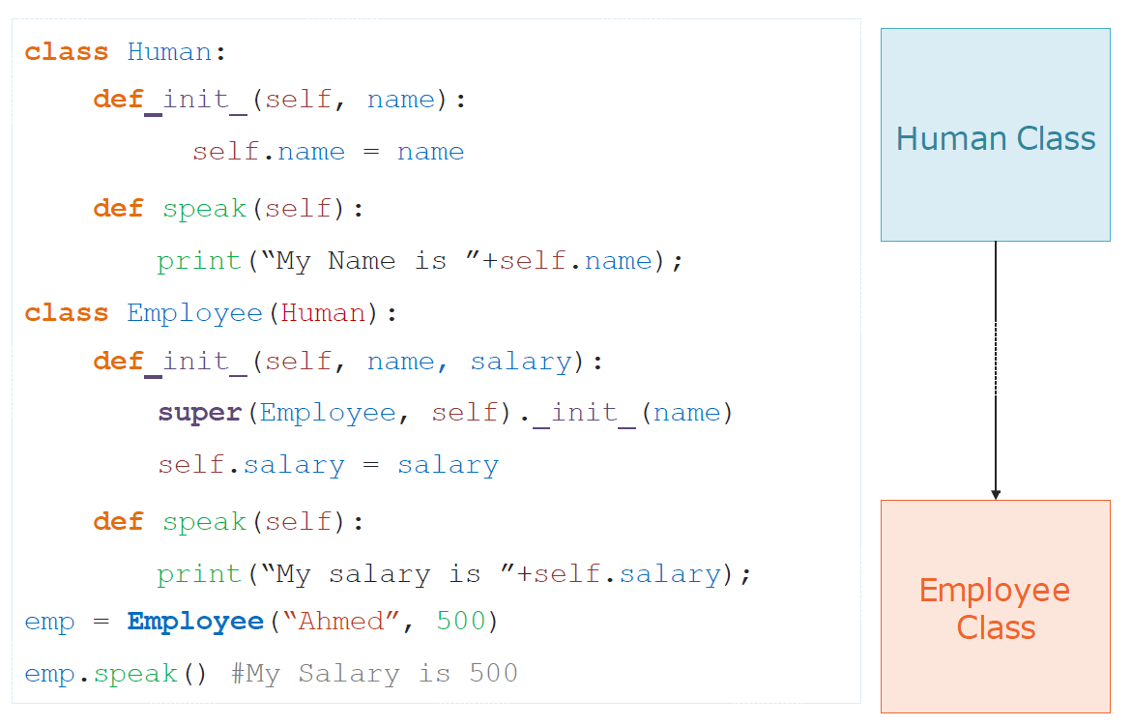
Method Overriding

Slide 15
Method Overloading
Two or more methods have the same name but different numbers of parameters or different types of parameters, or both.
python does not support method overloading by default. But there are different ways to achieve method overloading in Python.
The problem with method overloading in Python is that we may overload the methods but can only use the latest defined method.

Slide 16
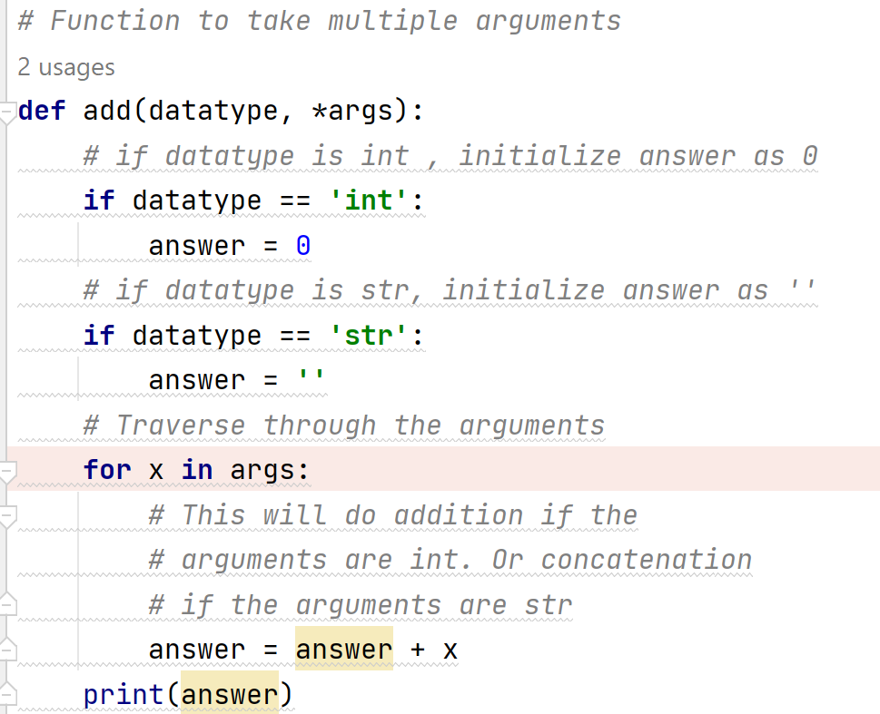
Method 1 (Not The Most Efficient Method):
We can use the arguments to make the same function work differently i.e. as per the arguments.

Slide 17
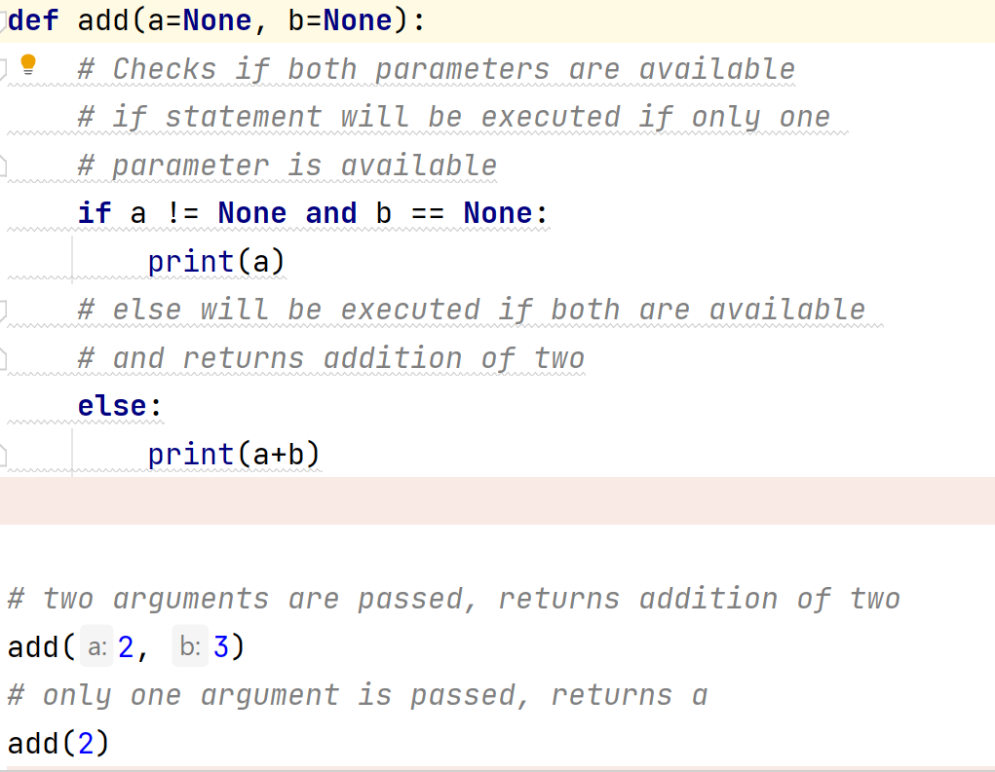
Method 2 (Not the efficient one)
by user defined function using “None” keyword as default parameter.

Slide 18
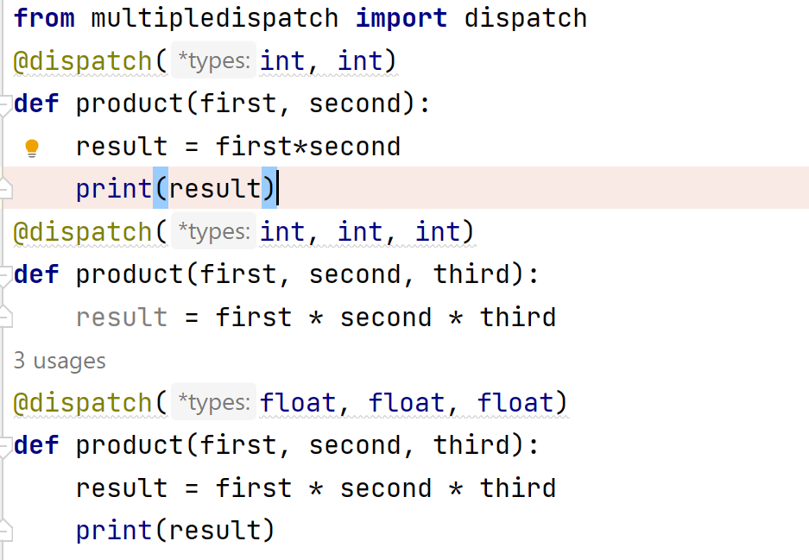
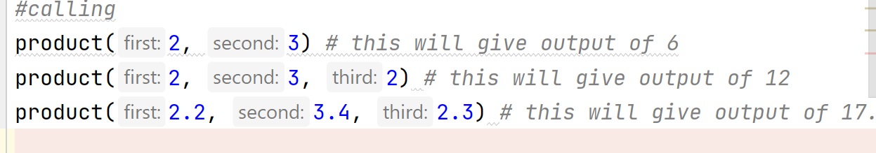
Method 3 (Efficient One)
By Using Multiple Dispatch Decorator
Multiple Dispatch Decorator Can be installed by:
pip3 install multipledispatch

Slide 19
Special Methods
Dunder or Magic Methods

Slide 20
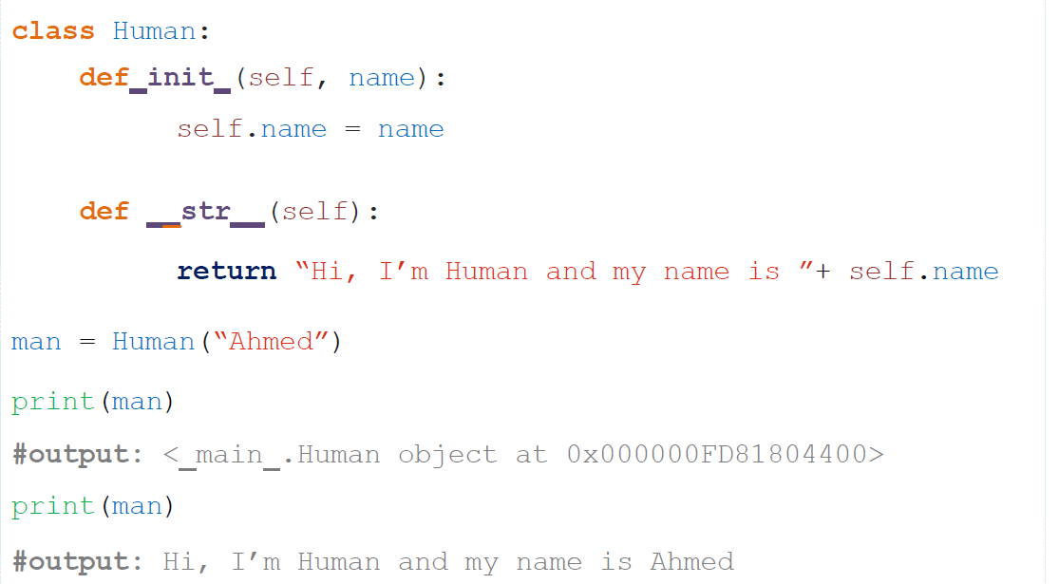
__str__
Method that controls how Object treats as printable

Slide 21
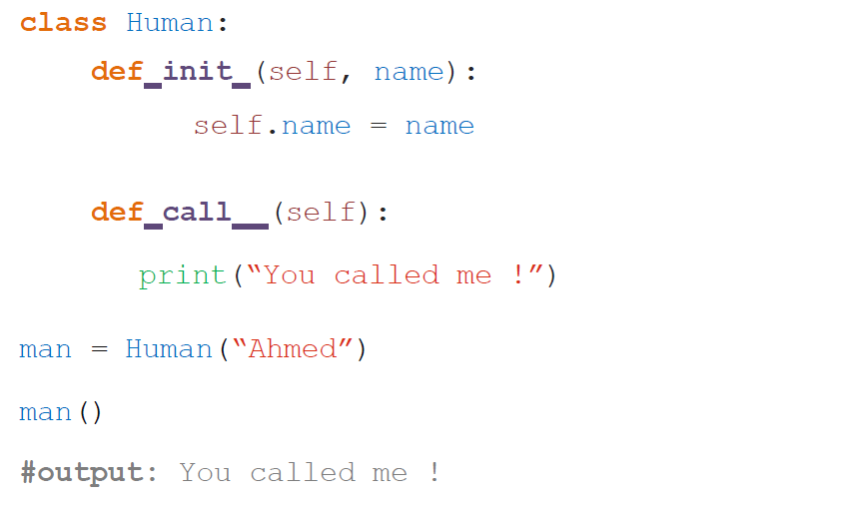
__call__
Method that controls how Object can show as callable

Slide 22
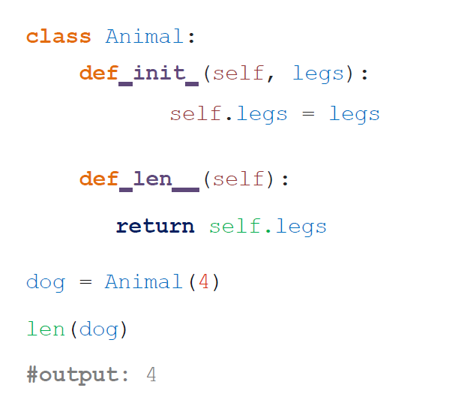
__len__
Method that controls when measure the Object length

Slide 23

Exercises

Slide 24


