Slide 1
A VAE and a DDPM on CelebA
Two generative models of 64×64 faces, built from primitive PyTorch layers

Slide 2
PROBLEM
The task
Learn a distribution over CelebA faces and sample new ones.
VAE — compress an image to a 128-number code, decode codes back to pixels.
DDPM — learn to reverse a process that turns an image into noise.
202,599 images · 64×64 · scored with the same FID and IS pipeline.
72.06
9.63
VAE — FID
DDPM — FID
35 min training
7 h 13 min training
02

Slide 3
DATA
Preprocessing
1. Crop the central 178×178 square — the extra height is background.
2. Resize to 64×64.
3. Random horizontal flip — training split only.
4. Scale pixels to [−1, 1].
Why [−1, 1]: the VAE decoder ends in tanh, so data and output space match.
The DDPM mixes images with unit Gaussian noise centered around 0.
03

Slide 4
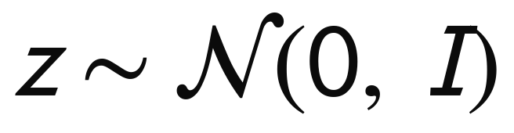
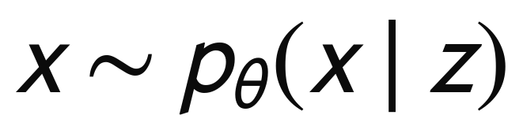
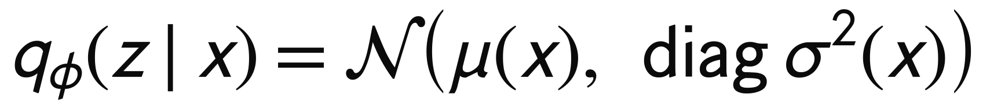
VAE · MODEL
The generative story
1. Draw a latent code
2. Decode it into pixels
p(z | x) is intractable, so a second network approximates it:
04

Slide 5
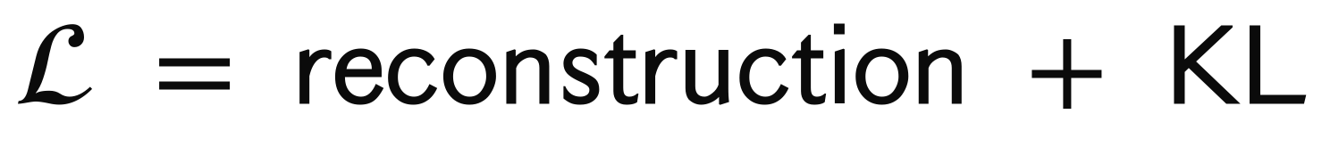
VAE · LOSS
The objective
log p(x) is intractable — the ELBO bounds it:
Negating gives two terms with distinct jobs:
Reconstruction keeps the decoder honest (resemble the input image as close as possible).
KL pulls the encoder's output onto the prior — which is what makes N(0, I) a valid place to sample from.
05

Slide 6
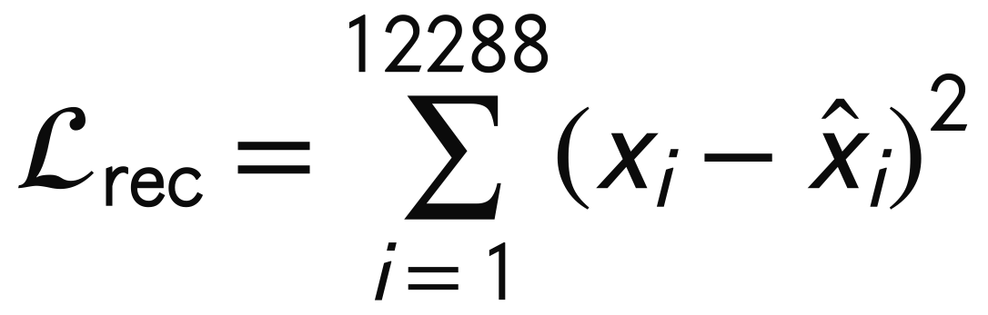
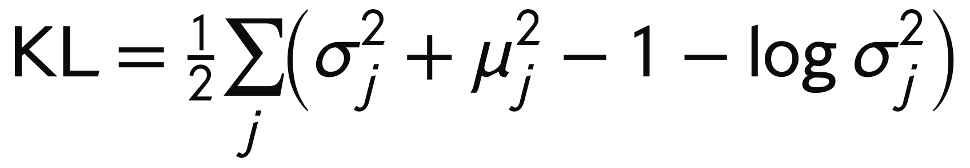
VAE · LOSS
The two terms
Reconstruction
KL, in closed form
The reconstruction is just squared error, while the KL closed form rewards the zero mean and unit variance.
06

Slide 7
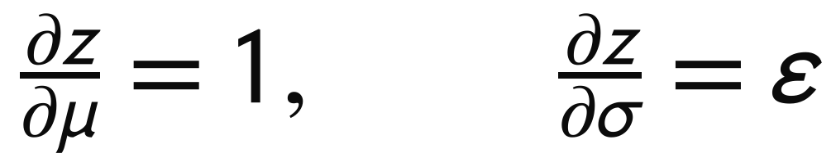
VAE · TRAINING
Reparameterization
Sampling is not differentiable — so rewrite z as a deterministic function of the parameters plus parameter-independent noise:
Gradients now reach the encoder. Without this the VAE cannot be trained at all.
07

Slide 8
VAE · STEPS
One training step
1. Encode the batch → μ, log σ²
2. Sample z = μ + σ ⊙ ε
3. Decode → x̂
4. Loss = summed squared error + KL
5. Backpropagate — through the decoder, and through μ and σ into the encoder
08

Slide 9
VAE · NETWORK
Architecture
Encoder | 4 × (Conv k=4 s=2 p=1 → BatchNorm → LeakyReLU) | 64 → 512 ch, 64² → 4²
Heads | two Linear layers | μ and log σ², 128-d
Decoder | Linear → 4 × ConvTranspose → 3×3 conv → tanh | 4² → 64², 3 ch out
Size | 8.73M parameters | 4.86M encoder + 3.88M decoder
k=4, s=2, p=1 halves H exactly, and its transpose doubles it exactly.
A final 3×3 conv cleans up transposed-convolution checkerboard artefacts.
09

Slide 10
VAE · LIMIT
Why VAE samples are blurry
Per-pixel squared error is the log-likelihood of a Gaussian decoder.
When several plausible images fit a code equally well, the loss is minimised by their average.
The average of many sharp faces is a smooth face.
This follows from the objective, so no amount of training fixes it.
It is the main thing on which diffusion wins.
10

Slide 11
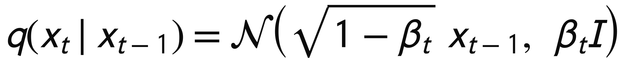
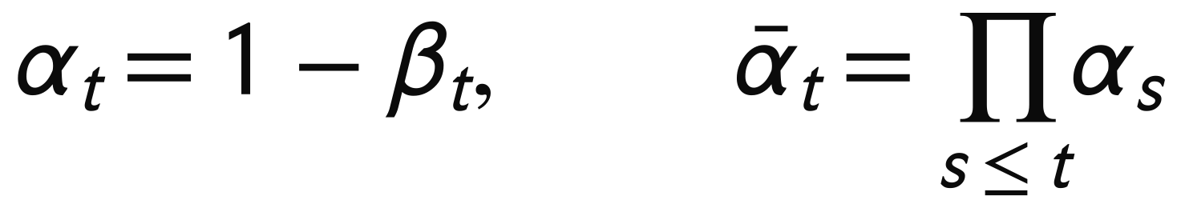
DDPM · MODEL
The forward process
A fixed process adds a little Gaussian noise at each of T = 1000 steps:
β grows linearly from 1e-4 to 0.02. After 1000 steps the image is indistinguishable from noise.
A network learns to undo one step; generation starts from noise and runs backwards.
11

Slide 12
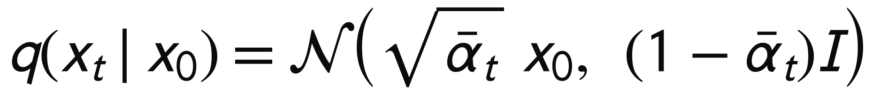
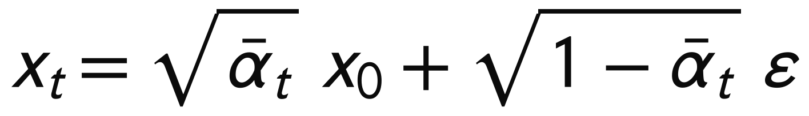
DDPM · MODEL
The formula that makes it practical in training
Composing t Gaussian steps gives another Gaussian:
so in code, one multiply–add:
Training at timestep 700 costs one operation, not 700 simulated steps.
This is why DDPM can be in parallel, while sampling is expensive and sequential.
12

Slide 13
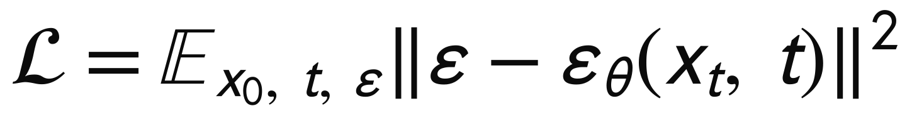
DDPM · LOSS
The training objective
The variational bound simplifies to a regression: given a noisy image, predict the noise.
13

Slide 14
DDPM · STEPS
One training step
1. Draw a clean image x₀ from the batch
2. Draw a timestep t ~ Uniform(0, 999) and noise ε ~ N(0, I)
3. Form xₜ in closed form — one multiply–add
4. Predict the noise ε̂ with the U-Net
5. MSE, backpropagate, then update the EMA weights
14

Slide 15
DDPM · NETWORK
The network
Same shape in and out — an image in, a noise map out.
Skip connections carry high-frequency detail around the bottleneck. Noise is entirely high-frequency, so a plain autoencoder would destroy exactly what we ask it to predict.
Self-attention at 16×16 and below — convolutions are local, so nothing else forces two eyes to match. Cost is (H·W)², affordable only at low resolution.
GroupNorm, not BatchNorm — sampling runs at tiny batch sizes.
The timestep enters every residual block as a per-channel bias:
15

Slide 16
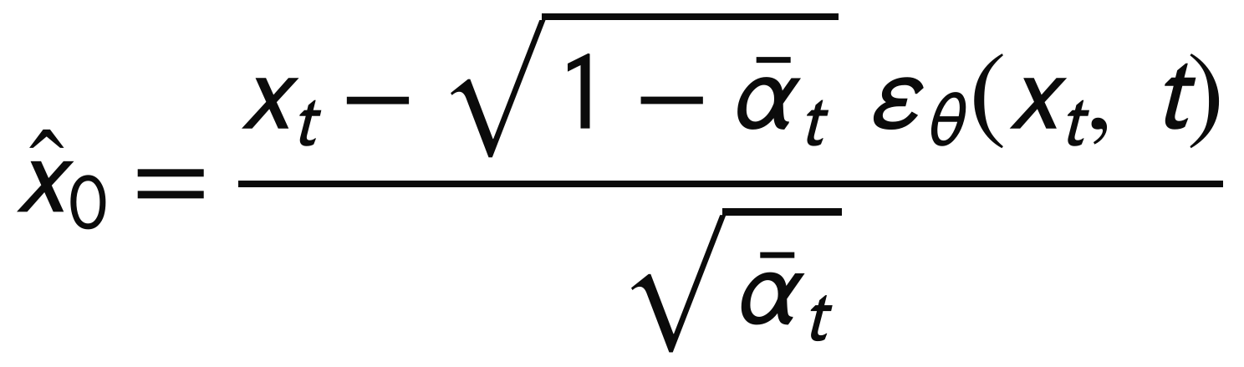
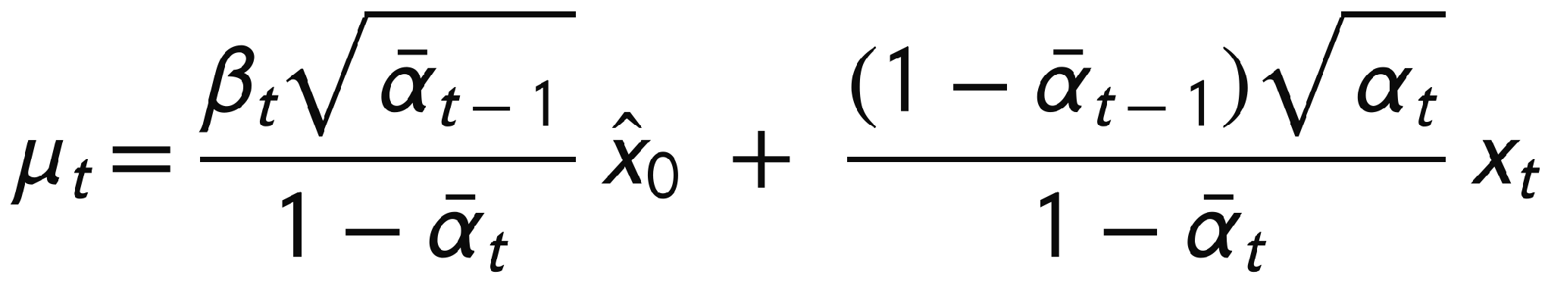
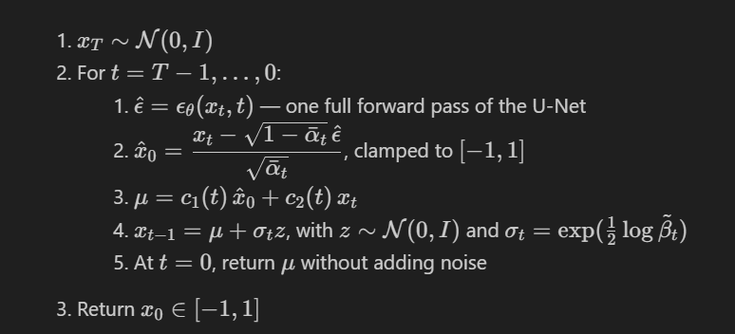
DDPM · SAMPLING
Sampling — ancestral, 1000 steps
Predict the noise → convert to an estimate of x₀ → clamp → step to the posterior mean → add noise.
16

Slide 17
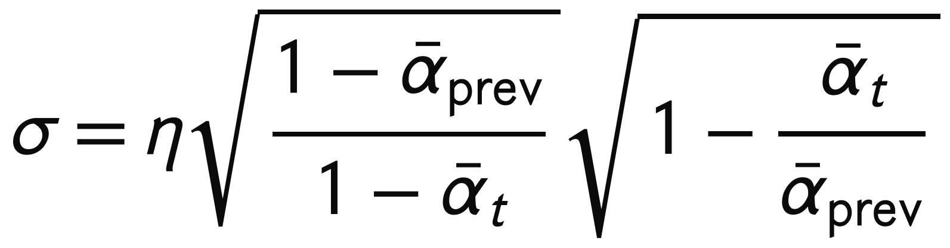
DDPM · SAMPLING
Sampling — DDIM, 50–100 steps
The objective only constrains the marginals q(xₜ | x₀). Many reverse processes share them — including a deterministic one that skips timesteps.
50 steps instead of 1000 is a 20× speedup for a small quality cost — and the only reason scoring 10,000 images was feasible.
17

Slide 18
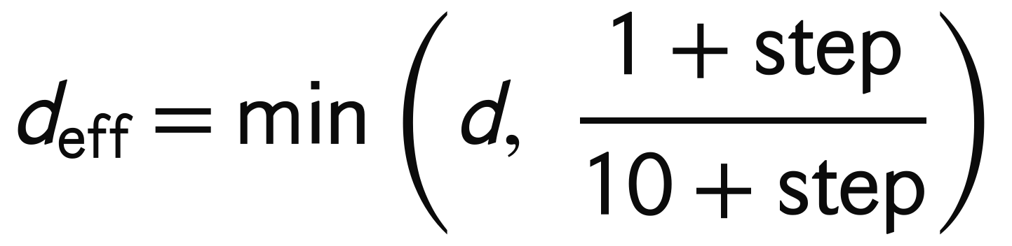
DDPM · TRAINING
The weight EMA
Diffusion quality is unusually sensitive to weight noise, so we sample from a smoothed copy:
But the shadow starts as a copy of the random initialisation, and with a fixed d = 0.9999 it stays there:
updates | still random init
1,000 | 90%
11,000 | 33%
30,000 | 5%
The fix — ramp the decay in from near zero:
At step 0 that is 0.1, so real weights dominate immediately.
18

Slide 19
EVALUATION
FID — lower is better
Summarise each image set as one 2048-d Gaussian over InceptionV3 features, then measure the distance:
First term: how far apart the two average images sit. Second: how differently the sets are spread.
So FID responds to realism and diversity — one perfect face every time scores terribly.
19

Slide 20
EVALUATION
Inception Score — and why it is weak here
Large when samples are confident and the set is diverse. Uses no labels, and never looks at the real images.
But ImageNet has no face class. Over 500 real CelebA images, Inception answers:
Windsor tie | 83 / 500
maillot | 65 / 500
jersey | 35 / 500
brassiere | 33 / 500
tench (a fish) | 24 / 500
Real CelebA scores IS = 3.07 ± 0.09 — don’t know what it means here? Ceiling maybe?
20

Slide 21
NUMBERS
Results
Model | FID ↓ | IS ↑ | Params | Training
VAE | 72.06 | 1.95 ± 0.03 | 8.73M | 25 ep · 35 min
DDPM (DDIM, 100 steps) | 9.63 | 2.57 ± 0.04 | 17.22M | 20 ep · 7 h 13 min
real CelebA | 0 | 3.07 ± 0.09 | — | —
RTX 3060 Laptop GPU (6 GB) · 10,000 generated images scored against 10,000 real.
21

Slide 22
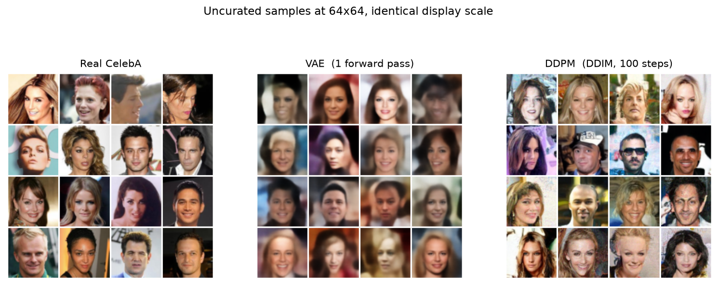
SAMPLES
Real · VAE · DDPM
23

Slide 23
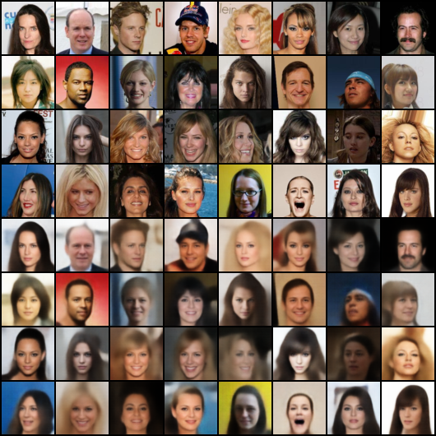
VAE · SAMPLES
What the 128-d code keeps
Top four rows real, bottom four reconstructed. Kept: identity, pose, gaze, hair, lighting. Lost: everything that occurs once — text on a sign, glasses, a smile's shape.
24

Slide 24
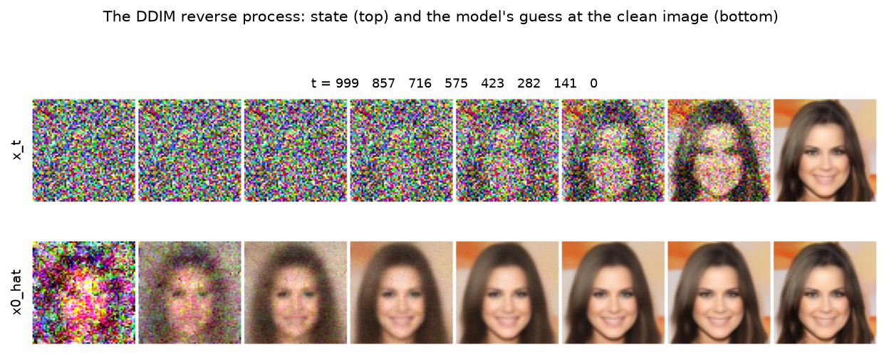
DDPM · SAMPLES
What the reverse process does
25

Slide 25
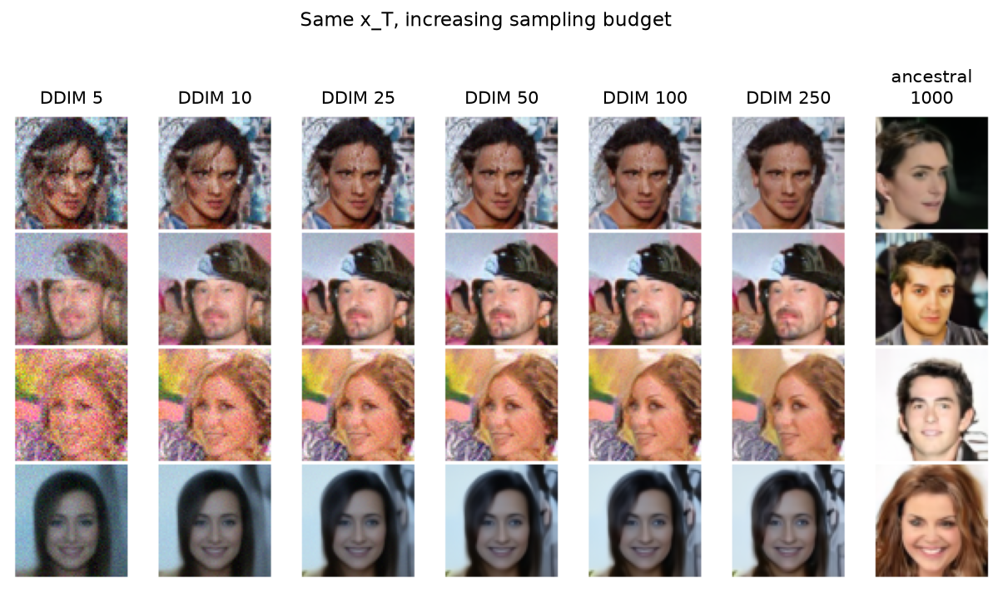
DDPM · SAMPLES
How few steps you can get away with
26

Slide 26
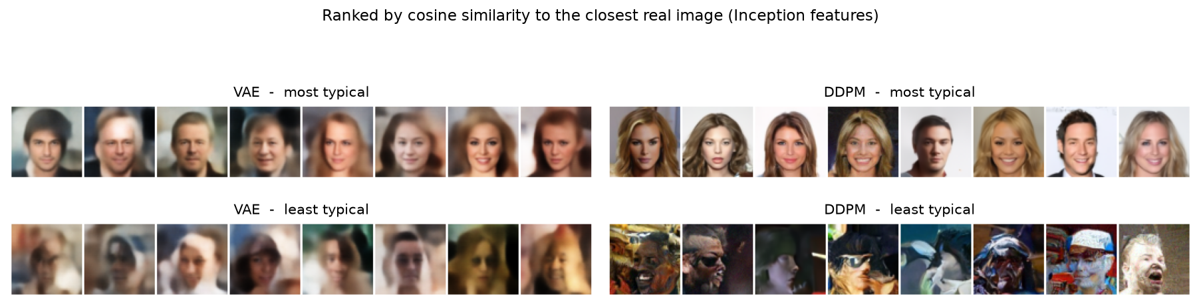
CHECK
The two models fail in opposite directions
The VAE's worst samples are boring — off-centre, dark, blurrier than its median, but always face-shaped. Failure mode: absence of detail.
The DDPM's worst samples are wrong — melted features, a mouth in the wrong place. Confidently rendered nonsense. Failure mode: commitment to the wrong answer.
28

Slide 27
Thank you
Abdelrahman Elaraby

