Slide 1

Learning Management System
1

Slide 2

Team Members
Abdelrahman Elzayat
Ammar Ashraf
Mahmoud Said
Moaz Shoeib
Omar Adly

Slide 3

Topic
Introduction
User (Interface and Experience)
Front
Back
Future Work

Slide 4

Introduction

Slide 5
Learning Management System
Introduction
Why LMS
Definition LMS
Advantages

Slide 6


Slide 7
Learning Management System
Problem Definition
Communication
Student Rate
University Expenses

Slide 8
Learning Management System
Problem Solution
Live Meeting
Online Exam
Electronic Payment

Slide 9

Large image
Front End

Slide 10
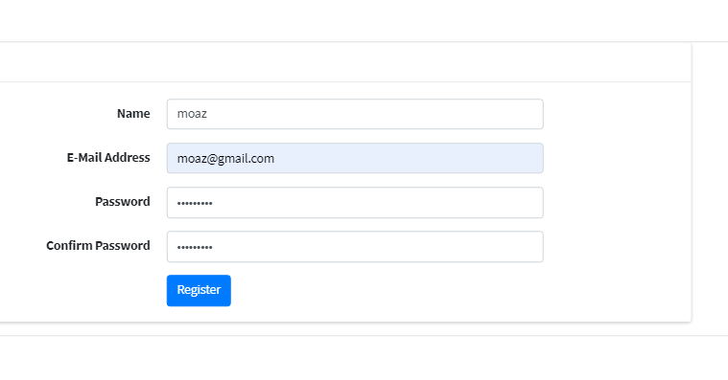
Learning Management System
Register Page

Slide 11
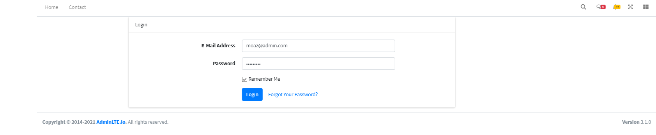
Learning Management System
Login Page

Slide 12
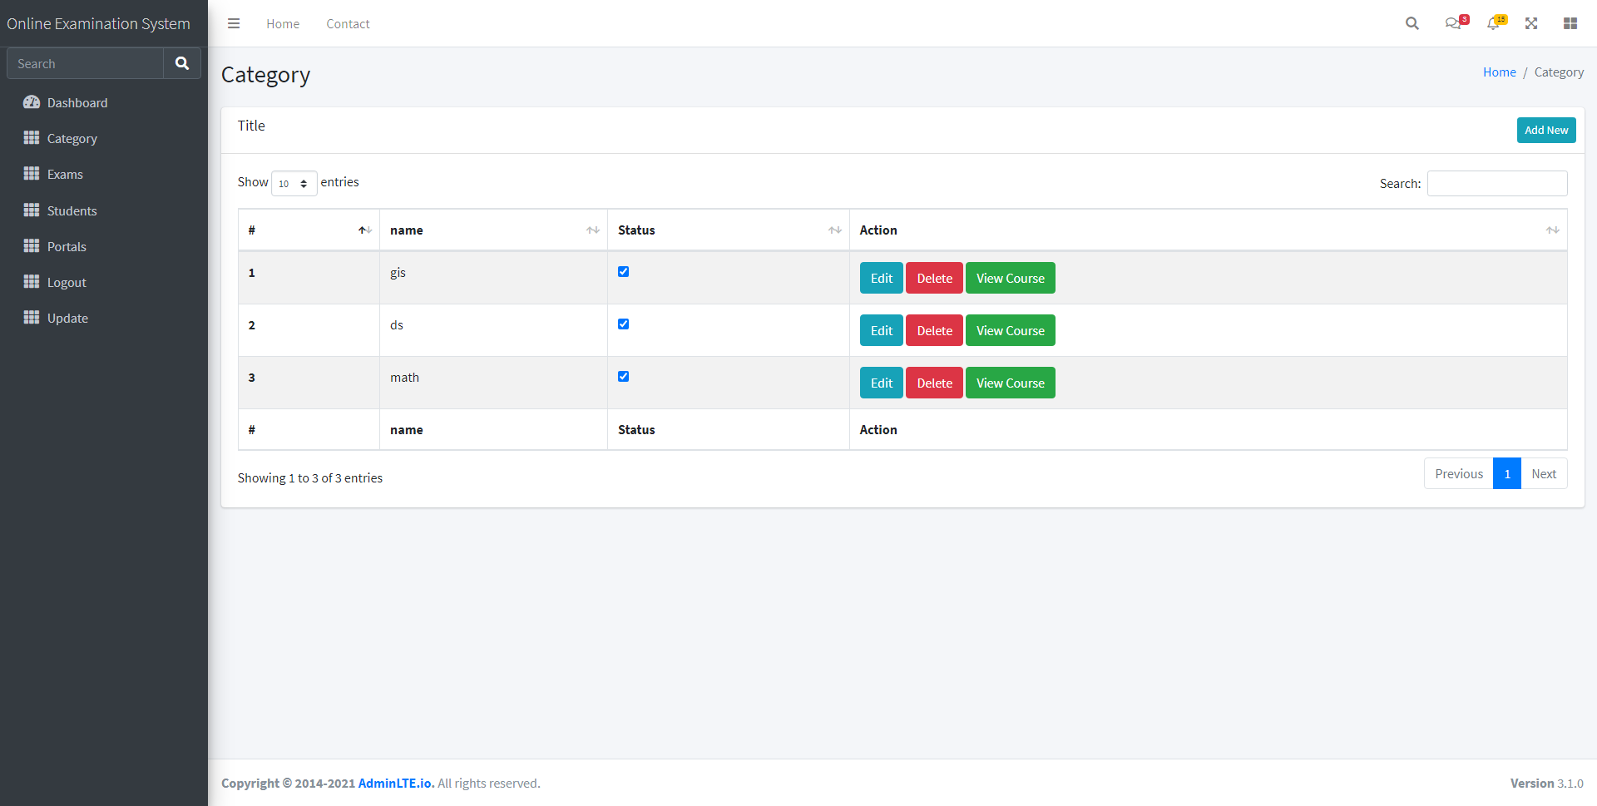
Learning Management System
Admin Page
Category / courses
Exams
Students
Update Profile
Logout

Slide 13
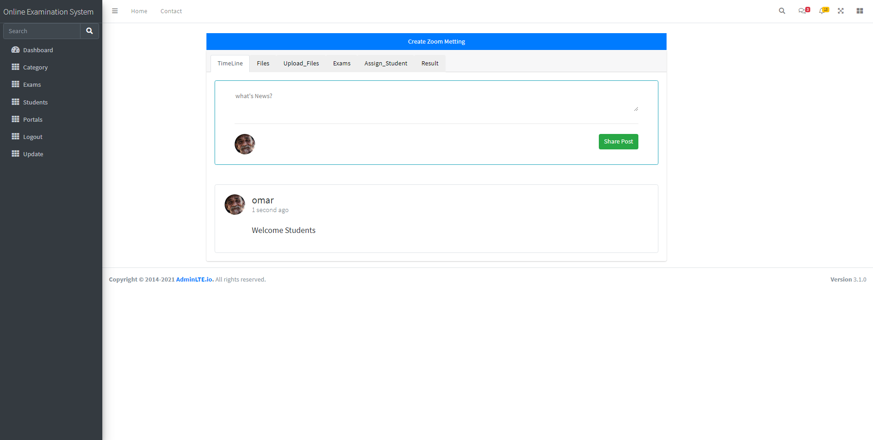
Learning Management System
Course Page (Admin)
TimeLine
Files
Upload Files
Exams
Assign Student
Result
Create Zoom Meeting

Slide 14
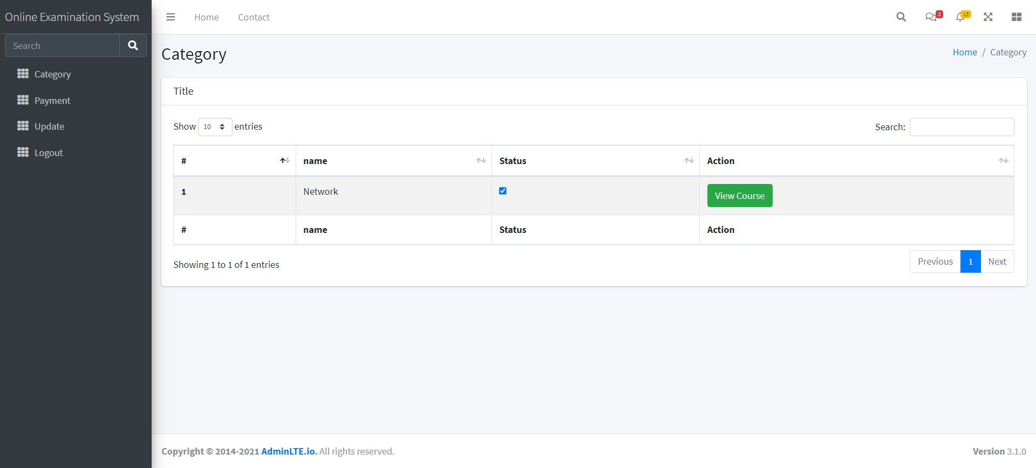
Learning Management System
Student Page
Category / courses
Payment
Update
Logout

Slide 15
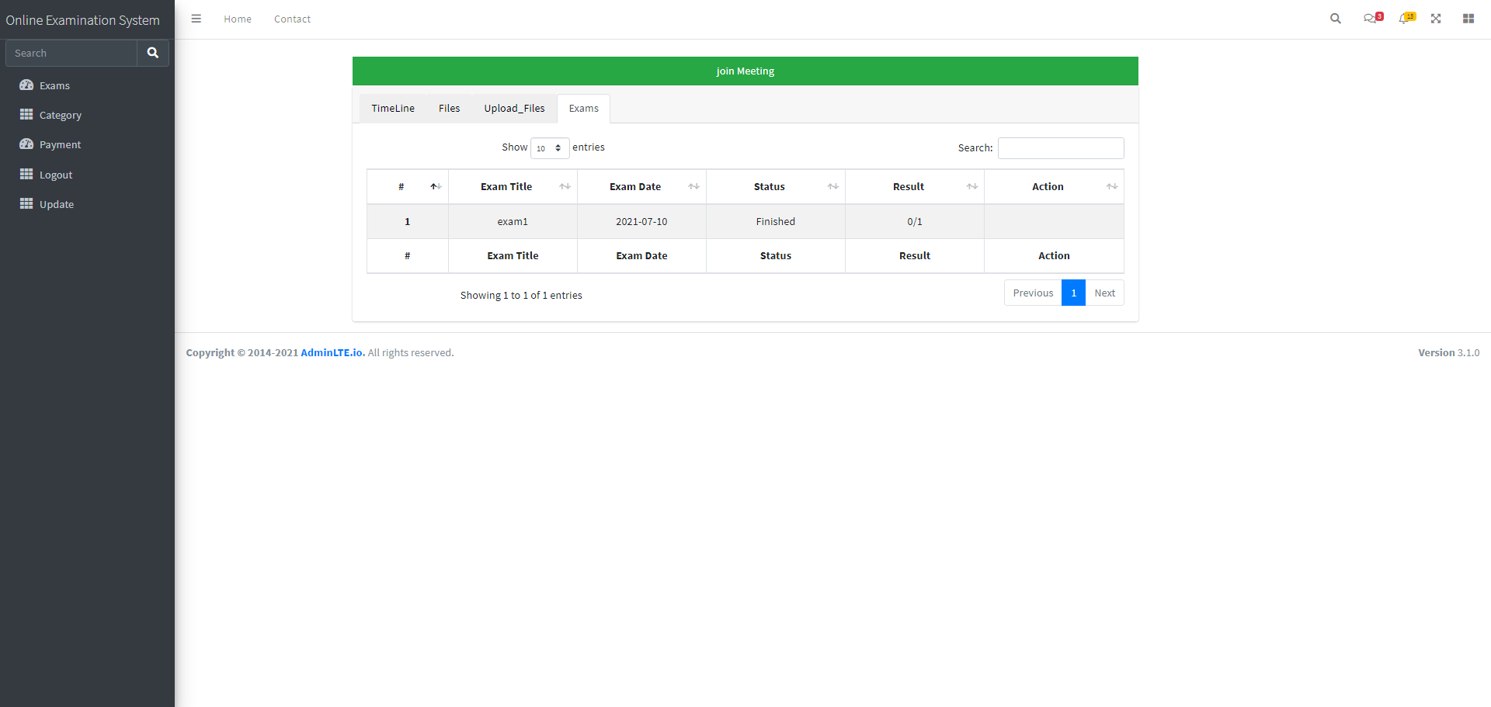
Learning Management System
Course Page (Student)
TimeLine
Files
Upload Files
Exams
Join Zoom Meeting

Slide 16

Back End

Slide 17
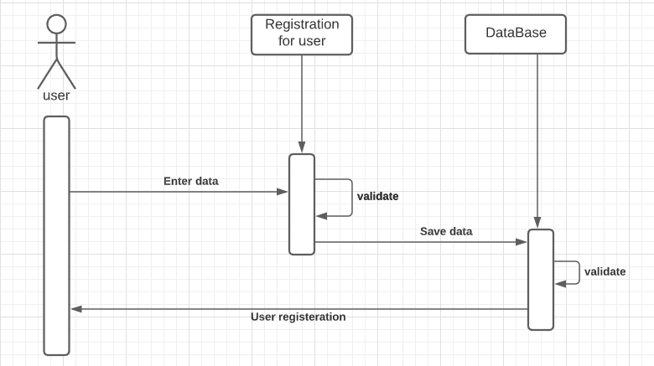
Learning Management System
Registration

Slide 18
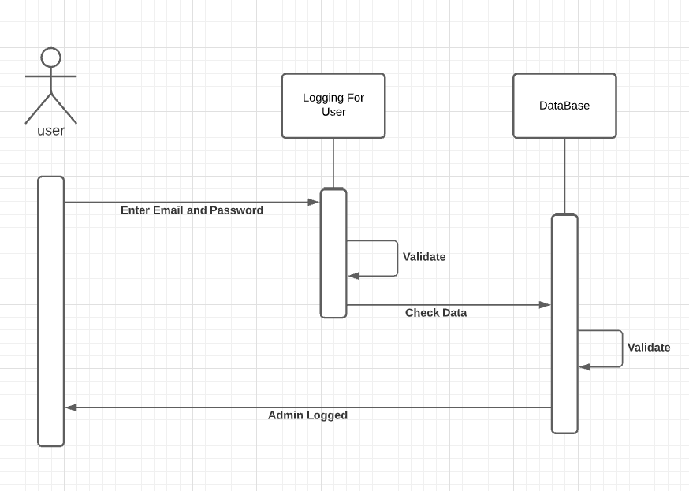
Learning Management System
Login

Slide 19
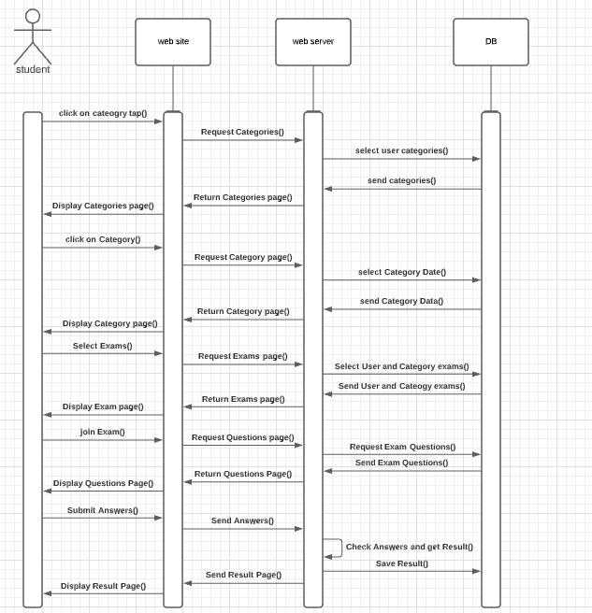
Learning Management System
Examination

Slide 20
Learning Management System
Course Page
TimeLine :
Show Posts
Share Post

Slide 21
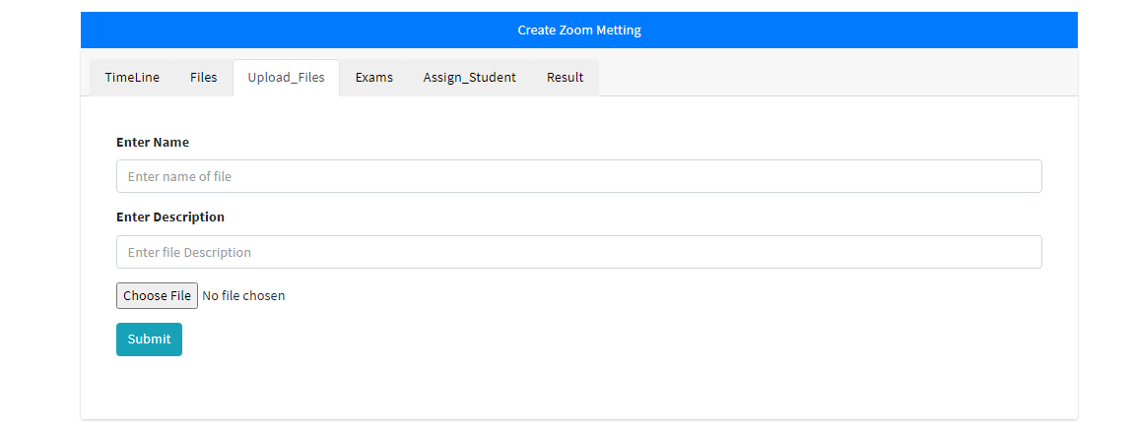
Learning Management System
Course Page
Upload Files:
Show Files
Store Files and Make Relations

Slide 22
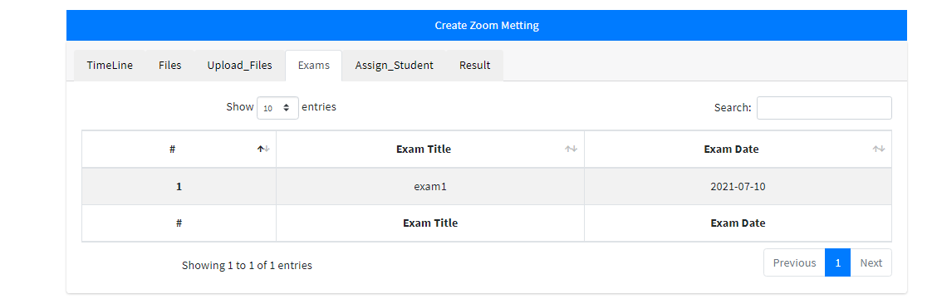
Learning Management System
Course Page
Exams:
Show Exams

Slide 23
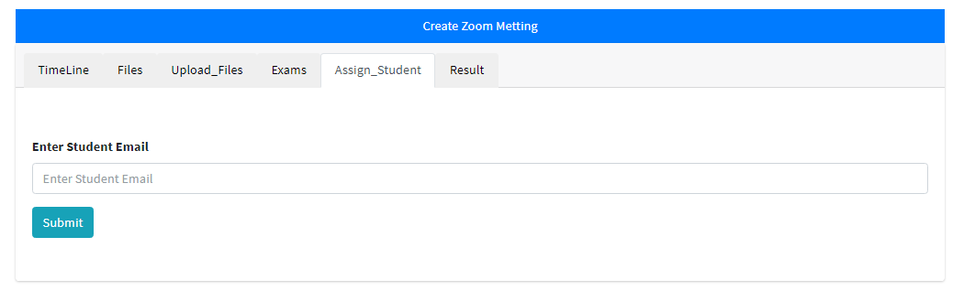
Learning Management System
Course Page
Assign Student:
Add Student To Course

Slide 24
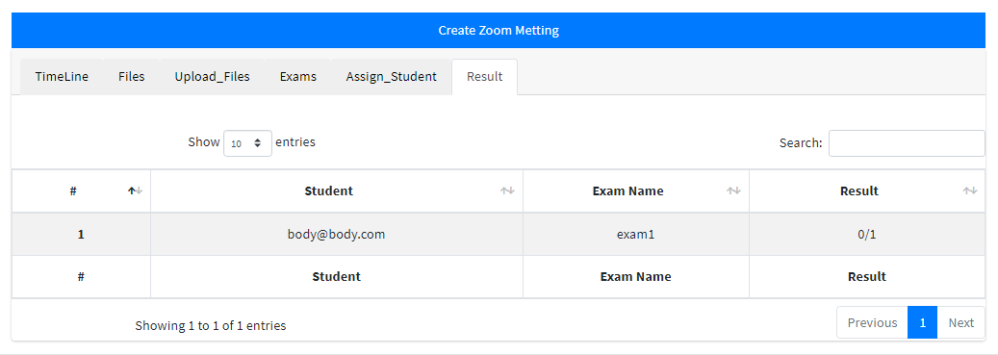
Learning Management System
Course Page
Result:
Show Students Results

Slide 25
Learning Management System
Course Page
Create Zoom Meeting:
Why Zoom
Store Link
Task Scheduling

Slide 26
Learning Management System
Future Work:
Build Sockets For Chat And Live Using Socket.io To Reduce Cost
Add Payment With Visa and MasterCard Not Just PayPal
Make APIs Output For Applications Mobile To Create Application Mobiles
Support Some Other’s Language Not Just English Language To People Around World Can Use IT
Sms APIs
Use AWS To Store Files In IT To Reduce Cost

Slide 27
Thank You
Supervised By:
DR. Hatem Abd-el-Kader

