Slide 1
Introduction to SQL on MYSQL

Slide 2
Review
What does SQL stand for?
a. Standard Query Linguistics
b. Structured Query Language
c. Strict Query Language
d. None of the above
MySQL requires which of the following to run?
a. Windows
b. Linux
c. Apple
d. Any of these

Slide 3
Using SQL
USER
MYSQL database server
mysql (command line or shell)
SQL
PhpMyAdmin (browser)
SQL

Slide 4
Connecting to MYSQL
Three ways to connect to MYSQL:
With ‘anonymous’ user: has less privileges (صلاحيات) of doing operations on MYSQL
- In CMD or shell you write
> mysql
With ‘root’ user: has all privileges & automatically created through the installation
- in CMD or shell you write:
> mysql –u root –p
With a created specific user: has the privileges you give
- in CMD or shell you write:
> mysql –u username –p password
> mysql –u Mahmoud -p *****

Slide 5
Connecting to MYSQL (cont.)
Connect with the ‘anonymous’ and ‘root’ users then apply these commands to show and prove the differences:
> Select user(); or > status; or > select current_user();
> Show grants;
> Show databases;
> Create database test;

Slide 6
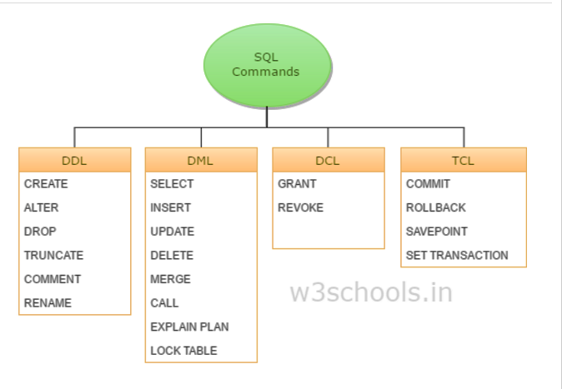
Start learning SQL
Overview of SQL commands:

Slide 7
Database Creation
Create a database:
> create database database_name;
> create database bakery_db;
Confirm database creation:
> show databases;
Use the created database:
> use database_name;
> use bakery_db;
Bakery_db

Slide 8
Tables creation
Example:
> Create table doughnut_list (
doughnut_name varchar(10),
doughnut_type varchar(6)
);
Confirm table creation:
> Show tables;
> Desc doughnut_list ;
To create a table:
> create table table_name (
column_name_1 data_type,
column_name_2 data_type,
…
column_name_n data_type );

Slide 9
Data types
Data types divided into categories based on data:
String types:
1. CHAR(length): fixed length of characters
2. VARCHAR(length): variable length of characters
Integer types:
1. INT(length): 4 bytes
2. BIGINT(length): 8-bytes
Floating-point types:
1. FLOAT(length): 4 bytes precision
2. DOUBLE(length): 8 bytes

Slide 10
Data types (cont.)
Fixed-Point Types
1. DECIMAL(precision, scale)
2. NUMIRC(precision, scale)
ENUM Types:
- A string object whose value is chosen from a list of values given at the time of table creation. For example: ENUM('small', 'medium', 'large')

Slide 11
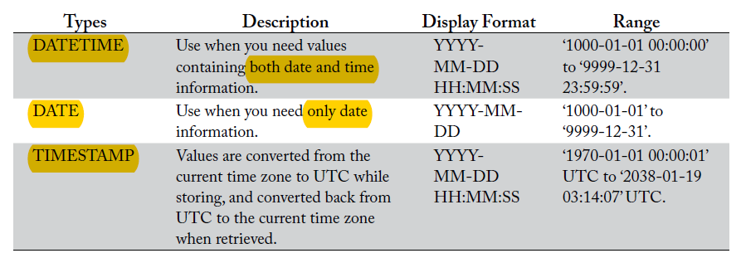
Data types (cont.)
DATETIME, DATE, and TIMESTAMP Types:

Slide 12
Inserting data
Inset data command:
> insert into table_name(column_name_1, column_name_2, …) VALUES(value_1, value_2, …);
Examples:
> Insert into doughnut_list(doughnut_name , doughnut_type) VALUES(‘Blooberry’, ‘filled’);
> Insert into doughnut_list VALUES(‘Cinnamondo’, ‘ring’);
> Insert into doughnut_list(doughnut_name ) VALUES(‘Rockstar’);

Slide 13
Task in section
create a database called car_agency
Create a table called car_table with the following columns
1. id number
2. model string
3. make string
4. color string
5. price decimal (7, 3)
6. date_of_make date
Insert two rows.

