Slide 1


Gecko-Finances Reshaping access to financial tools

Slide 2
1.7 billion do not have access to financial services.
https://globalfindex.worldbank.org/

Slide 3
The problem
Low access to financial tools
Need for financial education
Savings, banking institutions
Developing countries

Slide 4
The solution
Saving systems
Set aside money from purchases
Benefit from bank account
Financial management
Planning, advisory

Slide 5
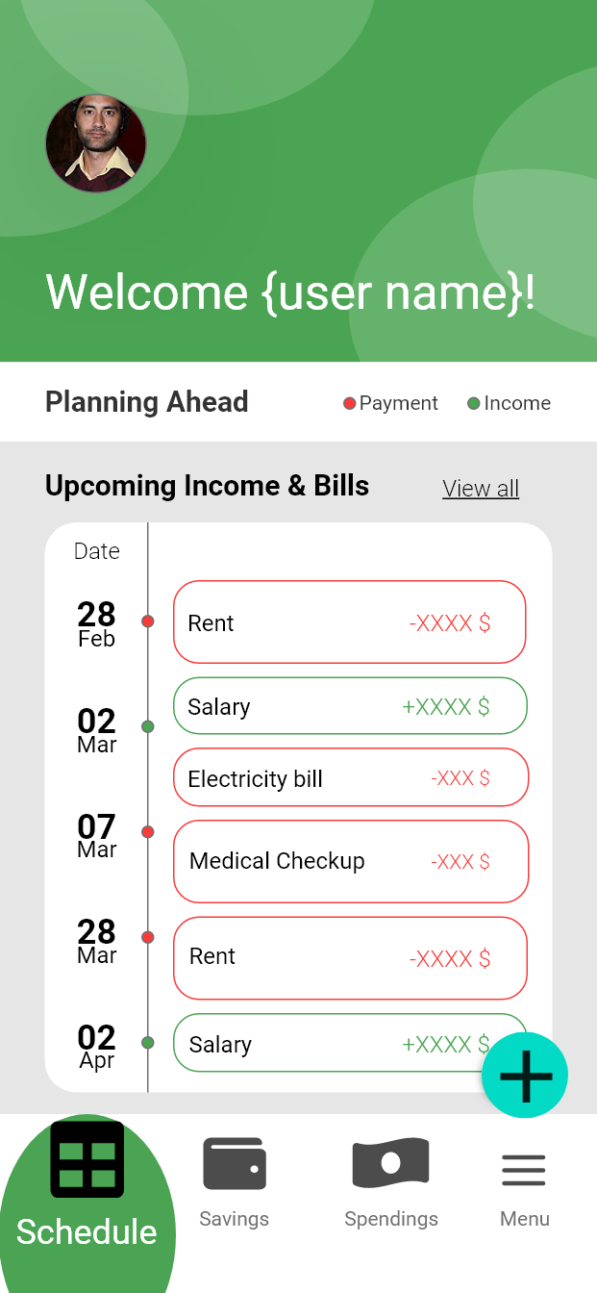
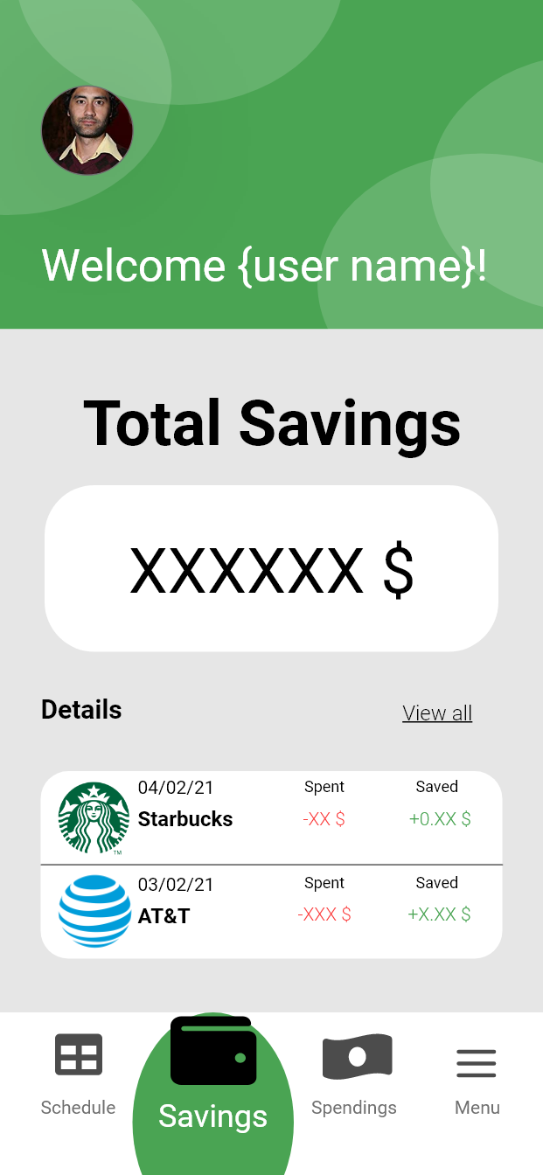
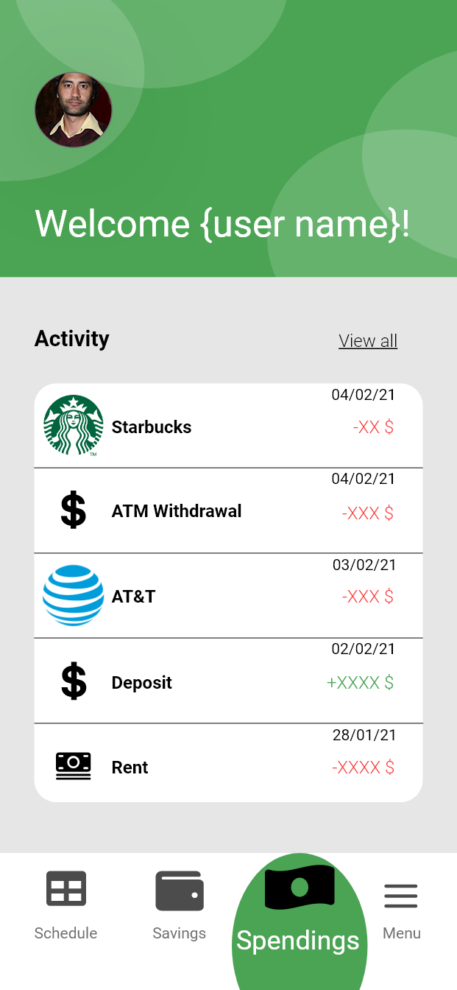
The app

Slide 6
Sustainability
Two-way system
Possibility to deploy in developed countries
Reward system
Interests paid back as points
More saving rewarded with extras

Slide 7
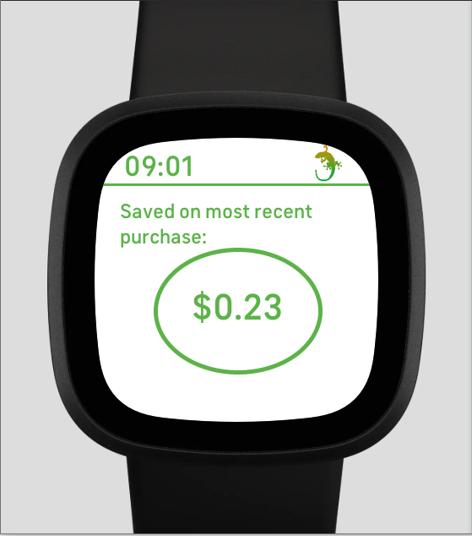
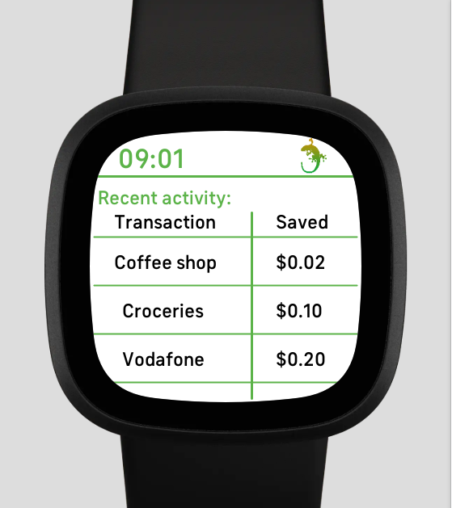
Gecko-Finances – Reshaping access to financial tools

