Slide 1
ai project (top)
Ali Hisham 211006277
Abdelrahman Ibrahim 211002951

Slide 2
Problem Statement:
Fake news has become a threat in the digital age. Spreading like wildfire online, it shows discord and mistrust
However, our machine learning projects TOP is emerging as powerful tools in the fight against misinformation. By analyzing vast amounts of data
TOP can identify patterns in language, source credibility, and dissemination methods that are often hallmarks of fake news. This allows TOP to flag suspicious content, empowering users to make informed decisions about the information they consume.

Slide 3
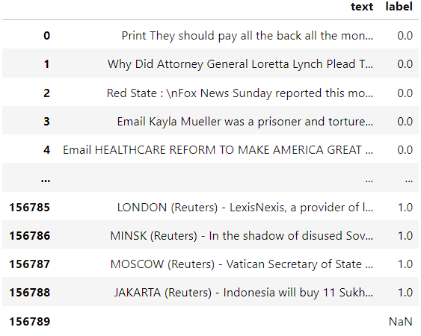
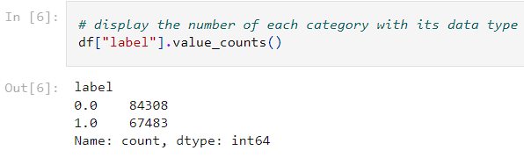
Data Description:
The data that’s used has many sources and we managed to collect it from different data storages.

Slide 4
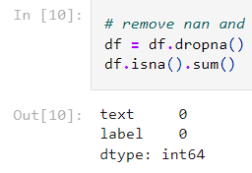
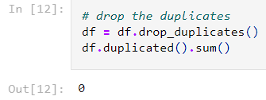

Data Preprocessing:
After analyzing the data, we had to eliminate the nan values, drop the duplicated rows, change the type of the label column from float to int.

Slide 5
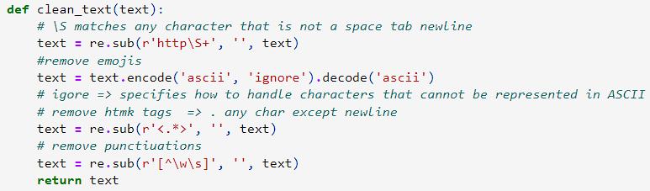
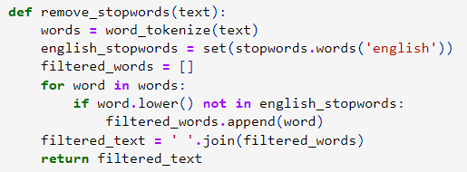
Data Preprocessing:
We defined a clean function that removes any unnecessary elements in one corpus, emojis, html tags, and punctuation.
Removing the stop words is like removing a heavy load from ml model because the stop words have no meaning and does not represent any thing in the corpus.

Slide 6
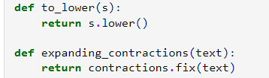
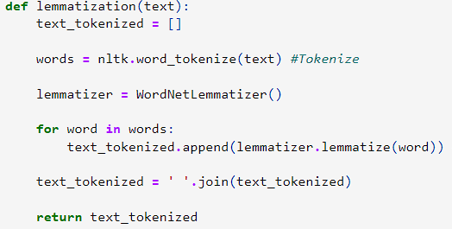
Data Preprocessing:
The upper function makes all the letters in small cases. The lower one expands any contraction words in the corpus.
What is lemmatization?
Its converting the word to its origin word. The lemmatization step is essential. Its like the stop words removing step, it removes a heavy load from the model because the model don’t care if the word is a noun, verb, etc.

Slide 7
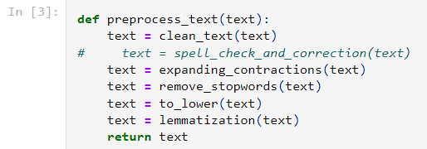
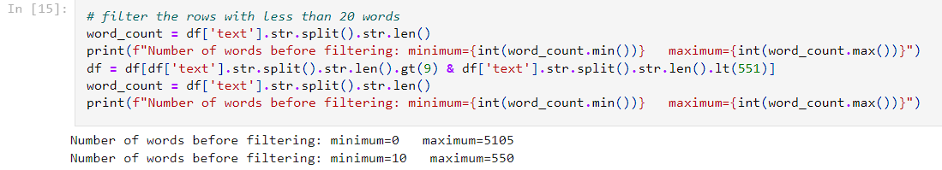
Data Preprocessing:
Putting all those functions together to apply it on the whole dataset. The run time for this cell may take from 8 to 10 minutes so be patient.
We removed the outliers by keeping the rows that has at least 10 words and at most 550 words.

Slide 8
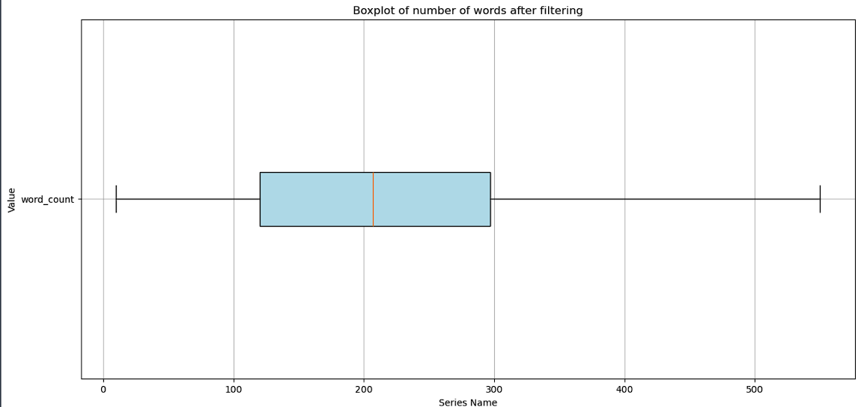
boxplot
can clearly see that We removed the outliers in this boxplot.

Slide 9
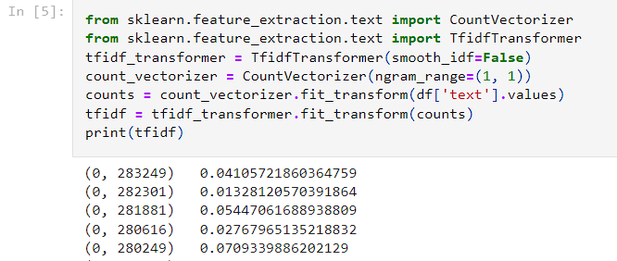
TF-IDF AND SPLITING DATASET
initializing count vectorizer to count the frequency of the word in the whole dataset, then tokenizing each word, then applying and calculating TF-IDF with unigram (single word).
Splitting the data into train and test set with 20% for the test set and don’t shuffle it we already did above.

Slide 10
Model fitting
We decided that we were going to use trees for the implementation.
First: Decision Tree
Second: Random Forest

Slide 11
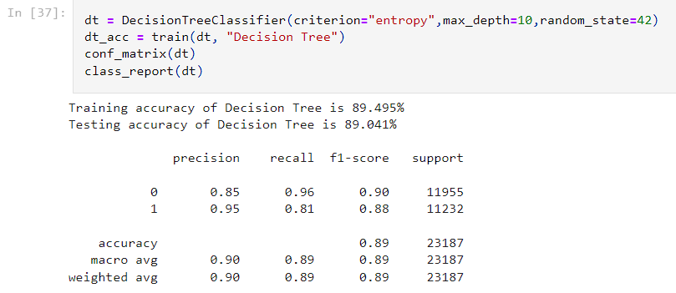
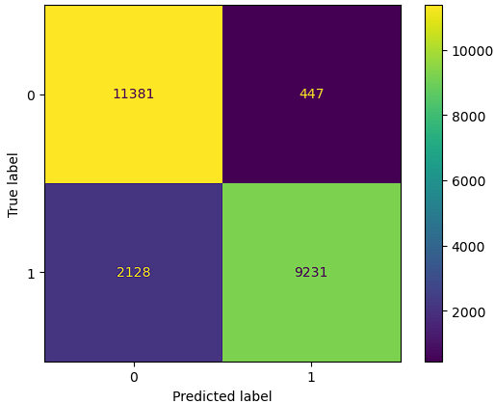
Decision tree
we choose entropy as a criterion and the max depth of the tree is 10 with random state = 42.
We trained the model, the test and train accuracy look very much close to each other. This means no overfitting. Also, the confusion matrix looks acceptable.
Confusion Matrix :

Slide 12
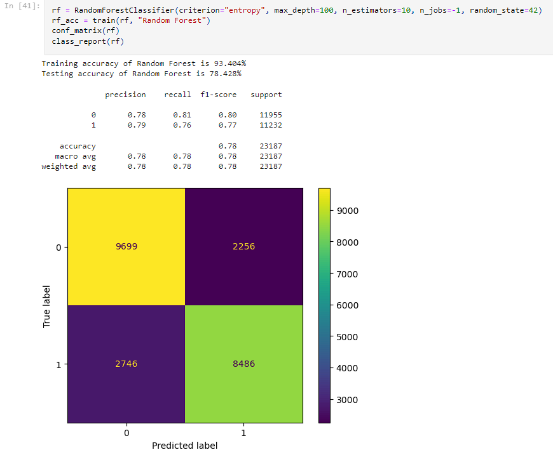
Random Forest
Random Forest is an ensemble learning that contain many other models and they all predict the output and choose the majority. From the name of the model, it’s a bunch of trees together.
10 decision trees each is entropy criterion and have 100 depth, the accuracy is good but there is a big difference between the test and train accuracy. Still the decision tree better.

Slide 13
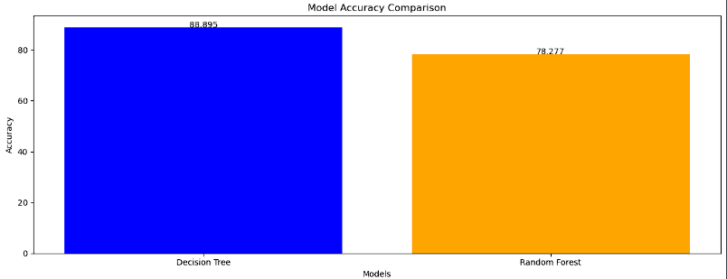
Accuracy comparison

Slide 14
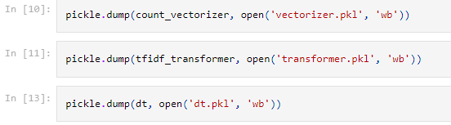
saving decision tree , TF-IDF vectorizer and transformer

Slide 15
api

Slide 16
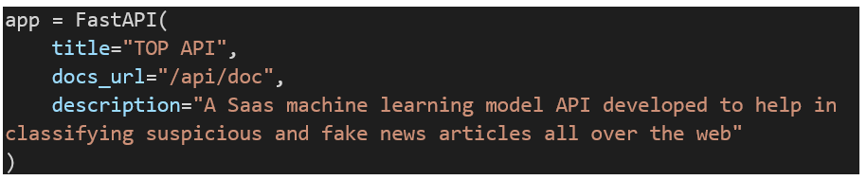
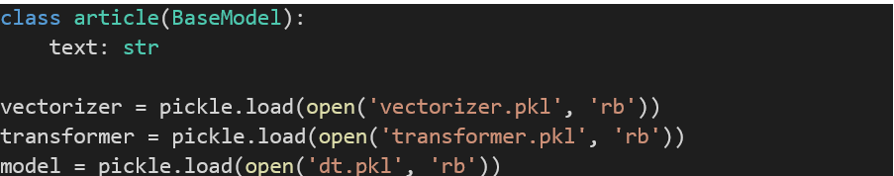
Fast api
used fastAPI platform to deploy TOPAPI
We initialized an instance from FastAPI that contain our api name, description, url of the api documentation.
we created a basemodel class that has an attribute text (news article to be classified). And we loaded the pickle files that we have saved earlier.

Slide 17
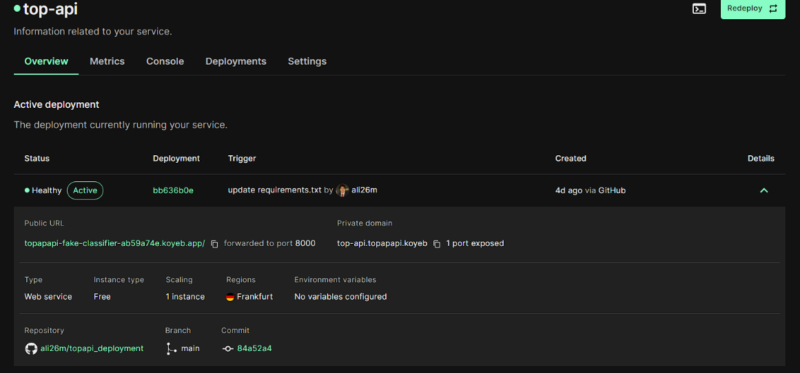
Api deployment in cloud
We choose KOYEB, platform as a service that deploy the api in free plan, it requires the files to be on github repo. And then with a simple click we deployed it.
To make TOPAPI more accessible we added it on RapidAPI a platform that has many many apis for use. It make you add logo or description and pricing (but we are free don’t worry).

Slide 18
Web app

Slide 19
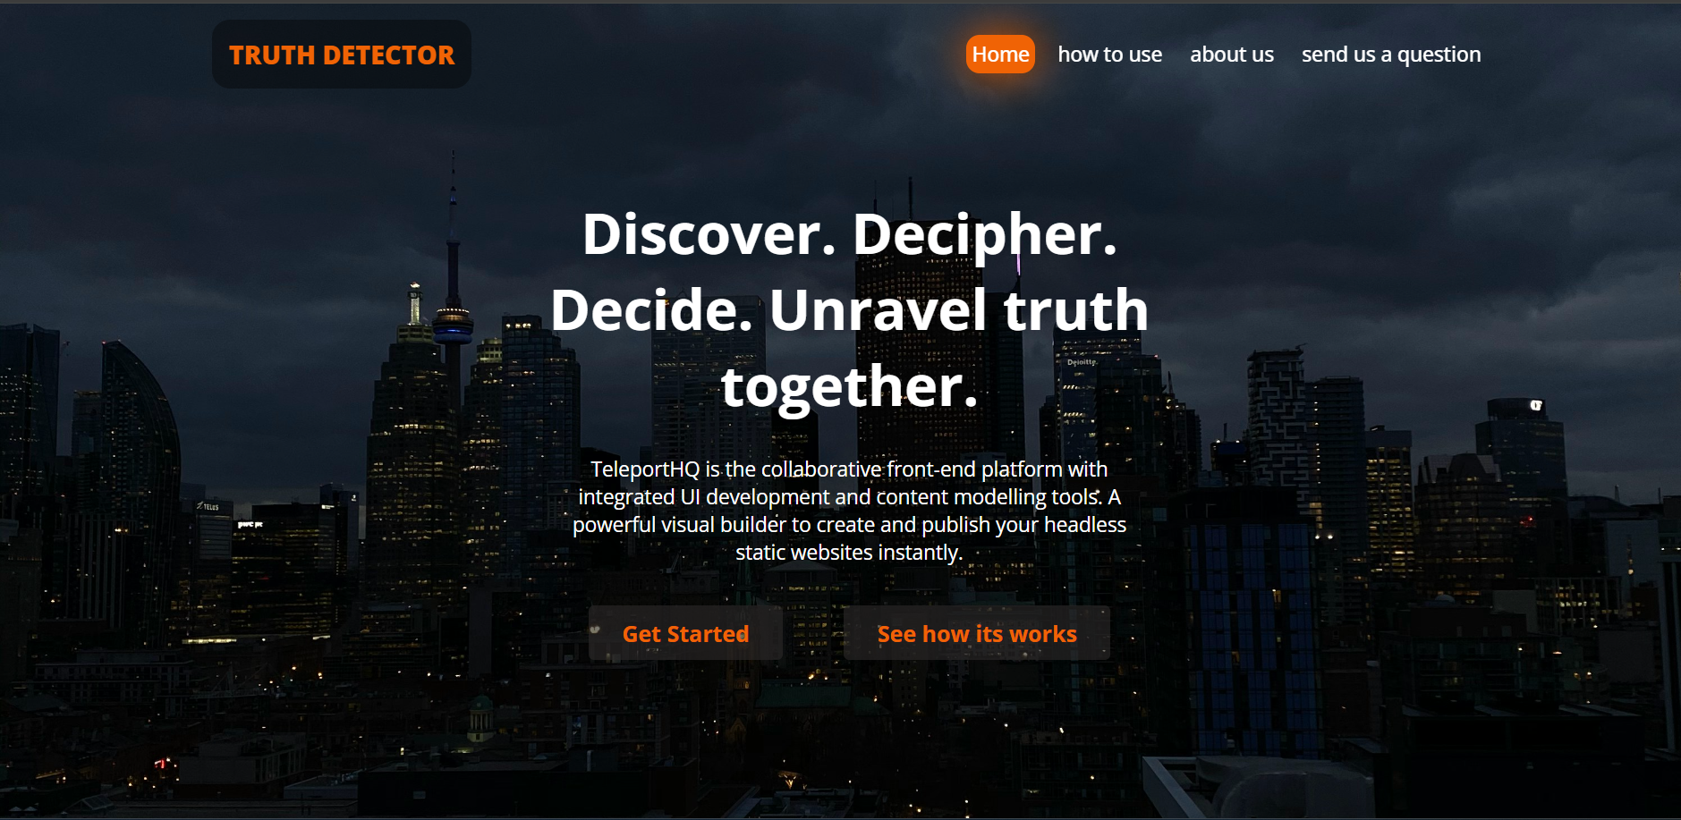
Web app description
after this important step we are able to use the endpoints as we wish. So we developed a web app for the model. It acts like a chatbot.
A web app to access it and detect the truth of an article you saw. With homepage that has tutorial videos, contact us, and showcasing our products and solutions.

Slide 20
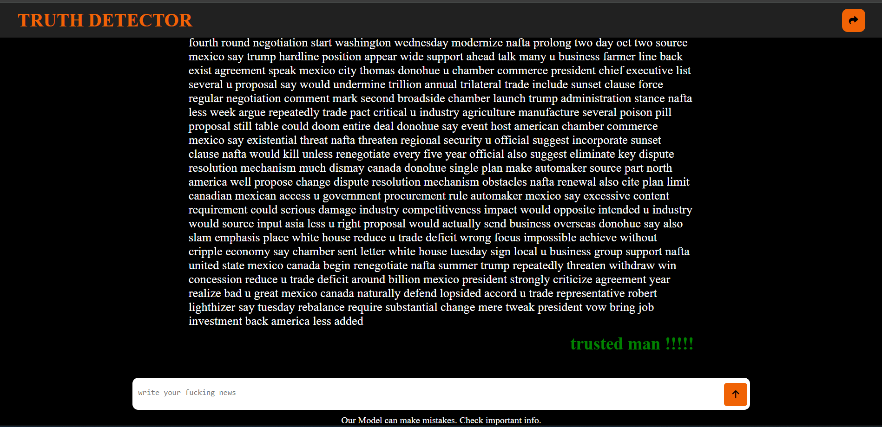
News classifier Chatbot

Slide 21
extension

Slide 22
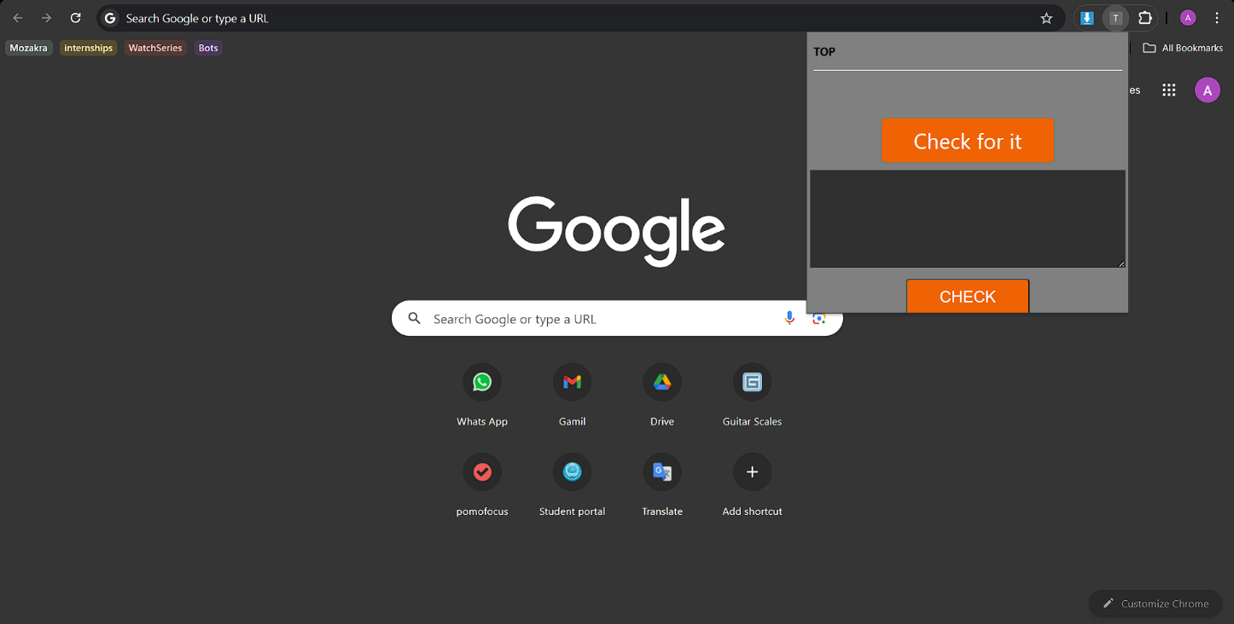
Extension description
We developed a Chrome extension. To make it easy on the user to access our model’s api with just simple steps.
Just copy the article you saw, paste it in the text area, click check and the result will display.

Slide 23
THANK YOU
Abdelrahman Ibrahim 211002951
Ali Hisham 211006277

