Slide 1
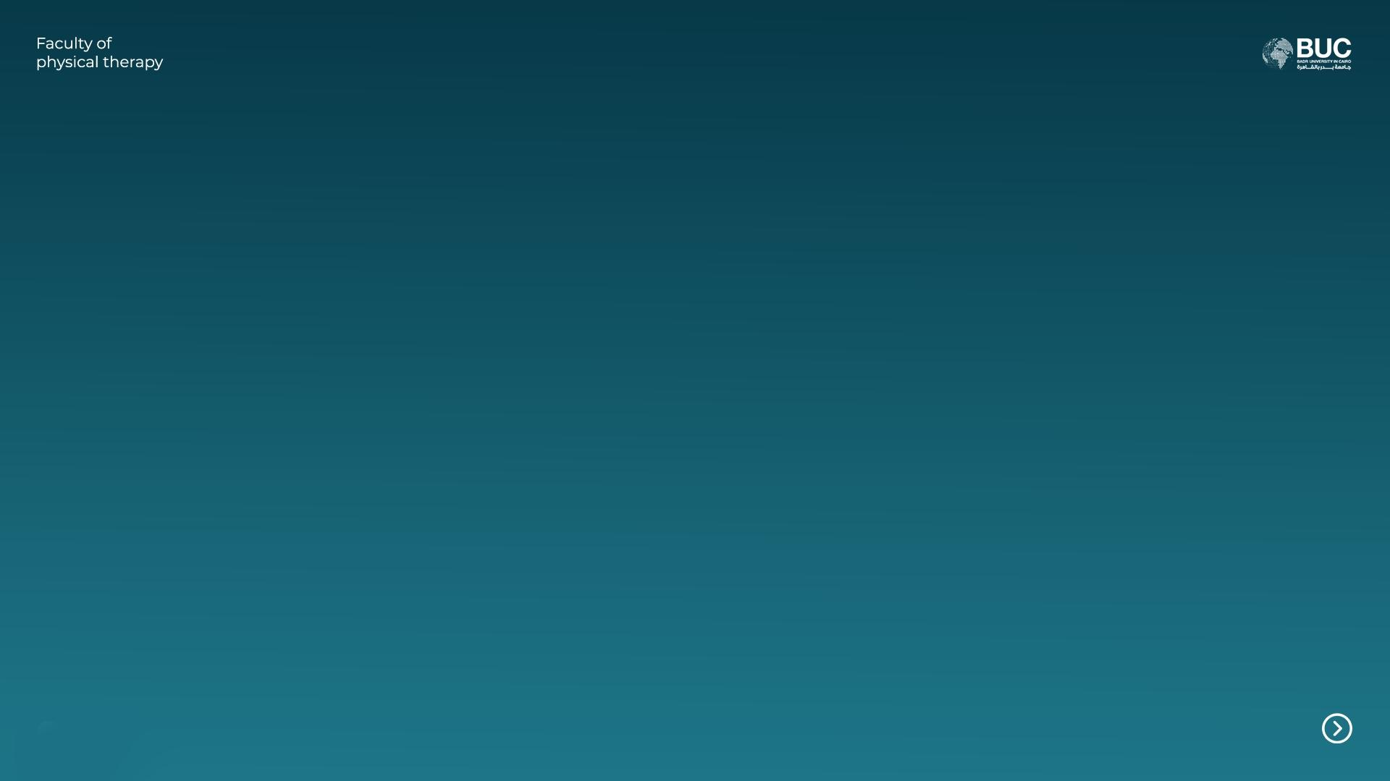
_{Case}

Slide 2
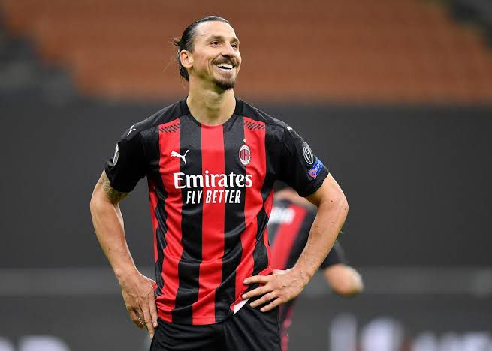
Citizenship: Se Sweden
Height: 1,95 m
Weight: 95kg
Position: Centre-Forward
Injury history: 2 ACL
Ex-taekwondo player

Slide 3
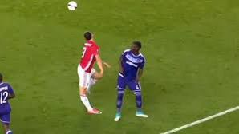
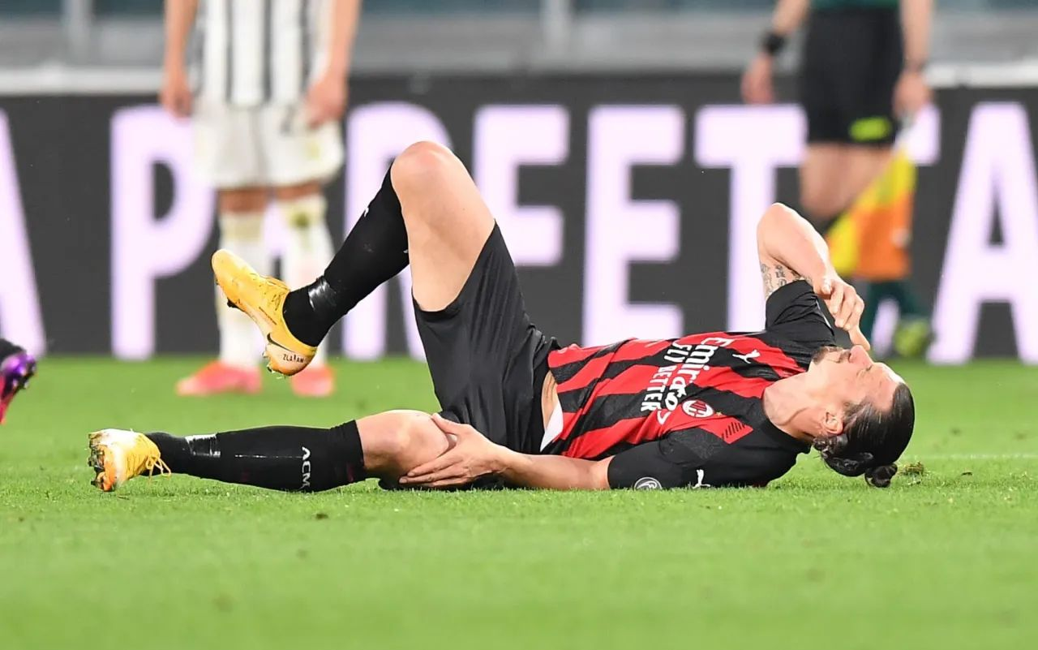
April 20, 2017 – Zlatan suffered his first ACL injury during a UEFA Europa League match between Manchester United and Anderlecht. He landed awkwardly after jumping for a header, injuring his right knee.
Age 35
2. May 22, 2022 – Although not injured in a single match, this date marks when Zlatan publicly revealed he had played six months with a torn ACL during the 2021–2022 season with AC Milan. The exact date of the injury isn’t publicly specified, but it likely occurred around November 2021
Age 40

Slide 4
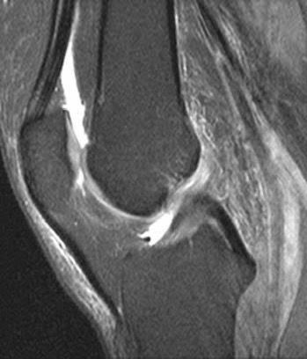
Anterior Cruciate ligament (ACL)The ACL extend from the anterior tibial spine, to the posteromedial aspect of the lateral femoral condvle
functions:the primary restraint against anterior translation (anterior shear) of the tibia on the femur (during extension).secondary restraint against varus or valgus motions and axial rotation
Anterior drawer test
MRI،ultrasound and evaluation by the therapists for diagnosis and getting the concept of the situation

Slide 5
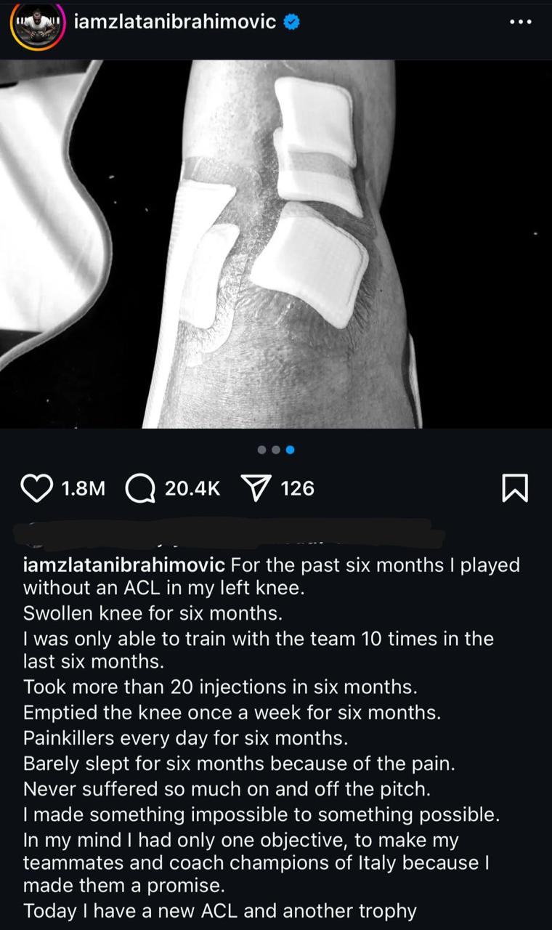
Presurgery program :
1- high dosage of pain killers
2- injections for swelling drainage from knee joint
3- anti inflammatory
4- RICE
1) REST : to ease the healing process 2) ICE:cool the area and gradually reduce swelling 3) COMPRESSION: can be done by knee braces to double the benefits so 1-it enhance venous return to the heart 2-reduce pain 3-support the joint 4) ELEVATION:to reduce swelling

Slide 6
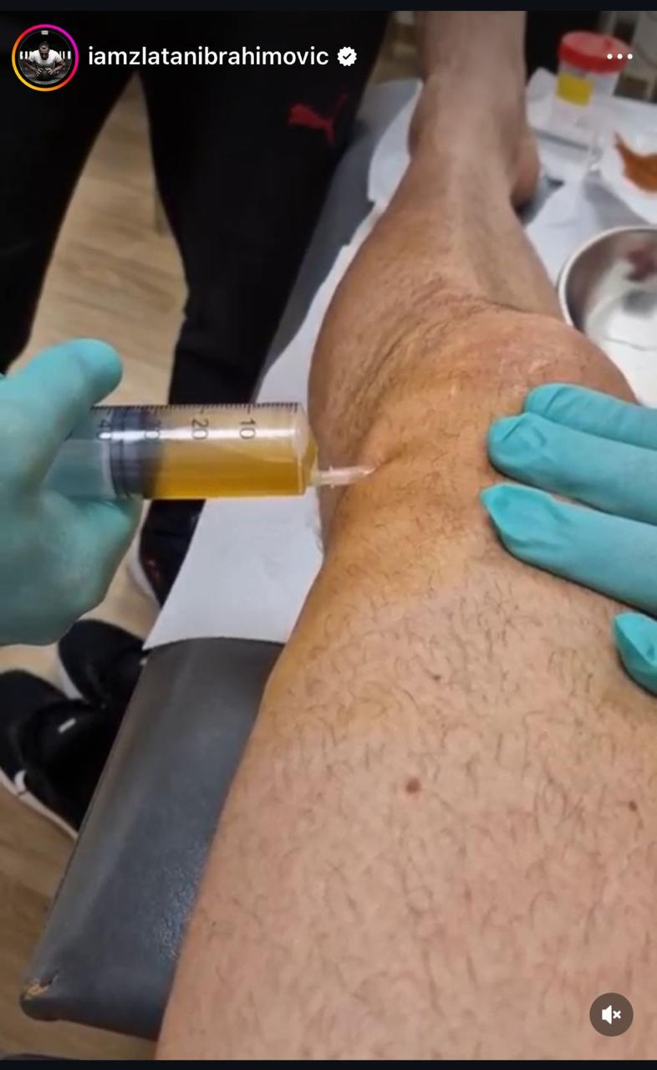

Slide 7
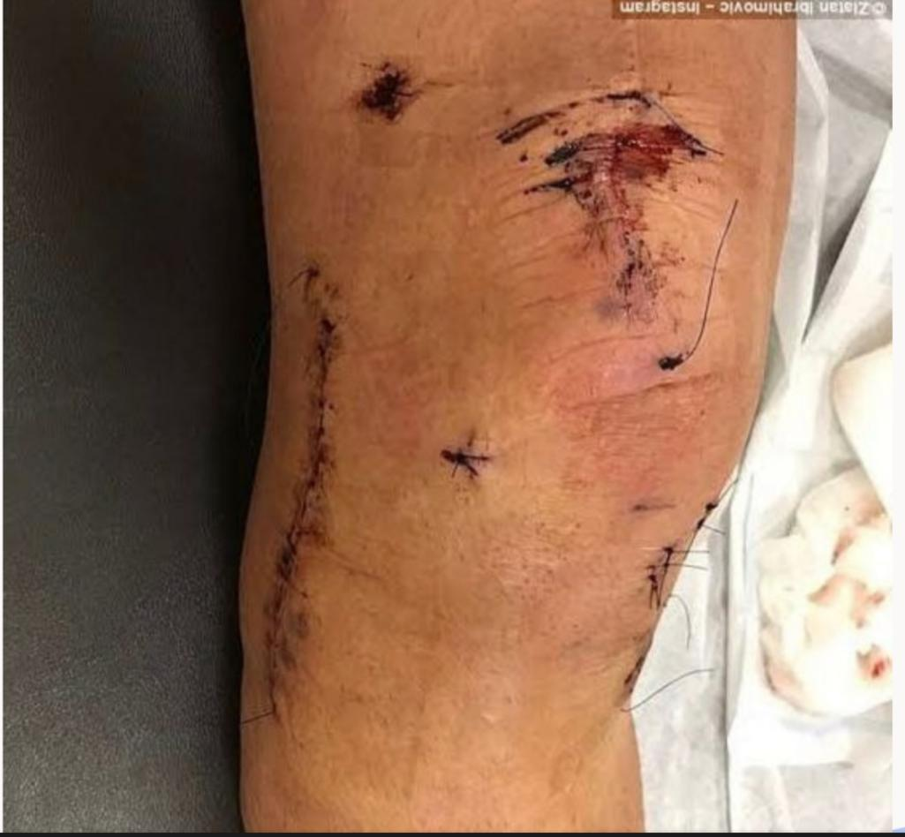
The traditional way to repair the damaged knee involves removing part of a player's hamstring and using that to create a new ACL , but It takes a long time for it to fuse to the bone and to restore strength in the hamstrings and quadriceps, because they're inactive for so long during this process. And in our case we can’t rule out the player for so long as it’s going to affect his career so using the keyhole surgery which means we can repair the existing ACL, using a technique known as an ARTHREX INTERNAL BRACE REPAIR, rather than taking tissue from the hamstring as we can also place the ACL back to it’s original place resulting in faster recovery and more effective performance .

Slide 8
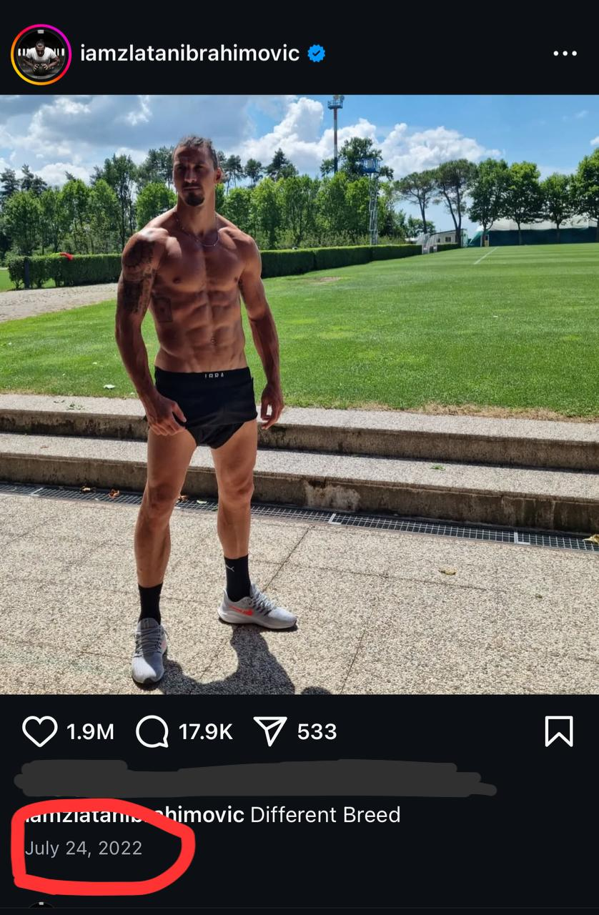
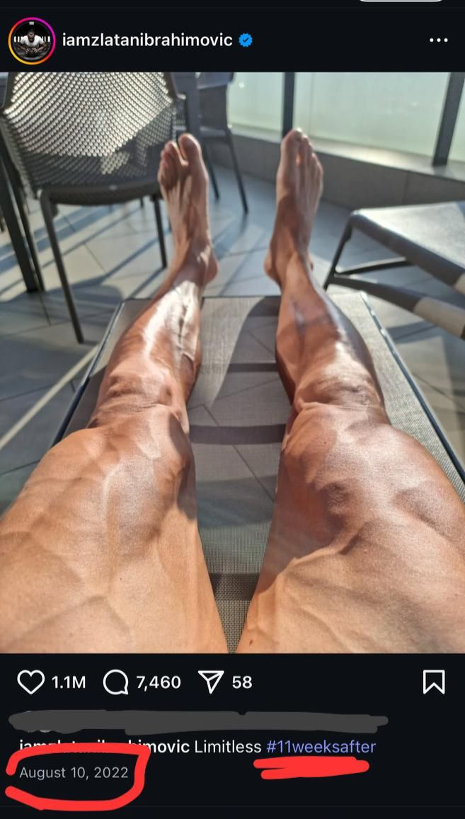
24_7_2022
10_8_2022

Slide 9
Post-Surgery Recovery (0-8 months)*:
. Early Post-Operative Phase (Day 1 to Week 1–2):-
Objective by using: CPM
- Prevent joint stiffness and adhesion formation
- Enhance synovial fluid movement to support healing
- Decrease post-op swelling and pain

Slide 10
Phase 2
1- Strengthening and Stabilization (2-8 weeks)
Strengthening exercises: Targeted quadriceps, hamstrings, glutes, and core muscles.
we can start by *active assisted exercise* within the second week to ensure that muscles are grade 3 and above by the start of phase 2 which is strengthening
2- starting phase 2 by static isometric for light strenghtening for the quadriceps and core muscles proceeding with isometric co-contraction for joint stability and strenghtening. ending the isometric exercises
by start of active resistance exercises using machinery resistance and resistance bands. the oxford progressive method and adding warming up to the workout we now have full strengthening program with less fatigue and cooling down ready to take the rehab to the next level.

Slide 11
examples
Squats: Strengthens quadriceps, hamstrings, glutes, and core muscles.
2. Lunges: Works on strength, balance, and functional movement.
3. Leg press: Targets quadriceps, hamstrings, and glutes.
4. Leg extensions: Strengthens quadriceps.
5. Leg curls: Targets hamstrings.

Slide 12
Phase 3
Phase 3: Advanced Strengthening and Agility (8-12 weeks): Agility and Speed Drills
Shuttle runs: Improves speed, agility, and quick changes of direction.
2. Cone drills: Enhances agility, speed, and reaction time.
3. Ladder drills: Improves footwork, agility, and speed

Slide 13
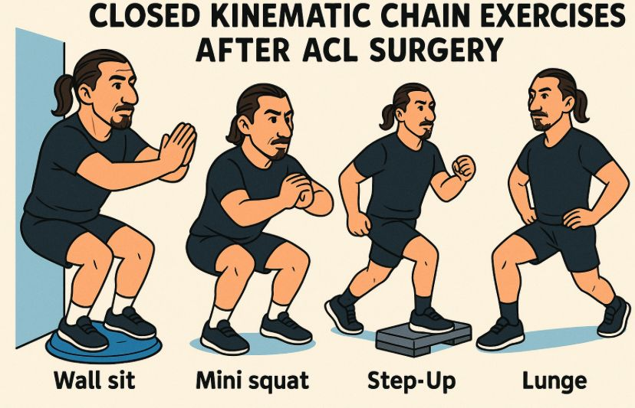
Plyometric Exercise
1-Box jumps: Enhances power and explosiveness.
2- Depth jumps: Improves power and reactivity.
3- Single-leg hops: Strengthens knee and improves balance.
Balance and Proprioception Exercises *closed kinematic chain exercise
1- Single-leg squats: Improves balance and stability.
2- .Balance boards or wobble boards: Enhances balance, proprioception, and stability.
3- Heel-to-toe walks: Improves balance and stability.

Slide 14
Phase4
Return to Match Fitness (3-6 months)
High-intensity training: Simulated match-like situations.
Tactical training: Focused on team tactics and strategies.
Match simulation: Participated in simulated matches.
Progressive overload: Gradually increased intensity and duration

Slide 15
Phase5
Return to Competition (6-9 months)
Return to training: Joined team training sessions and
Match preparation: Prepared for competitive matches.
Return to match play: Made successful return to professional football.

Slide 16
1. Individualized rehabilitation: Tailored to specific needs and goals.
2. Progressive overload: Gradual increase in intensity and duration.
3. Functional training: Incorporates match-like situations.
4. Dedication and perseverance: Essential for successful recovery.
There’s no much difference between world class athletes and an accountant complaining about the same injury so what makes the difference between the recovery time of both?
zlatan's lifestyle were giving him the ability to spend more than 5 hours a day in rehab sticking to the program fully and most importantly the nutrition plan that helps with healing

Slide 17
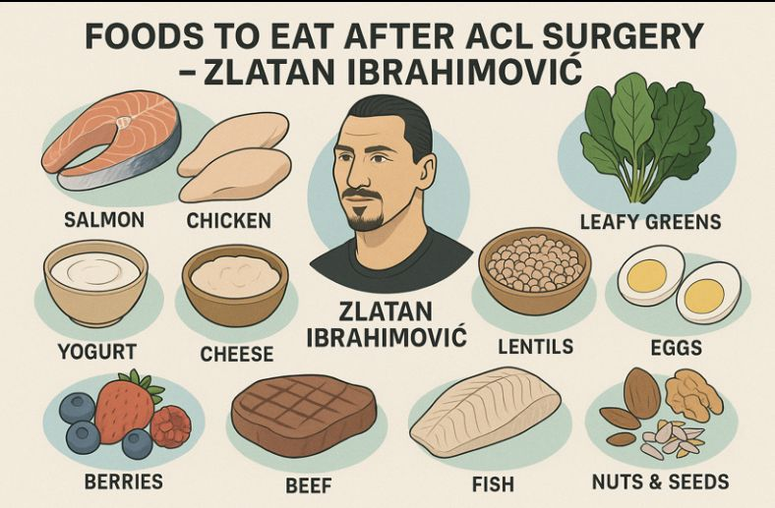
Ligaments are composed of various proteins and fibers, including:
Collagen: Provides strength and structure.
2. Elastin: Allows for elasticity and flexibility.
3. Proteoglycans: Helps maintain ligament hydration and structure.
Foods Supporting Ligament Health
Collagen-rich foods:
Bone broth
2. Gelatin
3. Fish with skin
4. Chicken with skin
2. Vitamin C-rich foods: Supports collagen production
1. Citrus fruits (oranges, lemons)
2. Berries (strawberries, blueberries)
3. Leafy greens (spinach, kale)
3. Omega-3 fatty acids: Reduces inflammation
1. Fatty fish (salmon, sardines)
2. Nuts and seeds (walnuts, chia seeds)

Slide 18
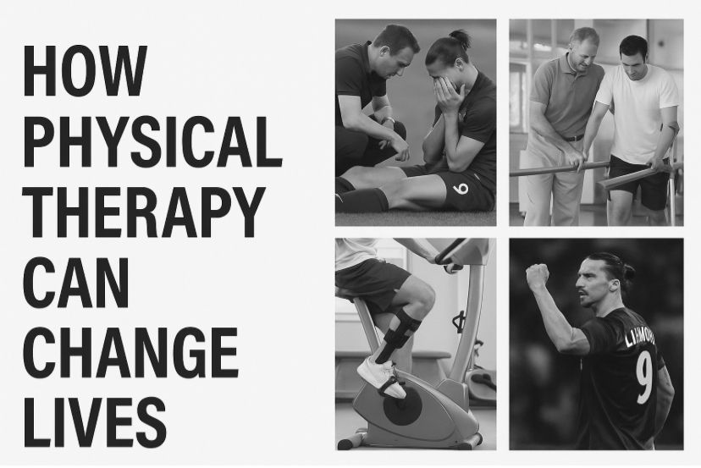
Zlatan Ibrahimovic's return to the pitch at 41 years old is a remarkable achievement that showcases his dedication, hard work, and passion for football. After undergoing ACL surgery, many would have thought that his career was nearing its end. However, Zlatan proved them wrong, defying expectations and pushing the boundaries of what is possible for a footballer at his age.
the therapist role doesn't end at the clinic's role it only starts there letting the patient go back to his normal life and keep pushing wether he's an athlete or not, achieved a record or just went back with the daily activities.

Slide 19


