Slide 1
Lung Cancer Project

Slide 2
Team Members:
Hussien Hassan
Ahmed Mohamed Khadr
Abdelrahman Mohamed

Slide 3
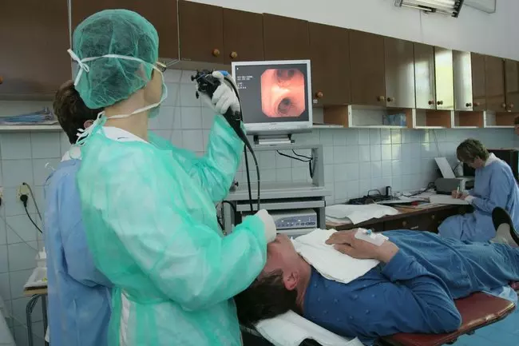
Why lung cancer project ?
Lung cancer is one of the deadliest cancers, but finding it early can save lives. Machine learning, especially Convolutional Neural Networks (CNNs), helps by analyzing lung scans to detect signs of cancer that doctors might miss. CNNs are trained to notice tiny details that are crucial for early diagnosis.

Slide 4
Lung Disease Dataset
The "Lung X-Ray Image Dataset" is a comprehensive collection of X-ray images that plays a pivotal role in the detection and diagnosis of lung diseases. This dataset contains a large number of high-quality X-ray images, meticulously collected from diverse sources, including hospitals, clinics, and healthcare institutions. The dataset comprises a total of 3,475 X-ray images, 1250 Images are normal,1125 images are Lung Opacity , 1100 images are Viral Pneumonia .

Slide 5
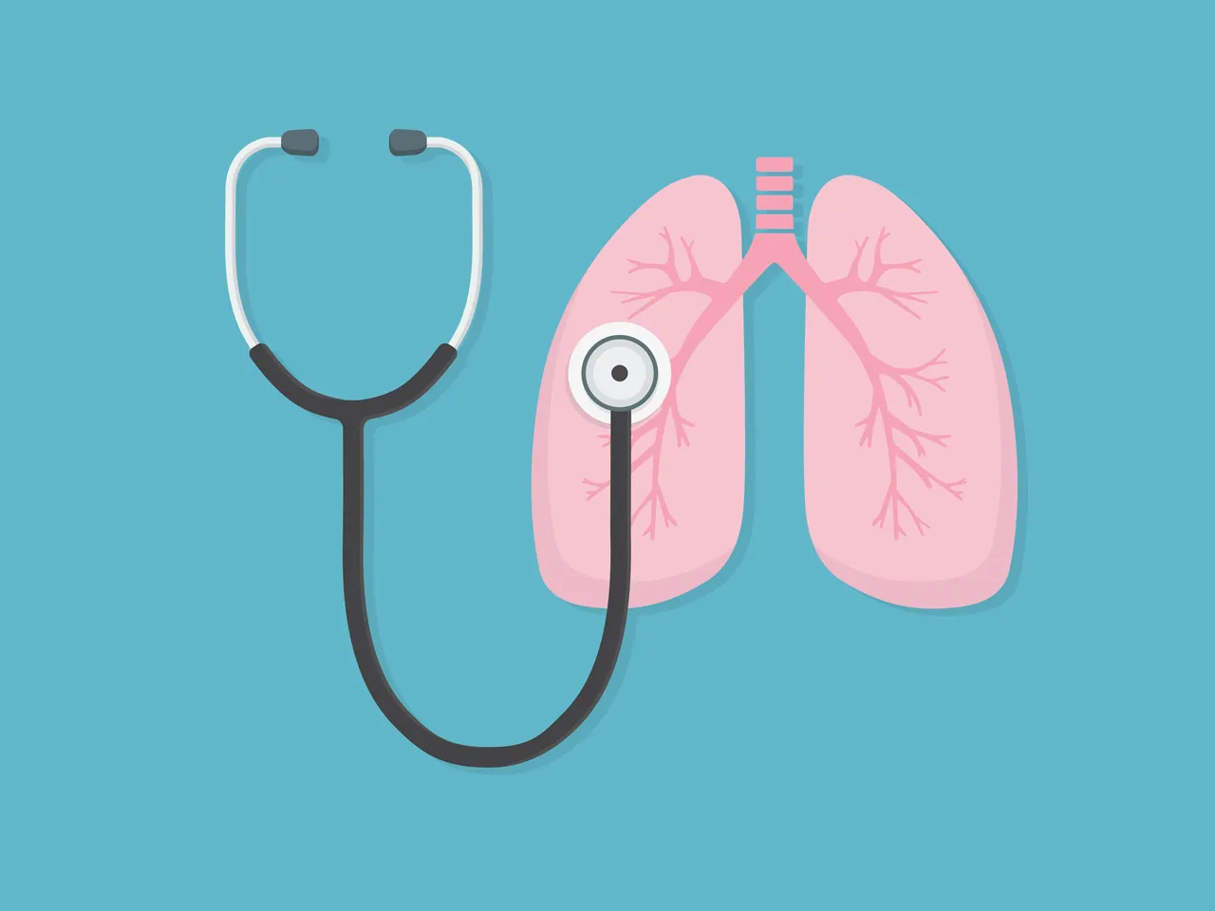
The importance of Lung cancer detection
Using this technology, we can assist doctors in detecting lung cancer earlier and more accurately. Early detection allows for quicker treatment, significantly enhancing survival chances. This approach isn't just about faster results; it provides patients more time and a better opportunity to fight cancer. Ultimately, it serves as a valuable tool for doctors, helping them make informed decisions and ultimately save lives.

Slide 6
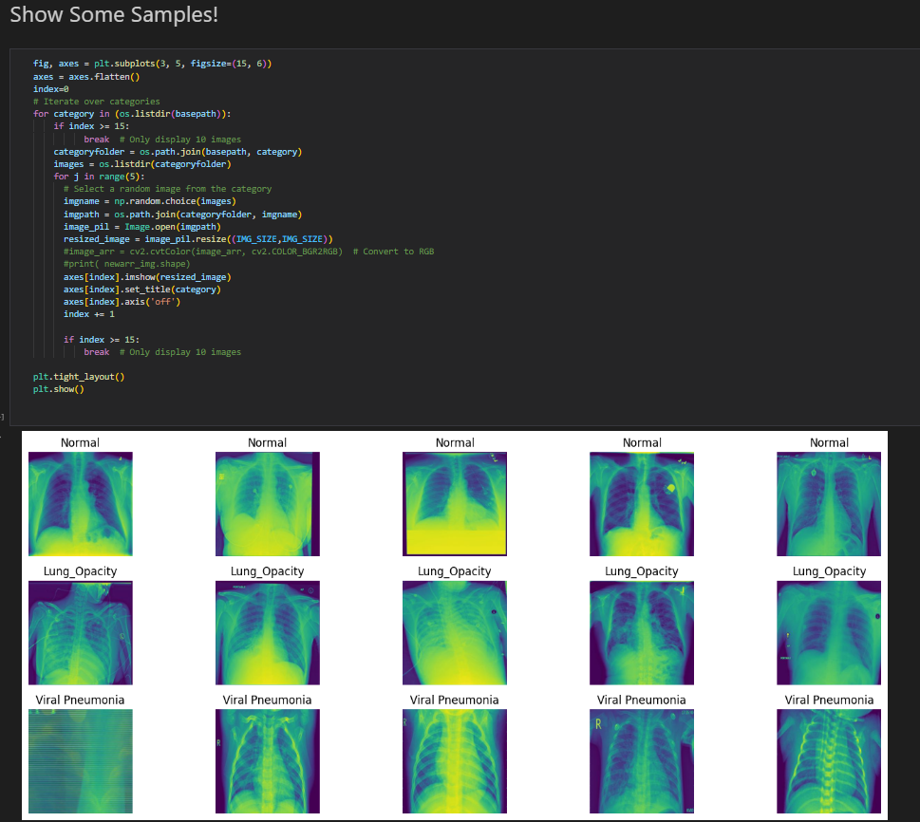
Visualizing Lung X-Ray Samples
This code shows random X-ray images from three categories: Lung Opacity, Normal, and Viral Pneumonia. It picks 5 images from each category, resizes them to 200x200 pixels, and displays them in a grid. This is useful for quickly looking at examples from the dataset before building a model to detect lung conditions like cancer.

Slide 7
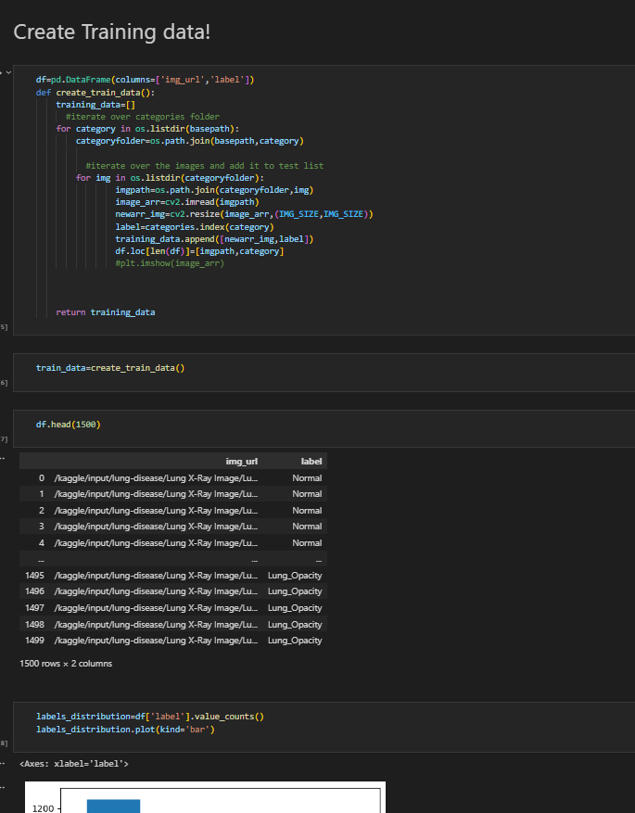
Preparing For Model Training
First loading X-ray images from three categories: Normal, Lung Opacity, and Viral Pneumonia
Then split Data set into training, validation, and test sets to ensure the model is trained and evaluated properly Finally resizing and scaling to be ready for the model to learn from This set

Slide 8
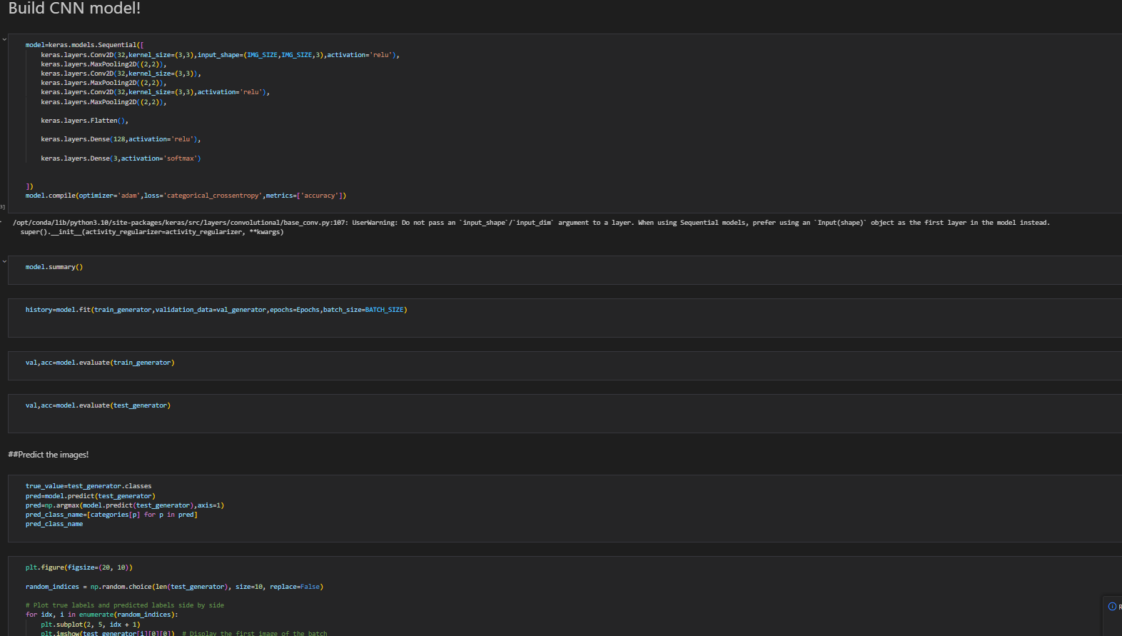
Training the Model and Making Predictions
Now for training the model and then making predictions on unseen images. It shows the actual and predicted results side by side, to evaluate how the model preformed. The confusion matrix helps measure accuracy by showing where the model gets things right or wrong. In the end, the model is saved so it can be used later for detecting lung conditions.

Slide 9
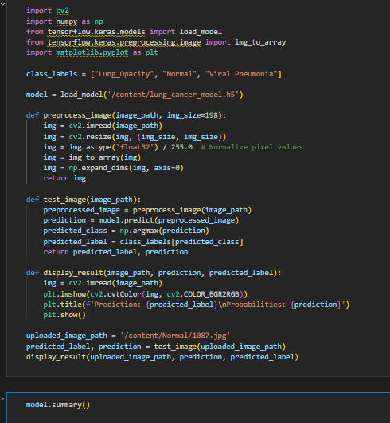
Loading and Testing the Lung Cancer Model
loading a pre-trained model for lung cancer detection and preparing it to predict new X-ray images.
First, we processed input image, normalizing it and resizing it so the model can interpret it.
After predicting the class of the image (Normal, Lung Opacity, or Viral Pneumonia),the result is displayed along with the confidence of the prediction.

