Slide 1
Algorithms for solving sequential (zero-sum) games
Main case in these slides: chess
Slide pack by
Tuomas Sandholm

Slide 2
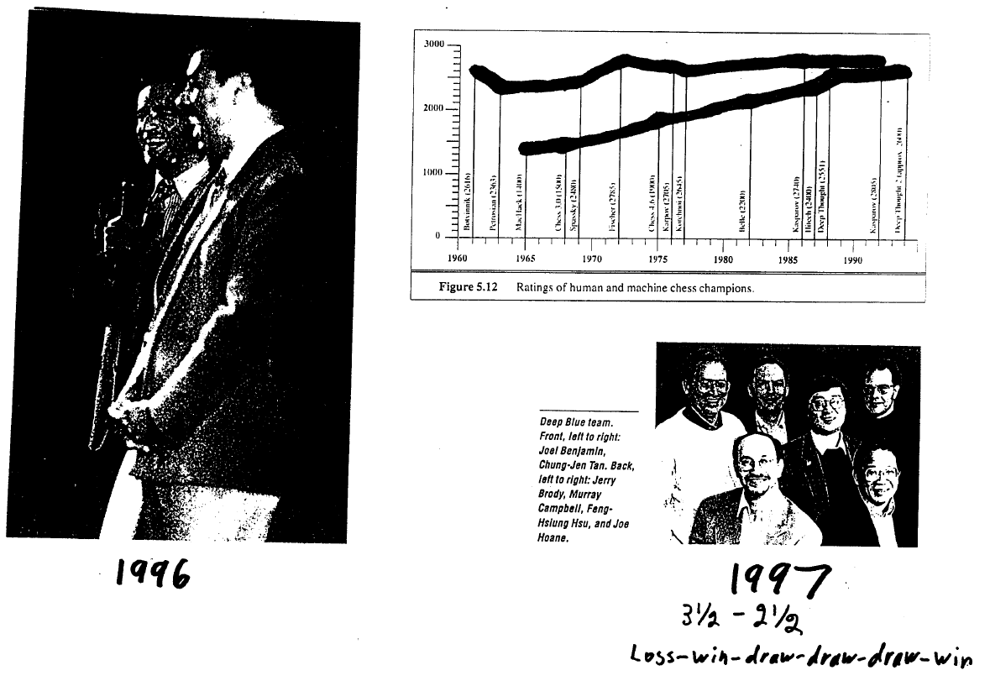

Slide 3
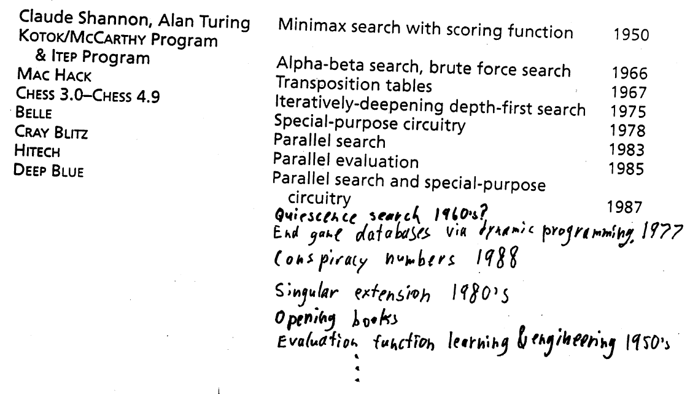
Rich history of cumulative ideas

Slide 4
Game-theoretic perspective
Game of perfect information
Finite game
  Finite action sets
  Finite length
Chess has a solution: win/tie/lose (Nash equilibrium)
Subgame perfect Nash equilibrium (via backward induction)
REALITY: computational complexity bounds rationality

Slide 5
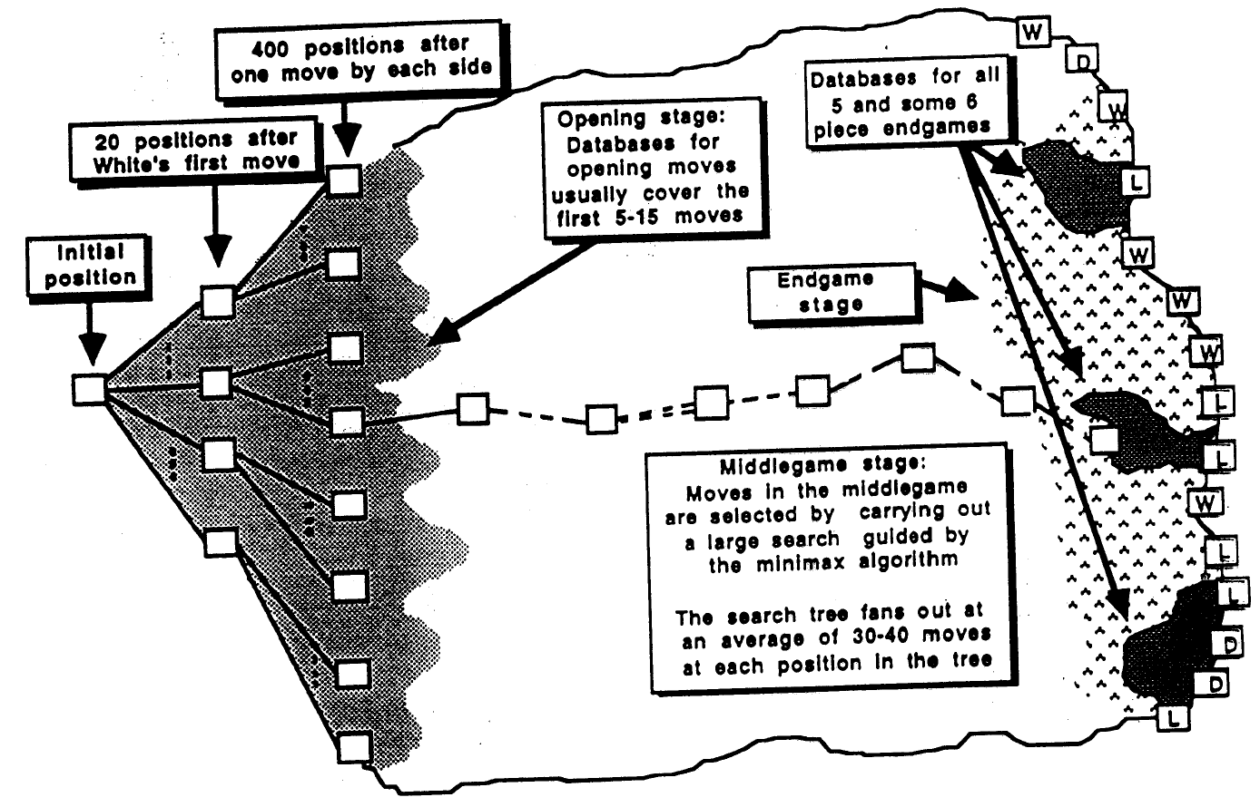
Chess game tree

Slide 6
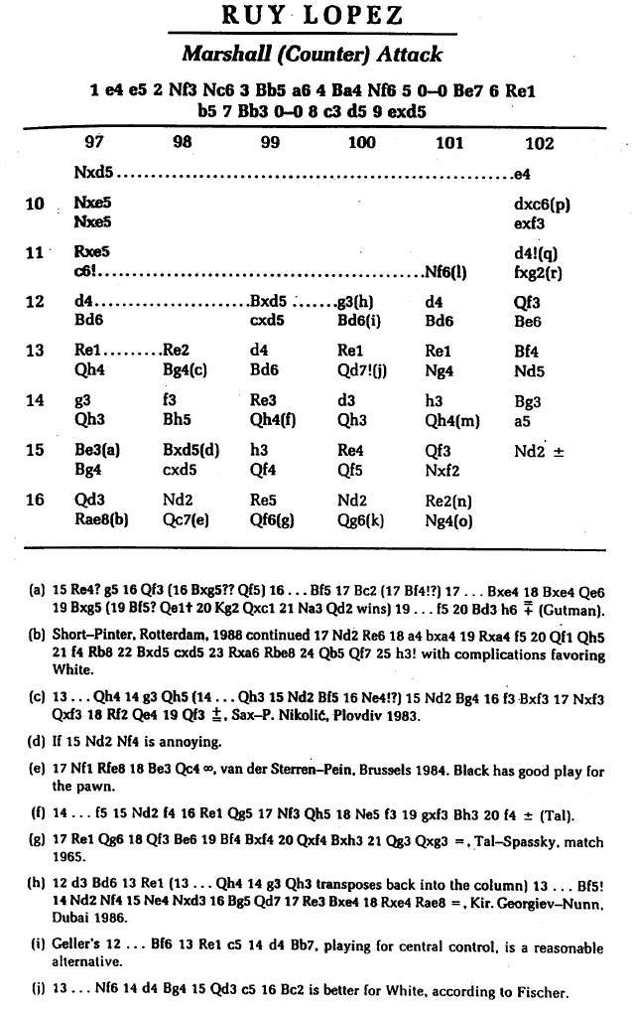
Opening books (available on CD)
Example opening where the book goes 16 moves (32 plies) deep

Slide 7
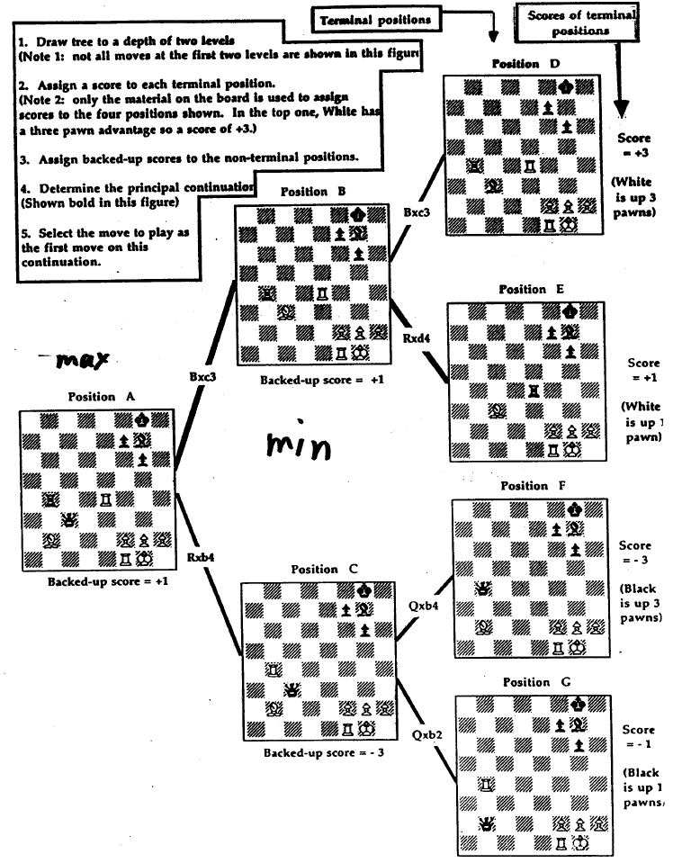
Minimax algorithm (not all branches are shown)

Slide 8
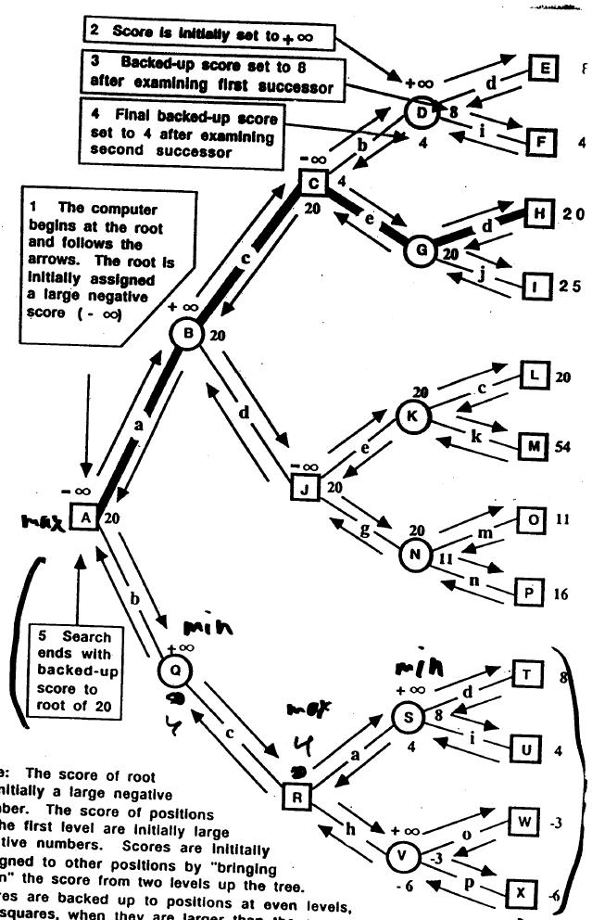
Deeper example of minimax search
ABJKL is equally good

Slide 9
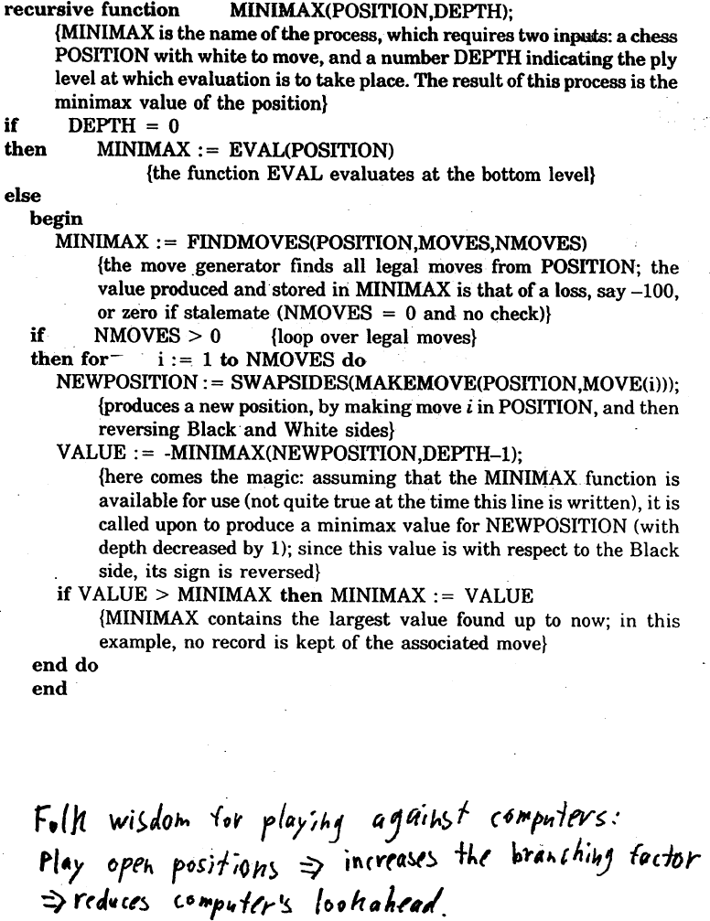

Slide 10
Search depth pathology
Beal (1980) and Nau (1982, 83) analyzed whether values backed up by minimax search are more trustworthy than the heuristic values themselves. The analyses of the model showed that backed-up values are somewhat less trustworthy
Anomaly goes away if sibling nodes’ values are highly correlated [Beal 1982, Bratko & Gams 1982, Nau 1982]
Pearl (1984) partly disagreed with this conclusion, and claimed that while strong dependencies between sibling nodes can eliminate the pathology, practical games like chess don’t possess dependencies of sufficient strength.
  He pointed out that few chess positions are so strong that they cannot be spoiled abruptly if one really tries hard to do so.
  He concluded that success of minimax is “based on the fact that common games do not possess a uniform structure but are riddled with early terminal positions, colloquially named blunders, pitfalls or traps. Close ancestors of such traps carry more reliable evaluations than the rest of the nodes, and when more of these ancestors are exposed by the search, the decisions become more valid.”
Still not fully understood. For new results, see:
  Sadikov, Bratko, Kononenko. (2003) Search versus Knowledge: An Empirical Study of Minimax on KRK, In: van den Herik, Iida and Heinz (eds.) Advances in Computer Games: Many Games, Many Challenges, Kluwer Academic Publishers, pp. 33-44
  Understanding Sampling Style Adversarial Search Methods [PDF]. Raghuram Ramanujan, Ashish Sabharwal, Bart Selman. UAI-2010, pp 474-483.
  On Adversarial Search Spaces and Sampling-Based Planning [PDF]. Raghuram Ramanujan, Ashish Sabharwal, Bart Selman. ICAPS-2010, pp 242-245.

Slide 11
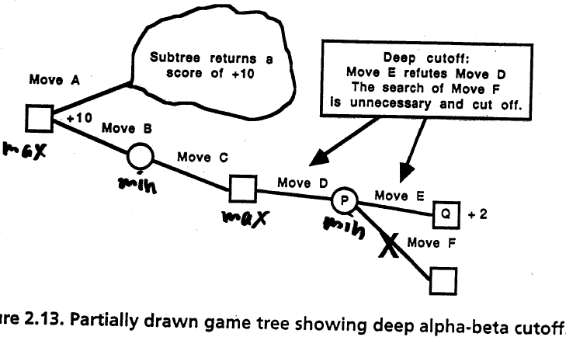
α-β -pruning

Slide 12
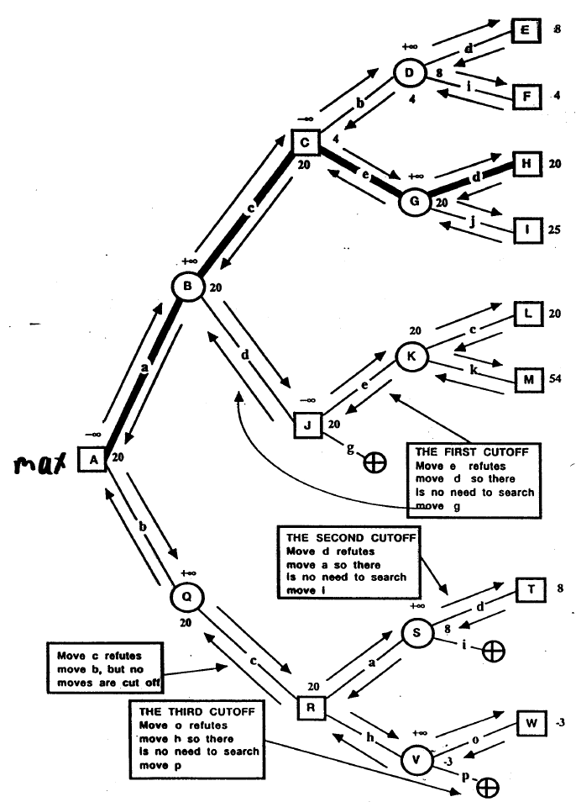
α-β -search on ongoing example

Slide 13
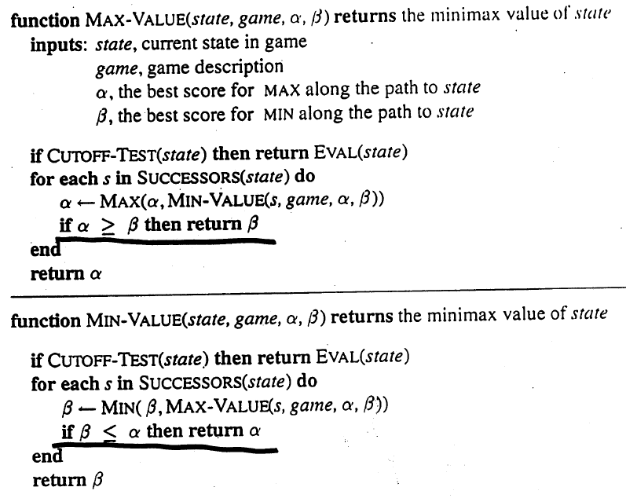
α-β -search

Slide 14
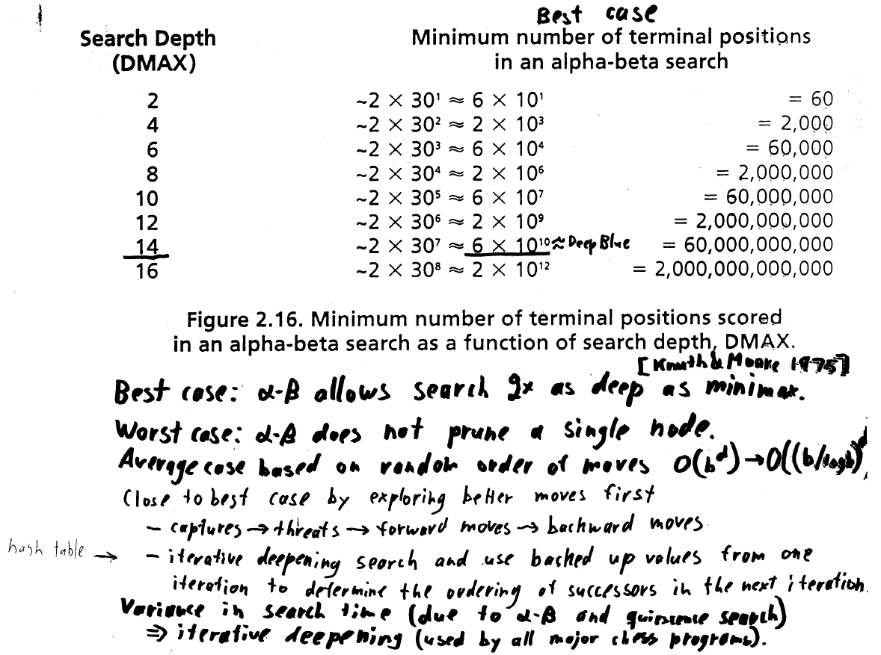
Complexity of α-β -search

Slide 15
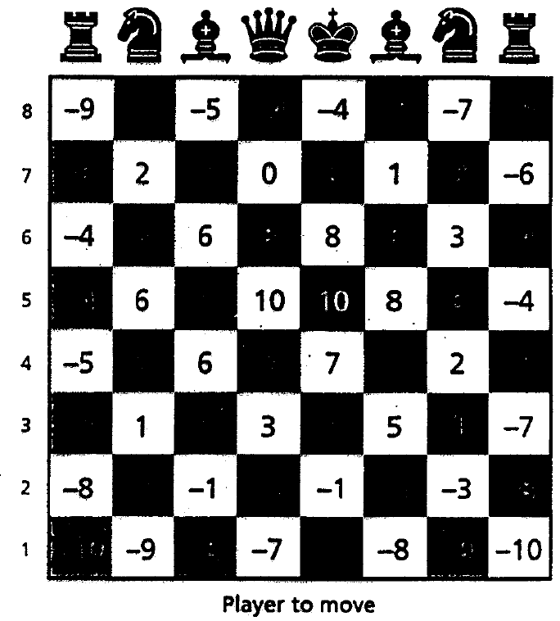
Evaluation function
Difference (between player and opponent) of
  Material
  Mobility
  King position
  Bishop pair
  Rook pair
  Open rook files
  Control of center (piecewise)
  Others
Values of knight’s position in Deep Blue

Slide 16
Evaluation function...
Deep Blue used ~6,000 different features in its evaluation function (in hardware)
A different weighting of these features is downloaded to the chips after every real world move (based on current situation on the board)
  Contributed to strong positional play
Acquiring the weights for Deep Blue
  Weight learning based on a database of 900 grand master games (~120 features)
    Alter weight of one feature => 5-6 ply search => if matches better with grand master play, then alter that parameter in the same direction further
    Least-squares with no search
  Other learning is possible, e.g. Tesauro’s Backgammon
    Solves credit assignment problem
    Was confined to linear combination of features
  Manually: Grand master Joel Benjamin played take-back chess. At possible errors, the evaluation was broken down, visualized, and weighting possibly changed
Deep Blue is brute force
Smart search and knowledge
engineered evaluation

Slide 17
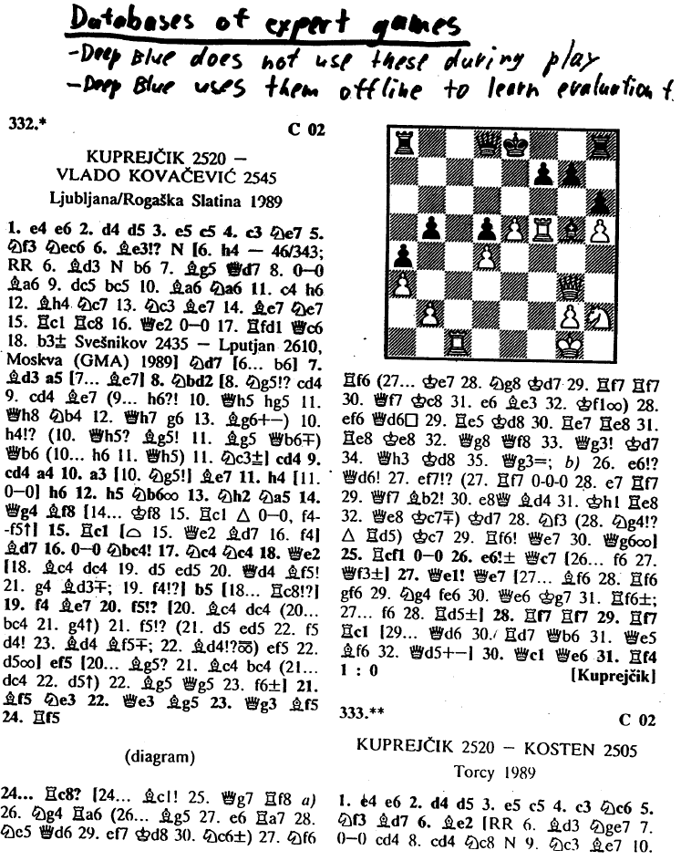

Slide 18
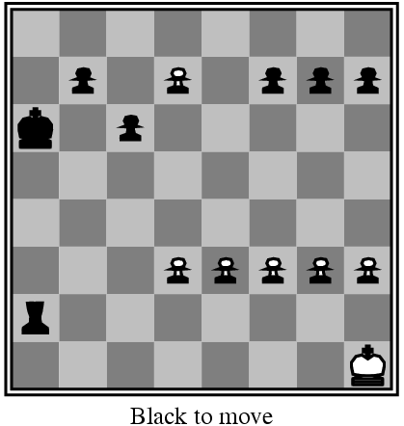
Horizon problem

Slide 19
Ways to tame the horizon effect
Quiescence search
  Evaluation function (domain specific) returns another number in addition to evaluation: stability
    Threats
    Other
  Continue search (beyond normal horizon) if position is unstable
  Introduces variance in search time
Singular extension
  Domain independent
  A node is searched deeper if its value is much better than its siblings’
  Even 30-40 ply
  A variant is used by Deep Blue

Slide 20
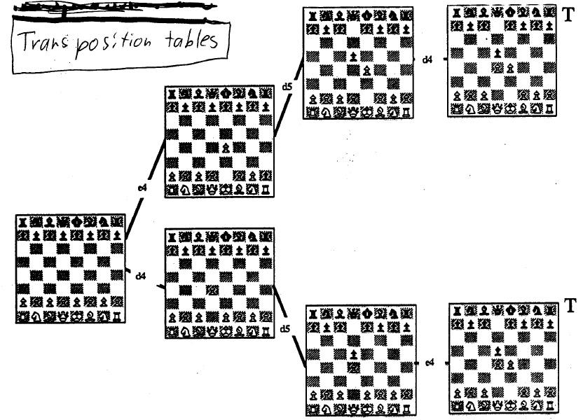
Transpositions

Slide 21
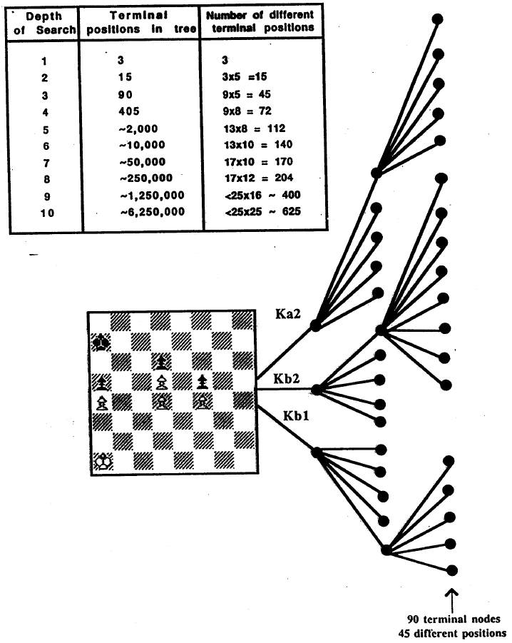
Transpositions are important

Slide 22
Transposition table
Store millions of positions in a hash table to avoid searching them again
  Position
  Hash code
  Score
  Exact / upper bound / lower bound
  Depth of searched tree rooted at the position
  Best move to make at the position
Algorithm
  When a position P is arrived at, the hash table is probed
  If there is a match, and
    new_depth(P) ≥ stored_depth(P), and
    score in the table is exact, or the bound on the score is sufficient to cause the move leading to P to be inferior to some other choice
  then P is assigned the attributes from the table
  else computer scores (by direct evaluation or search (old best move searched first)) P and stores the new attributes in the table
Fills up => replacement strategies
  Keep positions with greater searched tree depth under them
  Keep positions with more searched nodes under them

Slide 23
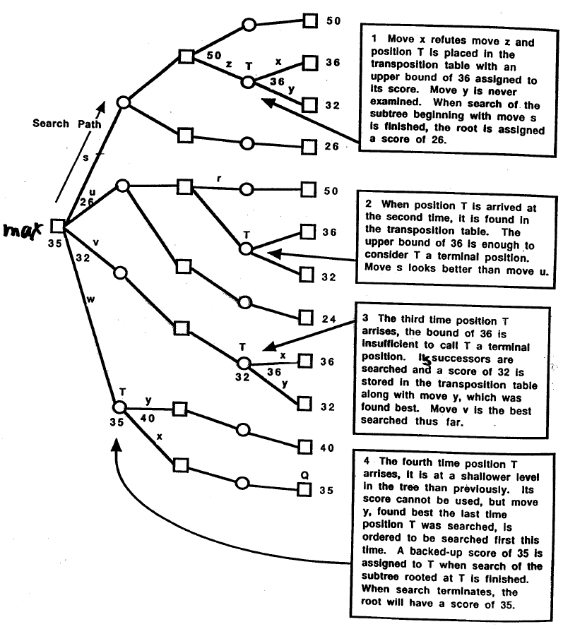
Search tree illustrating the use of a transposition table

Slide 24
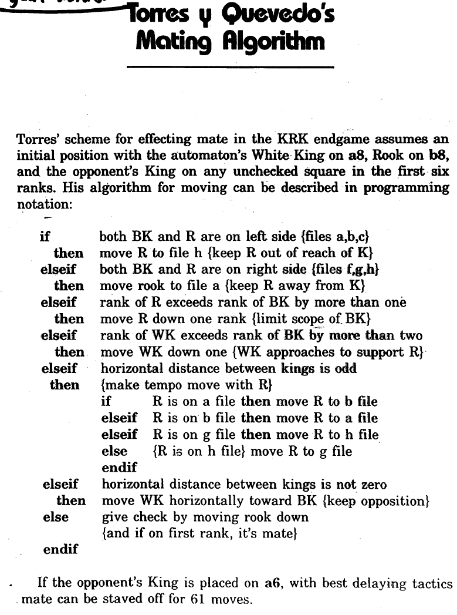
End game databases

Slide 25
Generating databases for solvable subgames
State space = {WTM, BTM} x {all possible configurations of remaining pieces}
BTM table, WTM table, legal moves connect states between these
Start at terminal positions: mate, stalemate, immediate capture without compensation (=reduction). Mark white’s wins by won-in-0
Mark unclassified WTM positions that allow a move to a won-in-0 by won-in-1 (store the associated move)
Mark unclassified BTM positions as won-in-2 if forced moved to won-in-1 position
Repeat this until no more labellings occurred
Do the same for black
Remaining positions are draws

Slide 26
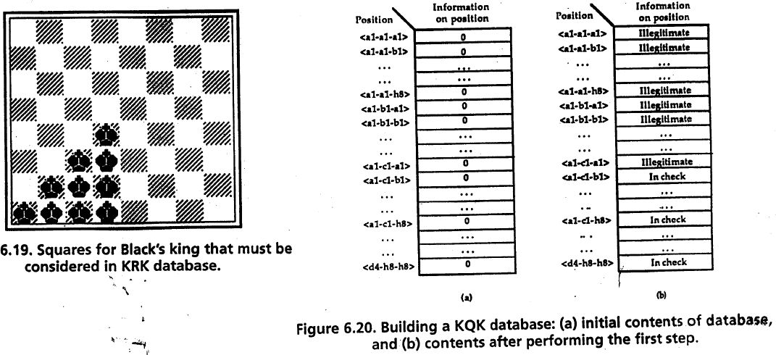
Compact representation methods to help endgame database representation & generation

Slide 27
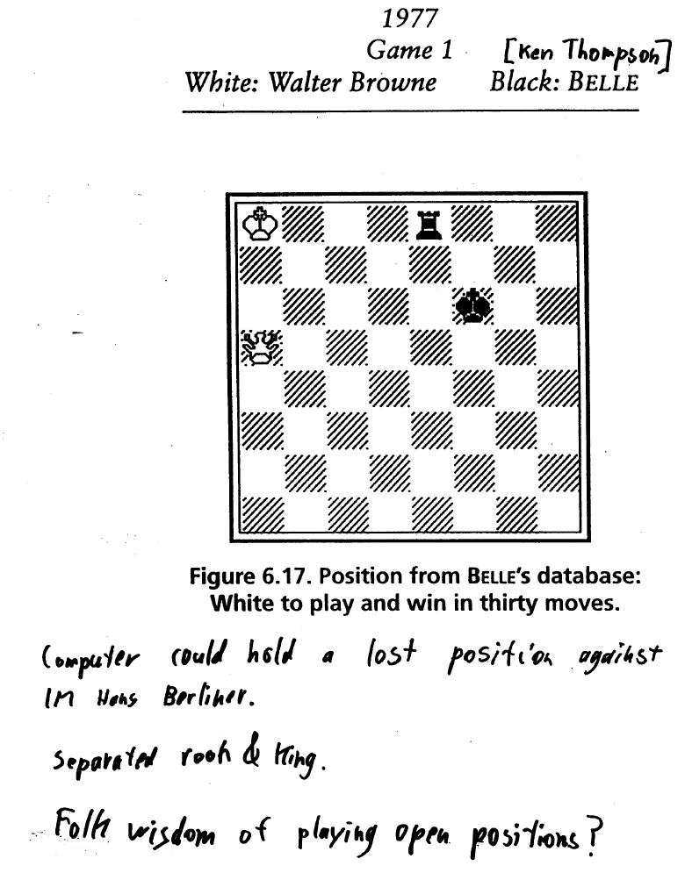
Endgame databases…

Slide 28
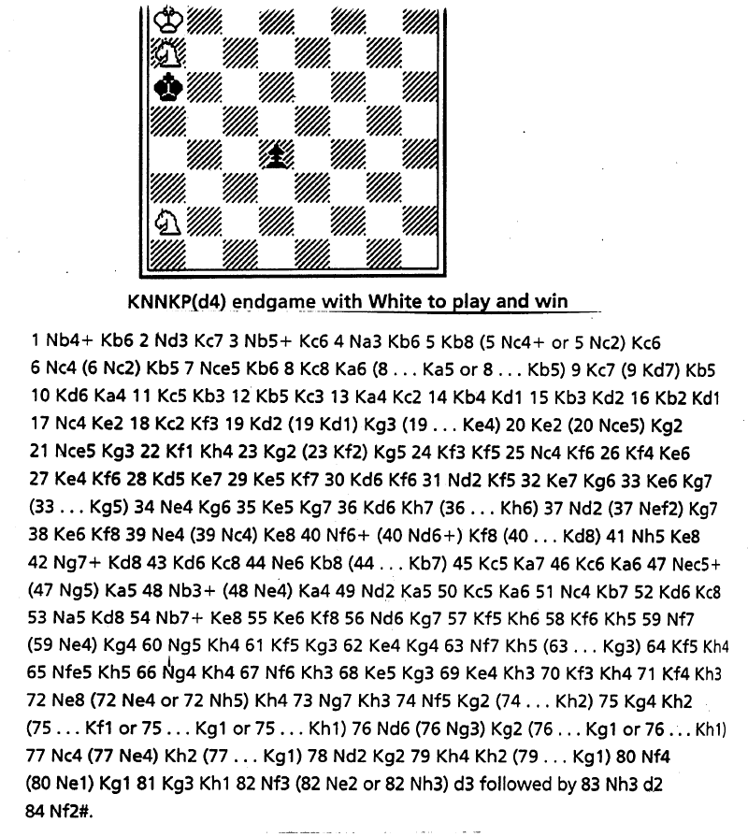
Endgame databases…

Slide 29
How end game databases changed chess
All 5 piece endgames solved (can have > 10^8 states) & many 6 piece
  KRBKNN (~10^11 states): longest path-to-reduction 223
Rule changes
  Max number of moves from capture/pawn move to completion
Chess knowledge
  Splitting rook from king in KRKQ
  KRKN game was thought to be a draw, but
    White wins in 51% of WTM
    White wins in 87% of BTM

Slide 30
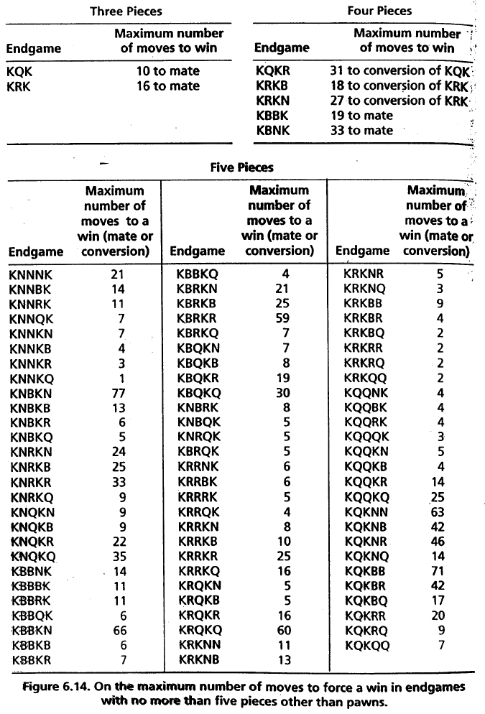
Endgame databases…

Slide 31
Deep Blue’s search
~200 million moves / second = 3.6 * 10^10 moves in 3 minutes
3 min corresponds to
  ~7 plies of uniform depth minimax search
  10-14 plies of uniform depth alpha-beta search
1 sec corresponds to 380 years of human thinking time
Software searches first
  Selective and singular extensions
Specialized hardware searches last 5 ply

Slide 32
Deep Blue’s hardware
32-node RS6000 SP multicomputer
Each node had
  1 IBM Power2 Super Chip (P2SC)
  16 chess chips
    Move generation (often takes 40-50% of time)
    Evaluation
    Some endgame heuristics & small endgame databases
32 Gbyte opening & endgame database

Slide 33
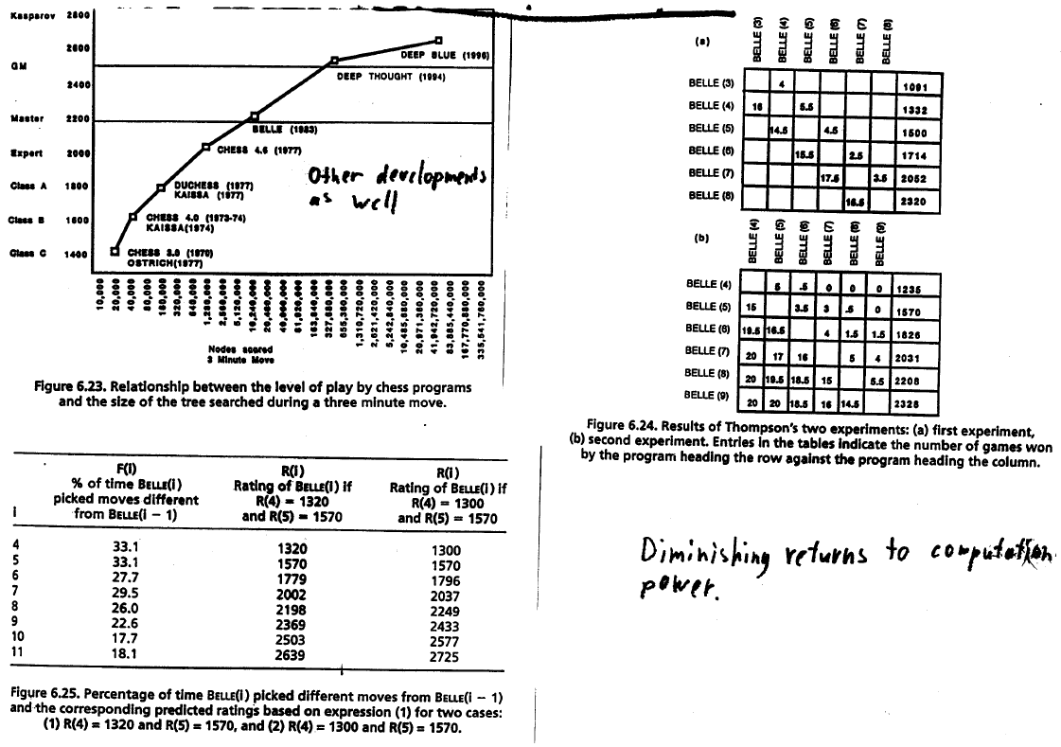
Role of computing power

Slide 34
Kasparov lost to Deep Blue in 1997
Win-loss-draw-draw-draw-loss
  (In even-numbered games, Deep Blue played white)

Slide 35
Future directions
Engineering
  Better evaluation functions for chess
  Faster hardware
  Empirically better search algorithms
  Learning from examples and especially from self-play
  There already are grandmaster-level programs that run on a regular PC, e.g., Fritz
Fun
  Harder games, e.g. Go
  Easier games, e.g., checkers (some openings solved [2005])
Science
  Extending game theory with normative models of bounded rationality
  Developing normative (e.g. decision theoretic) search algorithms
    MGSS* [Russell&Wefald 1991] is an example of a first step
    Conspiracy numbers
Impacts are beyond just chess
  Impacts of faster hardware
  Impacts of game theory with bounded rationality, e.g. auctions, voting, electronic commerce, coalition formation

