Slide 1
X-game Created by :Mostafa el-rafaee & Abdelrahman Hamdy
Presenter : Abdelrahman Hamdy Radwan

Slide 2
The project was made in the competition of the FCISASU union ( Summer projects ) .
It took as only 14 days | 3h/d.
It was rewarded as the 4th project

Slide 3
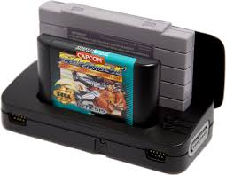
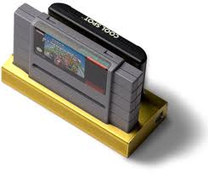
Game box

Slide 4
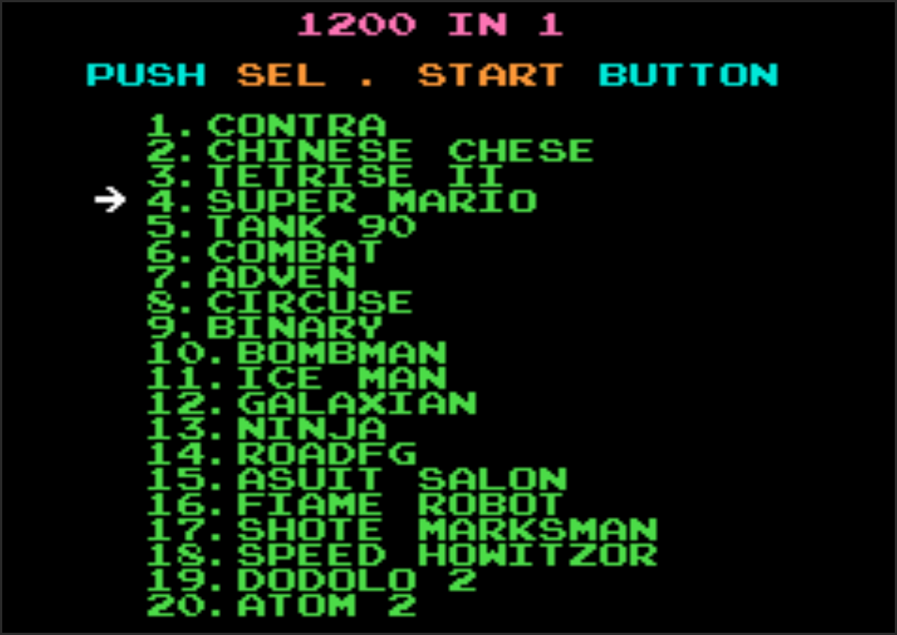

Slide 5
Agenda :
Let’s watch the game.
Minimum requirements .
Some functions (blocks)of the code.
Minimum requirements .
How to make such a project .

Slide 6
Minimum requirements
Very simple basics
Loops
Conditions
Arrays.
Then learn SFML

Slide 7
What’s SFML
Simple and Fast Multimedia Library (SFML) a portable application programming interface (API) for multimedia programming. It is written in C++ with bindings available for C, D, Python, Ruby, OCaml, .Net and Go.

Slide 8
Motion

Slide 9
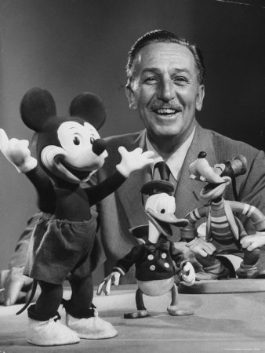


Slide 10
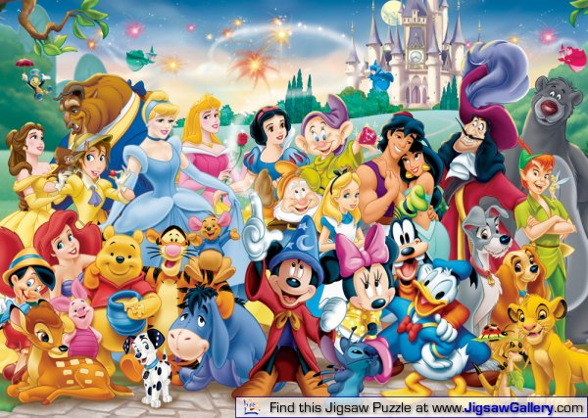

Slide 11
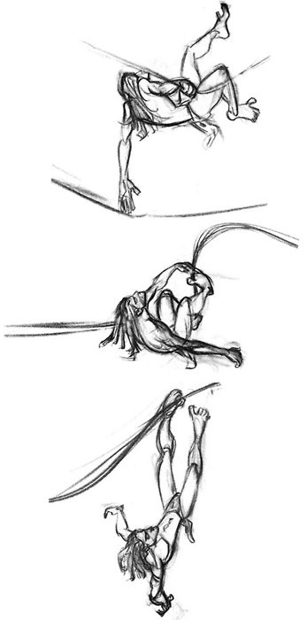


Slide 12


Motion
Back-man and bomber-man motion :
Through replacing frames ( pictures ) .
SFML function that enables you to move a point or a texture

Slide 13
Enemy motion
AI - graph – Dijkstra !!

Slide 14
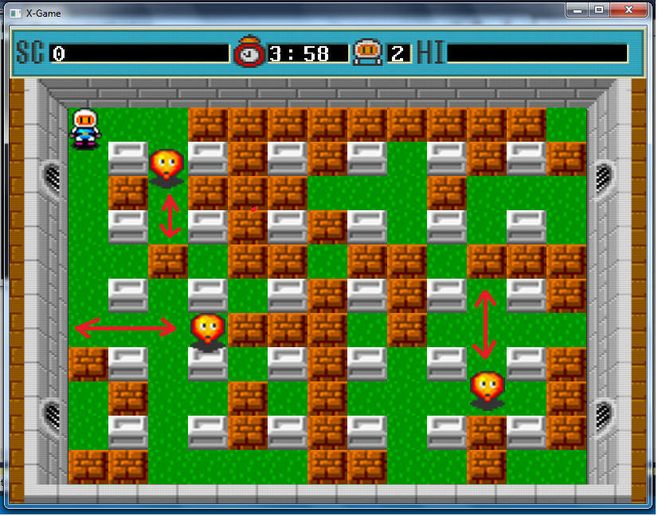

Slide 15
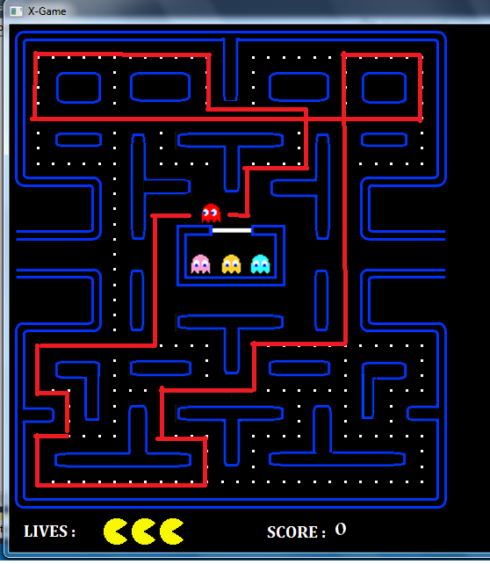
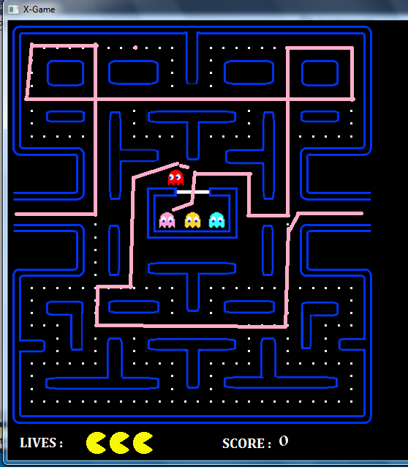

Slide 16
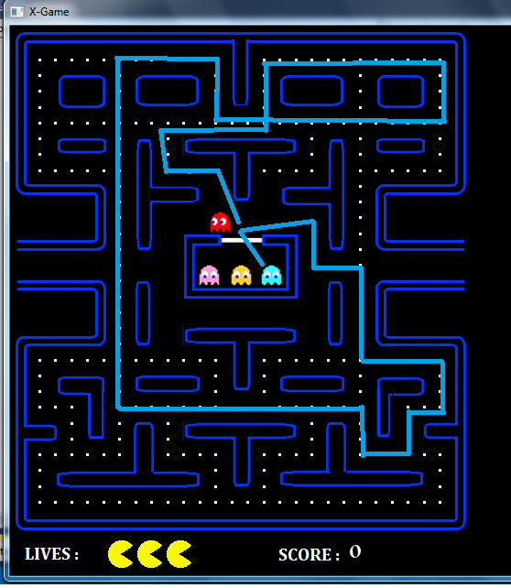
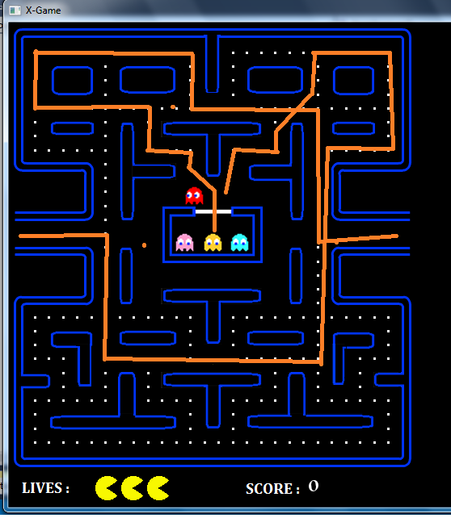

Slide 17
Board

Slide 18
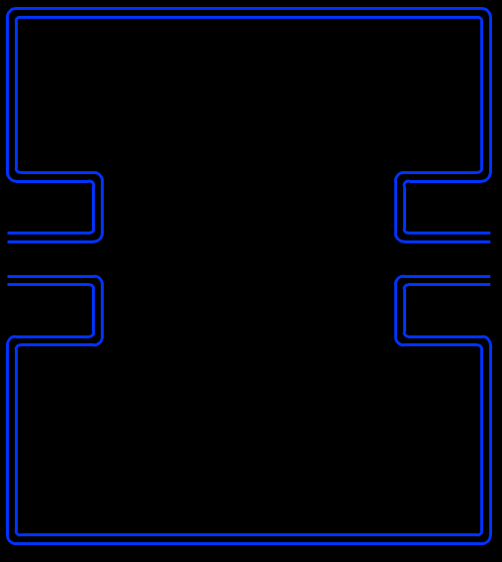
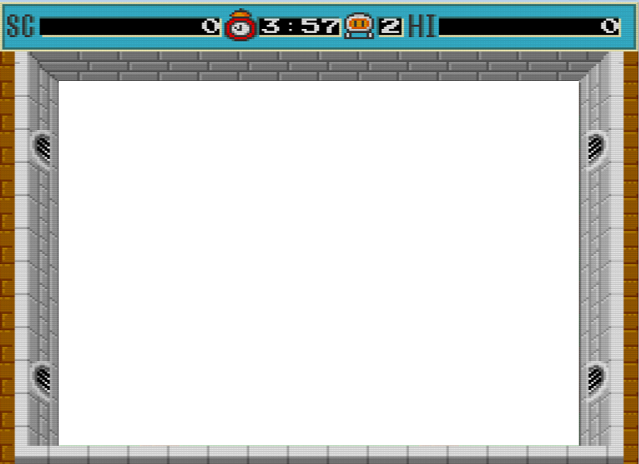
Back ground

Slide 19









Elements

Slide 20
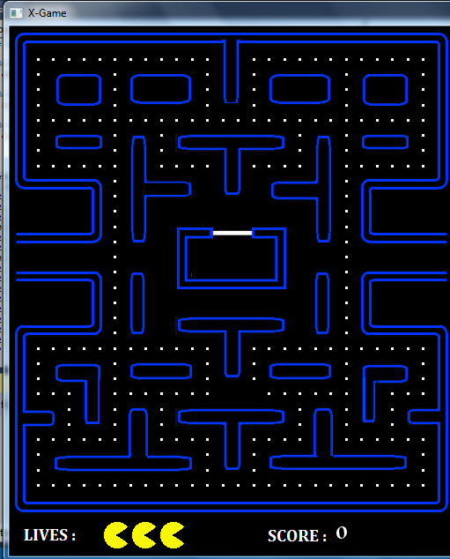

Slide 21
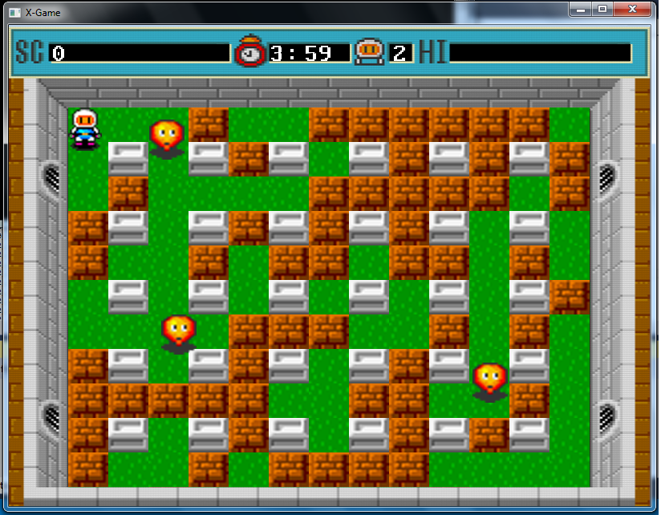

Slide 22
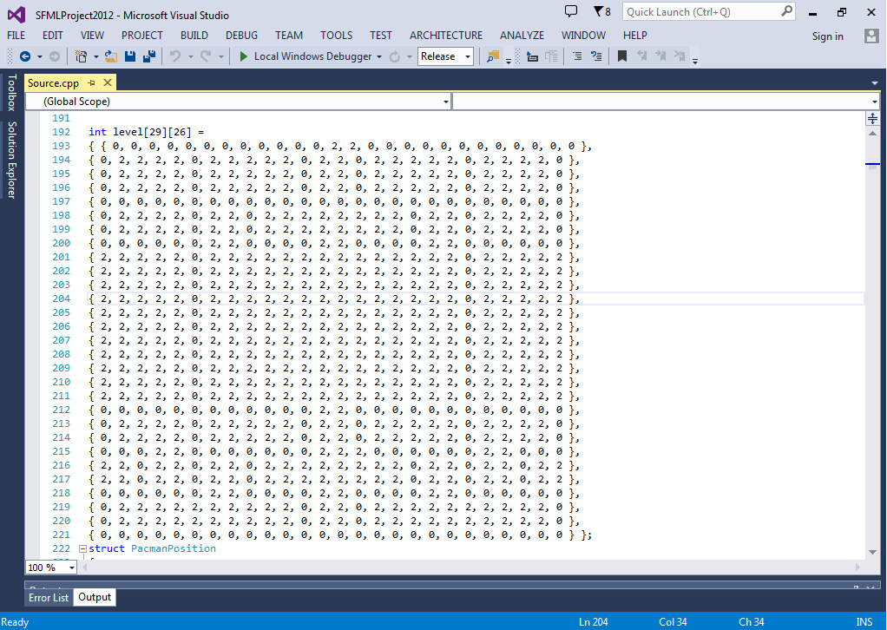

Slide 23
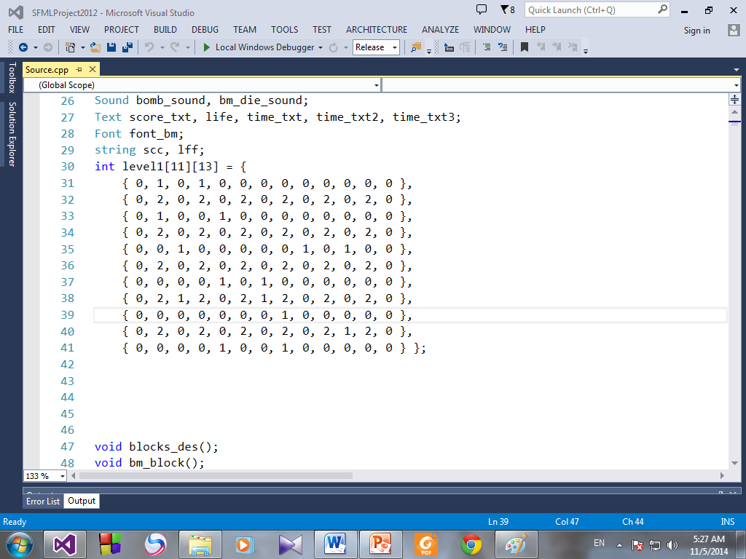

Slide 24


Slide 25
Interactions
Bomber-man:
Between enemy and blocks
Between hero and enemies
Between hero and blocks
Between hero and fire
Between enemies and fire

Slide 26
Interactions (CONT)
Back-man:
Between hero and enemies
Between hero and blocks

Slide 27


Win & Game over

Slide 28
Make your own game
http://www.sfml-dev.org/

Slide 29
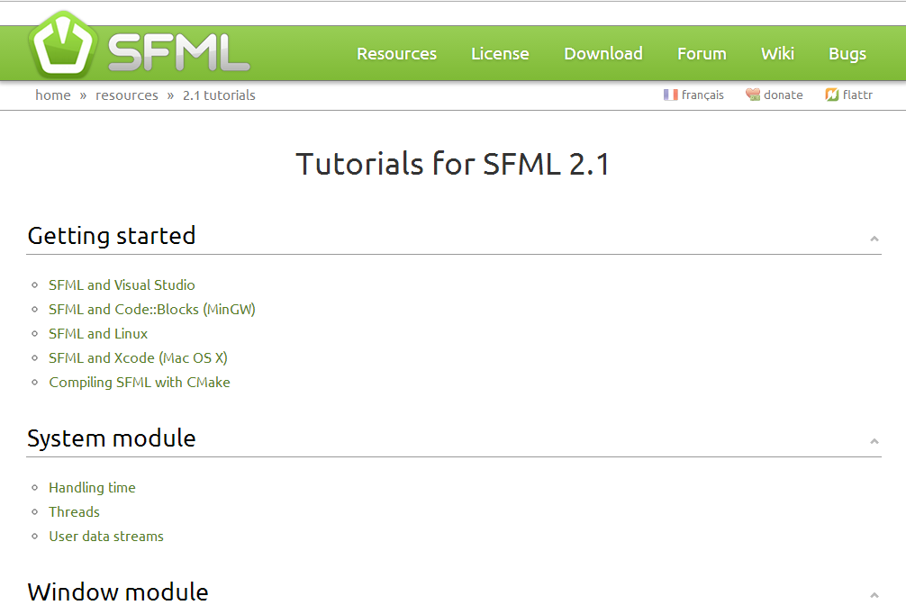

Slide 30
Fun with SFML
No motion
How fast the screen is cleared & how fast it is build again and been updated

Slide 31

Questions !!

Slide 32


