Slide 1
Outlines
Motivation and Objective
Analysis and design.
Current state:
Datasets representation.
The Model.
Training.
Testing.
Interface.
3

Slide 2
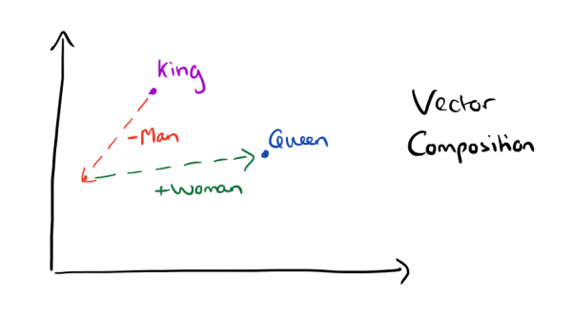
Dataset representation
Datasets: Cornell Movie Dialogue Corpus, Open Subtitles 2016.
Text representation using word embeddings (word2vec).
10

Slide 3
Outlines
Motivation and Objective
Implementation Phases
Datasets representation
The Model
11

Slide 4
Used Algorithms
What Do We Use?
A sequence-to-sequence model based on a recurrent neural network with long short-term memory.
12
Notes:
The model comes in 2014

Slide 5
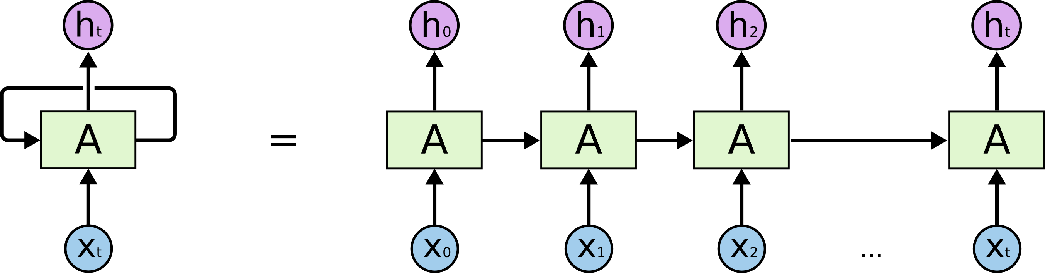
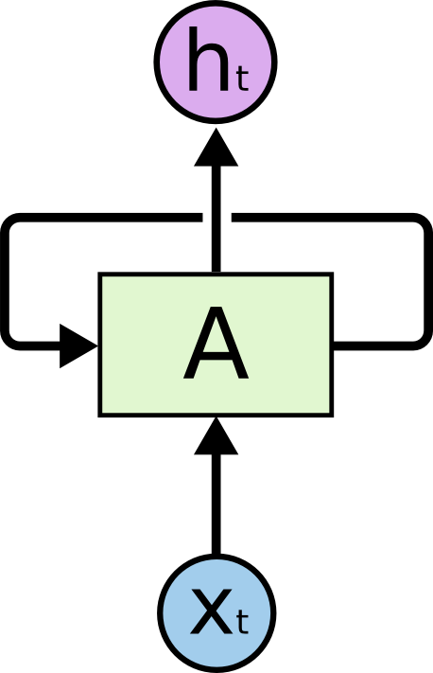
Recurrent Neural Network
14
Notes:
1994 the RNN

Slide 6
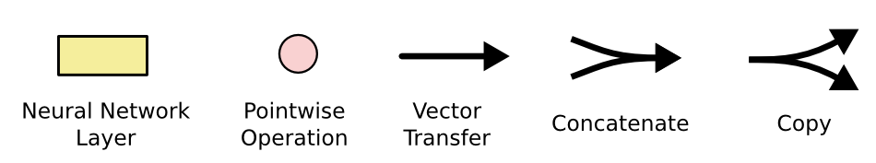

Long Short Term Memory (LSTM)
15
Notes:
The LSTM 1997

Slide 7
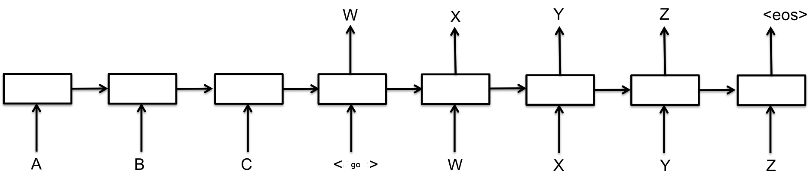
Sequence to Sequence Model
16

Slide 8
Outlines
Motivation and Objective
Implementation Phases
Datasets representation
The Model
Training
17

Slide 9
Model Training
Given a loss function, our objective is to find the parameters U, V and W that minimize it for the given data during the training phase.
Traditionally, we’d use the SGD method with BPTT to optimize the parameters, but this method is slow and suffers from the vanishing gradient problem.
We use LSTM to fix the vanishing gradient problem.
We use a variation of SGD (RMSPROP) to increase the performance.
19

Slide 10
Model Testing
After training the model we can evaluate it on the test set.
This will run the trained model on the test set.
We will get probability scores for unseen data.
We could imagine feeding in 100 potential responses to a context and then picking the one with the highest score.
21

Slide 11
Interface
Build a web application for the Bot, which allows the user to interact with the Bot and start a conversation.
24

Slide 12
Resources and Further Readings
A Neural Conversational Model 2015 [Oriol Vinyals, Quoc Le] [arxiv]
LSTM Neural Networks for Language Modeling [Sundermeyer] [pdf]
https://github.com/Conchylicultor/DeepQA.
The Unreasonable Effectiveness of Recurrent Neural Networks.
Deep Learning for Chatbots (part1, part2).
27

