Slide 1
Conversational Dialogue Model

Slide 2
Team members
Ibrahim Sharaf ElDen
Ahmed Gamal El-Taweel
AbdelHameed Hamed AbdelNaeem
Abdelrahman Hamdy Radwan
Yousr Ahmed Mohamed
Notes:
2

Slide 3
Outline
Motivation and Objective
Design
Current Status
Stages Finished
Problems Faced
Limitations
Expected Outcome
Prototype
3
Notes:
3

Slide 4
Outline
Motivation and Objective
4
Notes:
4

Slide 5
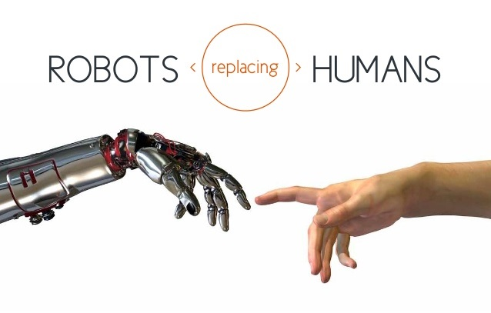
Motivation
5
Notes:
5

Slide 6
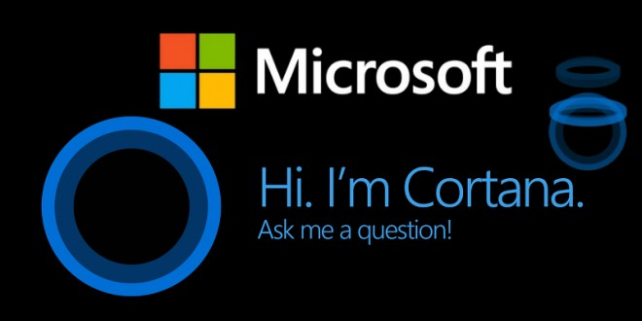

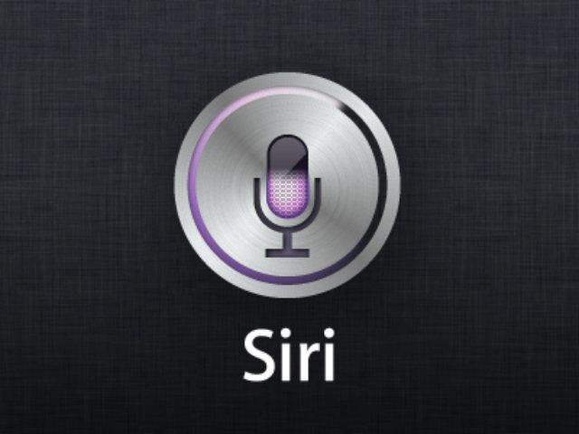
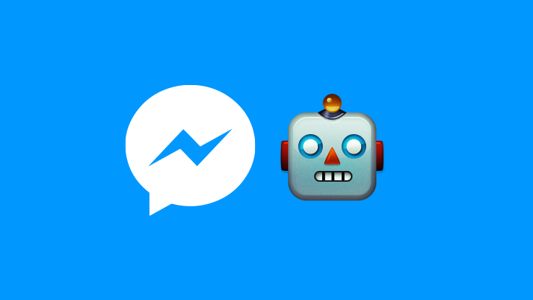
Motivation
6
Notes:
6

Slide 7
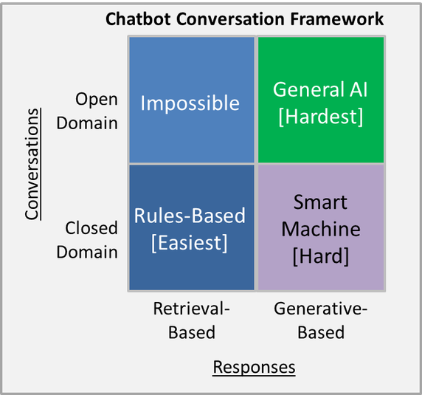
Motivation
Retrieval-based vs Generative-based
Open Domain vs Closed Domain
7
Notes:
7

Slide 8
Objective
Research on the state of the art Natural Language Processing algorithms and techniques.
Build an open domain, conversational dialogue system based on large dialogue corpora using generative models.
8
Notes:
8

Slide 9
Outline
Motivation and Objective
Design
9
Notes:
9

Slide 10
Design
10
Notes:
10

Slide 11
Outline
Motivation and Objective
Design
Current State
Finished milestones
11
Notes:
11

Slide 12
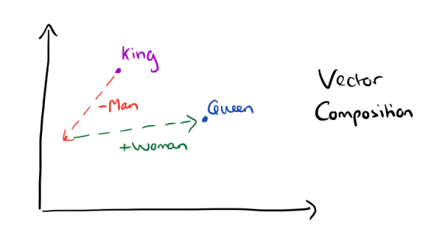
Dataset representation
Datasets: Cornell Movie Dialogue Corpus, Open Subtitles 2016.
Text representation using word embeddings (word2vec).
12
Notes:
2013
12

Slide 13
Model
A sequence-to-sequence model based on a recurrent neural network with long short-term memory.
13
Notes:
The model comes in 2014
13

Slide 14
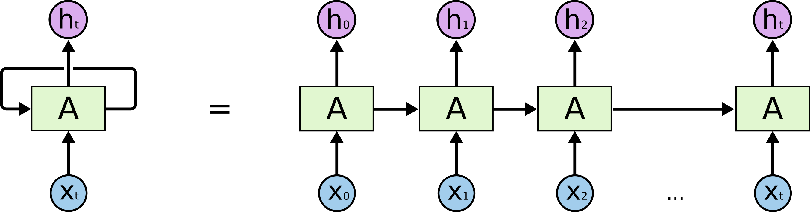
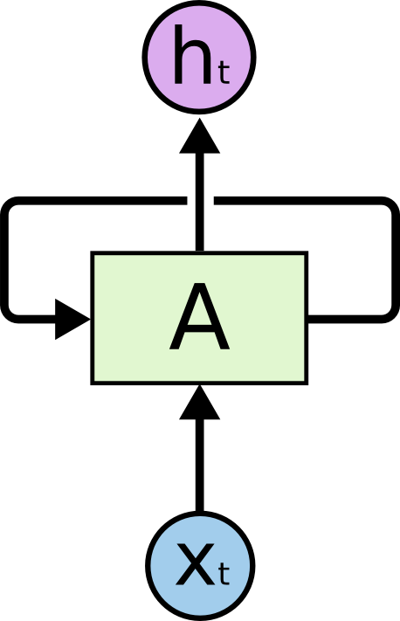
Recurrent Neural Network
14
Notes:
1994 the RNN
14

Slide 15
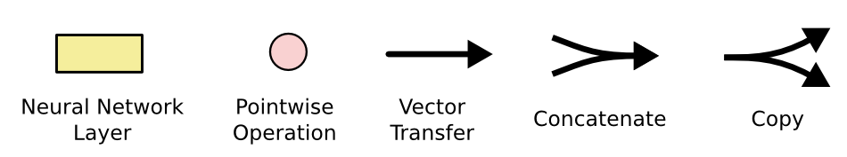

Long Short Term Memory (LSTM)
15
Notes:
The LSTM 1997
15

Slide 16
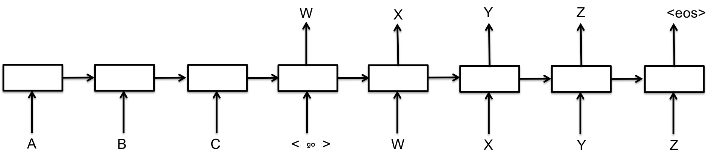
Sequence to Sequence Model
16
Notes:
16

Slide 17
Outline
Motivation and Objective
Design
Current State
Finished Milestones
In Progress Milestones
17
Notes:
17

Slide 18
Model Training
Given a loss function, our objective is to find the parameters U, V and W that minimize it for the given data during the training phase.
Traditionally, we’d use the SGD method with BPTT to optimize the parameters, but this method is slow and suffers from the vanishing gradient problem.
We use LSTM to fix the vanishing gradient problem.
We use a variation of SGD (RMSPROP) to increase the performance.
18

Slide 19
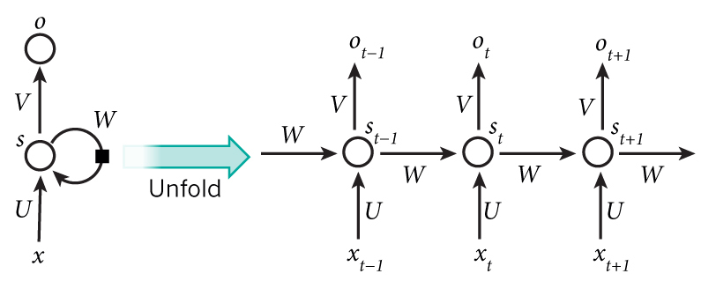
Model Training
18

Slide 20
Model Testing
After training the model we can evaluate it on the test set.
This will run the trained model on the test set.
We will get probability scores for unseen data.
We could imagine feeding in 100 potential responses to a context and then picking the one with the highest score.
19
Notes:
20

Slide 21
Interface
Build a web application for the Bot, which allows the user to interact with the Bot and start a conversation.
20
Notes:
21

Slide 22
Outline
Motivation and Objective
Design
Current State
Finished Milestones
In Progress Milestones
Limitations
21
Notes:
22

Slide 23
Limitations
Lack of closed domain conversational datasets which forced to the model to be open domain.
Connecting the model with Facebook Messenger, which needs our ML model to be hosted online.
22
Notes:
23

Slide 24
Outline
Motivation and Objective
Design
Current State
Finished Milestones
In Progress Milestones
Limitations
Expected Outcome
23
Notes:
24

Slide 25
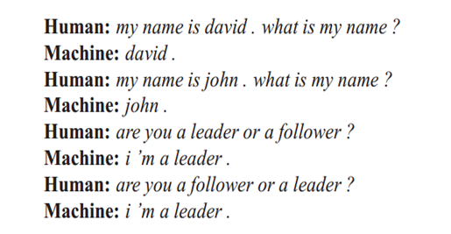
Expected Outcome
Example 1: Simple Q&A
24
Notes:
25

Slide 26
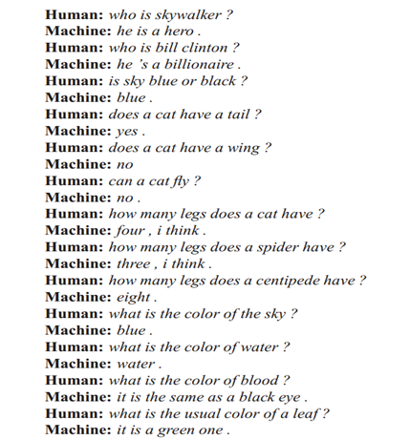
Expected Outcome
Example 2: General Knowledge
25
Notes:
26

Slide 27
Outline
Problem Definition
Design
Current State
Prototype
26
Notes:
27

Slide 28
Resources and Further Readings
A Neural Conversational Model 2015 [Oriol Vinyals, Quoc Le] [arxiv]
LSTM Neural Networks for Language Modeling [Sundermeyer] [pdf]
https://github.com/Conchylicultor/DeepQA.
The Unreasonable Effectiveness of Recurrent Neural Networks.
Deep Learning for Chatbots (part1, part2).
27
Notes:
28

Slide 29

28
Notes:
29

Slide 30
Thank You!
29
Notes:
30

