Slide 1
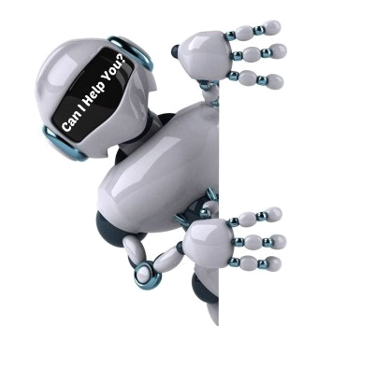
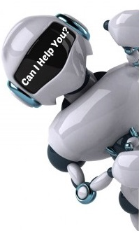
Conversational Dialogue Model (CHAT-BOT)
1

Slide 2
Team members
Abdel-Rahman Hamdy CS Abdel-Hameed Hamed CS Ahmed Gamal El-Taweel CS Ibrahim Sharaf CS Yousr Ahmed CS
Supervisors
TA. Zeinab Fouad DR. Wael Hamdy
Prof. Mostafa Aref
2

Slide 3
Outlines
Recap:
Motivation.
Objectives.
System Analysis & Design:
Data.
Analysis.
Design.
Used Algorithms
Existing solutions.
What we use.
Improvements.
Progress:
Stages Finished.
Problems Faced.
What’s Next.
References:
3

Slide 4
Outlines
Recap:
Motivation.
Objectives.
4

Slide 5
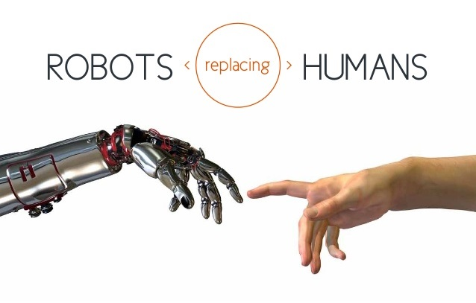
Conversational Dialogue Model (ChatBot)
5

Slide 6
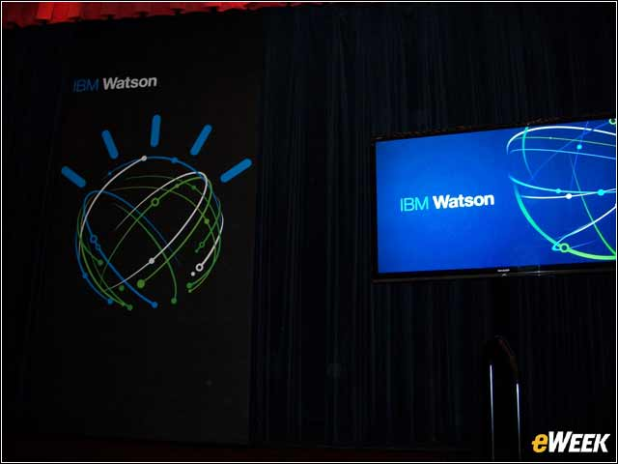



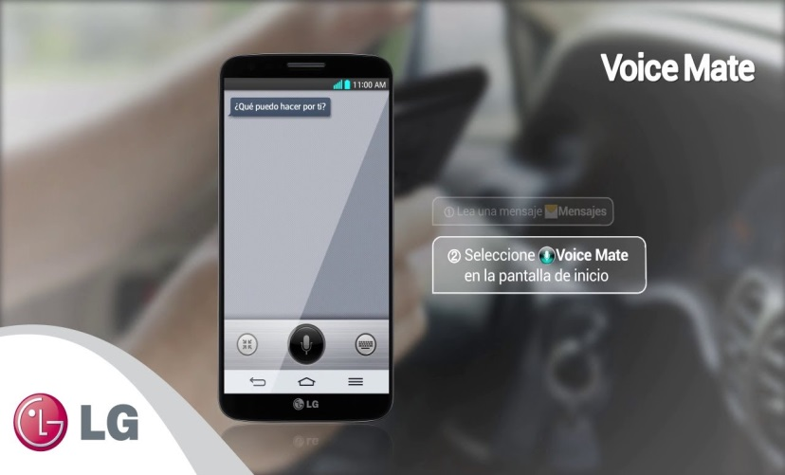

Some examples of ChatBots
6

Slide 7
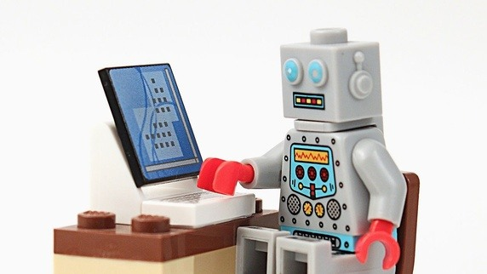
Types of ChatBots according to the usage
Strictly human-to-chatbot conversation: Open domain chatbot. To beat the Turing test — to become indistinguishable from humans during conversation.
7

Slide 8


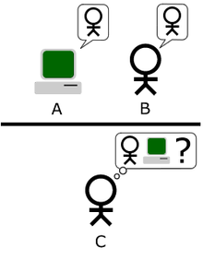
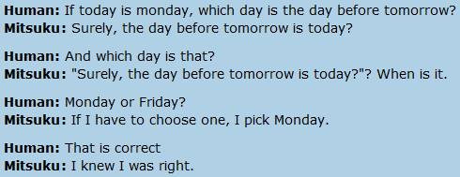
8

Slide 9
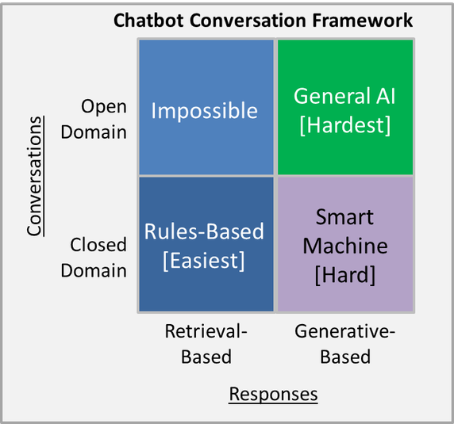
Objectives
To build an open domain, conversational dialogue system based on large dialogue corpus using generative models.
To Find new ways to improve interactions between human and machine.
To beat the Turing test.
9

Slide 10
Outlines
Recap:
Motivation.
Objectives.
System Analysis & Design:
Datasets.
Analysis.
Design.
10

Slide 11
Datasets
Cornell movie-dialogs corpus
Open Subtitles 2016.
11

Slide 12
Outlines
Overview:
The role of the system is to provide a chatbot that will be able to answer questions related to the admission procedure.
User:
A user is anyone who would like to visit the website and engage in a conversation.
12

Slide 13
Requirements
Open domain
Chatting
User interface
13

Slide 14
Analysis Requirements
Open Domain
The user can talk about most topics (personality, core knowledge, small talk, general knowledge etc.)
14

Slide 15
Analysis Requirements(cont.)
Chatting
The system should answer most of questions properly and ask questions too.
The system should allow user to chat.
The system should inform the user if an answer isn’t available to learn.
15

Slide 16
Analysis Requirements(cont.)
User Interface:
an easy to use
should be compatible with all commonly used browsers, such as Internet explorer, Firefox, Google chrome and Safari.
16

Slide 17
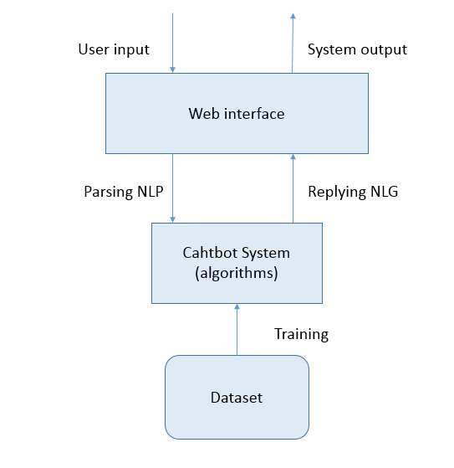
Design
17

Slide 18
Outlines
Recap:
Motivation.
Objectives.
System Analysis & Design:
Data.
Analysis.
Design.
Used Algorithms
Existing solutions.
18

Slide 19
Existing solutions:
Google Model
Microsoft Model
19

Slide 20
Google Model
Paper: A Neural Conversational Model
By: Oriol Vinyals - Quoc V. Le QVL Data Set: open-domain movie transcript dataset: OpenSubtitles
Used Algorithm: the sequence-to-sequence model based on a recurrent neural network with long short-term memory.
20

Slide 21
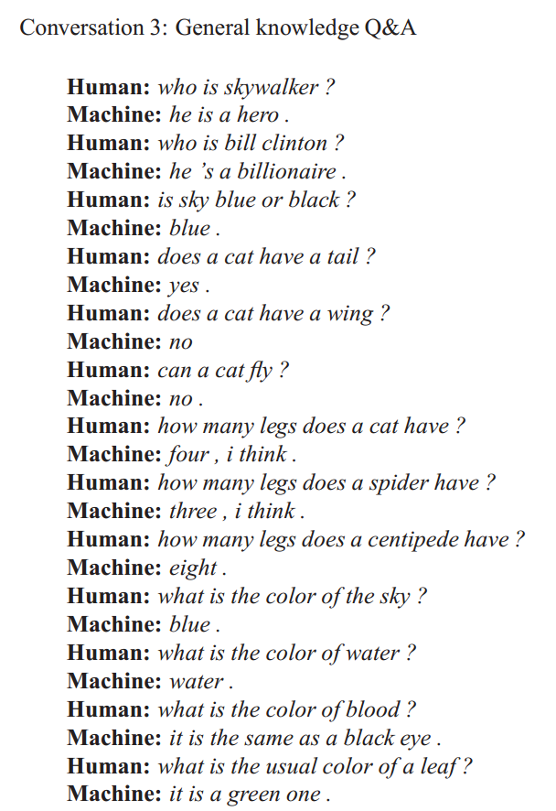
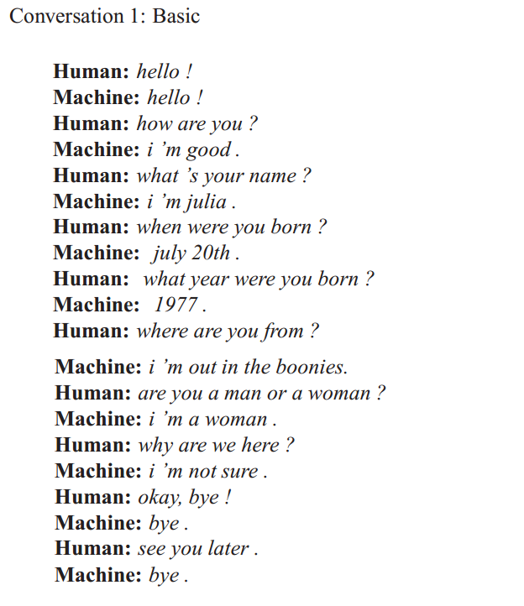
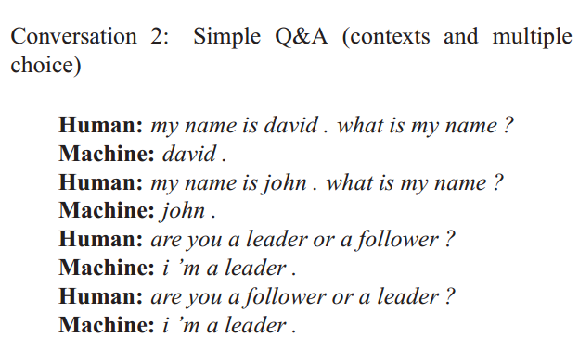
Google Model
Sample Output:
21

Slide 22
Microsoft Model
Paper: A Persona-Based Neural Conversation Model
By: Michel Galley - Chris Brockett Data Set: Twitter conversation snippets
Used Algorithm: the sequence-to-sequence model based on a recurrent neural network with long short-term memory.
22

Slide 23
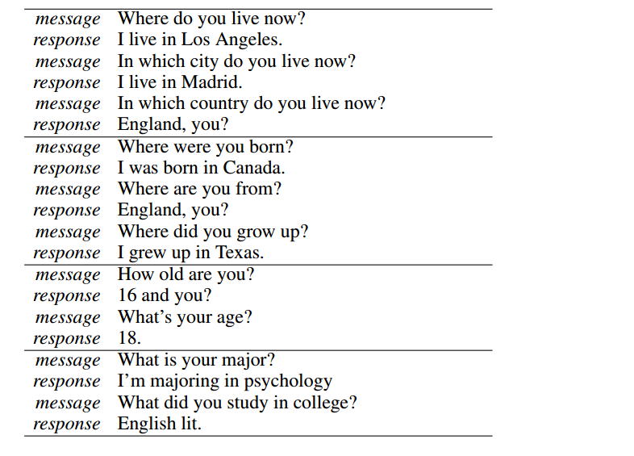
Microsoft Model
Sample Output:
23

Slide 24
Outlines
Recap:
Motivation.
Objectives.
System Analysis & Design:
Data.
Analysis.
Design.
Used Algorithms
Existing solutions.
What we use.
Improvements.
24

Slide 25
Used Algorithms
What Do We Use?
A sequence-to-sequence model based on a recurrent neural network with long short-term memory.
25

Slide 26
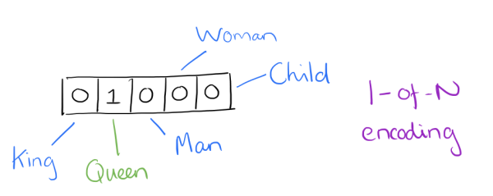
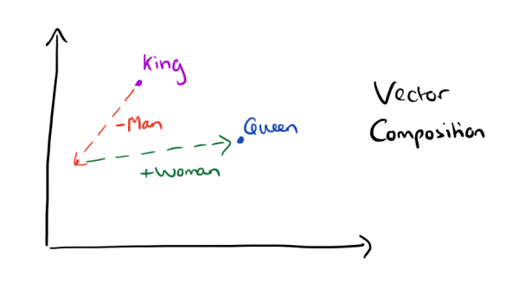
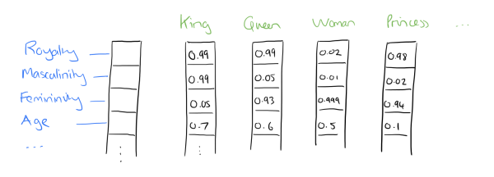
Word representation
Bag of words model.
Word Embedding model.
26
Notes:
2013.
Word2vec: group of related models that are used to produce word embeddings.
These models are shallow, two-layer neural networks that are trained to reconstruct linguistic contexts of words.
Word2vec takes as its input a large corpus of text and produces a vector space,

Slide 27
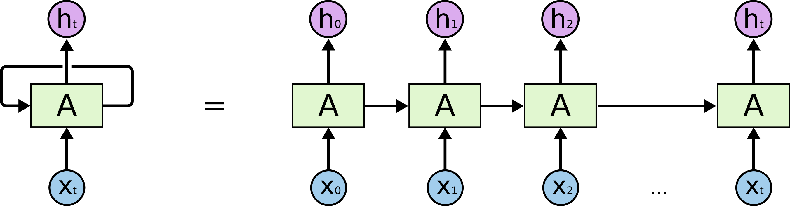
Recurrent Neural Network (RNN)
27
Notes:
Used in machine translation and language modeling.
Problem:
Pretend the word at last, ex: “there are clouds in the …”
“I grew up in France… I speak fluent French.”
The Problem of Long-Term Dependencies

Slide 28
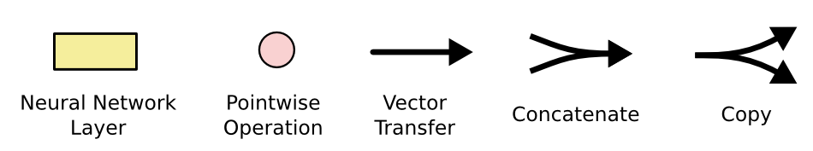

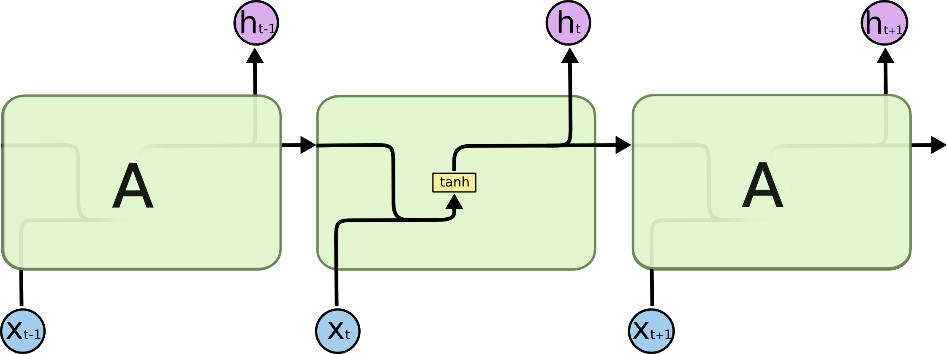
Long Short-Term Memory(LSTM)
28
Notes:
LSTM created by Sepp Hochreiter (creator of support vector machine) and Jürgen Schmidhuber in 1997
Sigmoid and tanh are activation function

Slide 29
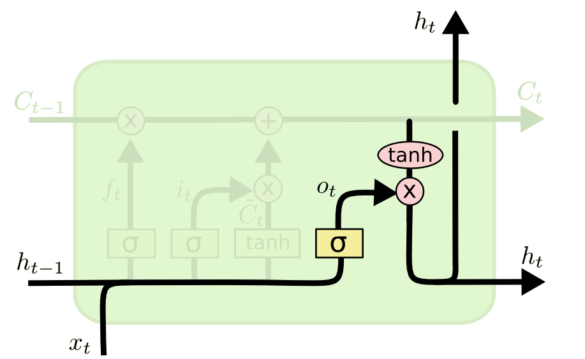
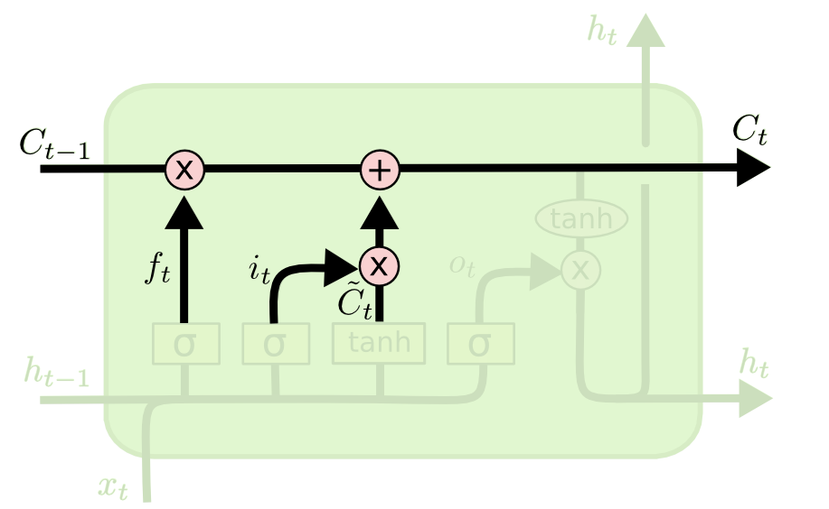
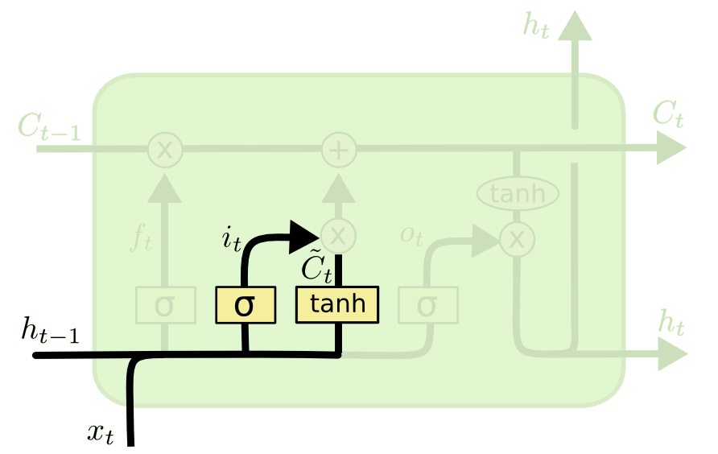
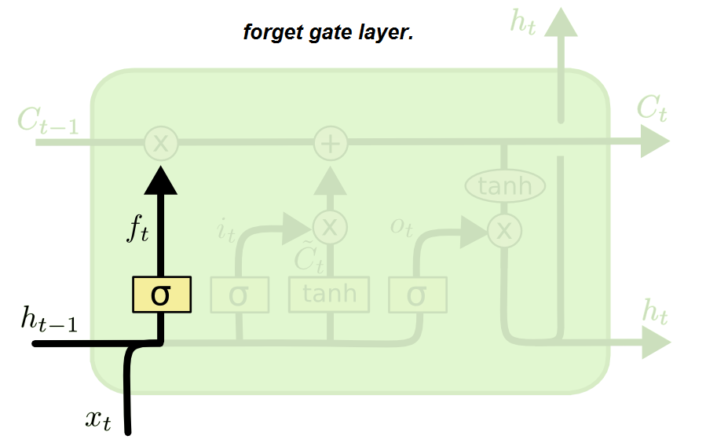
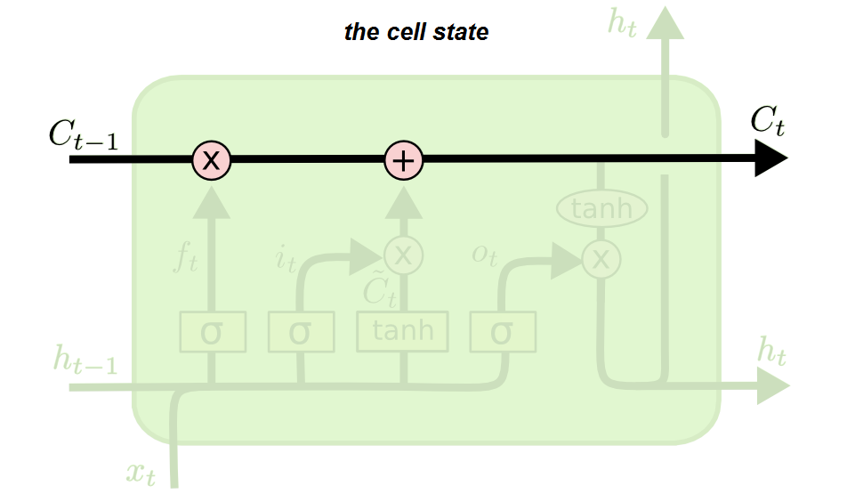
The Core Idea Behind LSTMs
29
Notes:
LSTM created by Sepp Hochreiter (creator of support vector machine) and Jürgen Schmidhuber in 1997
Sigmoid and tanh are activation function

Slide 30
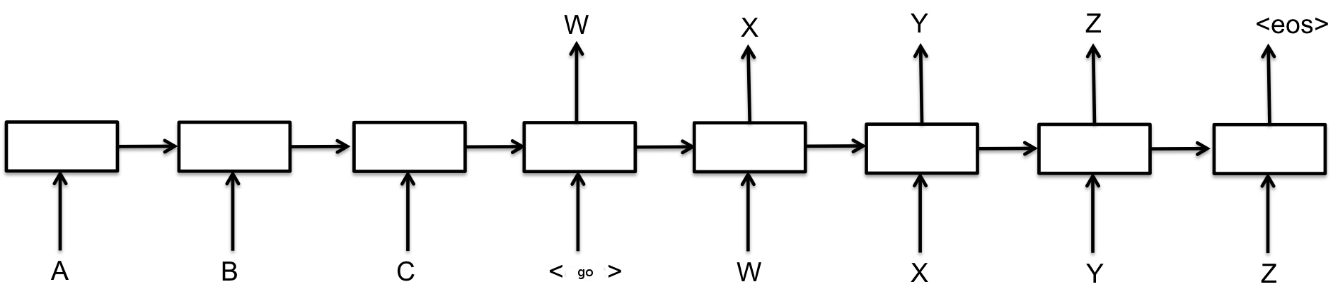
Sequence To Sequence Model(Seq2Seq)
30
Notes:
1- map the input sequence to a fixed-sized vector using one RNN, and then to map the vector to the target sequence with another RNN

Slide 31
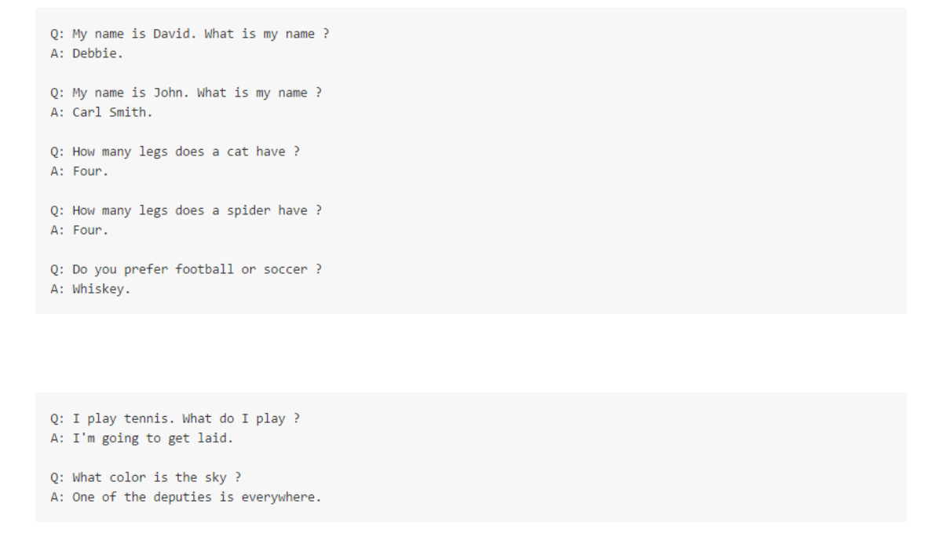
Do we need a better method ?
31
Notes:
LSTM created by Sepp Hochreiter (creator of support vector machine) and Jürgen Schmidhuber in 1997

Slide 32
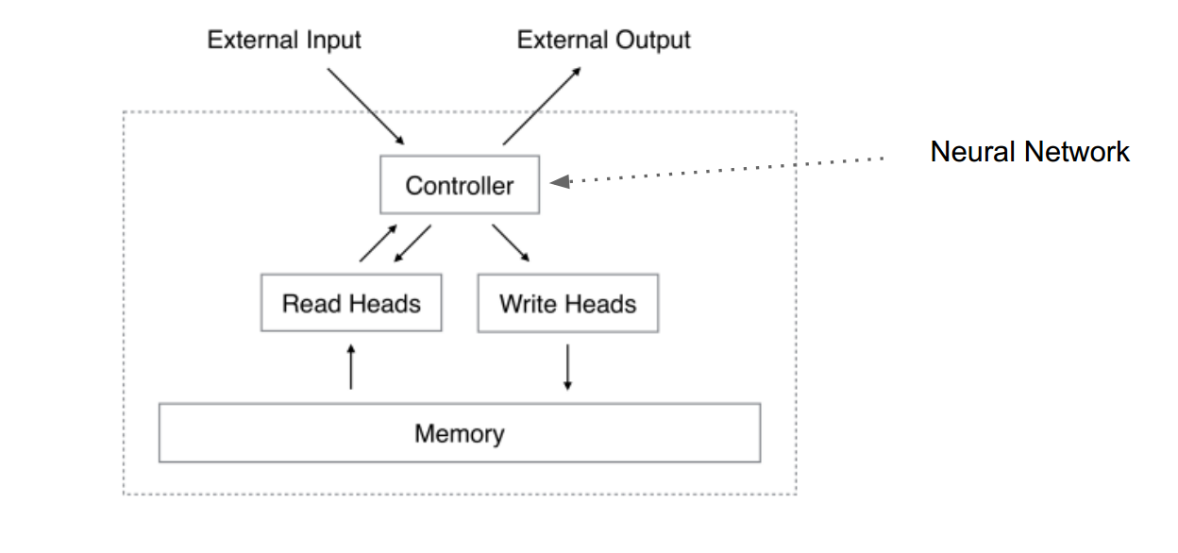
Neural Turing Machine
32
Notes:
Was proposed in 2014, It combines the fuzzy pattern matching capabilities of neural networks .

Slide 33
Outlines
Recap:
Motivation.
Objectives.
System Analysis & Design:
Data.
Analysis.
Design.
Used Algorithms
Existing solutions.
What we use.
Improvements.
Progress:
Stages Finished.
Problems Faced.
What’s Next.
3
33

Slide 34
Stages Finished
Setting up the environment: Linux OS, Anaconda package for Python and libraries and TensorFlow.
Gathering datasets: Cornell movie-dialogs corpus (220K), Open Subtitles 2016 (22.27M)
Cleaning datasets using BeautifulSoup for removing XML tags and NLTK for tokenization and stemming.
34

Slide 35
Problems faced
Switching the coding environment to Linux – Ubuntu.
Dealing with large text datasets.
Getting familiar with open source codebases.
35

Slide 36
What’s next
Text representation using word2vec.
Building the recurrent neural network model.
Feeding the model with the word vectors for training.
36

Slide 37
Outlines
Recap:
Motivation.
Objectives.
System Analysis & Design:
Data.
Analysis.
Design.
Used Algorithms
Existing solutions.
What we use.
Improvements.
Progress:
Stages Finished.
Problems Faced.
What’s Next.
References:
37

Slide 38
References:
LSTM Neural Networks for Language Modeling[Martin Sundermeyer]
Sequence to Sequence Learning with Neural Networks [Ilya Sutskever]
A Neural Conversational Model 2015 [Oriol Vinyals]
A Persona-Based Neural Conversation Model [Jiwei Li]
Neural Turing Machines [Alex Graves]
38

Slide 39
Questions ?
39

Slide 40
Thank You.
40

