Slide 1
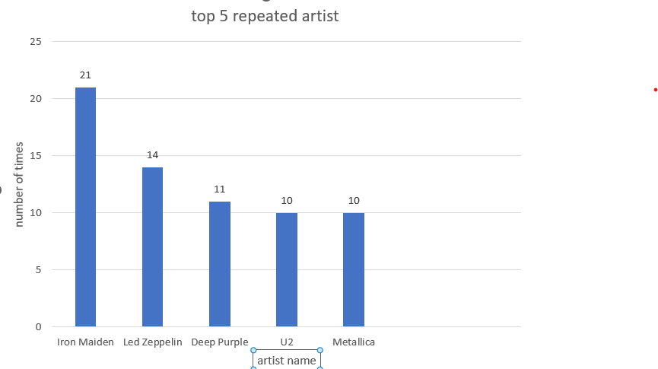
1- what are the top 5 repeated artists ?
<visualization>
<description>
This graph represent the most repeated artists .
It’s clear that iron maiden is the most repeated artist .

Slide 2
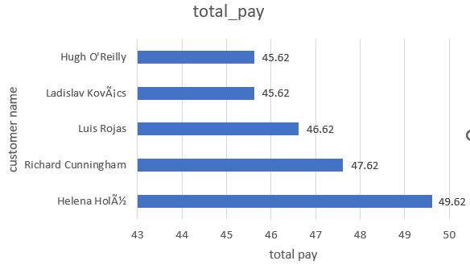
2- who are the top 5 customers in paying and what are their payments?
<visualization>
This graph represent the name of top 5 customers paid most and how much their total pay

Slide 3
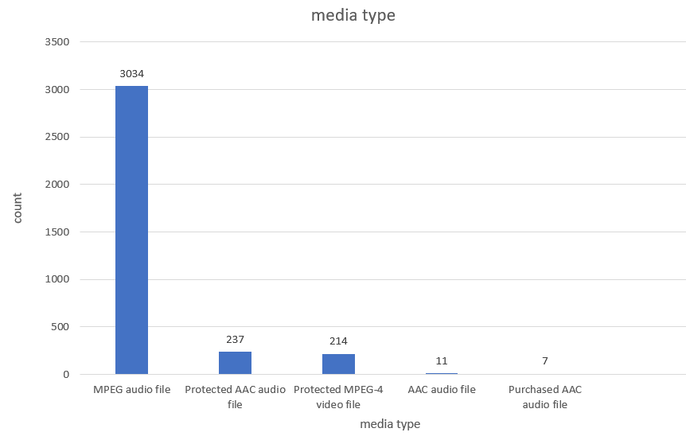
3- which is the most common media type?
Is clear that MPEG is the most commonly used media type .
From the graph it’s shown that MPEG audio is in the first place and exceed 10 times more than the Protected AAC audio in the second place .

Slide 4
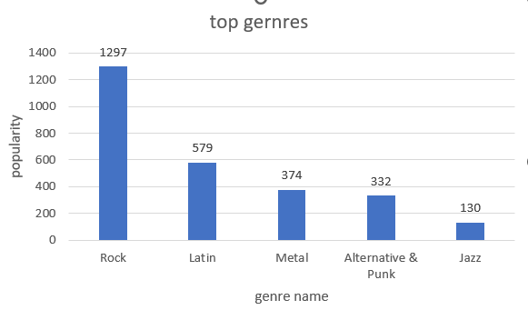
4 – what are the top genres preferred by listeners ?
The last graph to represent the most popular music genres prefferred by listners .

