Slide 1

Building a Secure AWS Network: Mastering Amazon VPC
Welcome! We're diving into the world of Amazon Virtual Private Cloud (VPC), exploring its core concepts, benefits, and hands-on configuration.

Slide 2
What is Amazon VPC?
Your Secure Private Network
Complete Control
Amazon VPC is a service that allows you to create and configure your own virtual network within AWS.
It gives you complete control over your network infrastructure, including subnets, security groups, and routing.

Slide 3

Benefits of Using an Amazon VPC
Enhanced Security
Scalability and Flexibility
Cost Optimization
Isolate your resources, restrict access, and configure firewalls for a secure environment.
Easily expand your network and deploy resources as your needs grow.
Optimize resource usage by controlling network traffic and reducing unnecessary costs.

Slide 4
Configuring a VPC: Step-by-Step
Create a VPC
1
Define your VPC's CIDR block and region. You can choose a 10.0.0.0/16 or 172.16.0.0/16 CIDR block.
2
Create Subnets
Divide your VPC into subnets for different purposes, such as public and private.
Configure Security Groups
3
Create security groups to manage inbound and outbound traffic for your resources.
4
Deploy Resources
Launch EC2 instances, databases, or other resources within your VPC.
Connect to the VPC
5
Use a VPN or Bastion host to securely access resources inside your VPC.

Slide 5
Defining Subnets and Network ACLs
Subnets: Organized Network Segments
Network ACLs: Security at the Subnet Level
Divide your VPC into subnets to manage resources logically and isolate traffic.
Network ACLs act as firewalls for your subnets, controlling traffic based on IP addresses.

Slide 6
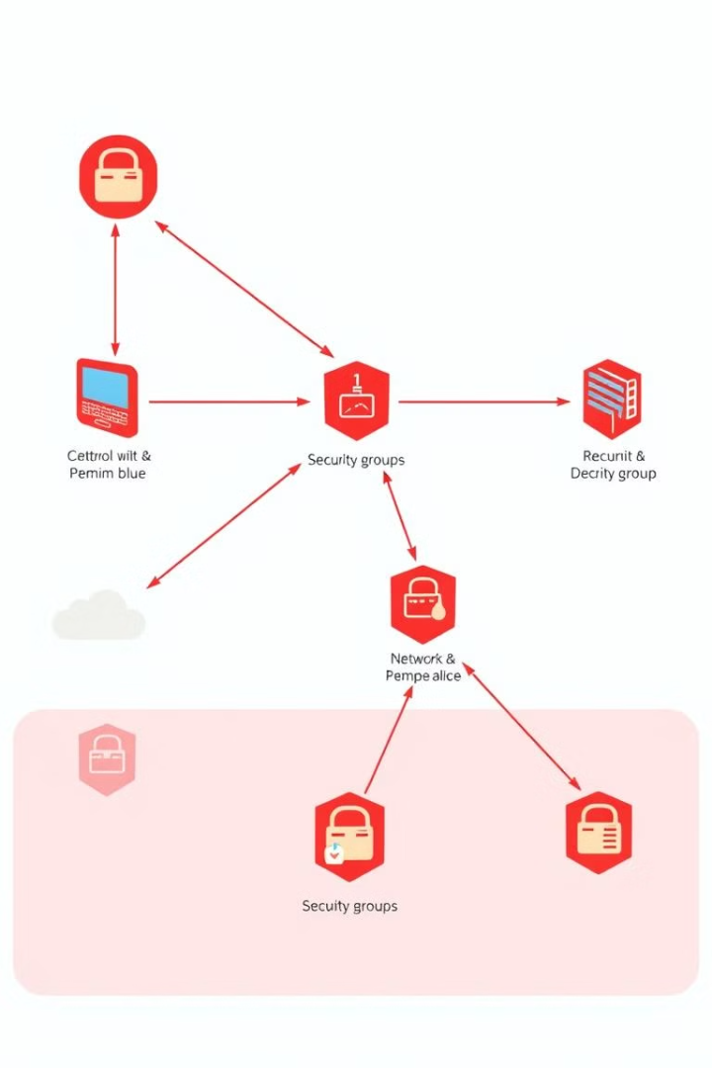



Implementing Security Groups
Traffic Control
Control inbound and outbound traffic based on protocols, ports, and source/destination IP addresses.
Resource Security
Attach security groups to instances, databases, or other resources for granular control.
Enhanced Protection
Security groups complement network ACLs, providing an additional layer of security.

Slide 7
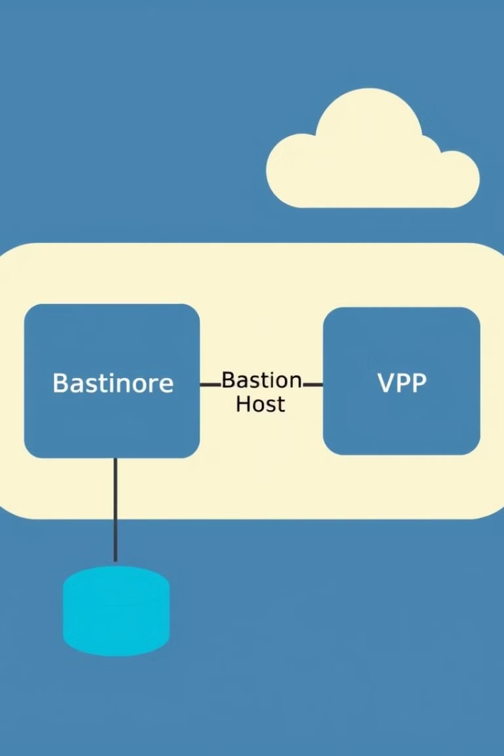


Connecting to the VPC: Bastion Hosts and VPN
Bastion Hosts
Bastion hosts act as secure gateways for accessing resources within the VPC.
VPN Connections
Establish secure connections from your on-premises network to your VPC.

Slide 8

Monitoring and Managing the VPC
1
2
CloudWatch
Flow Logs
Monitor VPC performance, health, and security using CloudWatch metrics.
Track network traffic patterns within your VPC for security and troubleshooting.

Slide 9
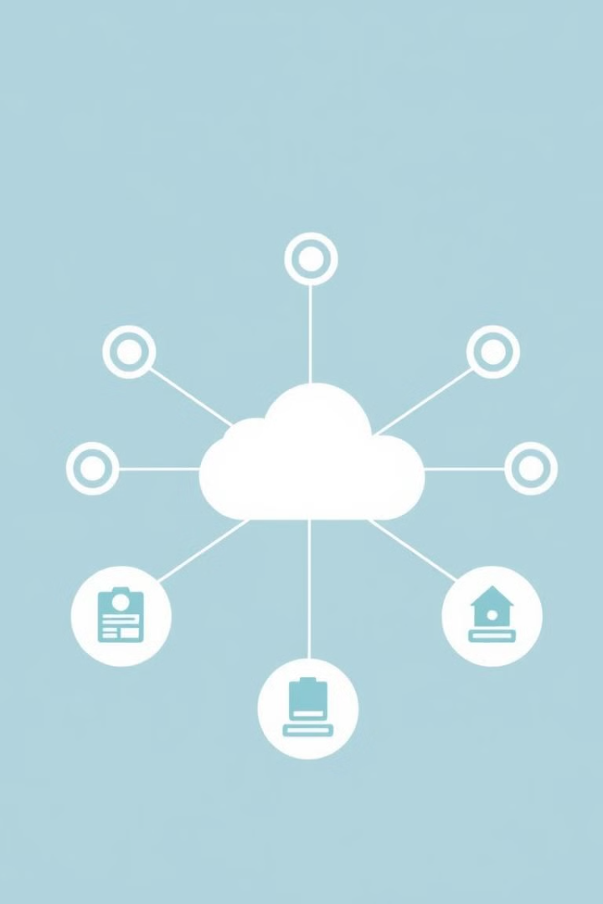
Conclusion and Next Steps
Congratulations! You've gained a solid understanding of Amazon VPC's fundamentals and how to build a secure network in the cloud. The next steps involve customizing your VPC with advanced features, including NAT gateways, route tables, and VPC peering.

