Slide 1
Handwritten Prescription Recognition​
Supervised by:
Dr. ahmed salah.
Al. Ghada hamed.

Slide 2
Team members:
Member name | Department | E_mail
Abdelrahman Ibrahim Abdelrahman | CS | Abdelrahman.shalaby1997@gmail.com
Aya Abd El-Basset Abd El-Samad | CS | ayaabdelbasset273@gmail.com
Donia Adel Mohamed | CS | Donia.adel301196@gmail.com
Ranya Roshdy Hassan | CS | ranya.roshdy97@gmail.com
Youssef Sherif Eid | CS | Joeshiref@hotmail.com

Slide 3
Main Points
Introduction.
Problem definition.
Motivation.
Objective.
Phases.
System architecture.
Related work and datasets.
Time plan.
References.

Slide 4

Introduction
Artificial Intelligence is being used in many fields nowadays.
Optical Character Recognition.
Handwritten Character Recognition.

Slide 5
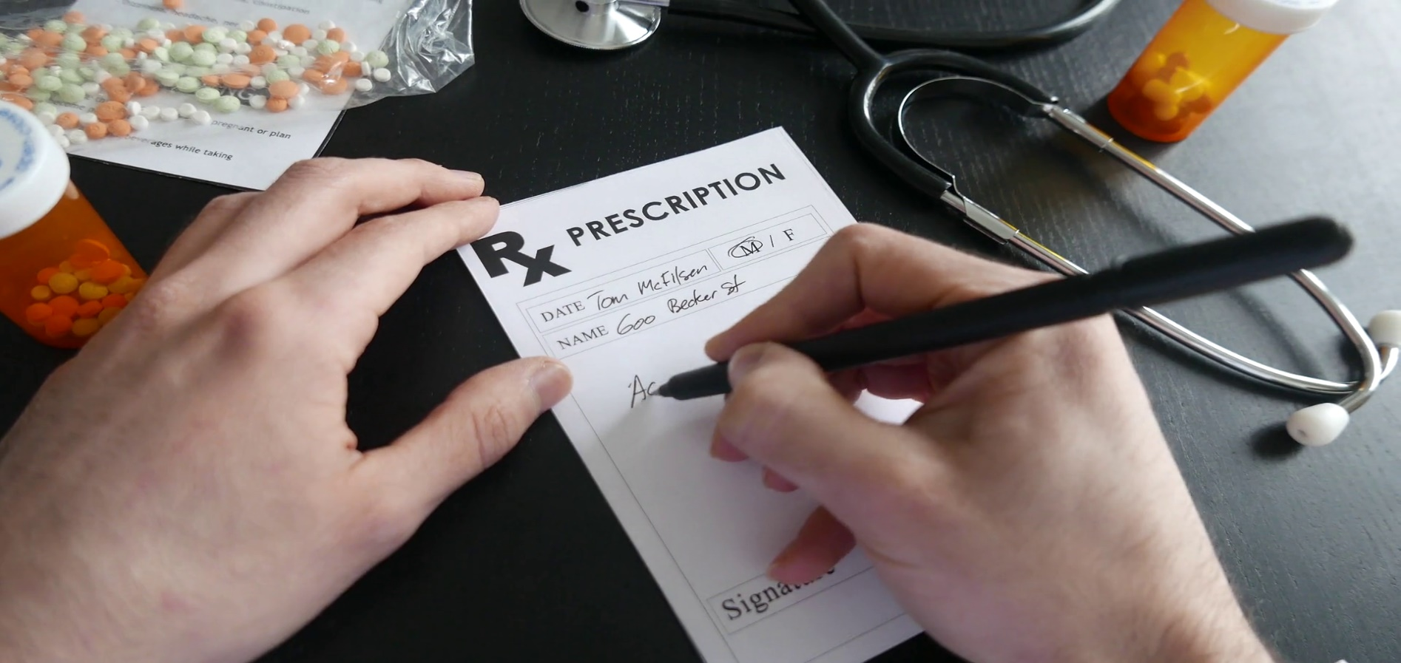
Problem Definition
Difficulty of medical doctors’ handwriting.
Issues of doctors' cursive handwriting.

Slide 6
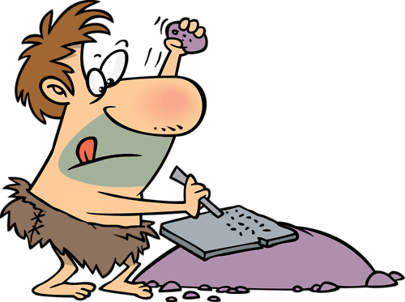

Motivation
Despite the abundance of technological writing tools, people still take their notes traditionally: with pen and paper.
In Egypt, patients verbally ask for medications.
Pharmacists find it difficult to read prescriptions.

Slide 7

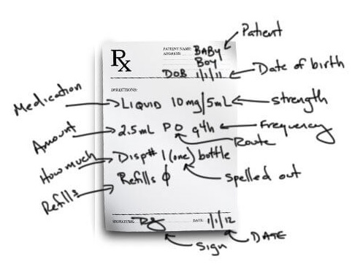
Objective
Implementing the current state-of-the-art of HCR.
Explore recognition techniques relevant to medical prescription.
Providing an exact or approximate medication.

Slide 8
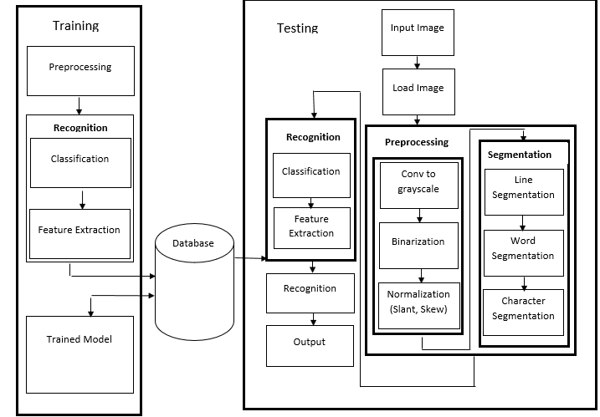
System Architecture
The process of the expected system

Slide 9
Phases
Preprocessing
Noise reduction
Binarization
Segmentation
Horizontal projection
Vertical projection
Feature Extraction
Loop finding
Classification
SVM
HMM
Syntax analysis
Semantic analysis
Postprocessing
Skew correction
Slant estimation
Edge detection
Normalization
Padding
Rotating
Stroke length
Stroke width
Crossing points
Row pixel
Softmax
Naïve Bayes
CNN
Error correction
Edge detection
Box method
Diagonal distance approach
Gradient operations approach
Standard deviation
MLP
Thresholding
Slant estimation and normalization
DAR technique
Feed Forward back propagation neural network
Notes:
El klam ely mktob fy kol phase da mogrd examples. Msh shart el project bt3na hy3ml kol da

Slide 10
Related Work
Paper no. | Preprocess | Segmentation | Feature Ext. | Classification | Postprocess
[1] | Slope and Slant correction Binarization Detect word Region core | Horizontal projection Vertical projection | - | KNN classifier. LeNet Architecture. AlexNet Architecture. Three-Layer Custom Architecture. | -
[2] | Noise removal Binarization | Horizontal projection Vertical projection | - | CNN classifier | -
[3] | Noise removal Skew correction Cropping and resizing Morphological operations | Horizontal projection Vertical projection | Convex hull | SVM | -

Slide 11
Related Work (Cont.)
Paper no. | Preprocess | Segmentation | Feature Ext. | Classification | Postprocess
[4] | Binarization Slant correction Smoothing and noise removal Normalization | Line segmentation | Box method Diagonal distance approach Mean Gradient operations approach Standard deviation Edge detection | MLP classifier | -
[5] | Noise Reduction Binarization Edge Detection Thresholding Skew detection Slant estimation and normalization | DAR technique | - | feed forward back propagation neural network | -

Slide 12
Datasets
Type | Name | Size | Content | Available
Characters | Emnist | 500 MB | Set of handwritten characters of lowercase and uppercase letters. | Yes
 | Nist | 1 GB | Hand printed samples forms from 3600 writers, 810,000 character images. | Yes
 | Chars74K | 200 MB | Segmented Characters from natural scenes. Hand-drawn characters. Characters from computer fonts. | Yes
Words | IAM | - | Dataset contains forms of unconstrained handwritten forms saved as PNG images. | Yes
Medical | Lack of medical datasets due to the variety of medical forms all over the world.

Slide 13
Suggested tools
Python
Anaconda
Numpy
opencv
Matlab
Visual studio
Tensor Flow
Notes:
Matlab: this tool help us to process the images and do the preprocessing
Python: contains optimized Machine Learning libraries
Tensor Flow: build models for neural networks.

Slide 14
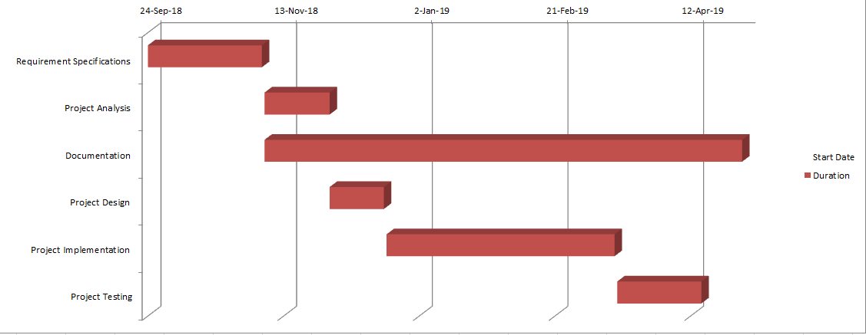
Time Plan
Project Activities | Start Date | End Date
Requirement Specifications | 24/9/2018 | 5/11/2018
Project Analysis | 6/11/2018 | 30/11/2018
Documentation | 6/11/2018 | 1/5/2019
Project Design | 30/11/2018 | 20/12/2018
Project Implementation | 21/12/2018 | 15/3/2019
Project Testing | 16/3/2019 | 16/4/2019
Notes:
Mention that this time-plan is etimated.
Some of the phases may overlap.

Slide 15
References
[1] Vishnu Sundaresan, Jasper Lin. “Recognizing Handwritten Digits and Characters” Stanfrod University fall 2015, CS231.
[2] Rohan Vaidya, Darshan Trivedi, Sagar Satra. "Handwritten Character Recognition Using Deep-Learning." Proceedings of the 2nd International Conference on Inventive Communication and Computational Technologies (ICICCT 2018) IEEE Xplore Compliant - Part Number: CFP18BAC-ART; ISBN:978-1-5386-1974-2.
[3] Pritam Dhande, Reena Kh arat. "Recognition Of Cursive English Handwritten Characters. " International Conference on Trends in Electronics and Informatics ICEI 2017.
[4] Gauri Katiyar and Shabana Mehfuz "A hybrid recognition system for off‑line handwritten characters." Department of Electrical Engineering, Jamia Millia Islamia, New Delhi, Indias.
[5] Savitha Attigeri "Neural Network based Handwritten Character Recognition system" Department of Computer Science and Engineering STJIT,Ranebennur 3 March 2018.

Slide 16

Questions?!

Slide 17


