Slide 1
Handwritten Prescription Recognition

Slide 2


Supervising Staff
Dr : Ahmed Salah
AI : Ghada Hamed
Notes:
تعرف بالـ staff المشرف علي المشروع

Slide 3


Team Members
Youssif Sherif Eid
Aya Abdelbasset
Donia Adel
Ranya Roshdy Hassan
Abdelrahman Ibrahim
Notes:
تعرف اعضاء الـ team

Slide 4










Agenda
Problem definition
Objective
System architecture
Introduction
Stages finished
Problem faced
Time Plan
References
Limitations
Future work
Notes:
دي الـ agenda الي هنتكلم عنها في الـ seminar

Slide 5

Agenda
Problem definition
Objective
System architecture
Introduction
Stages finished
Problem faced
Time Plan
References
Limitations
Future work
Notes:
دي الـ agenda الي هنتكلم عنها في الـ seminar

Slide 6
Introduction
Artificial Intelligence is being used in many fields nowadays.
Optical Character Recognition.
Handwritten Character Recognition.

Slide 7

Agenda
Objective
System architecture
Problem definition
Stages finished
Introduction
Problem faced
Time Plan
References
Limitations
Future work
Notes:
دي الـ agenda الي هنتكلم عنها في الـ seminar

Slide 8
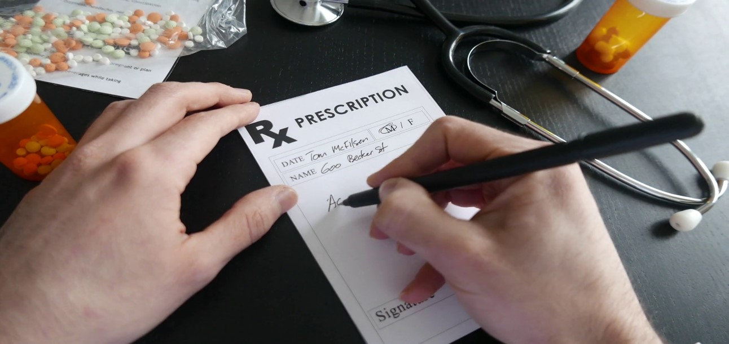
Problem Definition
The traditional way of writing still exist.
Difficulty of medical doctor’s handwriting.
Pharmacists find it difficult to read prescriptions.
Issues of doctor’s cursive handwriting.

Slide 9

Agenda
Problem definition
Objective
System architecture
Introduction
Stages finished
Problem faced
Time Plan
References
Limitations
Future work
Notes:
دي الـ agenda الي هنتكلم عنها في الـ seminar

Slide 10
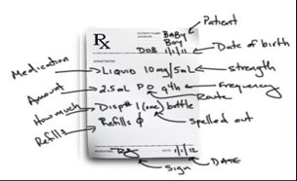
Objective
Implementing the state-of-the-art of HCR
Implementing recognition techniques relevant to medical prescription .
Providing an exact or approximate medication .

Slide 11

Agenda
Problem definition
Objective
Stages finished
System architecture
Introduction
Problem faced
Time Plan
References
Limitations
Future work
Notes:
دي الـ agenda الي هنتكلم عنها في الـ seminar

Slide 12
Stages finished
Analysis
Expectations understood.
Gathered requirements.
Design
Structure designed.
Implementation
Cursive handwritten recognition model.
Preprocessing phase (In process).

Slide 13

Agenda
Problem definition
Objective
Stages finished
System architecture
Introduction
Problem faced
Time Plan
References
Limitations
Future work
Notes:
دي الـ agenda الي هنتكلم عنها في الـ seminar

Slide 14
System Architecture
Preprocessing
Input Image
Feature Extraction
Recognition
Classification
Feature Extraction
Preprocessing
Image Enhancement
Classification
Database​
Trained Model
Recognition
Lines Segmentation
Output

Slide 15

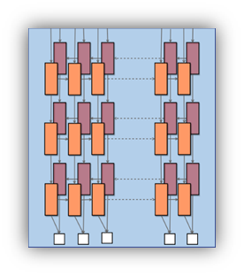
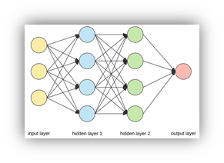

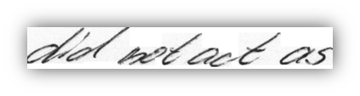
Model Architecture
Input:
RNN:
Recognize text
Output:
Text
Image
CNN:
Feature extraction
CTC:
Fix error
did not act as
Input
Output Text
CNN
RNN
Notes:
الـ system هتاخد الصورة
وتعمل عليها preprocessing عشان تطلع الورقة
وبعدها هنطلع الـ features المميزة
زنخلي الـ system يعمل train عليها

Slide 16
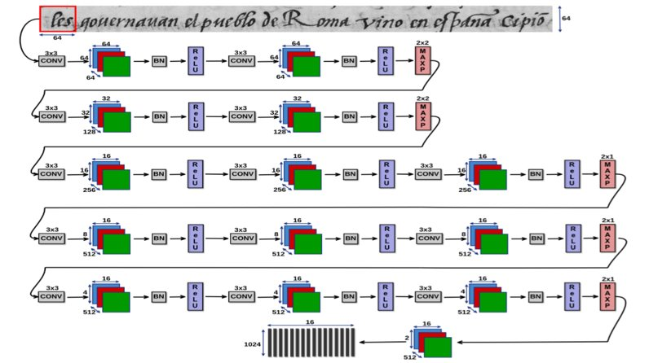
CNN Feature Extraction

Slide 17
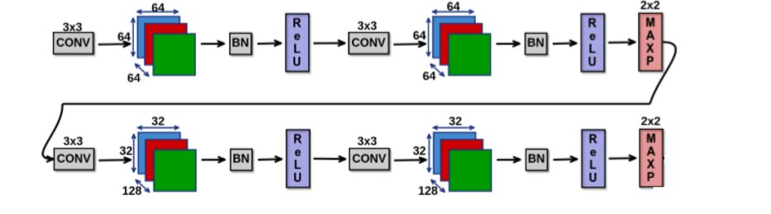
CNN Feature Extraction

Slide 18
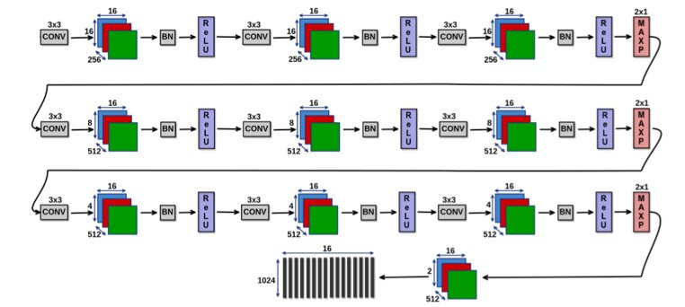
CNN Feature Extraction

Slide 19
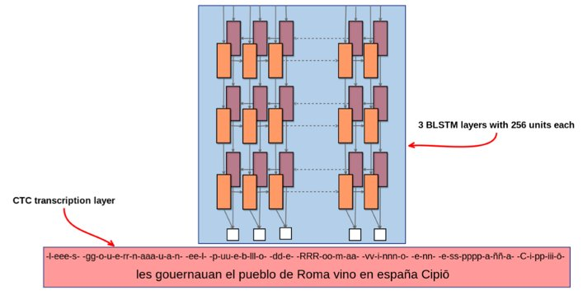
RNN

Slide 20

Agenda
Problem definition
Objective
System architecture
Introduction
Stages finished
Problem faced
Time Plan
References
Limitations
Future work
Notes:
دي الـ agenda الي هنتكلم عنها في الـ seminar

Slide 21
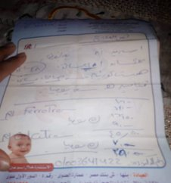

limitations
Completion date.​
Amount of Available resources.​
A line image.​
Image without noise.
Budget.

Slide 22

Agenda
Problem definition
Objective
System architecture
Introduction
Stages finished
Problem faced
Time Plan
References
Limitations
Future work
Notes:
دي الـ agenda الي هنتكلم عنها في الـ seminar

Slide 23
Problems faced
Not Available medical dataset (prescriptions)​
XML file of dataset labels​
Computing power not available​
Available dataset was separated into folders

Slide 24

Agenda
Problem definition
Objective
System architecture
Introduction
Stages finished
Problem faced
Time Plan
References
Limitations
Future work
Notes:
دي الـ agenda الي هنتكلم عنها في الـ seminar

Slide 25
Future work
Complete our train with huge dataset
Collect prescriptions dataset
Set new environment more powerful
Try to work in GPU

Slide 26

Agenda
Problem definition
Objective
System architecture
Introduction
Stages finished
Problem faced
Time Plan
References
Limitations
Future work
Notes:
دي الـ agenda الي هنتكلم عنها في الـ seminar

Slide 27
Time plan
Project Activities | Start Date | End Date
Requirement Specifications | 24/9/2018 | 5/11/2018
Project Analysis | 6/11/2018 | 30/11/2018
Documentation | 6/11/2018 | 15/5/2019
Project Design | 30/11/2018 | 20/12/2018
Project Implementation | 21/12/2018 | 15/5/2019
Project Testing | 15/5/2019 | 5/6/2019
Notes:
اتكلم عن كل phase هيبداء امتي ، وهينتهي امتي

Slide 28

Agenda
Problem definition
Objective
System architecture
Introduction
Stages finished
Problem faced
Time Plan
References
Limitations
Future work
Notes:
دي الـ agenda الي هنتكلم عنها في الـ seminar

Slide 29
References
Mohamed Yousef, Khaled F. Hussain, and Usama S. Mohammed "Accurate, Data-Efficient, Unconstrained Text Recognition with Convolutional Neural Networks"
Laurence Likforman-Sulem, Edgard Chammas and Chafic Mokbel "Handwriting Recognition of Historical Documents with Few Labeled Data"

Slide 30
The End
Any questions?

Slide 31
Thank
You

