Slide 1
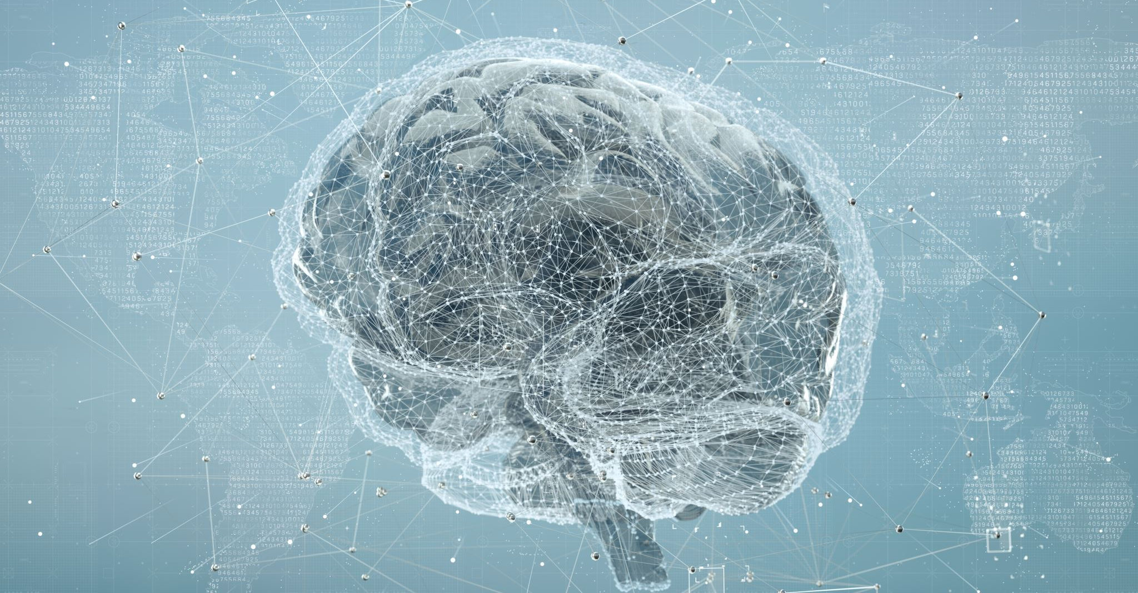
AI-Powered Multilingual Mental Health Chatbot
Group 3: Abdelrahman wael
Abdelrahman taghyan
Abdelrahman Almakhzangy
Mahmoud yasser
Ehab ahmed

Slide 2
Problem Description
Mental health care is inaccessible for millions.
- Language barriers hinder emotional expression and understanding.
- There's a lack of multilingual, emotionally aware free support systems.

Slide 3
System Architecture
1. User Input
2. Language Detection API
3. Translation to English
4. NLP / Intent Detection
5. Response Generation
6. Translate back to User Language

Slide 4
Overview
- Advanced LLMs (Gemini 1.5 Flash)
- Structured Data Extraction via Function Calling
- Semantic Search with ChromaDB
- LangGraph for Agent Orchestration
- Gradio for User Interface

Slide 5
1. Large Language Models (LLMs)
- Gemini 1.5 Flash supports multimodal input.
- Extremely large context window (millions of tokens).
- Flash variant optimized for low-latency interactions.
- Uses prompt engineering for empathetic, non-diagnostic support.

Slide 6
Embedding Model: embedding-001
- Captures semantic similarity using vector space.
- Different task types improve accuracy (document vs query).
- Supports precise retrieval of related context.

Slide 7
2. Structured Data Extraction
- Uses Gemini Function Calling for reliability.
- Returns structured outputs (e.g., JSON) for downstream use.
- analysis_schema defines expected fields like:
• primary_concern
• severity_level
• key_themes

Slide 8
Why Structured Output?
- Freeform responses are hard to parse.
- Function Calling ensures consistent output format.
- Schema enforces data types and required fields.

Slide 9

3. Vector Search with ChromaDB
- Stores and retrieves vectors (text + metadata).
- Uses cosine similarity or distance metrics.
- 1 / (1 + distance) used as relevance score.
- Thresholding filters irrelevant results.

Slide 10
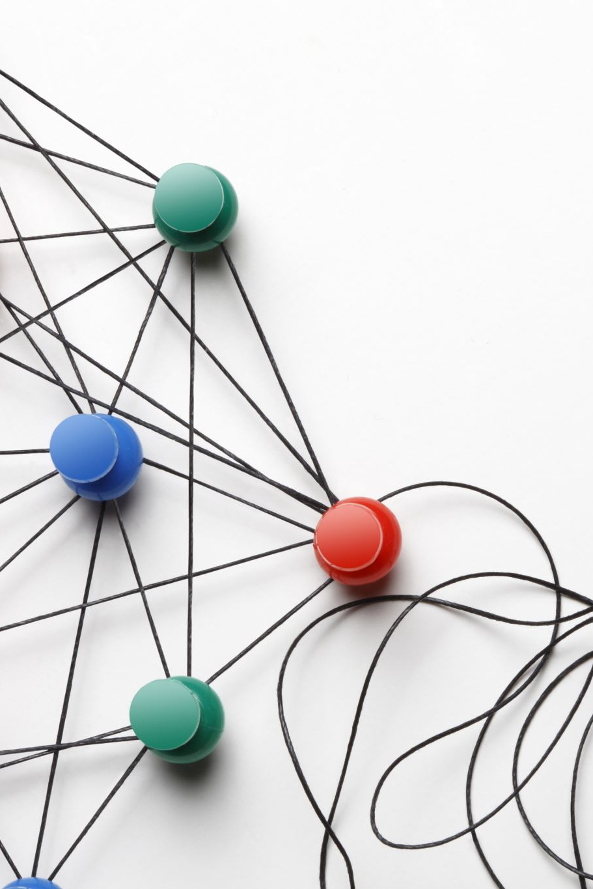
4. LangGraph Orchestration
- Models the pipeline as a graph of nodes.
- Each node performs a specific task.
- MentalHealthAgentState carries the shared state.
- Conditional logic routes workflow dynamically.

Slide 11

LangGraph Nodes
- analyze_input_node: runs Gemini Function Calling
- retrieve_info_node: fetches relevant chunks
- generate_response_node: produces final reply
- route_decider: chooses next step based on analysis

Slide 12
5. RAG Pipeline Flow
user_input -> analyze_input_node
-> route_decider
-> (if needed) retrieve_info_node
-> generate_response_node
-> final_response

Slide 13
6. Gradio Interface
- Wraps the chatbot as a web interface.
- gr.ChatInterface handles input/output display.
- Meshes cleanly with backend (run_agent).
- Simplifies user interaction.

Slide 14
Evaluation & Future Work
- Initial tests: Accurate translation + empathy
- Feedback loop for improvements
- Next: Voice support, more languages, therapist referral, emotion detection

Slide 15
CHALLENGES AND SOLUTIONS
- Maintaining emotional tone
- Context in conversations
- Avoiding misinformation
- Balancing automation and empathy

Slide 16
Summary
- Combines cutting-edge tools for emotional AI support.
- Scalable, multilingual, intelligent chatbot.
- Practical architecture: Gemini, Function Calling, ChromaDB, LangGraph, Gradio.

