Slide 1

ENGINEERING
PROJECT
PROPOSAL
Here is where your presentation begins

Slide 2
01
Problem definition
02
Analysis model
TABLE OF CONTENTS
03
Architecture and design model

Slide 3

Problem definition
01

Slide 4
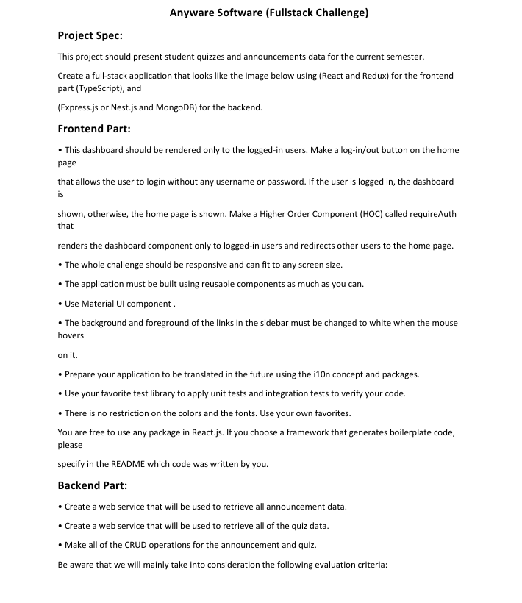


Slide 5
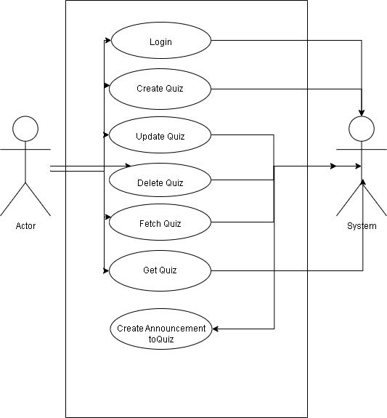
Analysis model

Slide 6
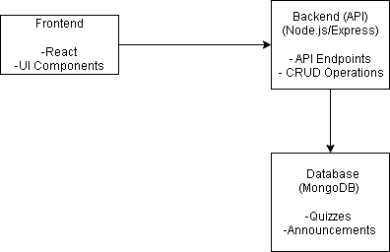
Architectural design model

