Slide 1
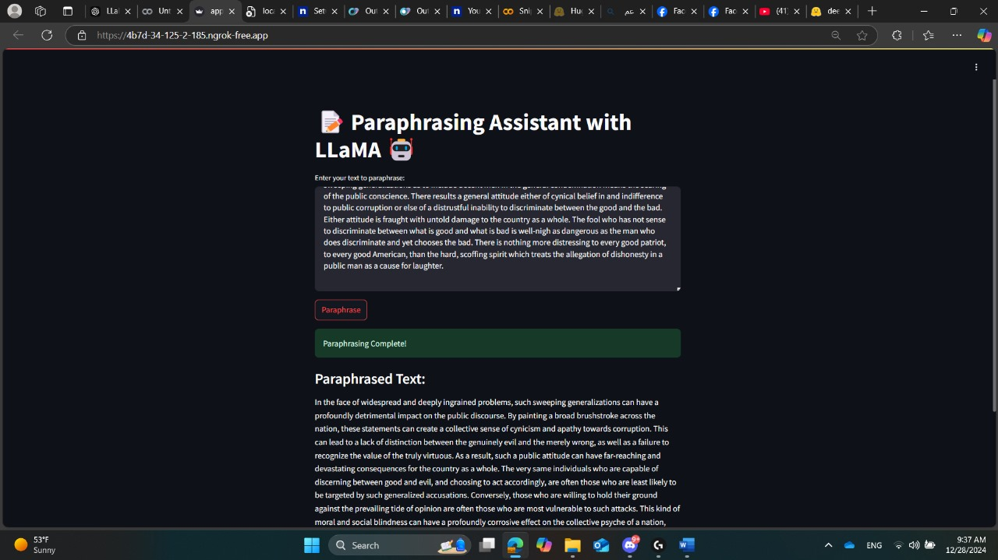
The results demonstrate that traditional machine learning models, such as Random Forest and XGBoost, outperformed deep learning and transformer-based models, achieving accuracies of 93% and 92%, respectively. In contrast, generative models like Silma and T5-small exhibited lower performance, highlighting the effectiveness of traditional approaches for this specific task.
AIS411
Paraphrasing Tool Using Llama Models
Team: Ziad Maher, Omar Mohamed, Abdelrahman Nasser, Youssef Alaa
Abstract
Material & Methods
This paper presents the design and implementation of a paraphrasing tool leveraging LLaMA models of varying scales (1B, 3B, and 8B). The primary focus is on utilizing prompt engineering to improve paraphrasing accuracy and address challenges faced during fine-tuning. The methodology highlights the effectiveness of prompt-based adjustments in generating coherent paraphrases while overcoming repetitive output issues. Results from multiple iterations demonstrate the capabilities of the tool, as well as areas for future improvement.
Our methodology involves three steps as Model Selection: LLaMA 1B, 3B, and 8B models were tested to evaluate scalability and performance. 2.Prompt Design: Multiple prompts were iteratively tested to identify the most effective configurations. 3.Evaluation Metrics: Outputs were evaluated based on semantic similarity, fluency, and grammatical accuracy.
Introduction
Paraphrasing tools have become vital in modern natural language processing (NLP) tasks such as content rewriting, summarization, and plagiarism detection. Transformer based models, particularly LLaMA (Large Language Model Meta AI), offer advanced capabilities for language understanding and generation. Despite their potential, fine tuning such models for specific tasks like paraphrasing can pose challenges. This paper explores the development of a paraphrasing tool using LLaMA models (1B, 3B, and 8B) and addresses fine-tuning limitations through prompt engineering
Results & Discussion
Conclusion
The developed paraphrasing tool demonstrates the potential of LLaMA models combined with prompt engineering to deliver high-quality paraphrases. While fine-tuning proved resource-intensive and less effective, prompt engineering offered a practical alternative.
The paraphrasing tool was tested using LLaMA 1B, 3B, and 8B models across diverse input types. Key findings include: • Improved Accuracy with Larger Models: The 8B model consistently outperformed smaller variants in generating coherent and contextually relevant paraphrases. • Reduced Repetition: Prompt engineering successfully mitigated repetitive outputs. • Processing Efficiency: While the 1B model was computationally efficient, the quality of outputs improved significantly with larger models.
References
1] Touvron, H., Lavril, M., Izacard, G., et al. (2023). LLaMA: Open and Efficient Foundation Language Models. Meta AI Research. [2] Vaswani, A., Shazeer, N., Parmar, N., et al. (2017). Attention is All You Need. Advances in Neural Information Processing Systems. [3] Brown, T., Mann, B., Ryder, N., et al. (2020). Language Models are Few-Shot Learners. Advances in Neural Information Processing Systems. [4] Raffel, C., Shazeer, N., Roberts, A., et al. (2020). Exploring the Limits of Transfer Learning with a Unified Text-to-Text Transformer. Journal of Machine Learning Research. [5] Radford, A., Wu, J., Child, R., et al. (2019). Language Models are Unsupervised Multitask Learners. OpenAI. [6] Lewis, M., Liu, Y., Goyal, N., et al. (2020). BART: Denoising Sequence to-Sequence Pre-training for Natural Language Generation, Translation, and Comprehension. Proceedings of ACL.
Acknowledgement
We would like to thank Dr. Ensaf and Eng Ziad for their great help in this project.

